Slide 1
An Introduction of China Geo-Explorers Xiaosen Wang China Data Center University of Michigan xiaosenw@umich.edu

Slide 2
About China Data Center
Background:
Established in 1997
Provide comprehensive and unique data from the government statistics, population Census and economic Census in China.
China Data Online service (with more than 200 institutional subscriptions worldwide):
China Statistical Database
China Census Database
China Spatial Database (China Geo-Explorer)

Slide 3
Features of China Geo-Explorer
Rich and Unique databases
Flexible Functions for Data Selection
Multiple Formats for Data Export
Easy and Time-saving Reports, Charts, and Maps
Unlimited Data service from Limited databases
Great Value for Affordable Prices
No GIS skills needed for spatial analysis and mapping

Slide 4
Rich and Unique Databases
Government statistics at province, city, and county levels (1949 -)
Population Census data by province, city, county, and township (1953, 1964, 1982, 1990, 2000, 2010)
Economic Census data by province, city, county, and ZIP code (1995, 2001, 2004 and 2008)
Firm level data with geo-referenced ZIP code locations (address, contact, ownership, industry, starting year, revenue and employee scales)
GIS maps of province, city, county, township, and ZIP code

Slide 5
Flexible Functions for Data Selection
Select data by administrative units (province, city, county and township)
Select data by self-defined areas
Select data by X&Y locations
Select data with spatial tools from map

Slide 6
Multiple Formats for Data Export
Export data, report or maps to different formats:
HTML
PDF
Excel
Word
GIS shape file

Slide 7
Easy and Time-saving Reports, Charts & Maps
Reports (HTM, PDF, Excel, Word):
Pre-defined
Customized reports
Charts:
Dynamic links to tables and maps
Maps
make maps for all or selected areas
Export to JPG or PDF files

Slide 8
Unlimited data service from Limited databases
Unlimited data from different X&Y locations and spatial ranges
Unlimited reports for selected provinces, cities, counties and townships
Unlimited charts for selected regions and industries
Unlimited maps for selected regions and variables

Slide 9
Great Value for Affordable Prices
China Geo-Explorer offers more than 5,000 variables with a value of more than $500,000:
China 2010 Population Census Data with GIS Maps (Province, City, County and Township)
China 2000 Population Census Data with GIS Maps (Province, City, County and Township
China 2000/2010 Population Census Data with Comparable GIS Maps (Province, City and County)
China Population GRID Data with Township Boundary Maps
China Historical County Population Census Data with GIS Maps (1953, 1964, 1982, 1990)
China 1995 Industrial Census Data with GIS Maps (Province, City, County and ZIP code)
China 2001 Basic Unit Census Data with GIS Maps (Province, City, County and ZIP code)
China 2004 Economic Census Data with GIS Maps (Province, City, County and ZIP code)
China Firm Level Data with GIS Maps (more than 7 millions records)
China Province Statistical Indicators with Maps (1949-)
China City Statistical Indicators with Maps (1996-)
China County Statistical Indicators with Maps (1997-)

Slide 10
Membership and Subscription
China Geo-Explorer I | Annual Fee | Notes
 | $3,800 | FTE > 8000
 | $3,200 | FTE: 6,000-8,000
 | $2,600 | FTE: 4,000-6,000
 | $2,000 | FTE < 4,000
China Geo-Explorer II | Annual Fee | CGE I + GIS Map Export
 | $6,800 | FTE > 8,000
 | $5,800 | FTE: 6,000-8,000
 | $4,800 | FTE: 4,000-6,000
 | $3,800 | FTE < 4,000

Slide 11
List of Institutional Memberships
Harvard University
Yale University
Stanford University
MIT
University of Pennsylvania
New York University
U C Berkeley
Columbia University
Duke University
University of Michigan
Asia Development Bank
National Singapore University
Nanyang Technology University
Chinese University of Hong Kong
Shanghai University of Finance and Economics
University of Nottingham Ningbo
Xi'an Jiaotong-Liverpool University
……

Slide 12
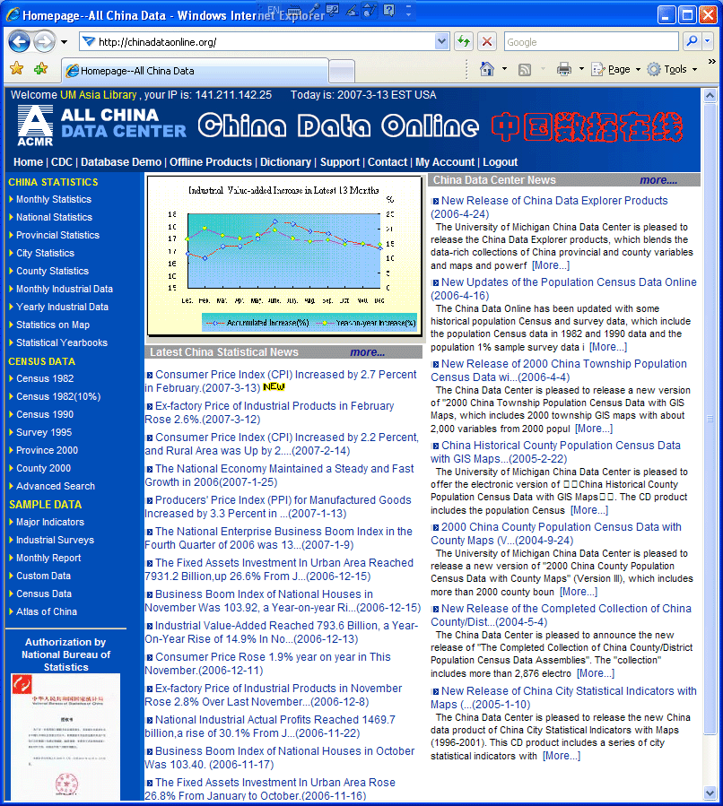
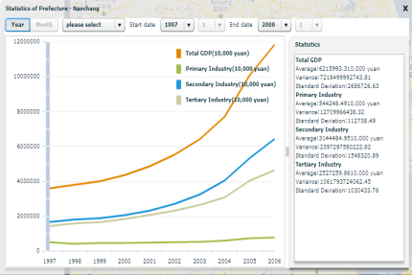
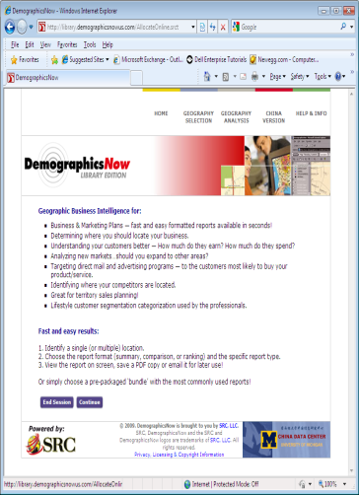
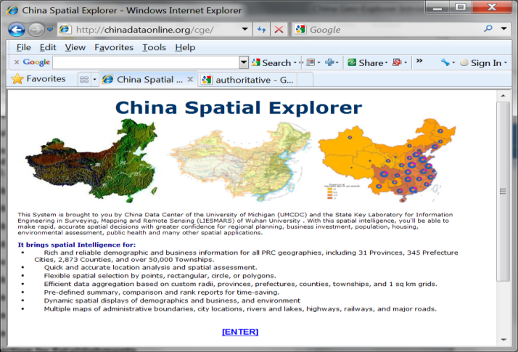
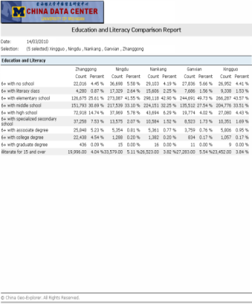
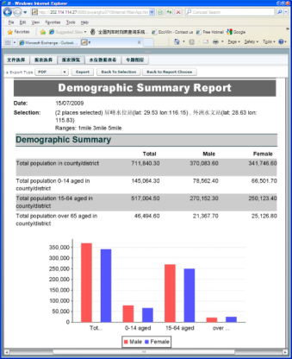
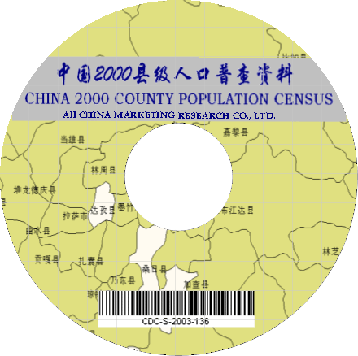
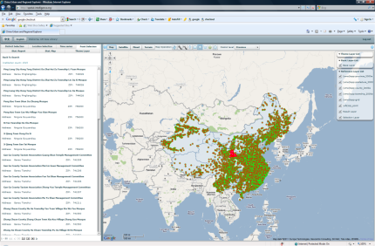
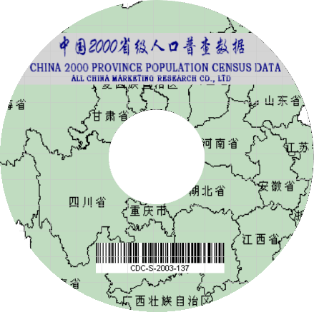
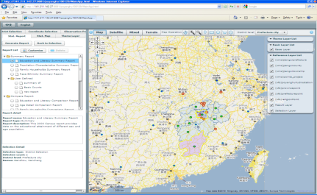
China Geo-Explorer An Integration of Data and Analysis for Spatial Studies
Statistics
Data
Output
Charts
Tables
Reports
Census
GIS
Maps
Modeling
PySAL
StatGeo

Slide 13
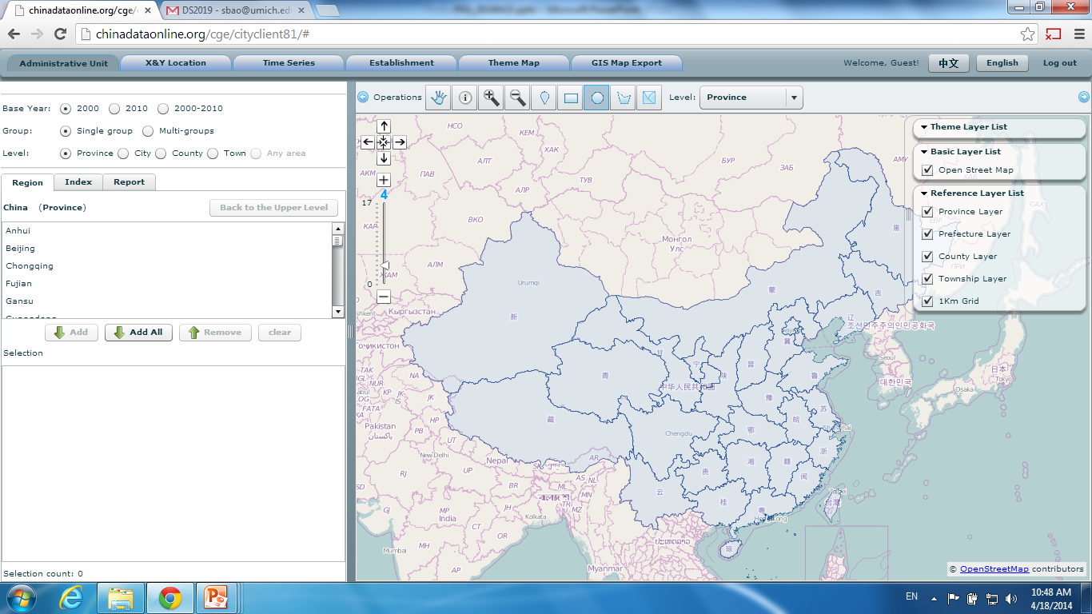
Report Analysis
Spatial select by map
Select by administrative units
Notes:
13

Slide 14
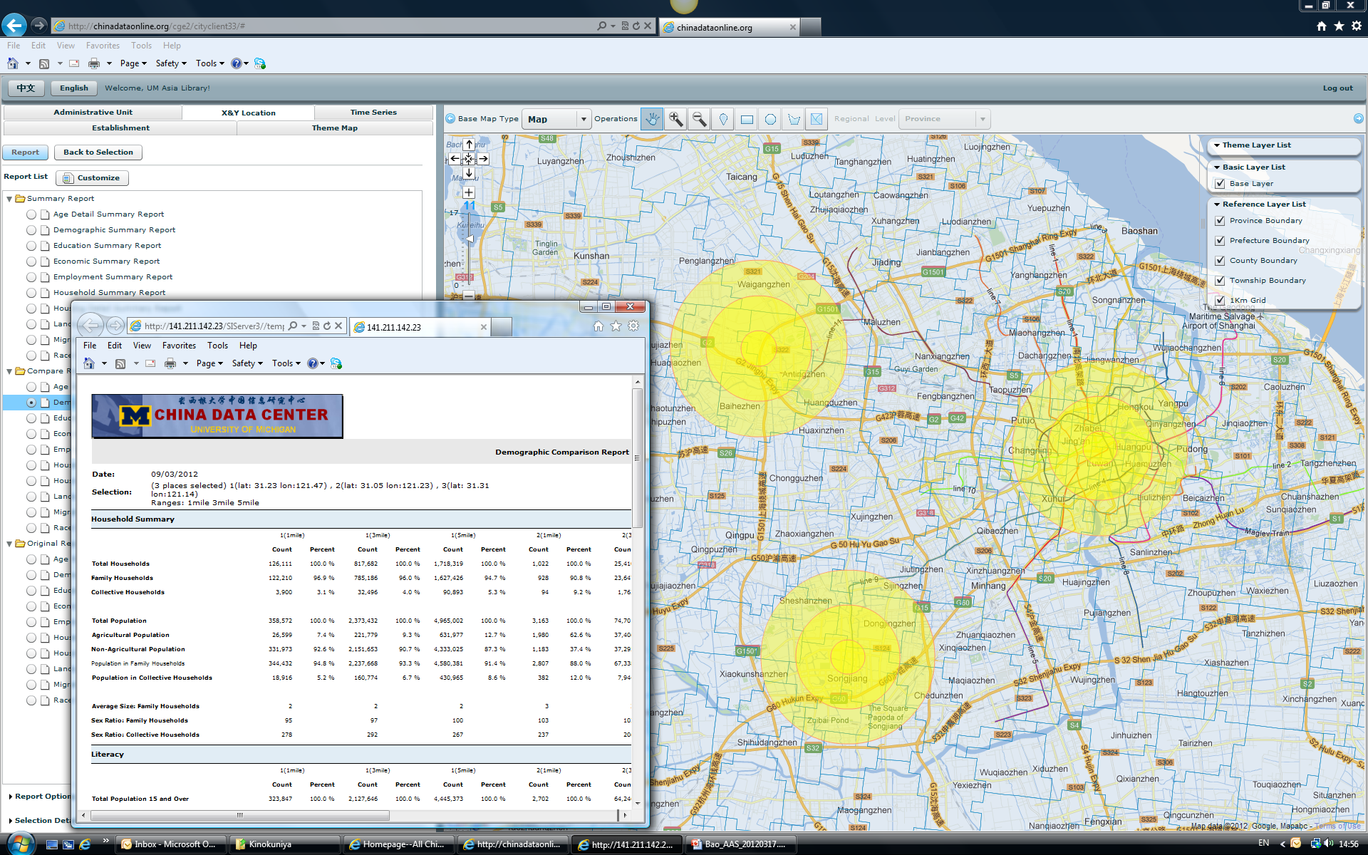
Location Analysis

Slide 15
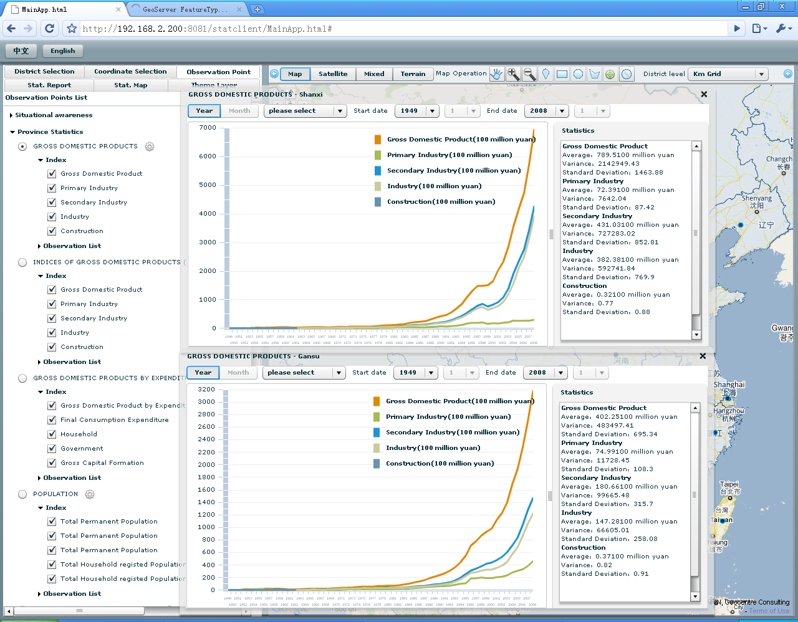
Trend Analysis
Notes:
15

Slide 16
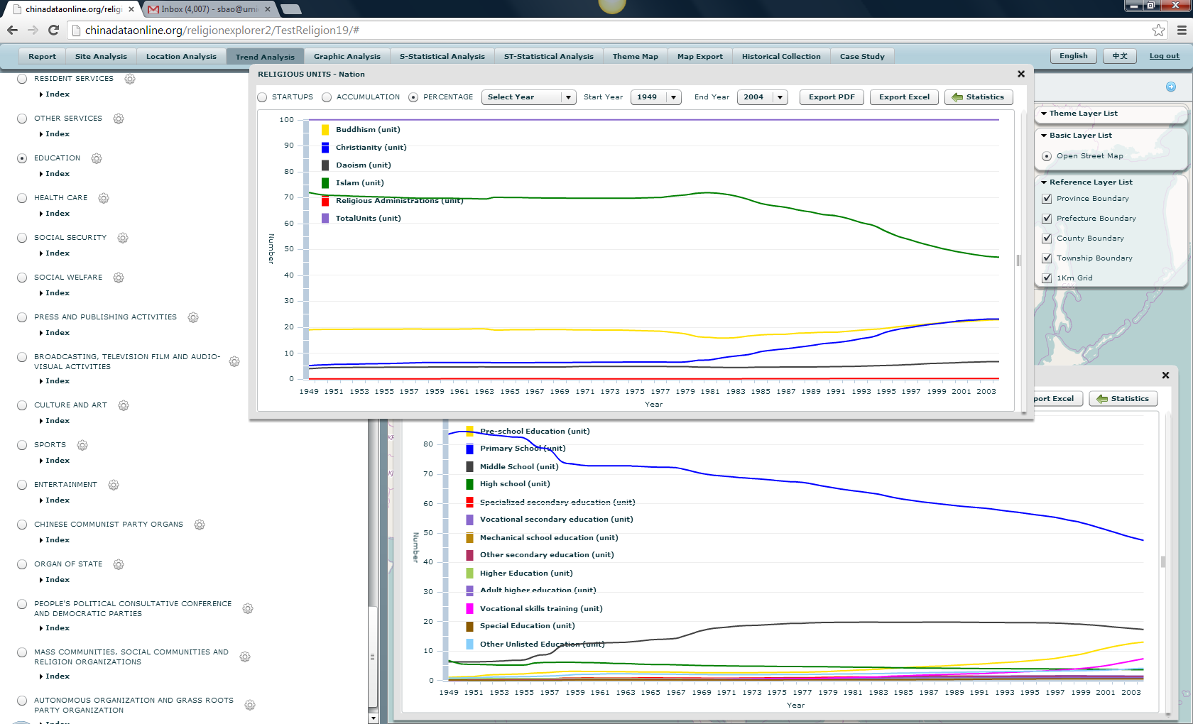
Structural Analysis

Slide 17
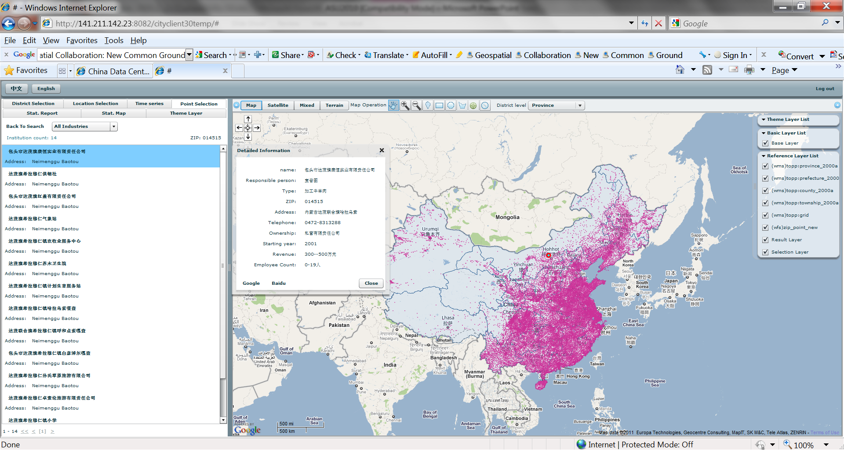
Establishments Analysis

Slide 18
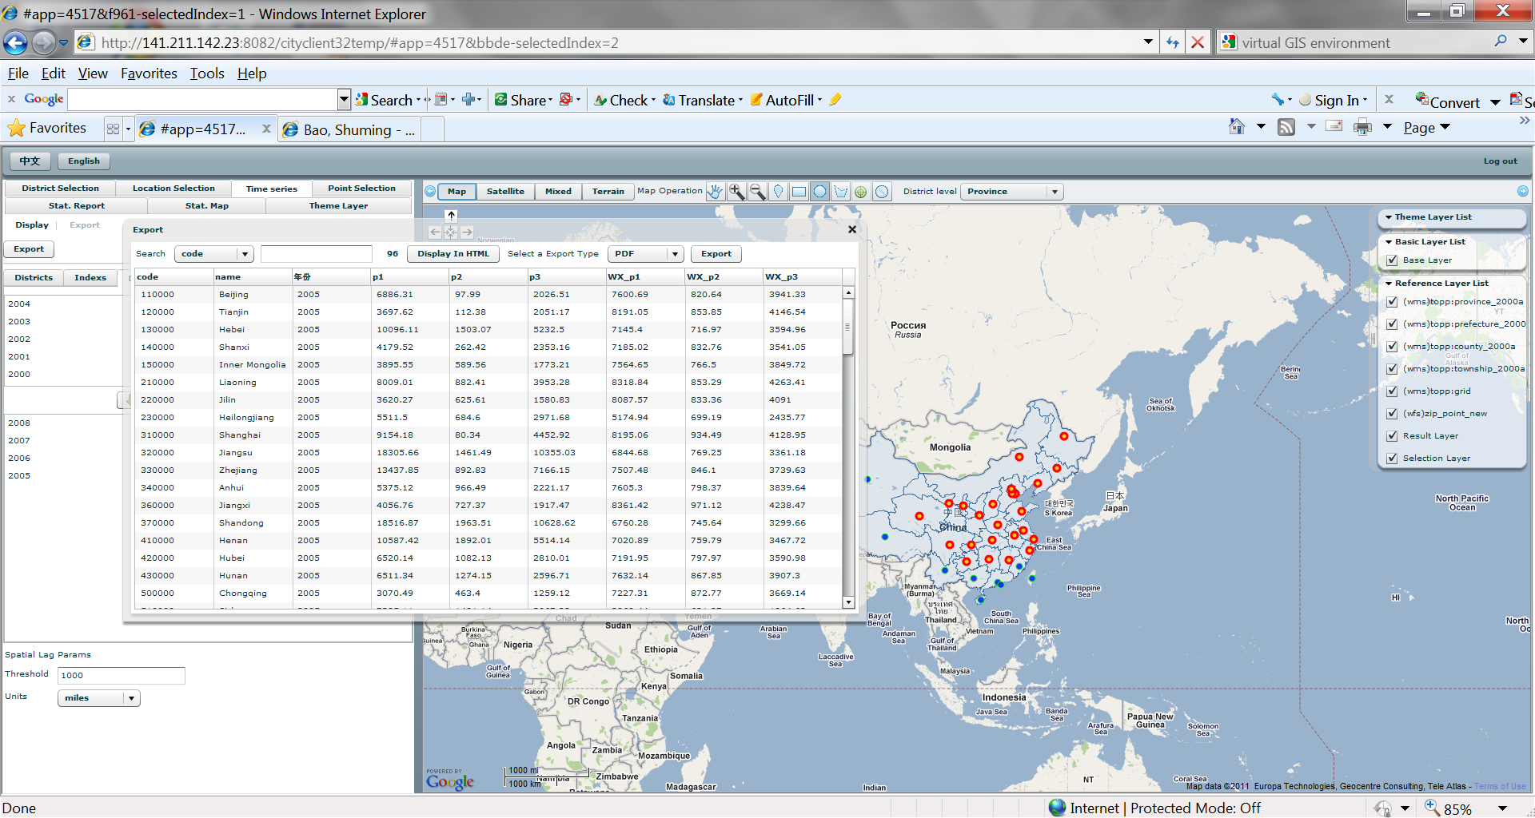
Space-Time Panel Data
Notes:
18

Slide 19
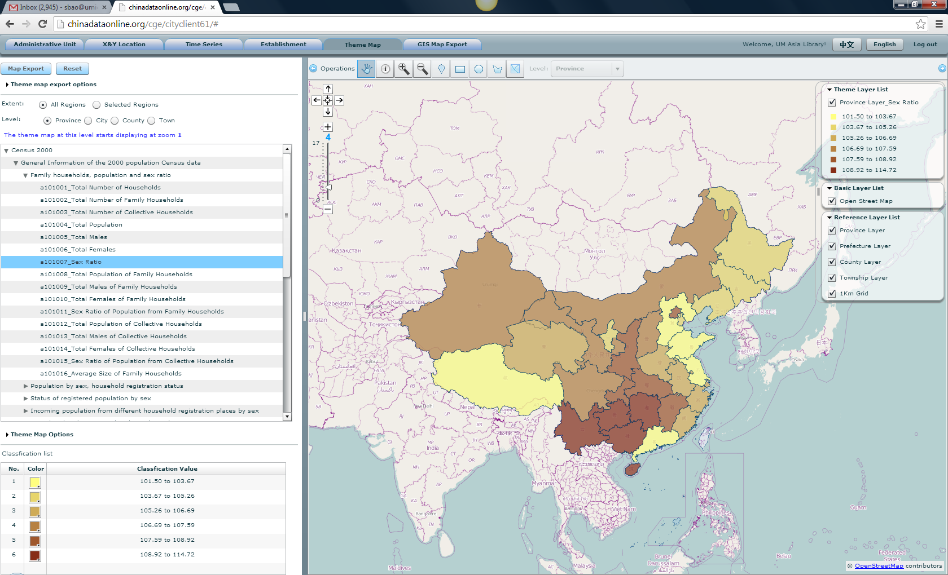
Theme Map

Slide 20
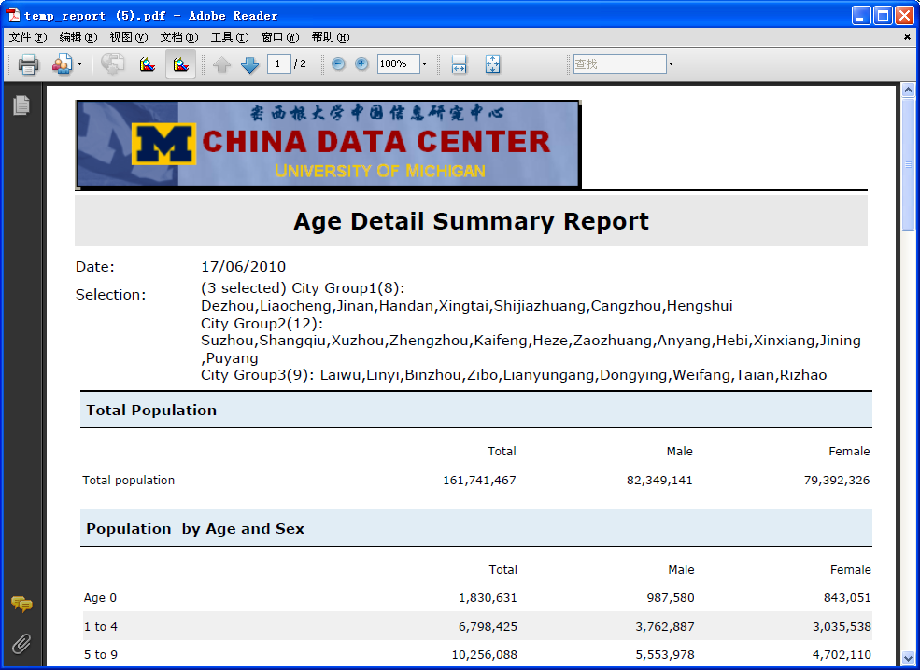
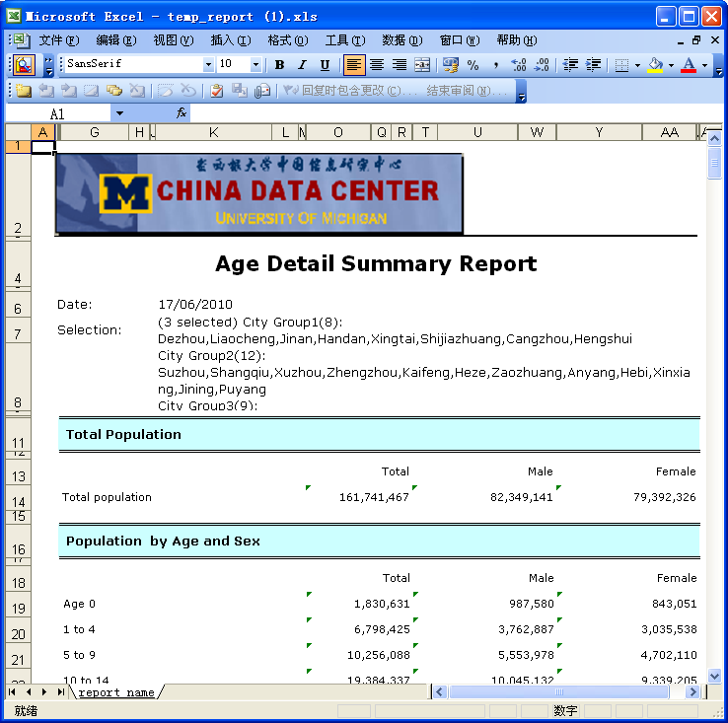
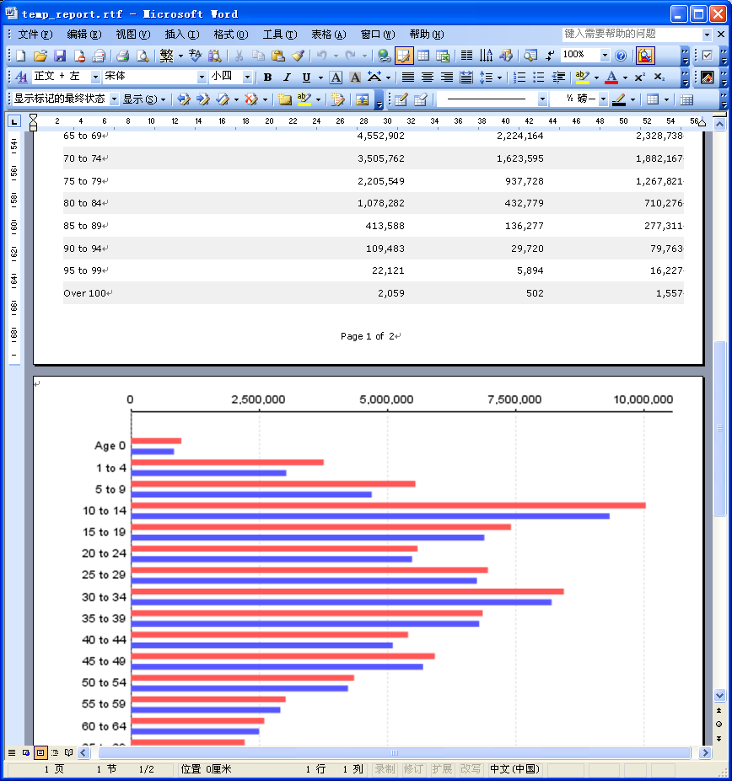
Multiple Outputs
Notes:
20

Slide 21
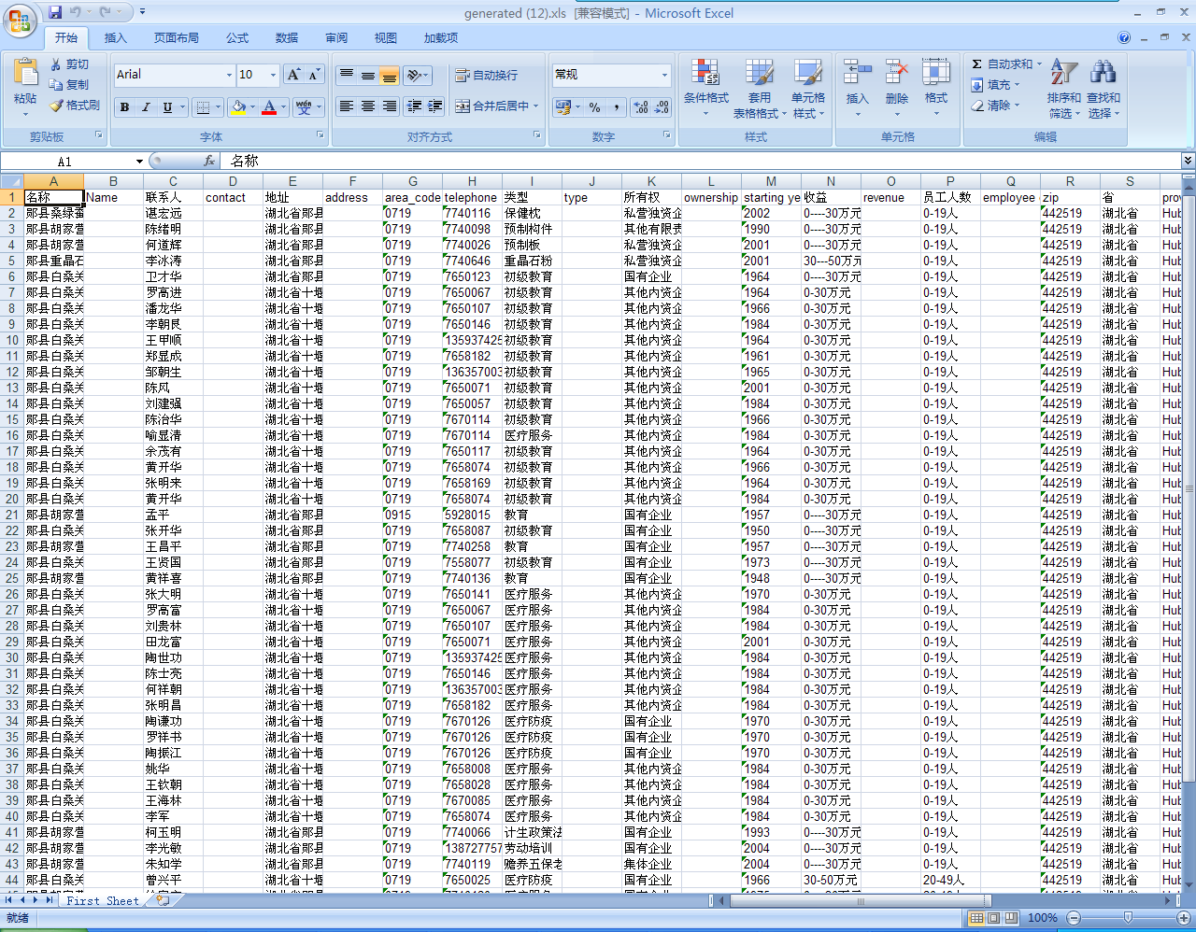
Data Export
Notes:
21

Slide 22
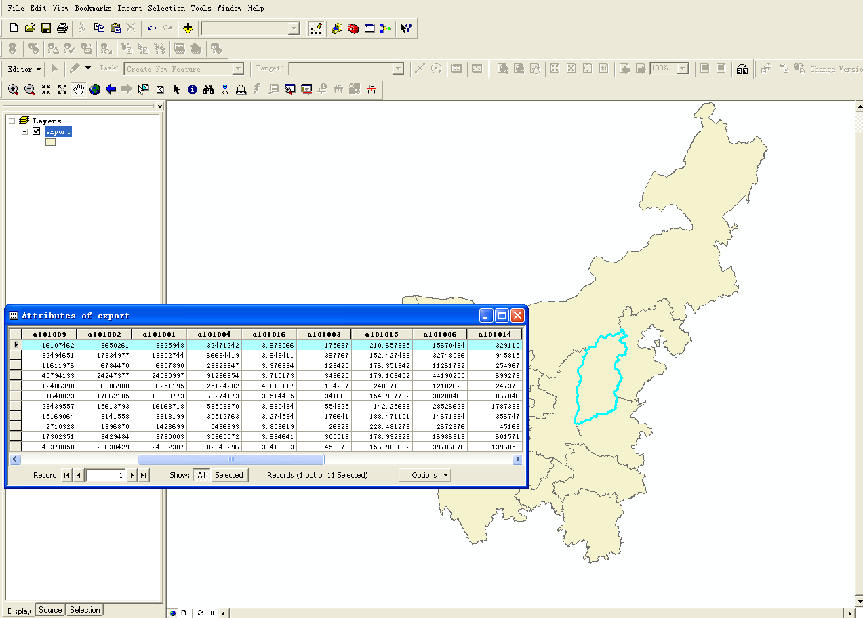
GIS Map Export

Slide 23
US Geo-Explorer Service
Data Sources:
Applied Geographic Solutions, Inc. (“AGS” - www.appliedgeographic.com)
InfoGroup, Inc. (www.infogroup.com)
Data Coverage:
Population Census (State, County, Tract, Block, Metropolitan, CCD, Place)
Census 1970, 1980, 1990, 2000, 2010
American Community Survey
Economic Census (State, County, Metropolitan)
Annual Census reports from 1986 to current
Establishments (individual companies and organizations)
Firm level records for 2013 (85 fields)
Aggregated data by State, County, Tract, Block, Metropolitan, CCD, Place, ZIP (1997-2013)
State
Metropolitan
County
CCD
TRACT
BLOCK

Slide 24
To Apply for a Trial
China Data Center
Chinadata@umich.edu
(734)647-9610

