Slide 1
Mongolian Prints and Manuscripts in Tibetan Language kept in the Naprstek Museum in Prague
Helena Heroldová
Náprstek Museum, Prague

Slide 2
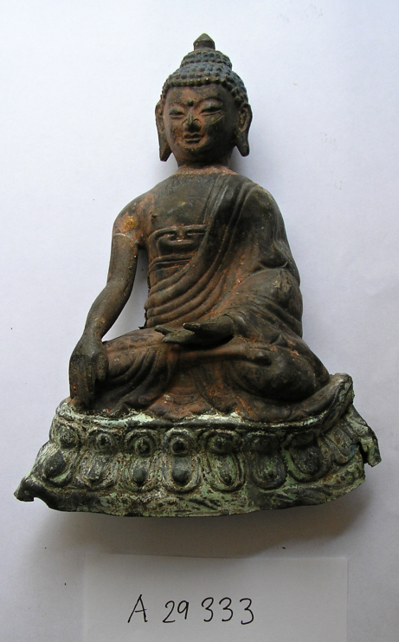
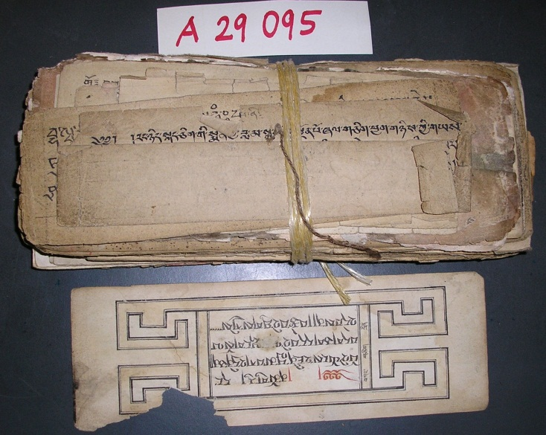
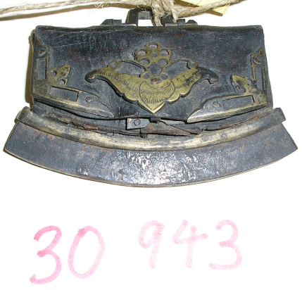
Collection and Collectors

Slide 4
Prints and Manuscripts

Slide 5
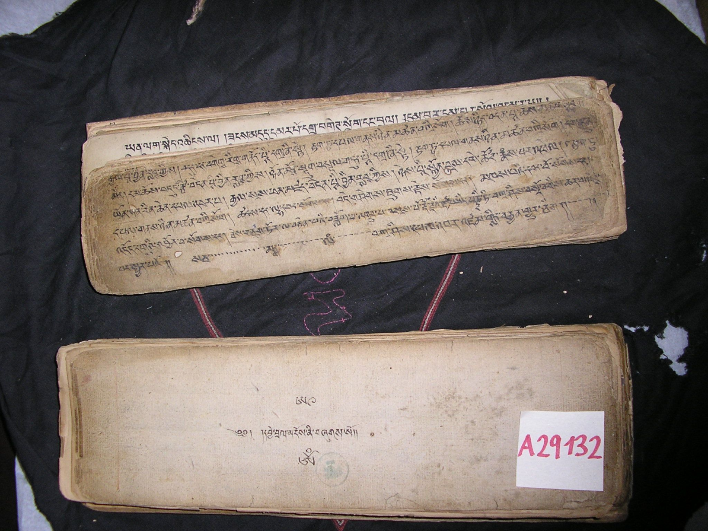

Slide 6
Condition

Slide 7
Scanning

Slide 8
Description

Slide 9
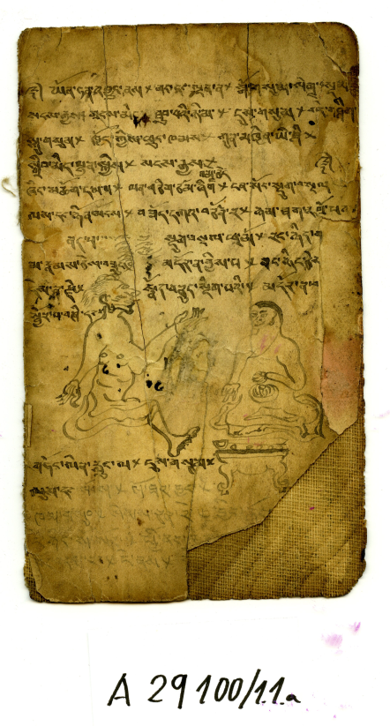
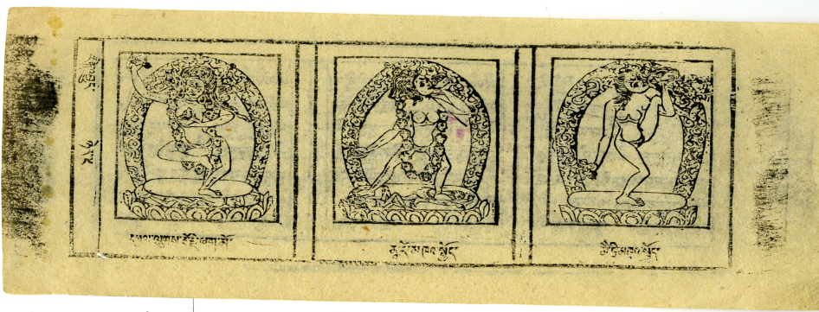
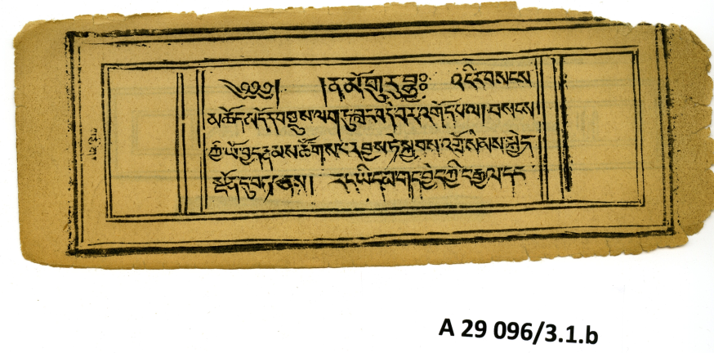
Variability

Slide 10
