Slide 1
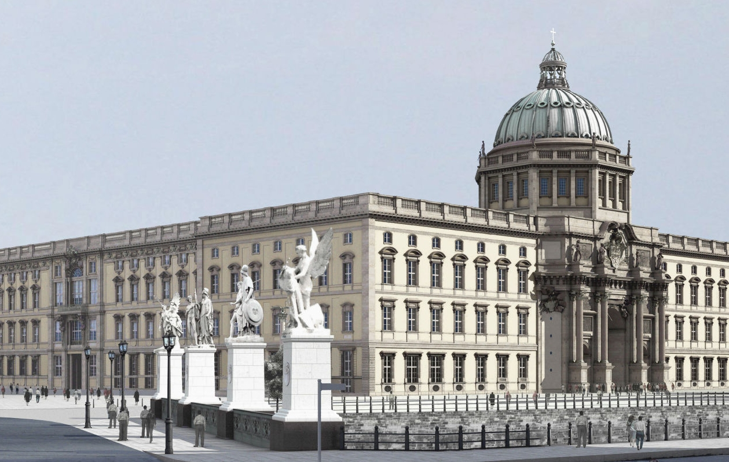


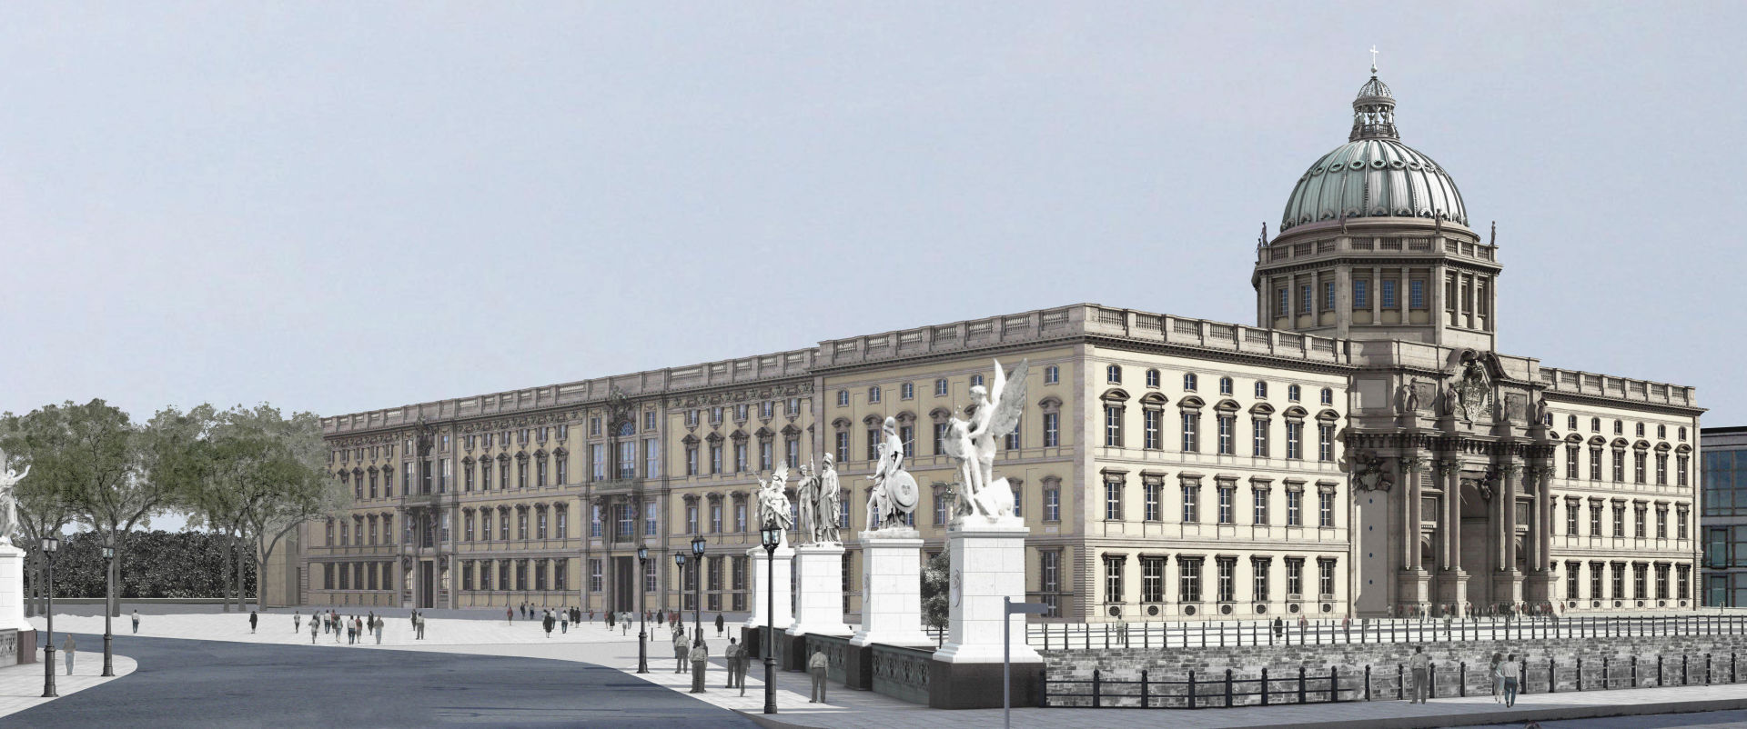
The Typographia Sinica on its way from the
Great Elector‘s Palace to the Humboldt Forum

Slide 2
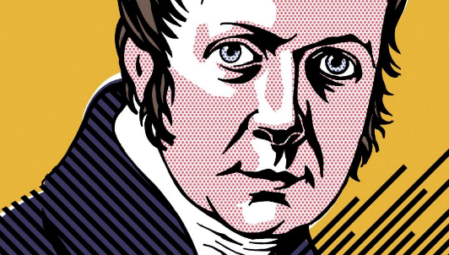
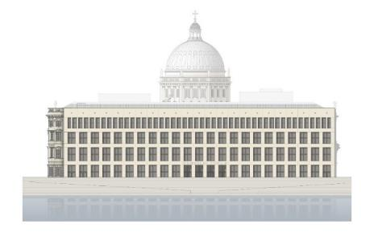
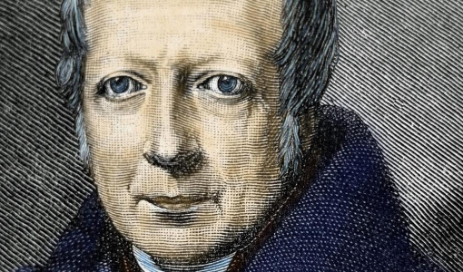
Alexander von Humboldt (14.09.1769-06.05.1859)
HuF Belvedere
Wilhelm von Humboldt (22.06.1767-08.04.1835)
Humboldt Forum
Spring 2017 – loan request from the Humboldt Forum Directorship
The Humboldt Forum is designed to bring together contemporary research and science with Berlin’s history and a wide array of exhibitions and accompanying events.
The Humboldt Forum shall be a dynamic location that inspires new insights into the world of yesterday, today and tomorrow.
It is named after and inspired by Alexander and Wilhelm von Humboldt.
It is inspired by their enthusiasm for exploring the world with open eyes and understanding it as a complex interwoven system of nature and culture.

Slide 3

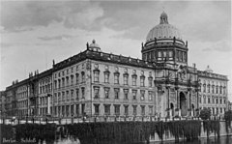
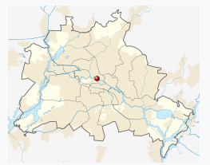
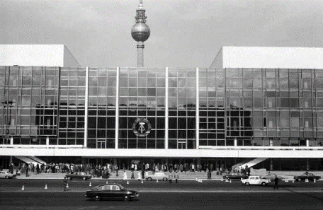
History of the Site
From monastery to Berlin Palace and parade ground, and from Palace of the Republic to cultural building site – over the last 800 years the Schlossplatz has witnessed more social, urban, political and cultural developments than virtually any other location in Berlin
The Humboldt Forum showcases a broad array of objects that invite to explore this eventful history.
The Typographia Sinica has been chosen as an object from the very early beginnings of the electoral library
Besides treasures and rarities it shall illustrate the Great Elector‘s interest for the arts and sciences and his intellectual environment
The Stadtschloss (Berlin Palace) in the 1920s
Location within Berlin
The Palace of the Republic in the 1980s

Slide 4
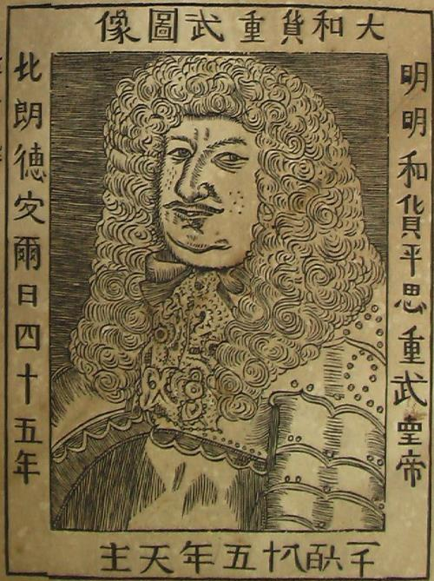
The East Asia Department of the Berlin State Library owes it‘s early Sinica the Great Electors‘(1620-1688) thirst for knowledge and his ambitious trade interests on the one hand and two proto – sinologues on the other.
Following the Dutch model the Great Elector intended to establish an East India trading company.
The Great Elector intended to participate in the lucrative trade with China. His country was marked by the Thirty Year‘s war, and suffered from heavy population losses. The Great elector wanted to incourage his country to achieve wealth and power.
Highly trained in maritime shipping and trade the Dutch Admiral Aernoult Gijsels van Lier (um 1593-1676) advised him in his colonial plans. The Admiral had been working for the Dutch East India Companie already at the age of sixteen, in 1618 he had become chief merchant and naval commander of the counting houses of Ambon (Molukken).
beneath:1685 Anno Domini
left: In the 45th year of Brandenburg
above: portrait of the Great Elector, the warrior
right: the extremely wise Elector Pingsi [eventually for Friedrich Wilhelm; 平ping=Frieden=Fried-rich], the warrior, the emperor

Slide 5
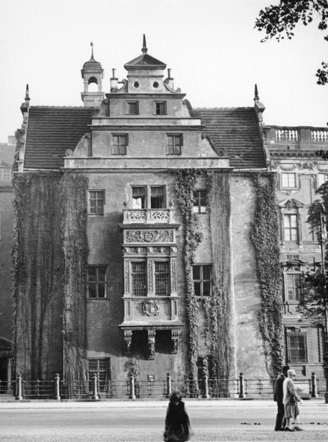
The Great Elector was interested in scientific and technical instruments, and related findings.
The collections in the art and rarity chambers at the so-called pharmacy wing of his Berlin Palace hosted numerous valuable items, like natural objects, curiosities, numismatic collections (Numismata), books, and antiquities from many regions of the world.
Pharmacy wing of the Berlin Palace, 1661-1784

Slide 6
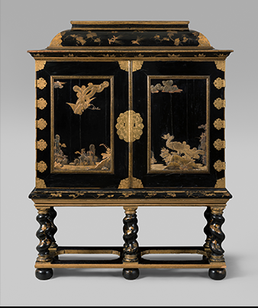
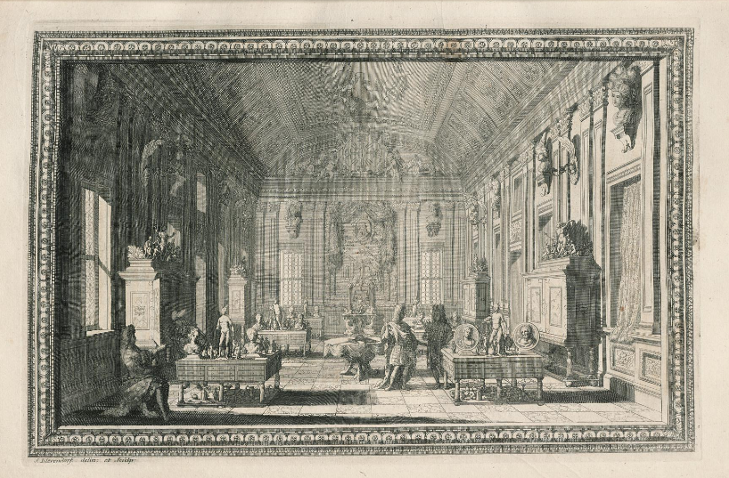
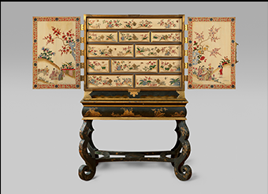
Beger, Lorenz: Thesaurus Brandenburgicus Selectus ... , 1696
– for these valuable items specially cabinets –
– amongst them particularly remarkable :
– medal cabinets, decorated by Gérard Dagly (1660-1715) with asiatic lacquer works–

Slide 7
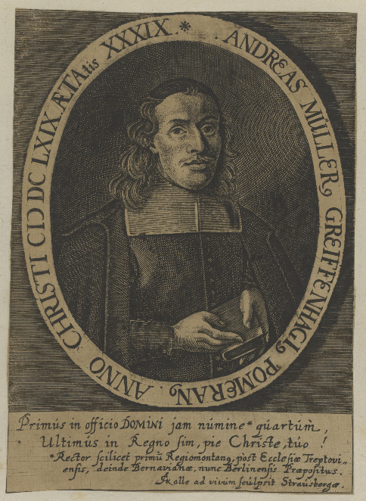
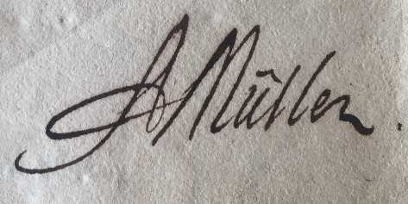
Around 1670 the Great Elector was negotiating with Aernoult Gijsels van Lier, with intend to buy his Chinese books from him. Later on acquisitions directly from the Netherlands or from Christian Raue‘s (1613-1677) collections.
Involved in these negotiations was Andreas Müller. He studied oriental languages, attended several universities, travelled to England and the Netherlands, and exchanged lively correspondence with the scholars of his time.
Because of his outstanding knowledge of the Oriental languages Müller was appointed provost at the Nikolai Church in 1667
Along wih Christian Mentzel he was a central figure of the early Sinology in Germany.
Andreas Müller (1630-1694)
Andreas Müller‘s signature

Slide 8
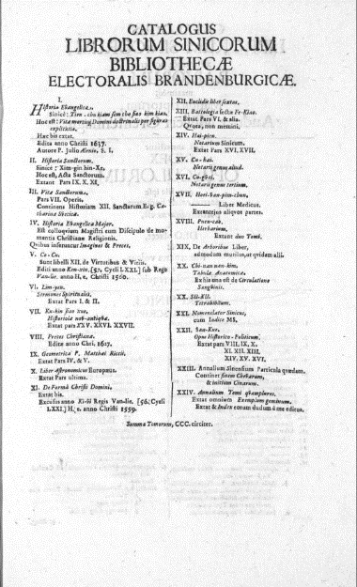
His position in Berlin offered him the opportunity to deal in the Oriental Mss stored at the Electoral Library.
In a dedication of thanks from 1665 (Excerpta manuscripti cujusdam Turcici …) Müller wrote, that the Great Elector allowed him to use the library from the beginning.
Among the treasures of the library Müller emphasised the Orientalia with the „Tschinensia“– the earliest known mention of the library‘s Sinica at all.
350 years ago, on November 18 1668 the idea came to him to present a key for the Chinese script/language (Clavis Sinica) [= „ein Handgrif ein / wie die Sinesische Schrift möchte leichte gemacht werden“ = a method to make the Chinese script easy].
Plan for a Typographia Sinica
Müller, Andreas: Catalogus Librorum Sinicorum Bibliothecae Electoralis Brandenburgicae, 1683

Slide 9
– outwardly plainly designed cabinet („Ladenschrank“) –
– plank construction –
– ten technically skillfully constructed drawers –

Slide 10
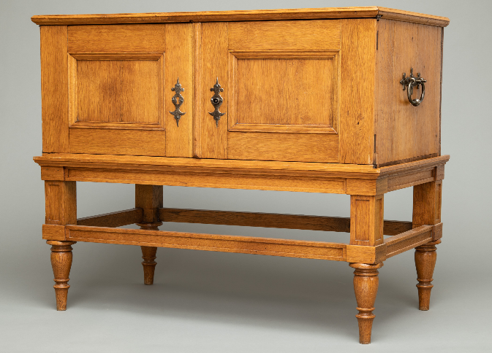
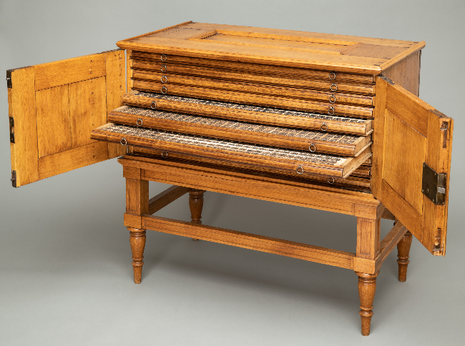
– very similar to the electoral medal cabinets –
– made from solid oak wood –
– on an underframe with baluster shaped feet –
– cutting date of the wood used: 1674 (through dendrochronological analyses) –
– probably repeatedly overhauled –

Slide 11
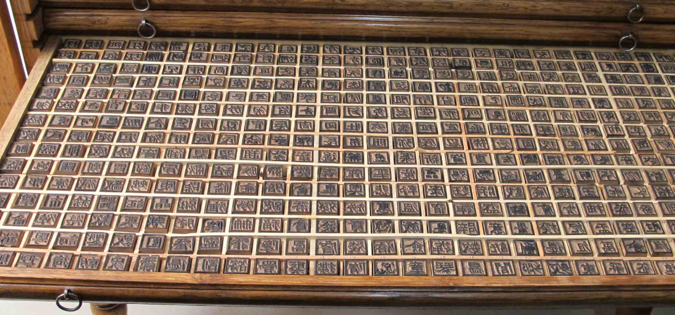
– 3287 printing types – each ca. 2,5 cm³ –

Slide 12
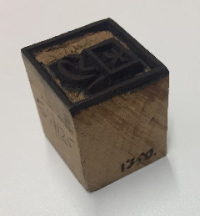
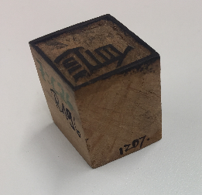
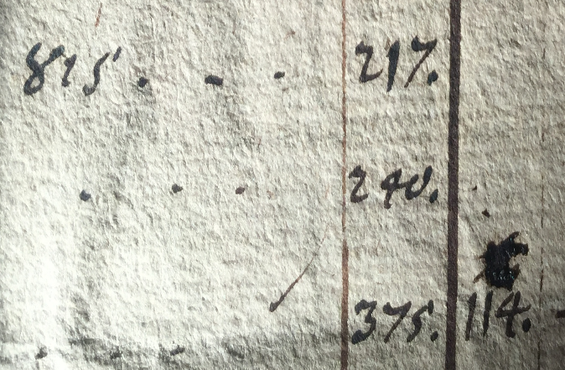
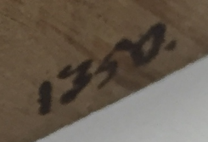
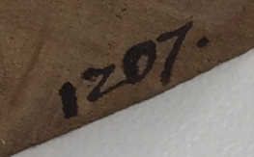
Comparing the handwriting on the types with that in Andreas Müller‘s Mss (Handschriftenacta, SBB, Handschriftenabteilung
– on the upper side were cut the Chinese characters –
– on (mostly) the right side Müller noted numbers in ink –
– no directly recognizable order –

Slide 13
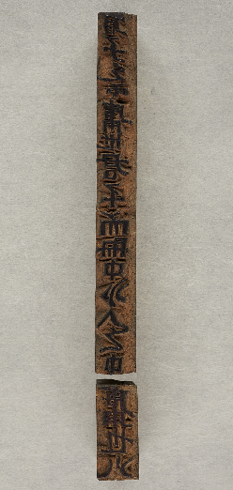
There also smaller printing types in Chinese and Syriac.
Chinese, from Müller (Müller‘s letter to Athanasius Kircher from 1675, inter alia a quotation from Zhongyong 中庸)
Chinese, from Christian Mentzel (1622-1701) (used in his Sylloge Minutiarum lexici Latino-Sinico-Characteristici, Nürnberg 1685)
Syriac, from Müller, quotations from the Nestorian Stone from 781 from Xi’an, displayed in Kirchers China monumentis …, 1667
君子之中庸也 君子而时中 小人之中 庸也小[人而无忌惮也]
… "The superior man embodies the course of the Mean; the mean man acts contrary to the course of the Mean. The superior man's embodying the course of the Mean is because he is a superior man, and so always maintains the Mean. The mean man's acting contrary to the course of the Mean [ is because he is a mean man, and has no caution].“

Slide 14
3 D-digitisation of the Typographia Sinica
Our purpose for the 3D-digitisation:
Virtual presentation of the TS in the web
Comparison of the TS-set of printing types
with our digitised old collection/texts in our ITR
(which were the texts Andreas Müller consulted, and probably had been part of the library‘s old collection)
Discovery of the Müller-system for the
Arrangement of the printing types in the drawers
The production of replicas of the
printing types
For the exhibition in the Humboldt-Forum:
The production of palpation models
(for handicapted people)
Our requirements for the 3D-digitisation:
- All created files must be suitable to be presented in the Internet.
- All printing types:
· the upper surface of the cubes with the Chinese characters: 3D scan (high resolution relief, rotatable, slewable etc.)
· the remaining five sides of the cubes: 2D scan in high resolution (unambiguous readability of the written information on the cube sides)
· clear allocation of all sides to the respective cube in order to present all sides as one unit (as 3D cube or as „unfolded“ cube sides)

Slide 15
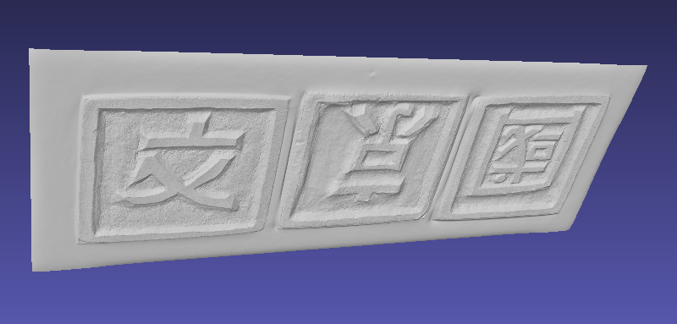
2D Testscan (CRUSE Digital Imaging Equipment)

Slide 16
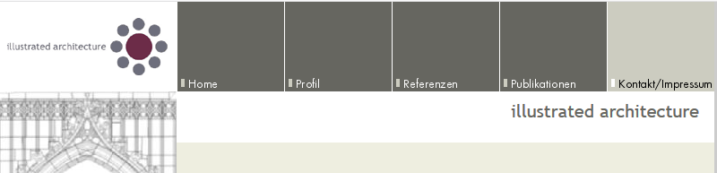
Photogrammetry and Optical Digitising
Starting with 250 x 250 pixel each printing type
followed by two iterations in 500 x 500
and 1000 x 1000 pixel
using pixelshift in combination with two focal lengths

Slide 17
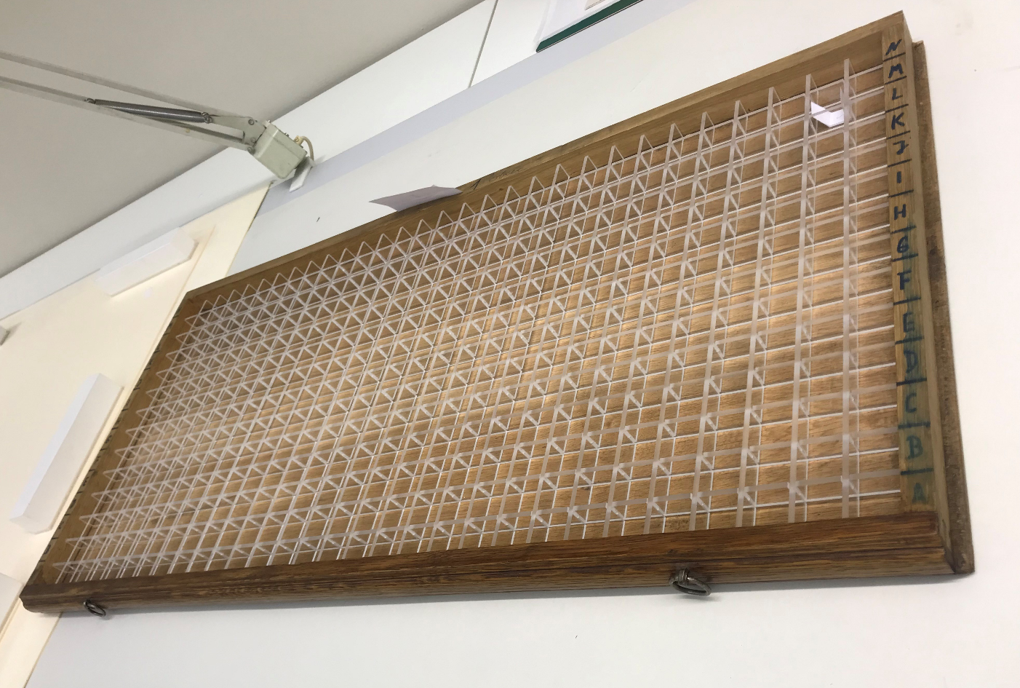
First step: new grid made of plexiglass

Slide 18
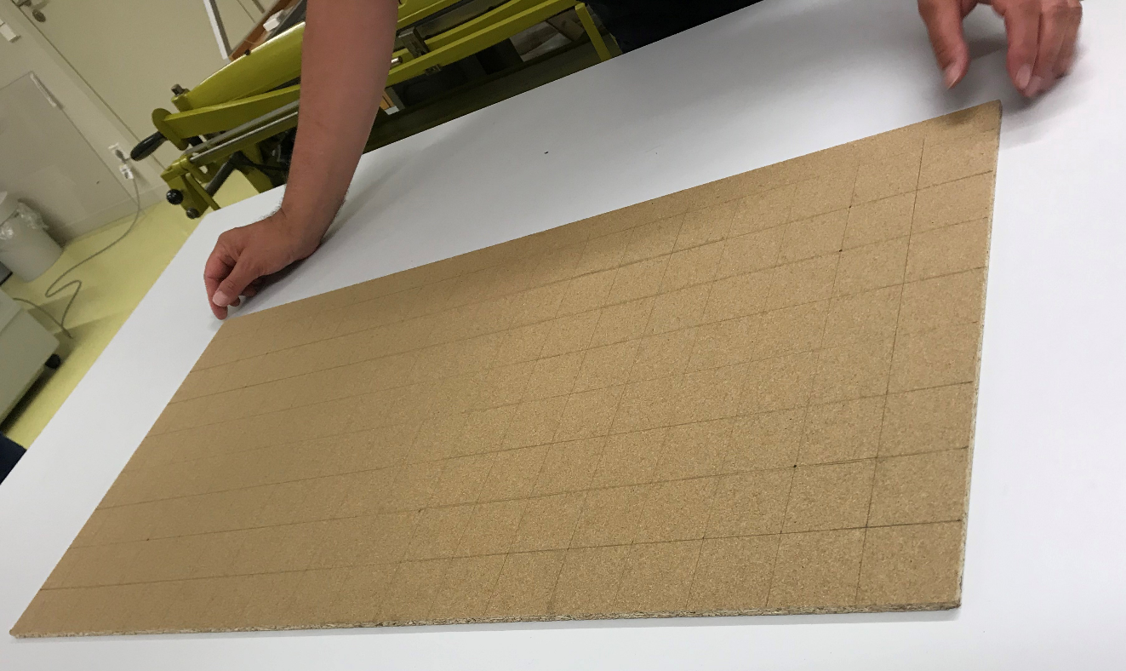
Illustrated Architecture prepared a matrix to place and rotate the
printing types at a fixed position and with sufficient space in between

Slide 19
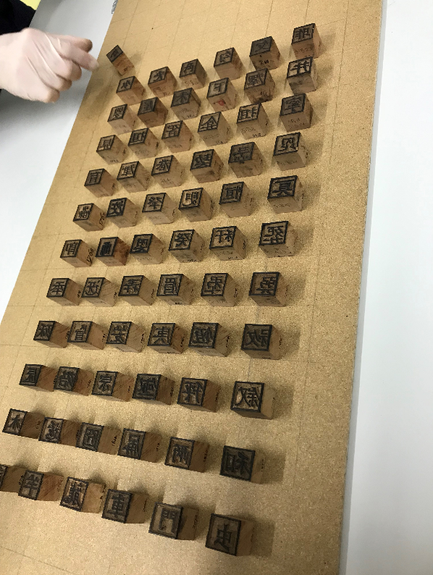
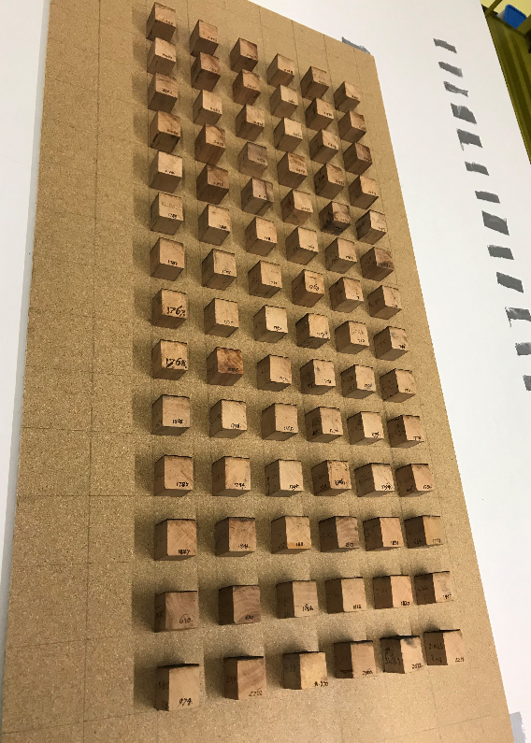
The printing types put one by one on the matrix
The printing types rotated one time on the matrix

Slide 20
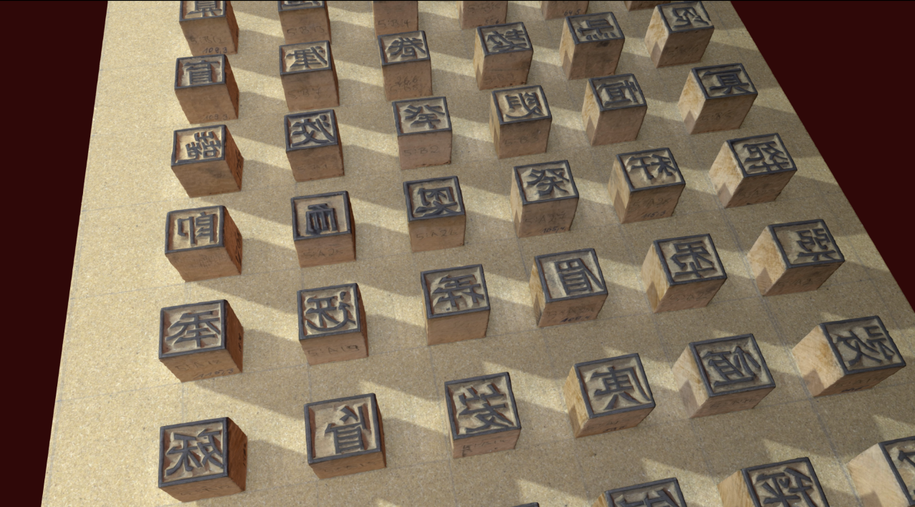

Slide 21
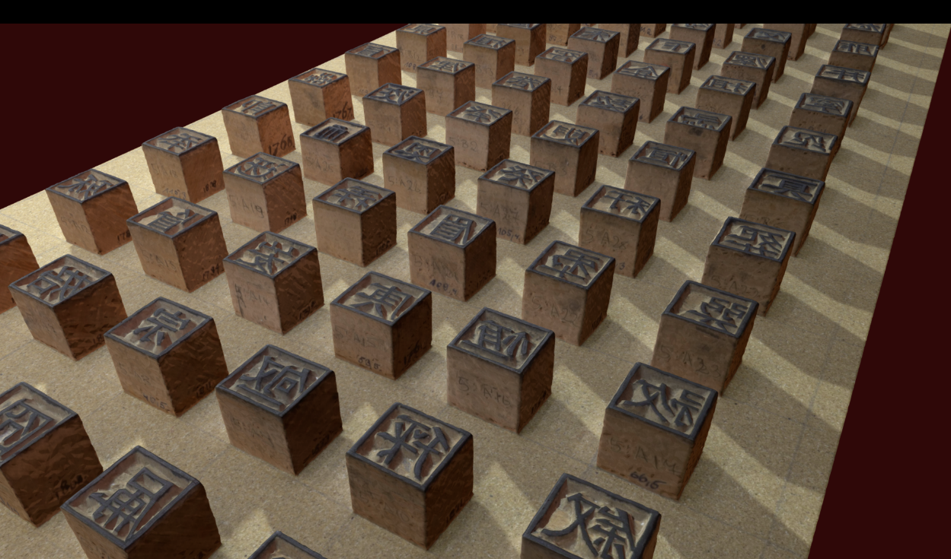

Slide 22
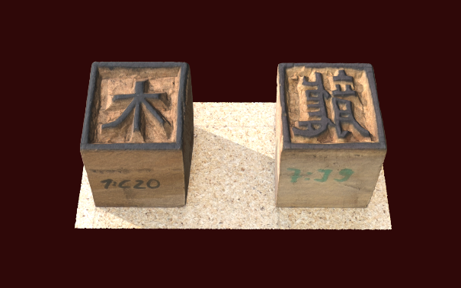
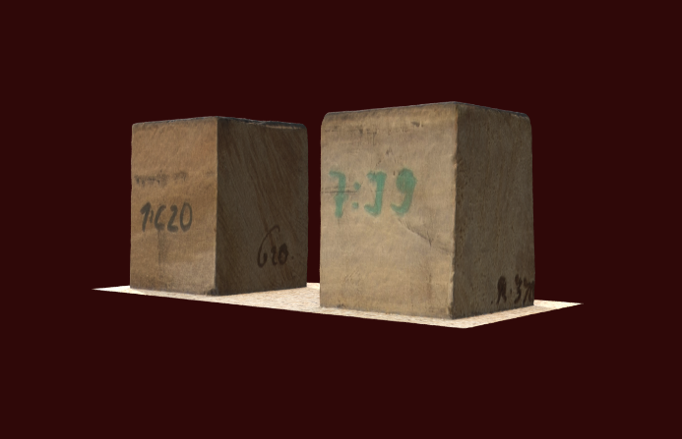
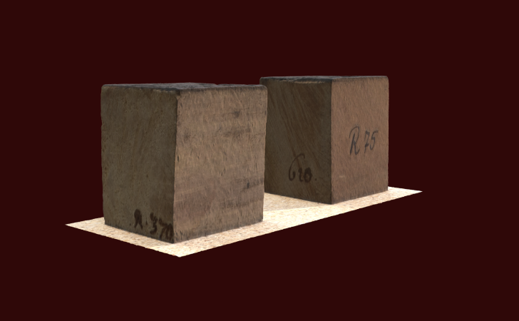
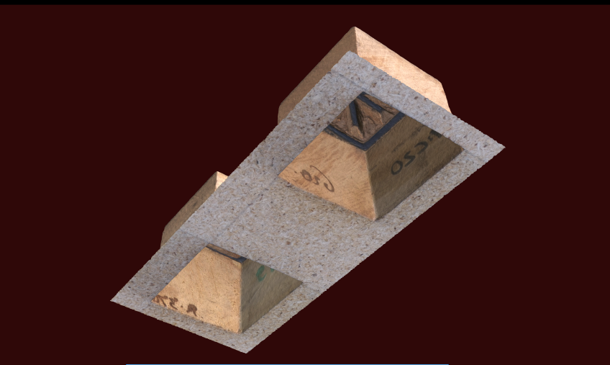
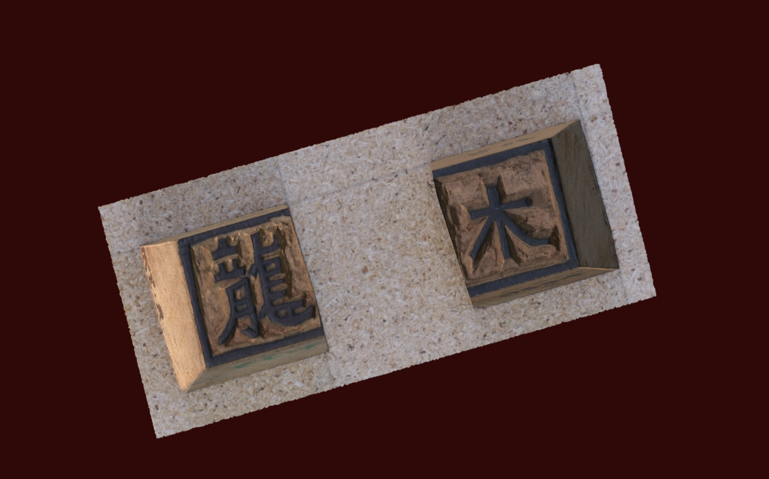

Slide 23
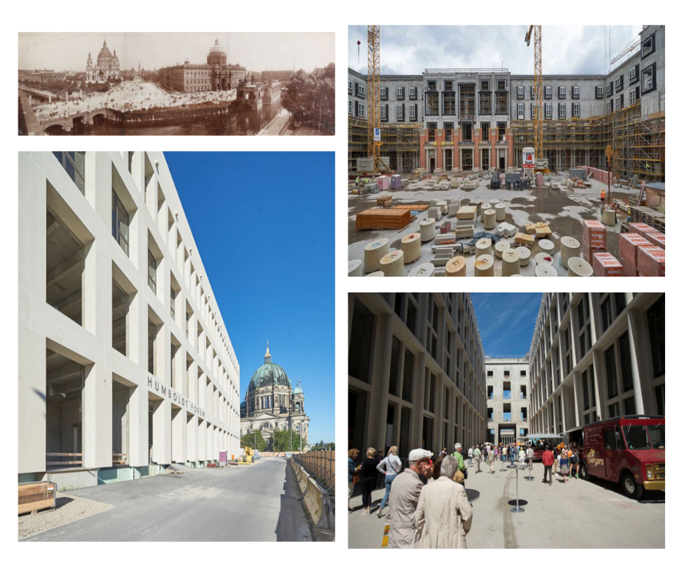
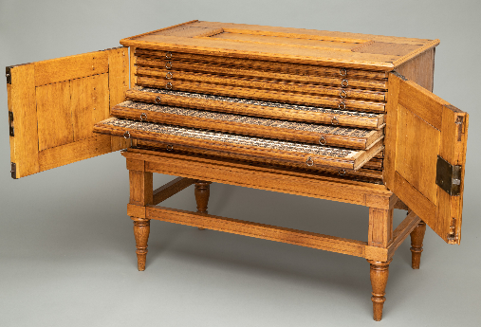
„The Typographia Sinica … becomes an ambassador of the Humboldt Forum – to take on the enormous task to cause curiosity, understanding, and empathy for the cultures of the world, …“
(Neil MacGregor)

