Slide 1
Open Access Strategy and Practice in Chinese Special Library：
the Development of National Center for Philosophy and Social Sciences Documentation
Oslo·September,2019

Slide 2
1
Introduction of CASS
Contents
2
Basic Information
3
Overseas promotion

Slide 3
Introduction of CASS
01

Slide 4
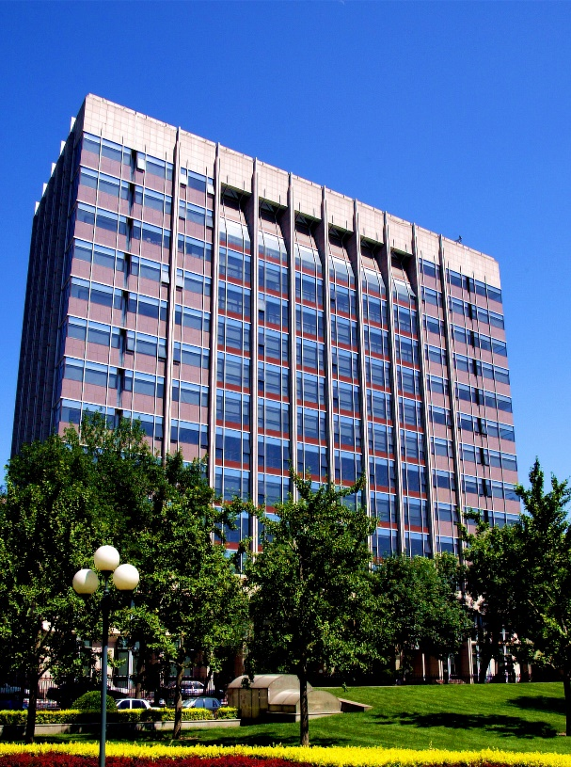
1
Introduction of CASS library
The Full name – Chinese Academy of Social Science Library (Survey and Data Information Center )
A special library and information center attached to Chinese Academy of Social Sciences that be founded in 1957
A comprehensive information service organization integrating traditional document services and modern data and information services with high-end think-tank services as well as information infrastructure services.

Slide 5
02
National Social Sciences Database

Slide 6
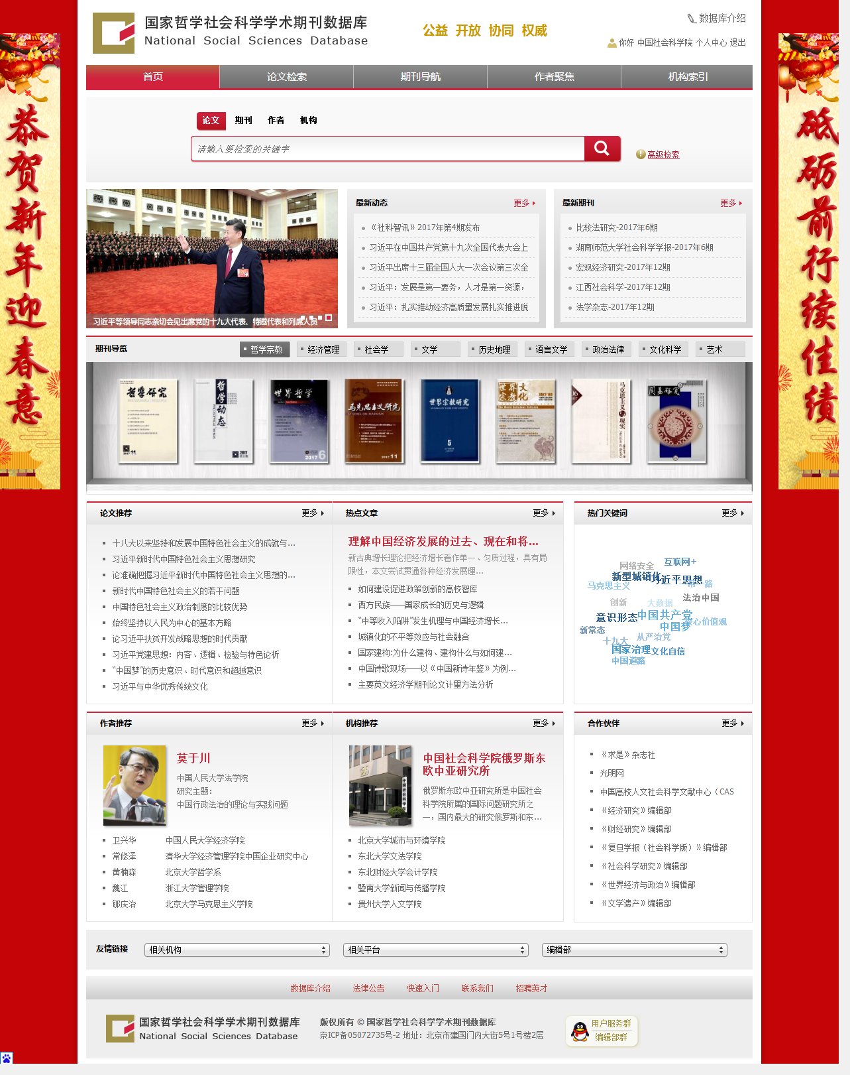
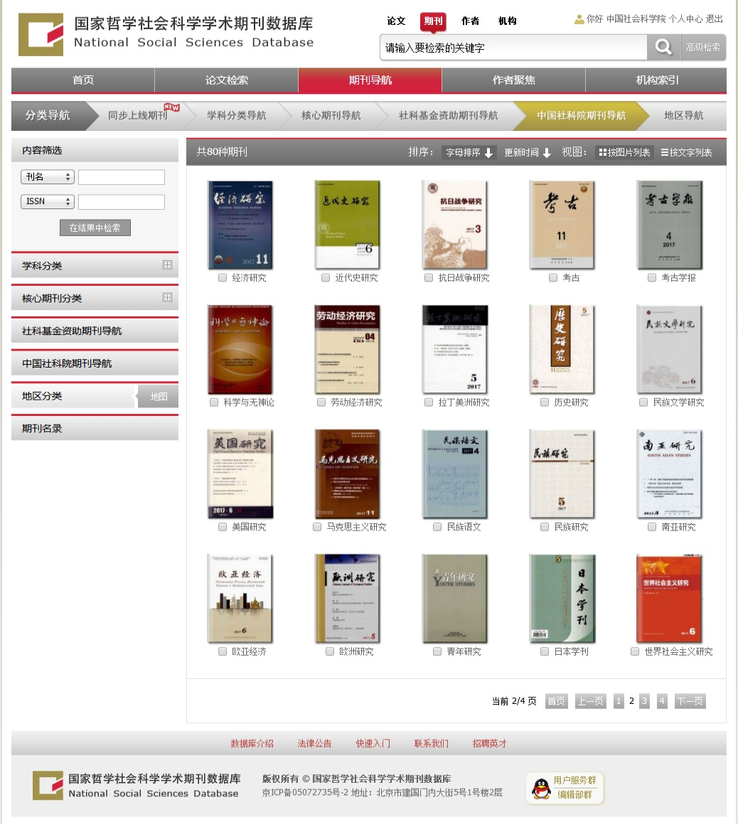
2
Introduction of National Social Sciences Database
In July of 2013, the National Social Sciences Database started to provide online services.
In 2016, NSSD had became the most important part of NCPSSD

Slide 7
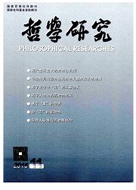
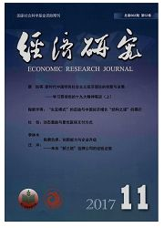
2
Introduction of Contents
Over 2000 excellent academic journals, including more than 600 Chinese core journals and 80 academic journals from CASS
More than 10 million full-text articles and the number is constantly growing
Covering subjects of humanities and social sciences ,such as politics,economy,laws,philosophy,history，etc.
700 journals dating back to the first issue while the earlist first issue is 1920.
All the journals and articles are formally authorized by journal editorial departments which signed works use agreement.

Slide 8
2
Functions
Full-text free online reading, download
Retrieving and browsing journals and articles in various ways
Statistical analysis and
multi-mode sorting for retrieval results
Information subscription
Subscribes to push

Slide 9
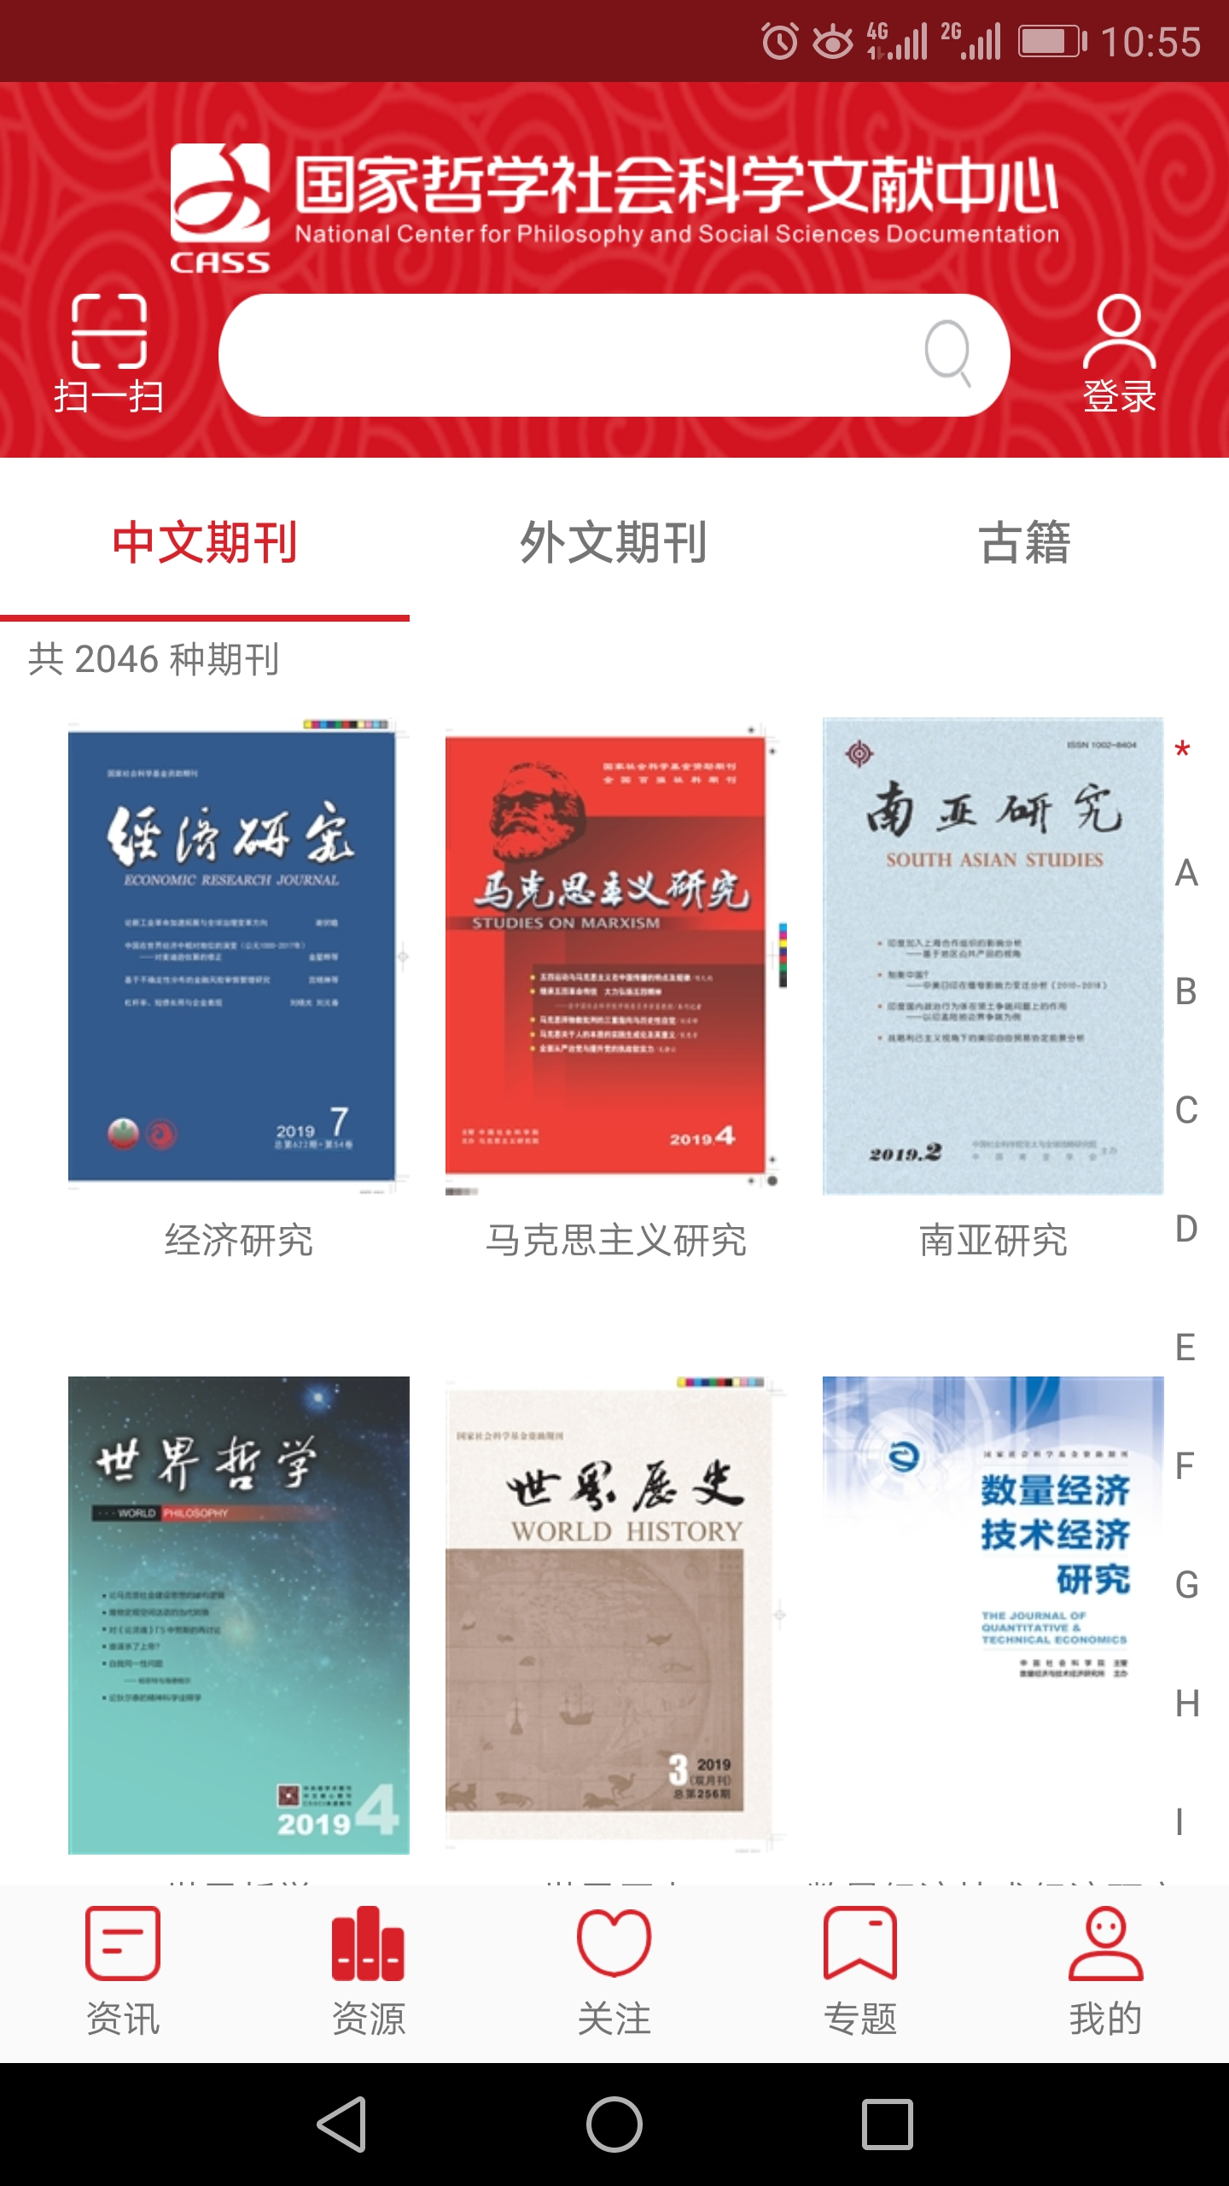
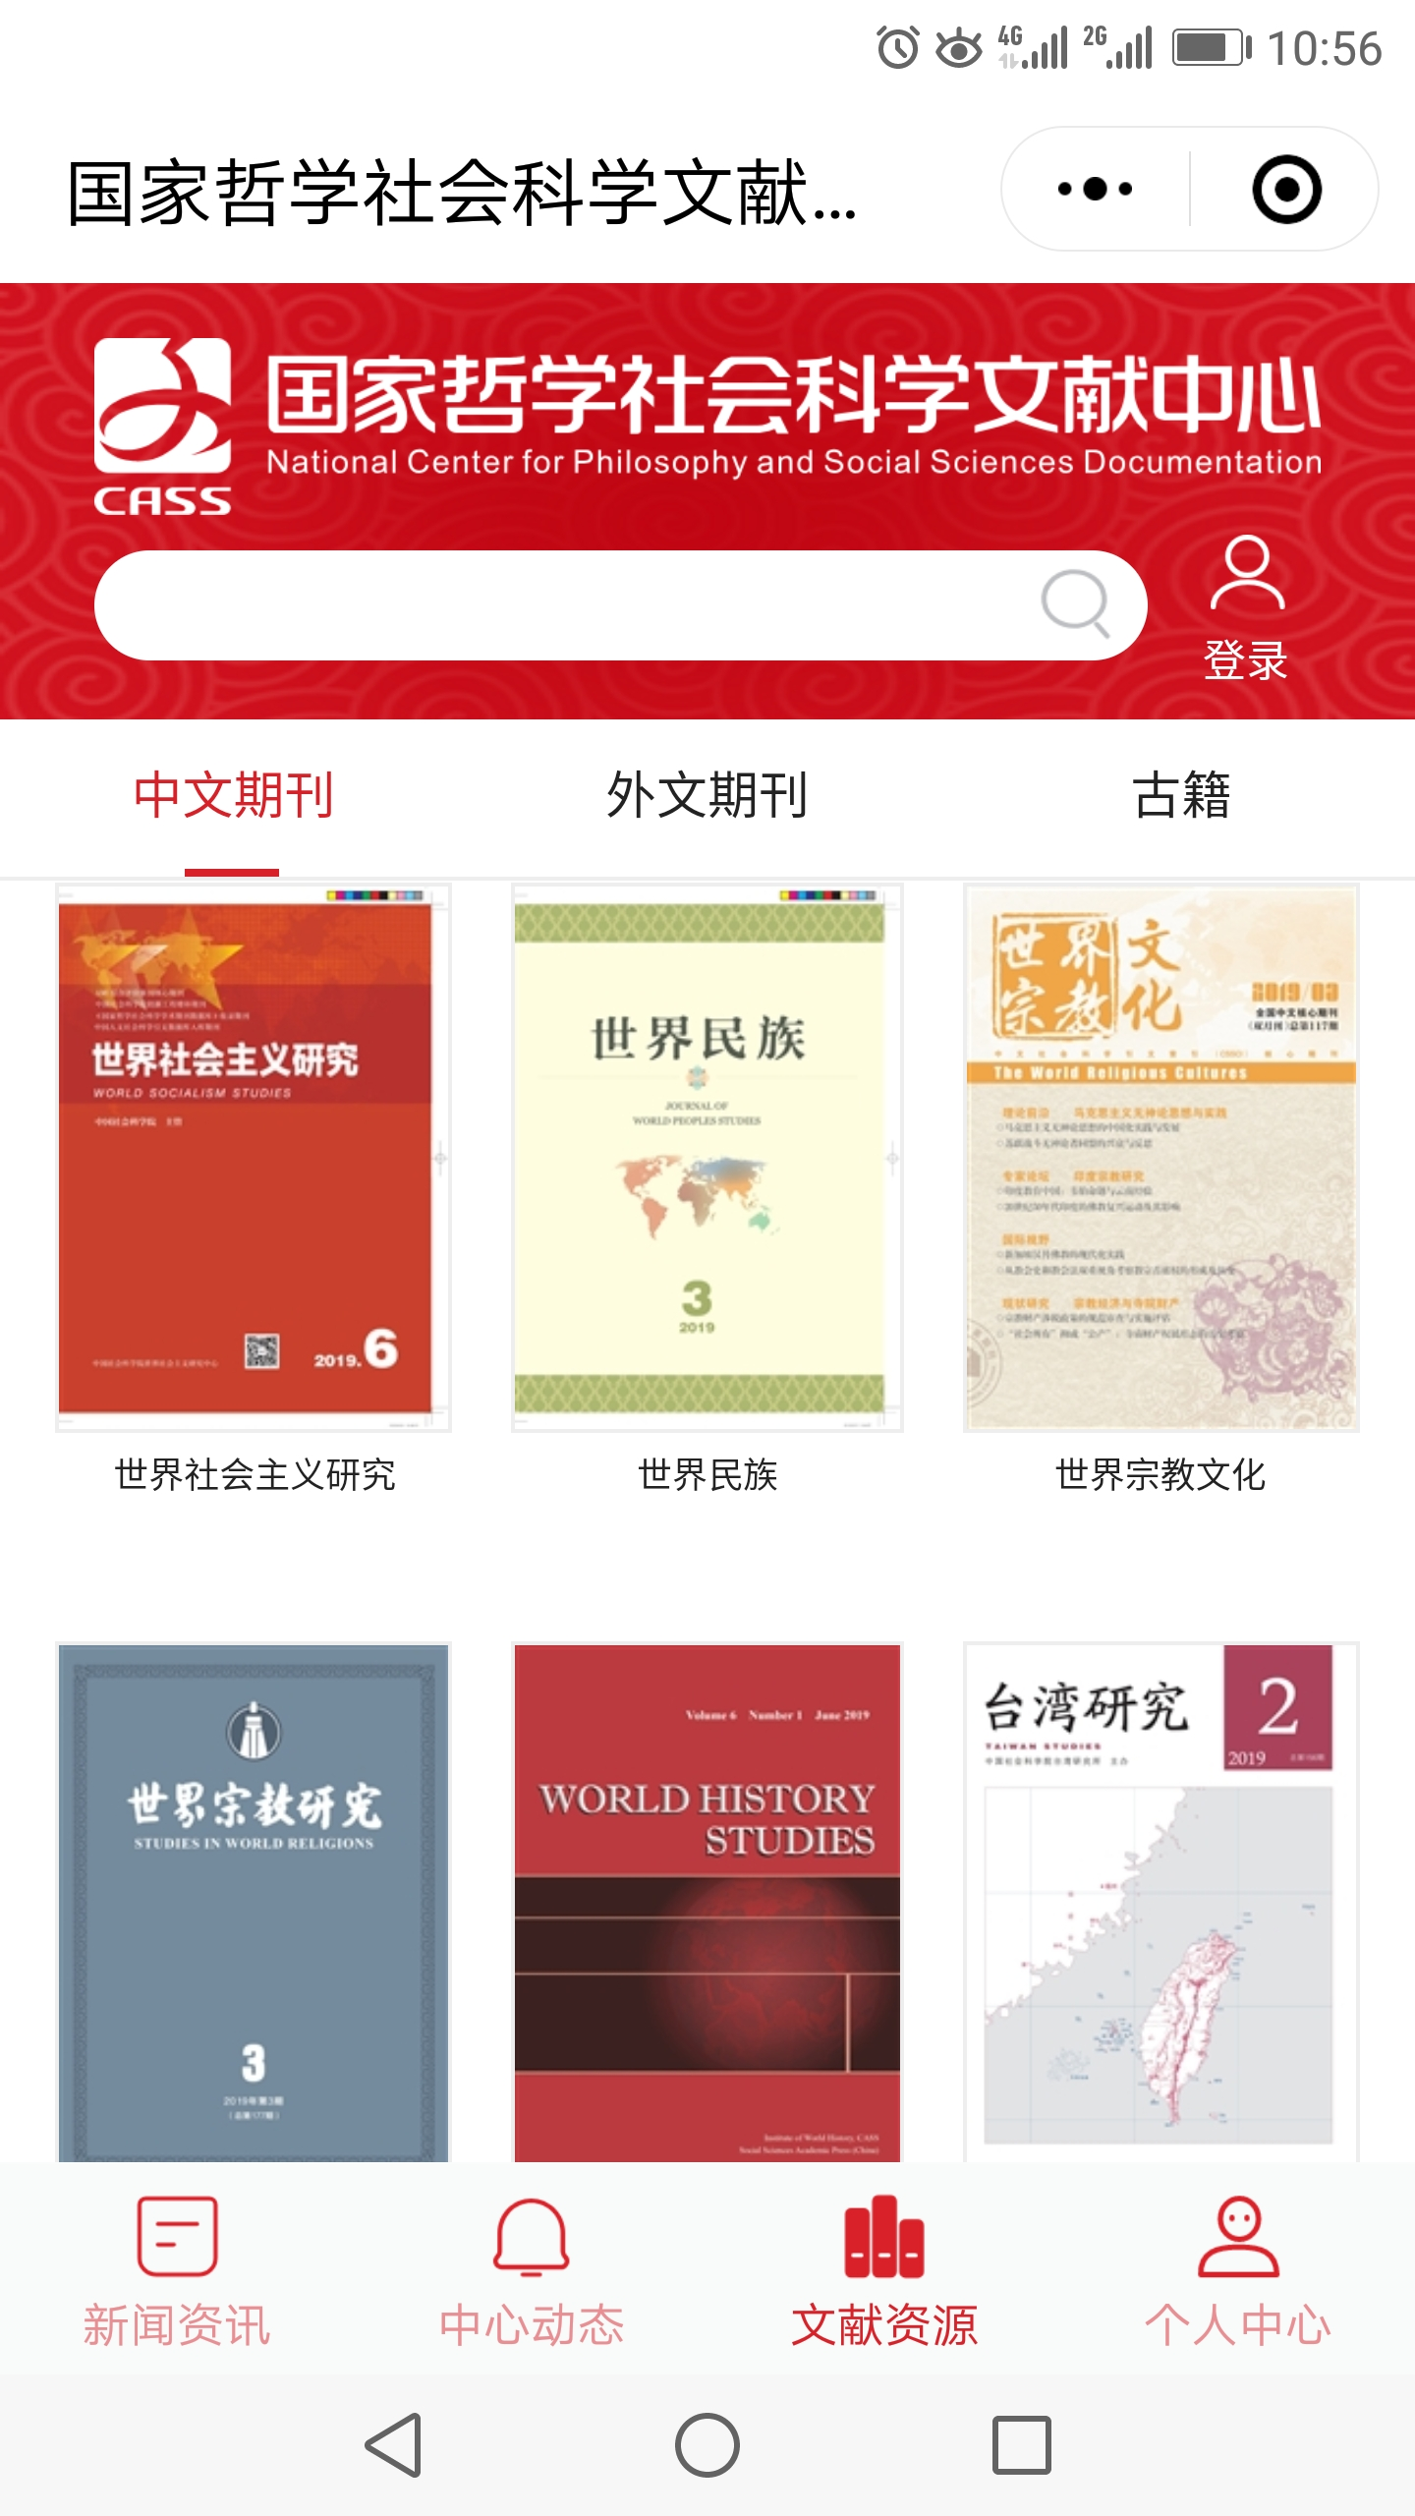
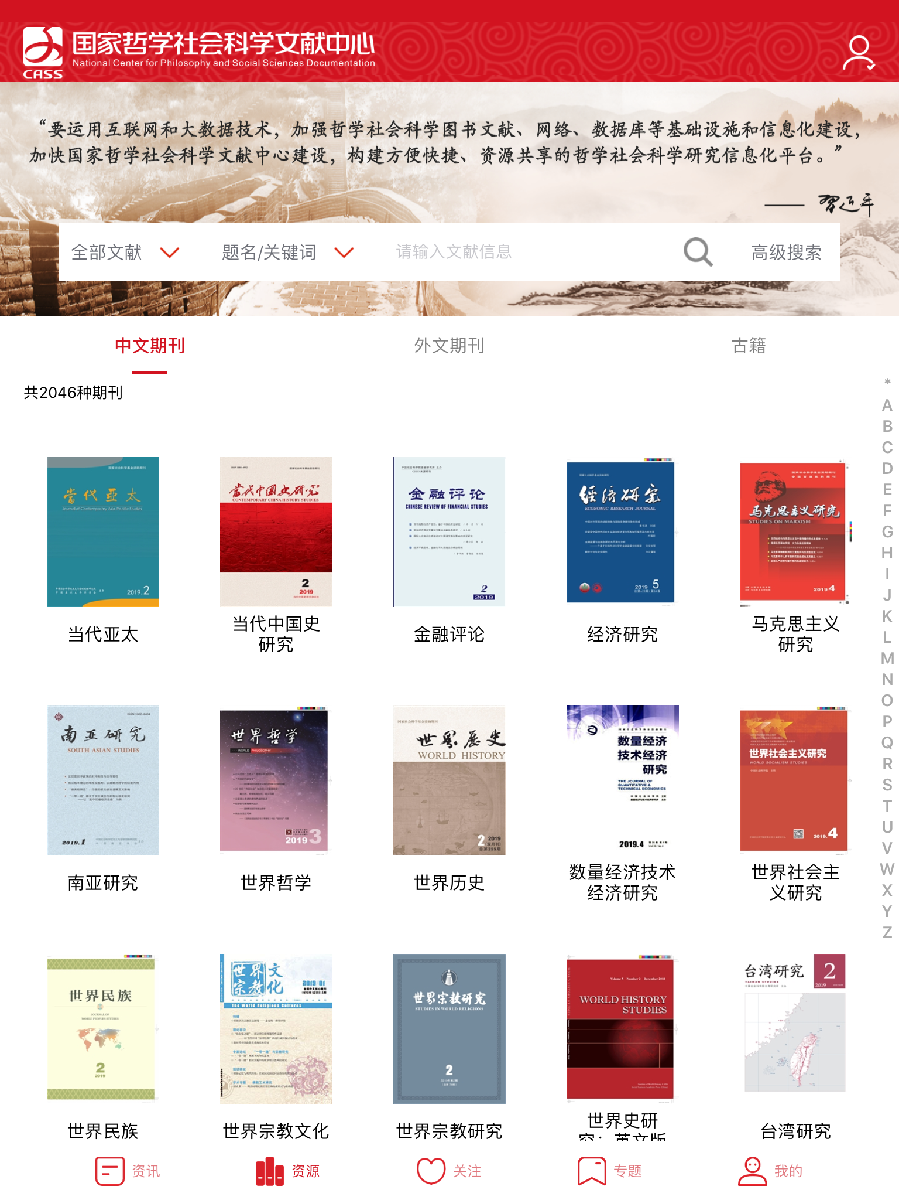
2
Mobile terminals of use
APP
Wechat applet
APP for PAD

Slide 10
2
Social Influence
More than 560 millions hits on the websites
More than 28 millions full-text download
More than 1,200,000 individual registered users
24,000 institutional users including universities, academic institutions and 600 institutions from overseas
55
70
85
40
60
80

Slide 11
Overseas promotion
03

Slide 12
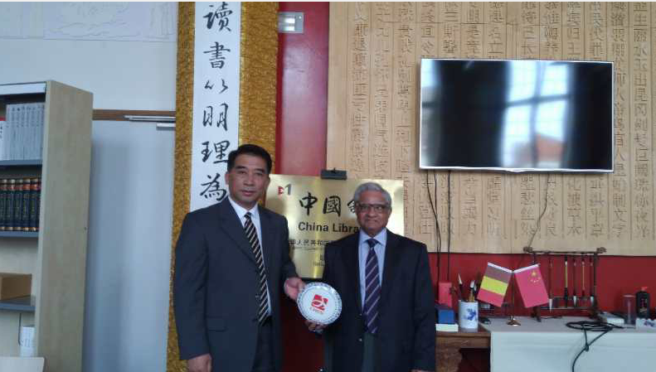
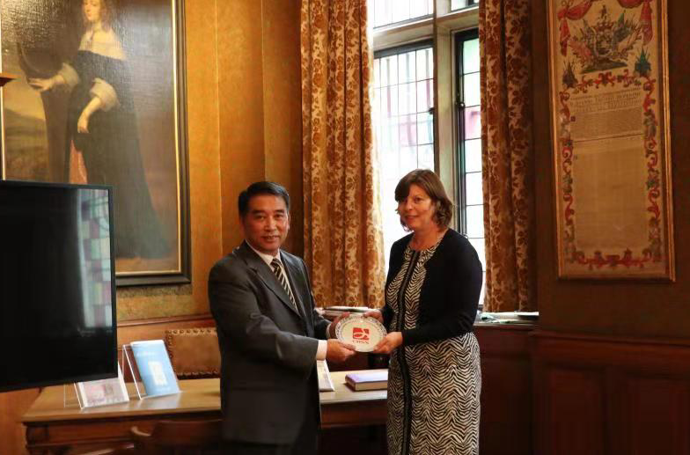
3
Overseas Promotion海外推广
In May of 2018, under the invitation of European College, I had visited European Council Library, European College library and Library of Leuven University

Slide 13
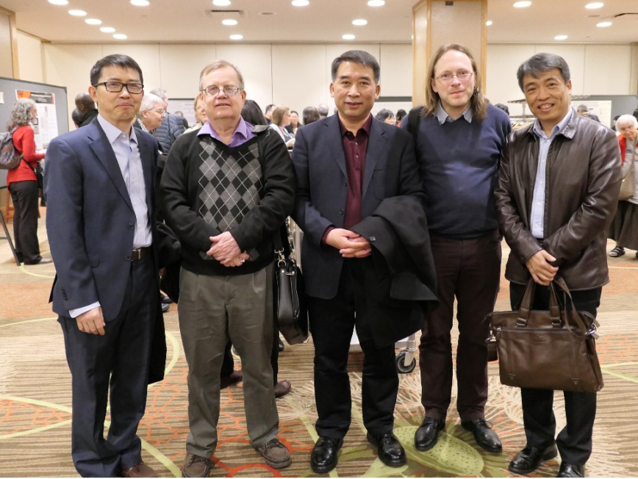
3
Overseas Promotion海外推广
In the March of this year, we have attended the AAS conference in Denvor and communicated with many friends who are at present.

Slide 14
National Center for Philosophy and Social Sciences Documentation
http://www.ncpssd.org/
National Social Sciences Database
http://www.nssd.org/

Slide 15
Thank You!

