Slide 1
Free datasets for Chinese Digital humanities
Inga-Lill Blomqvist, Nordic Institute of Asian Studies
Marc Gilbert, Leiden University Libraries
Joshua Seufert, Princeton University Library

Slide 3
Academic institutions

Slide 4
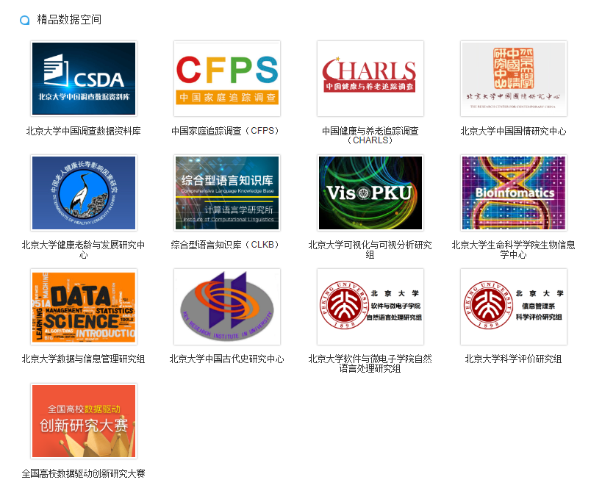
北京大学 开放研究数据平台 Peking University Open Data platform
http://opendata.pku.edu.cn/

Slide 5
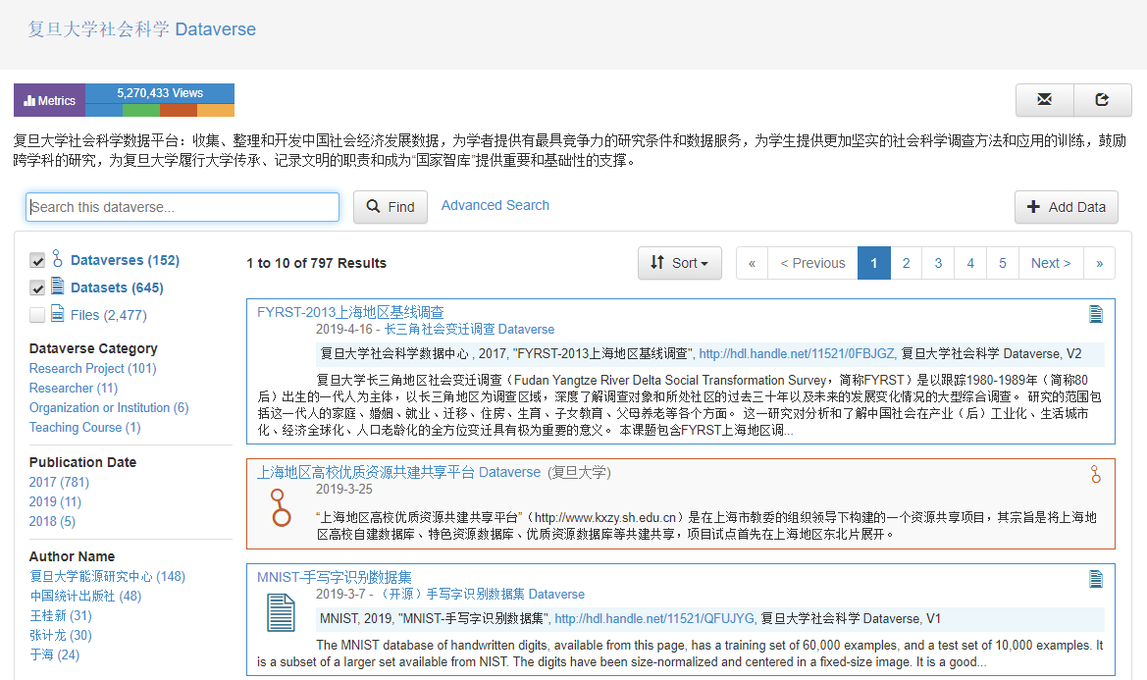
复旦大学社会科学数据平台 Fudan University Social Science Data Repository
https://dvn.fudan.edu.cn/dvn/

Slide 6
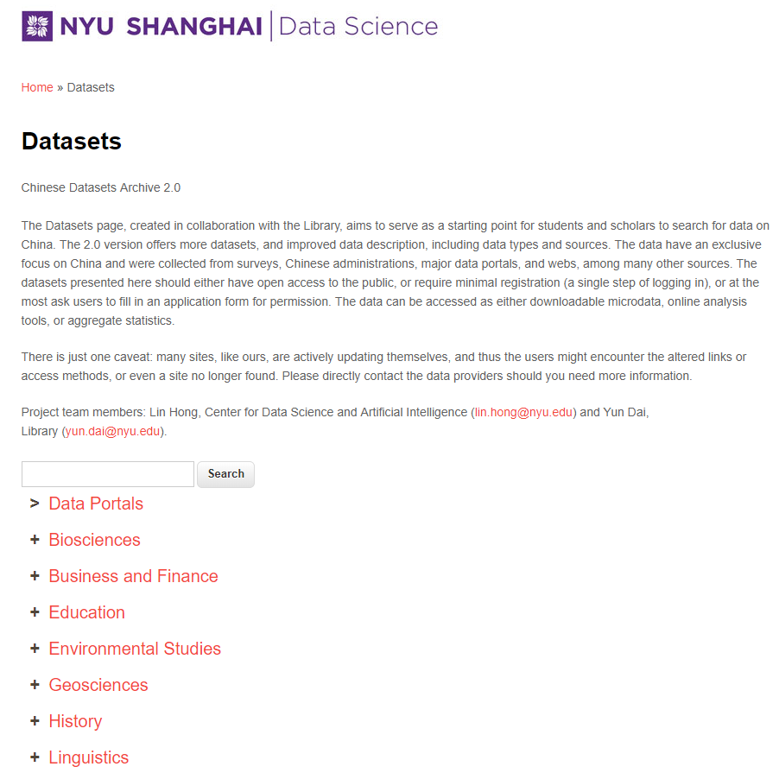
上海纽约大学 NYU Shanghai
https://datascience.shanghai.nyu.edu/datasets

Slide 7
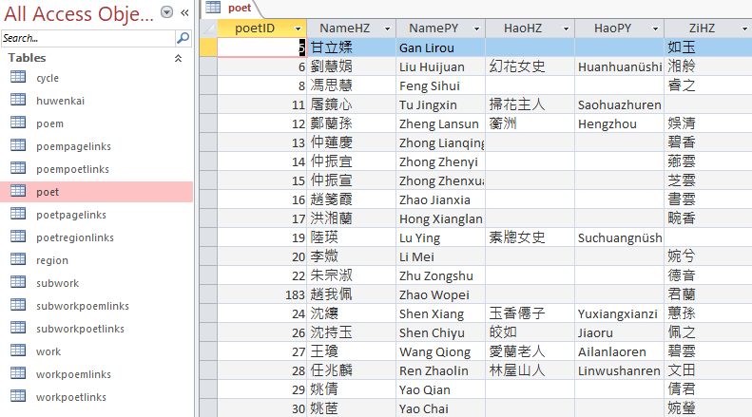
明淸婦女著作 Ming Qing Women's Writings
http://digital.library.mcgill.ca/mingqing/

Slide 8
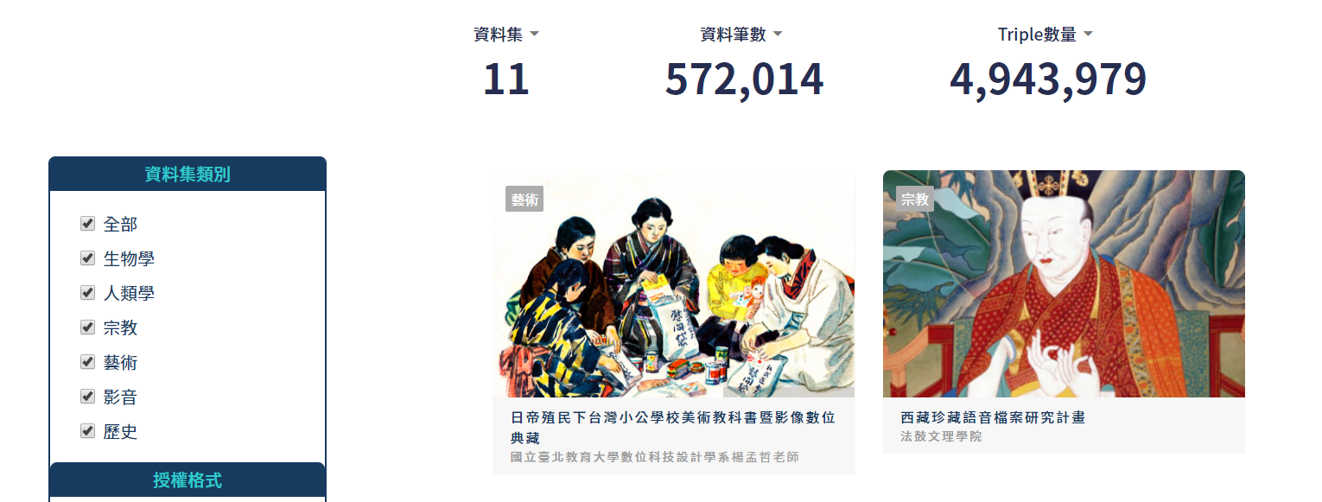
鏈結開放資料實驗室 LODLab
http://data.ascdc.tw/data.php

Slide 9
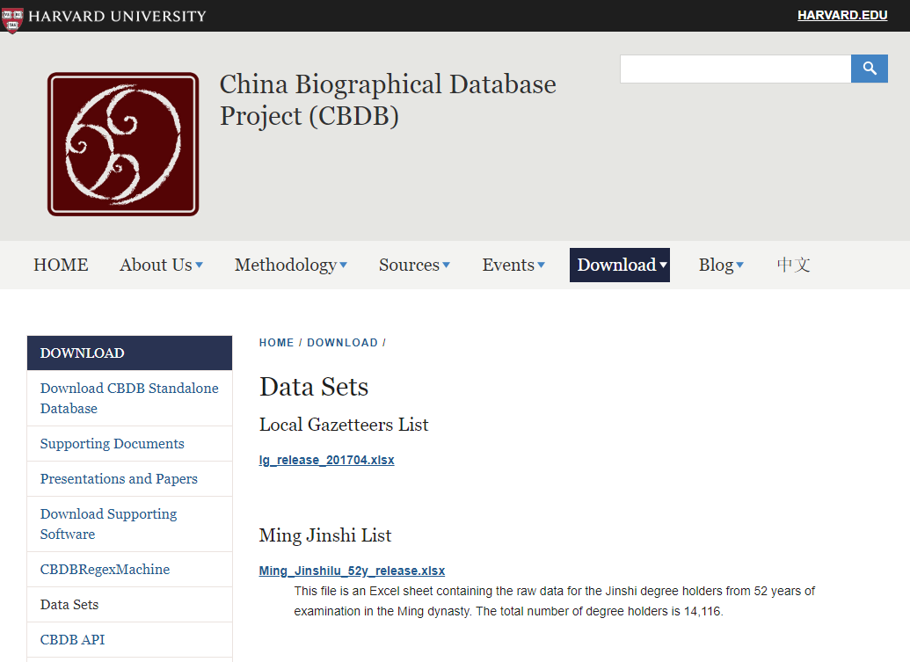
China Biographical Database
https://projects.iq.harvard.edu/cbdb

Slide 10
Authorship of Chinese Women’s Periodicals
http://mhdb.mh.sinica.edu.tw/ACWP/index.php

Slide 11
GIS

Slide 12
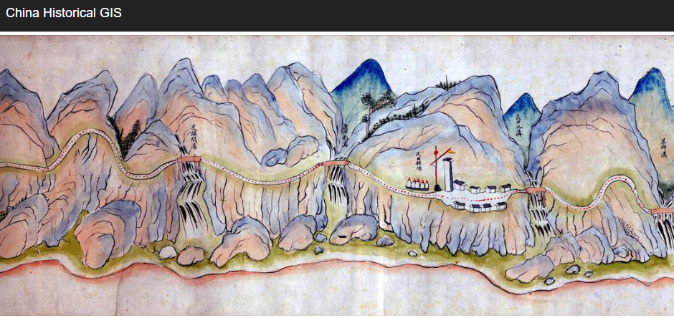
China Historical GIS
https://sites.fas.harvard.edu/~chgis/

Slide 13
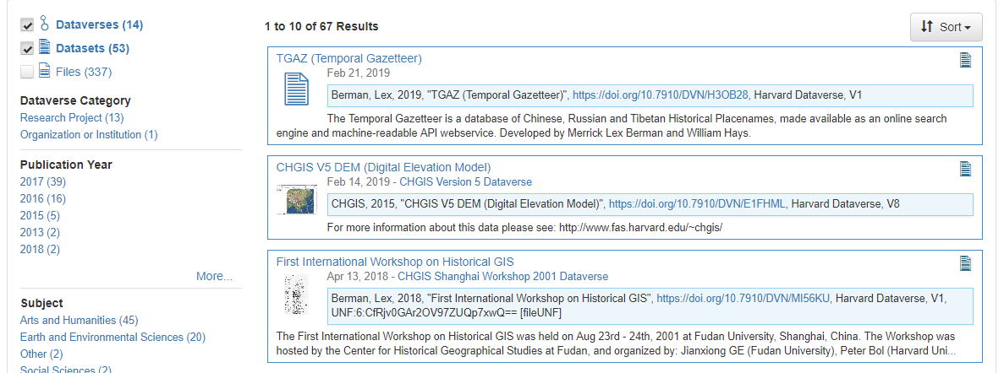
Harvard Dataverse – China Historical Geographic information system
https://dataverse.harvard.edu/dataverse/chgis

Slide 14
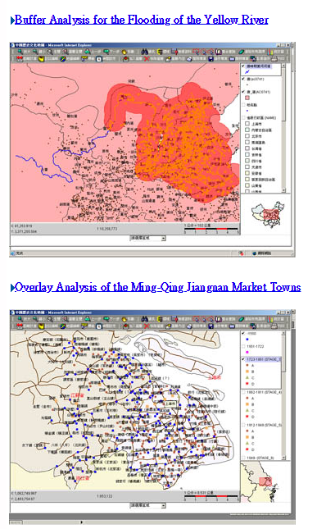
中華文明之時空基礎架構 Chinese Civilization in Time and Space
http://ccts.sinica.edu.tw/research.php?lang=zh-tw
http://ccts.sinica.edu.tw/download/userguide_en.pdf

Slide 15
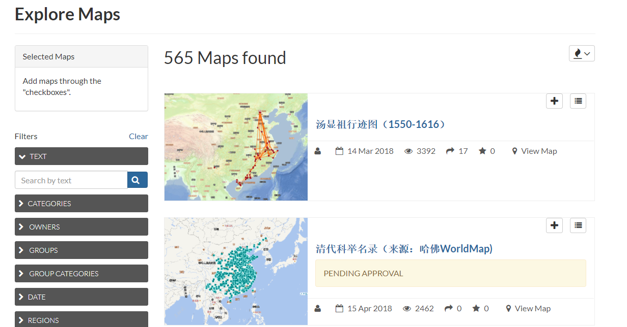
学术地图发布平台 Academic Map Publishing Platform
http://amap.zju.edu.cn/

Slide 16
Qing Demographic History
http://gis.rchss.sinica.edu.tw/QingDemography/data.htm

Slide 17
Official Data

Slide 18
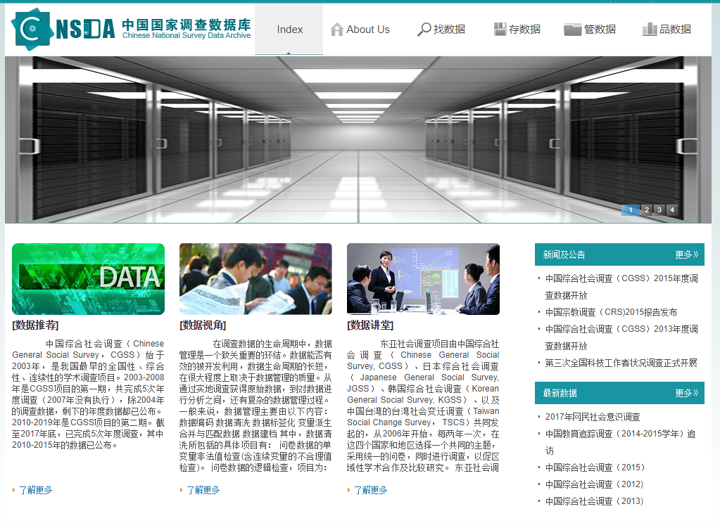
中国国家调查数据库 Chinese National Survey Data Archive (CNSDA)
http://www.cnsda.org/

Slide 19
国家数据 National Data
http://data.stats.gov.cn/

Slide 20
More resources

Slide 21
https://biogref.org/

Slide 22
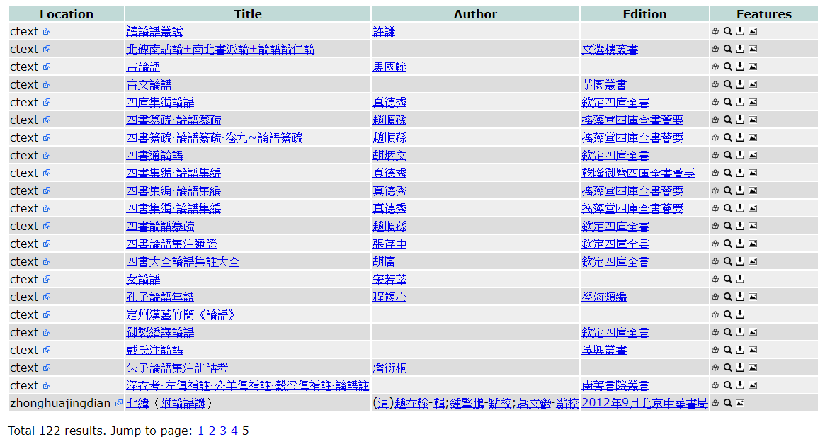
textref.org/

Slide 23
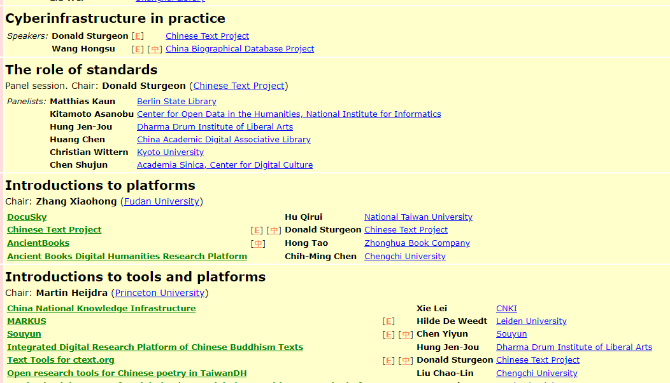
International Conference on Cyberinfrastructure for Historical China Studies 「中國歷史研究的網絡基礎設施」國際研討會 March 13th - 16th 2018, Harvard Center, Shanghai
https://ctext.org/digital-humanities/shanghai2018

Slide 24
"That's all Folks!" by Christophe Becker is licensed under CC BY-ND 2.0

