Slide 1
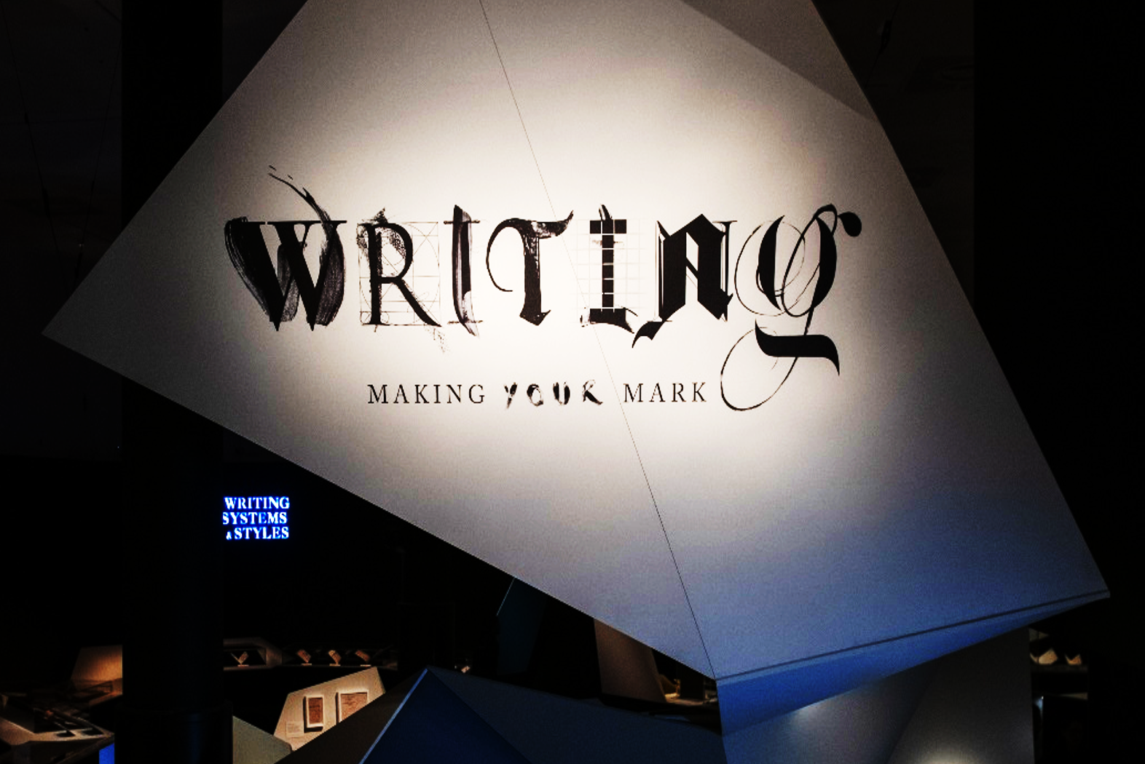

EMMA HARRISON
Curator, Chinese collections
The British Library
EASL Annual Conference
University of Oslo
6 September 2019
Notes:
Put your hand up if you’ve already seen the exhibition.
Who knows what a curator is? Or what a curator does? Don’t worry if you don’t know because lots of people don’t know. Basically, curators are people who look after collections of items, objects or ‘things’. For example, I am Curator of Chinese collections, which means I look after all the Chinese collections in the British Library. I am also one of four curators that worked on this exhibition and that means the four of us got to decide what to do with all of the things in the exhibition, which is all about writing. We decided what to include, what not to include and what stories we wanted to tell.
This involved some very difficult decisions because there are a lot of items in the British Library and almost all of them have writing on them. Does anyone know how many items there are in the British Library? [Answer: 170 million+]

Slide 2

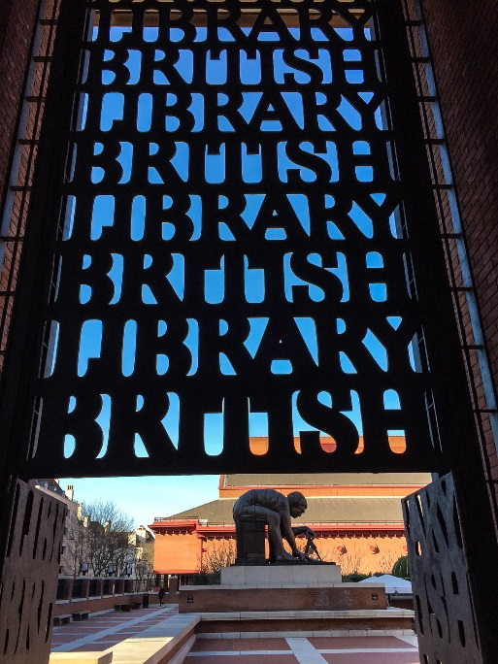
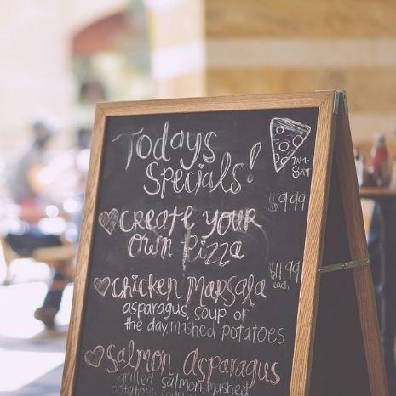
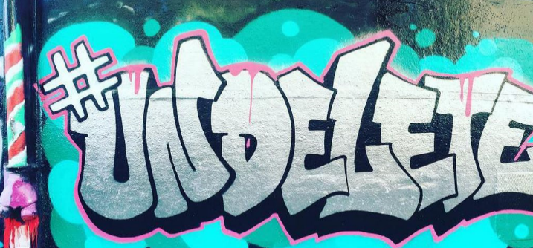
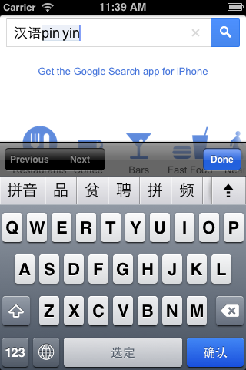
WHY WRITING?
Writing is:
- one of humankind’s greatest achievements
- taken for granted in modern life
    continually evolving
    beautiful, powerful and diverse
This exhibition is a celebration of writing
- All over the world
- Past, present and future
- Created by different people for different reasons
    Using a range of different writing technologies

Slide 3





WHO’S WHO
Curators:
Adrian Edwards (Head of Printed Heritage)
Michael Erdman (Curator, Turkish & Turkic collections)
Emma Harrison (Curator, Chinese collections)
Péter Toth (Curator, Ancient & Medieval manuscripts)
External advisor / book editor:
Ewan Clayton (Professor of Design, University of Sunderland)

Slide 4

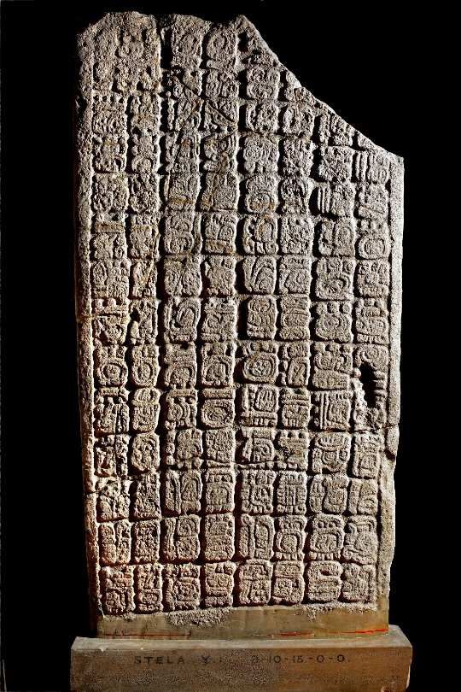
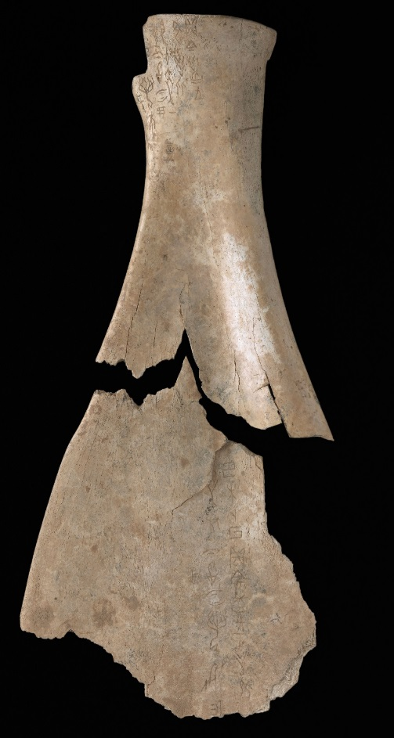
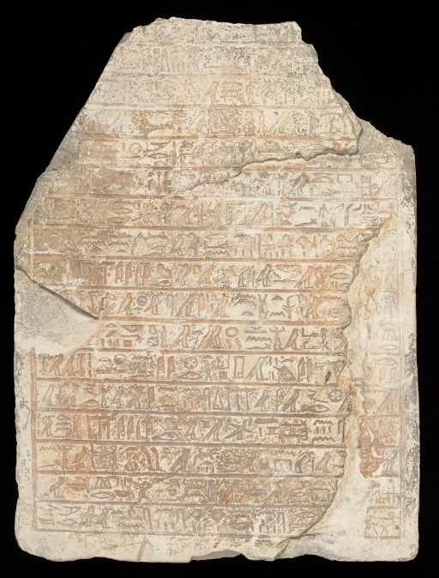
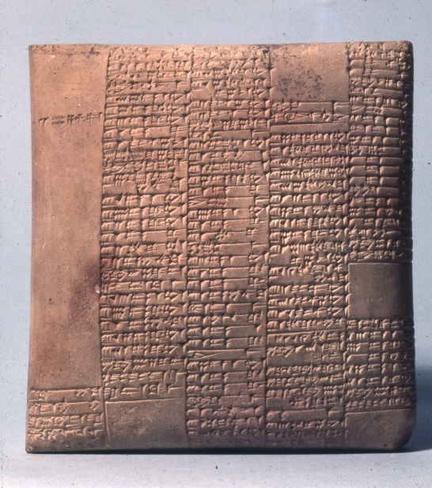
❶ THE ORIGINS OF WRITING
Courtesy of the British Museum
Courtesy of the British Museum

Slide 5
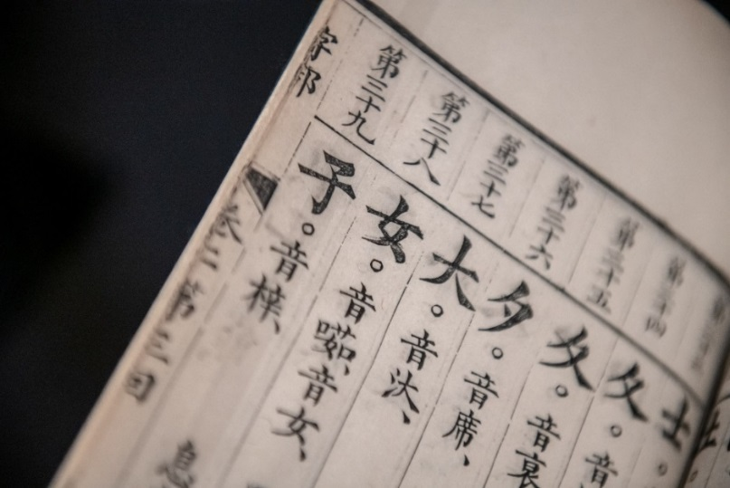
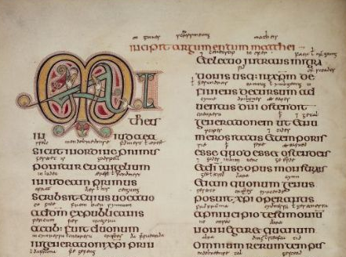
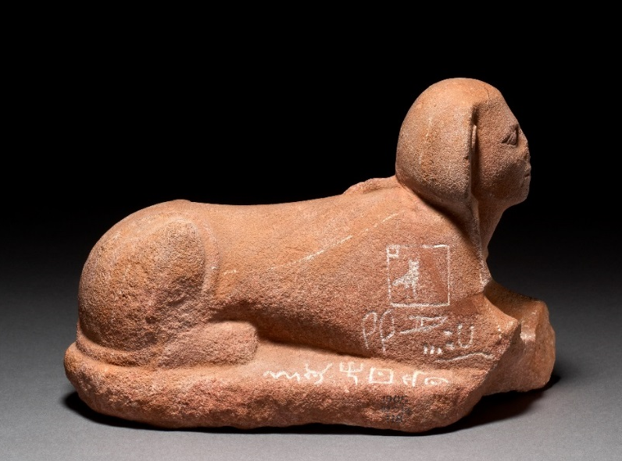
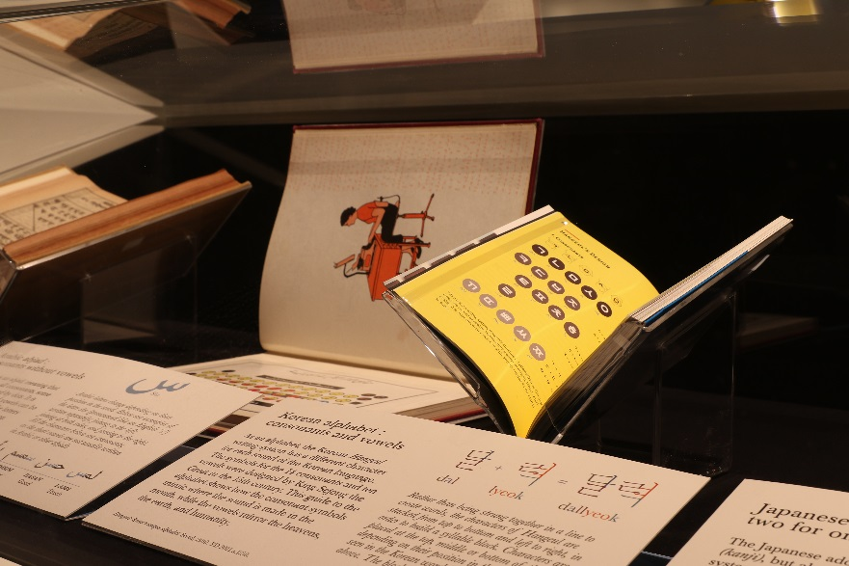
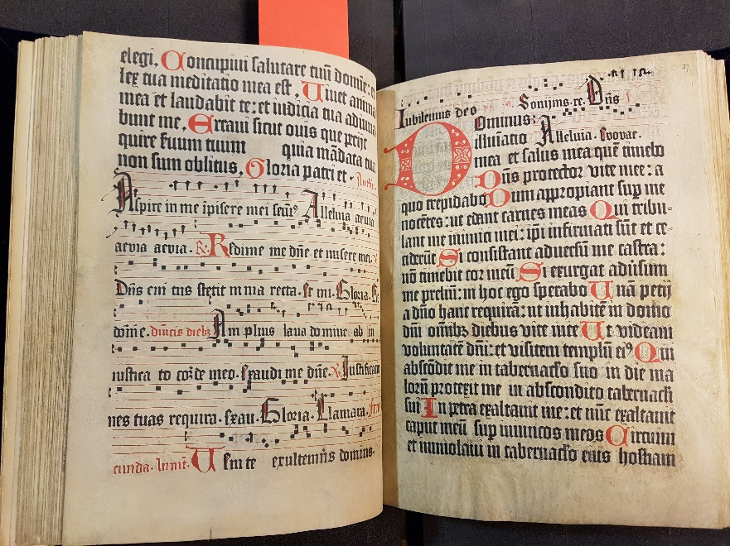
❷ WRITING SYSTEMS & STYLES
Courtesy of the British Museum

Slide 6
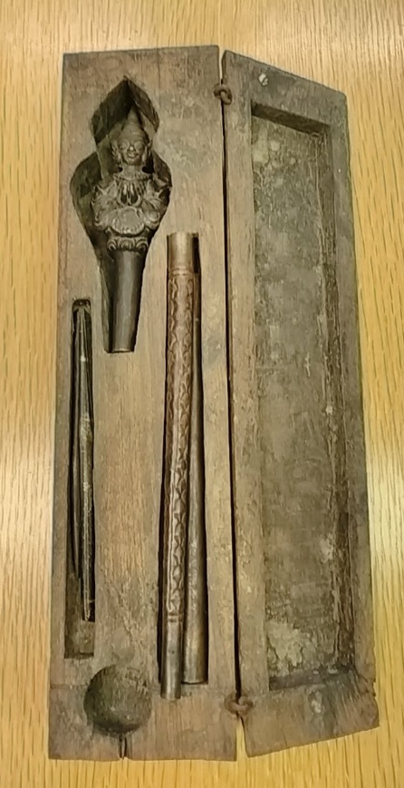
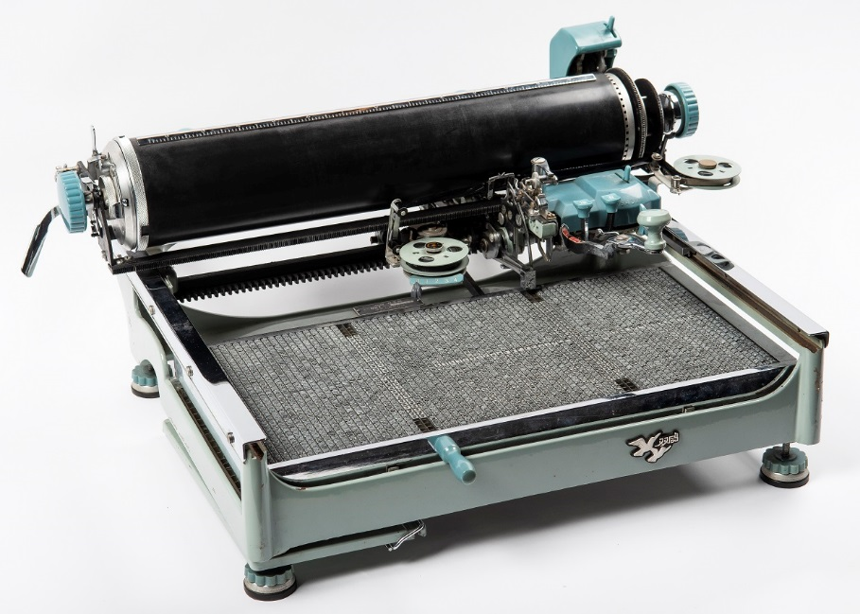
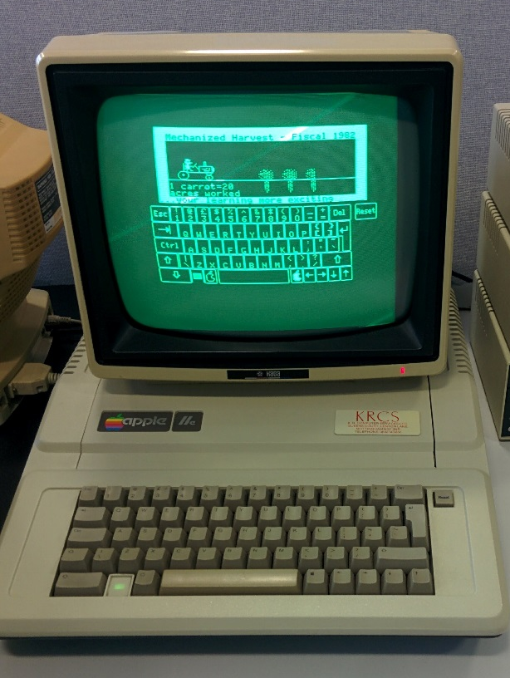
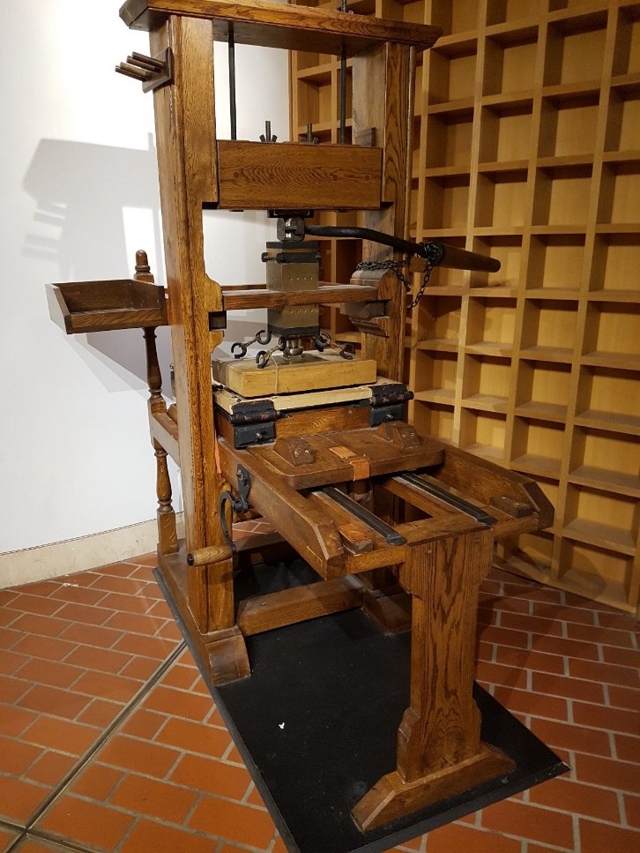
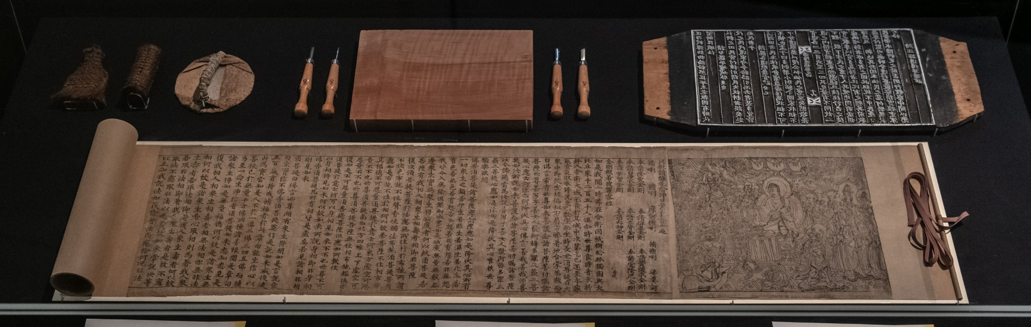
❸ MATERIALS & TECHNOLOGY

Slide 7
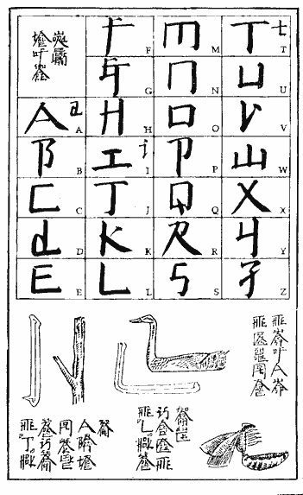
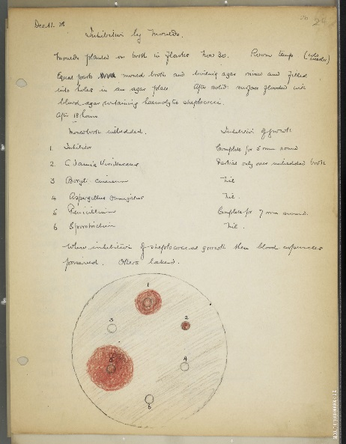
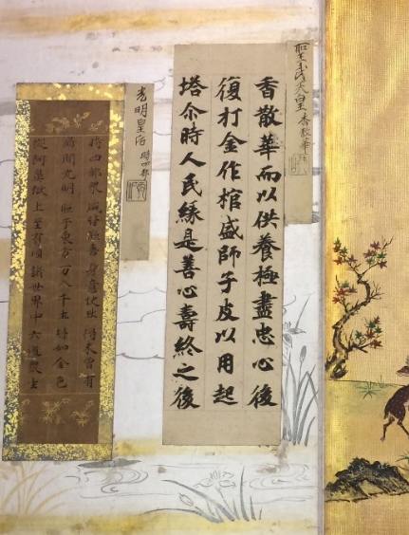
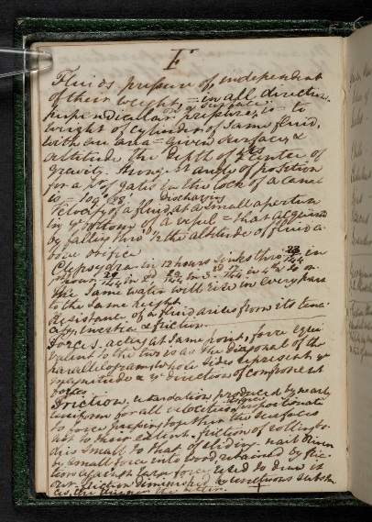
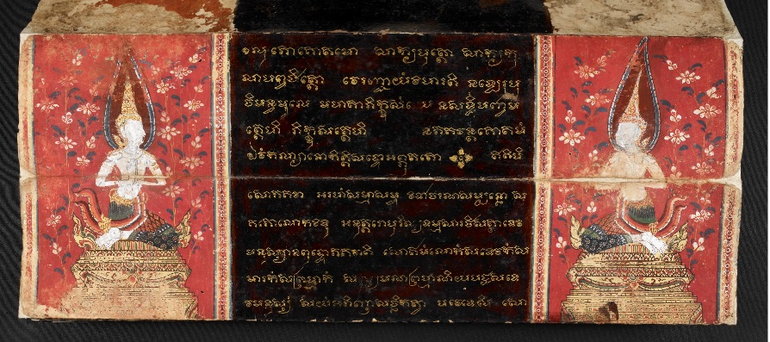
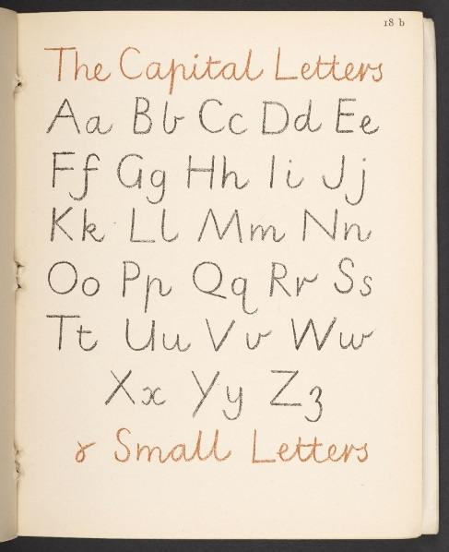
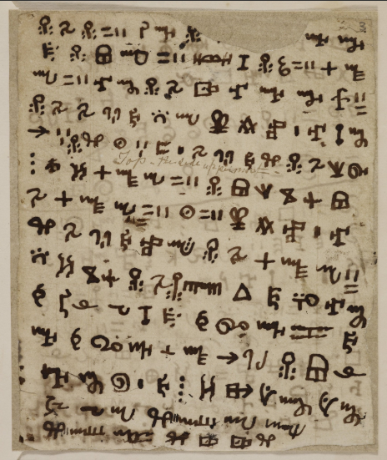
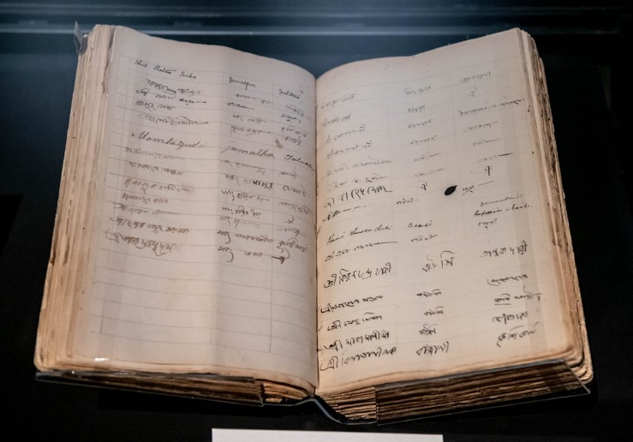
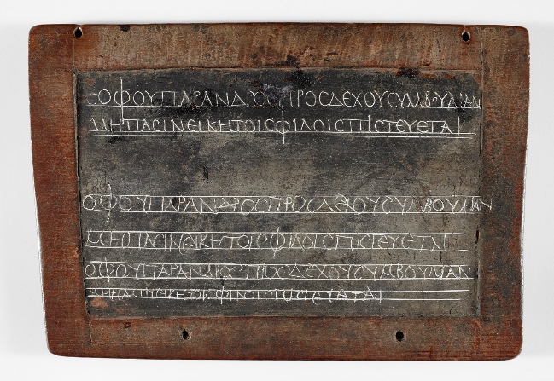
❹ PEOPLE & WRITING
Note-takers
Artists & Designers
Learners
Citizens

Slide 8
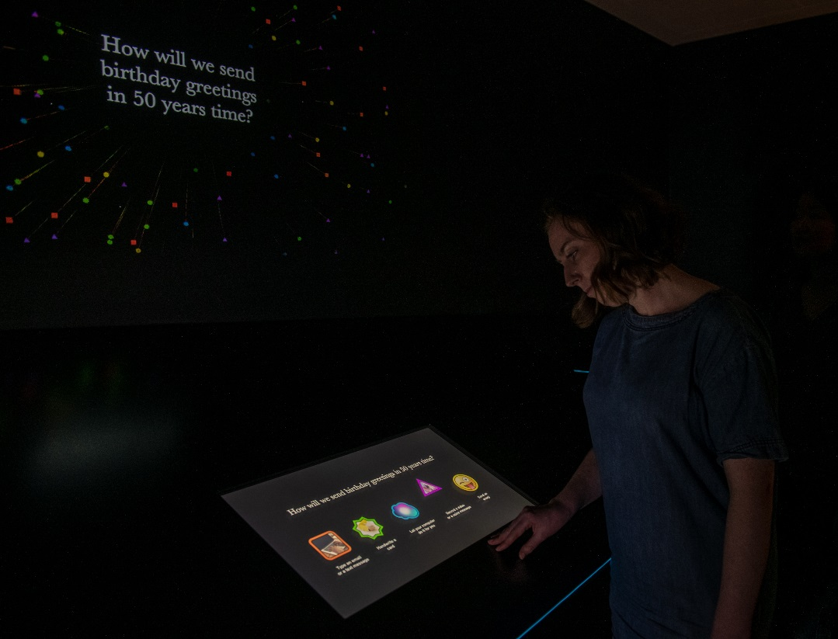

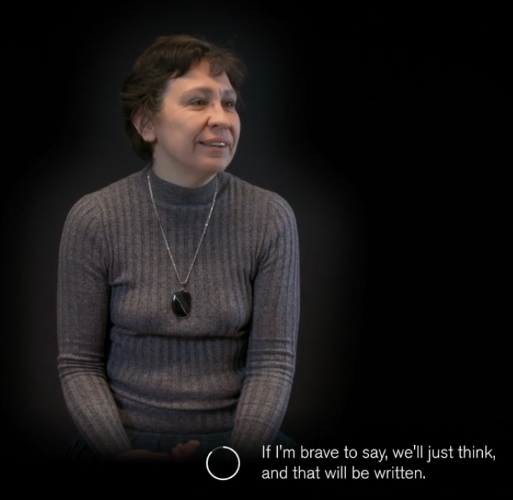
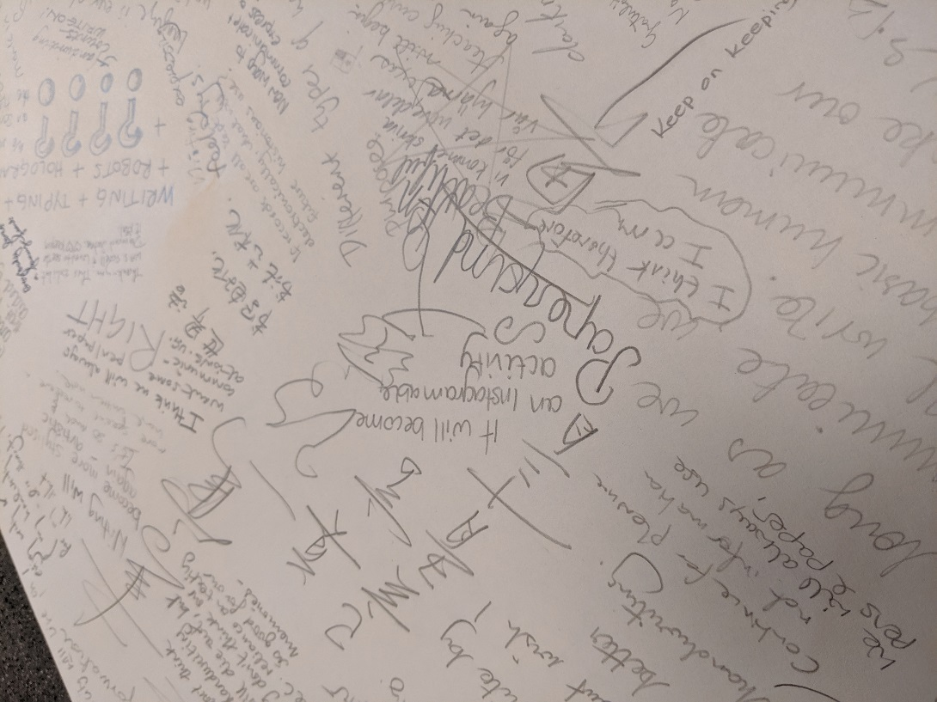
❺ THE FUTURE OF WRITING

Slide 9
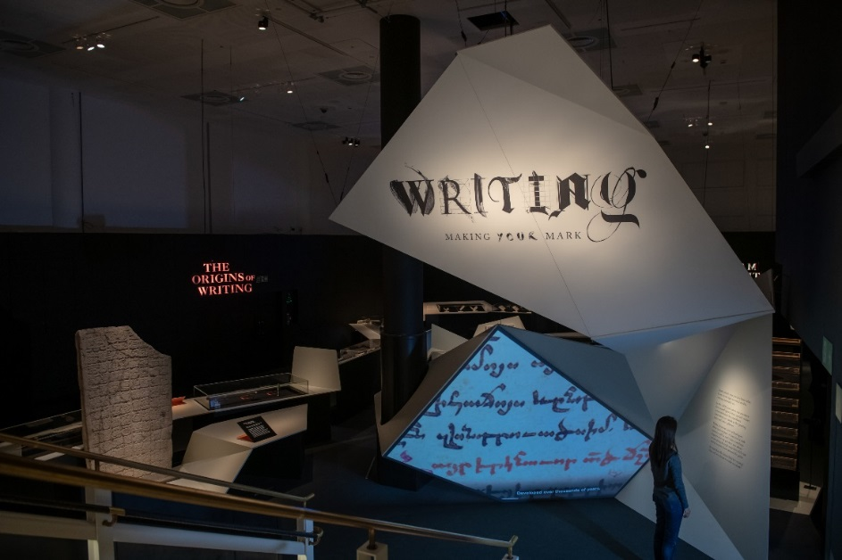
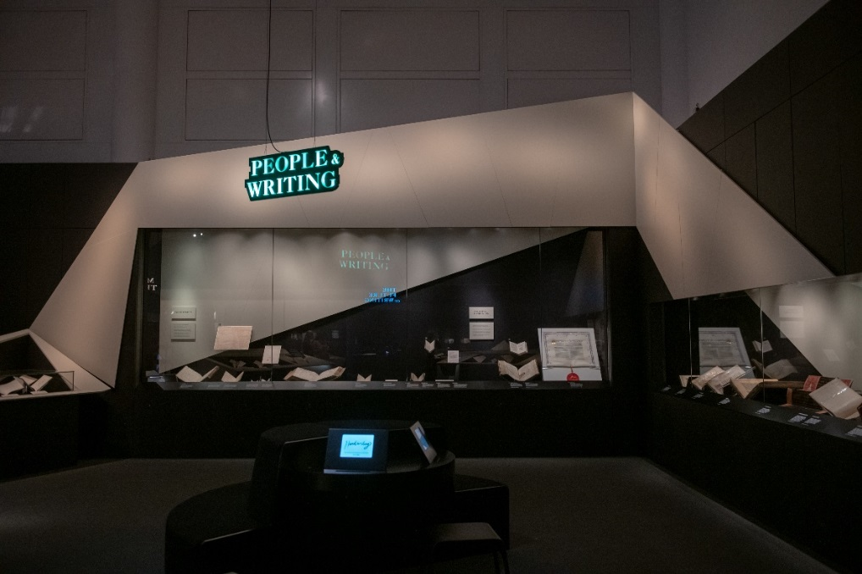
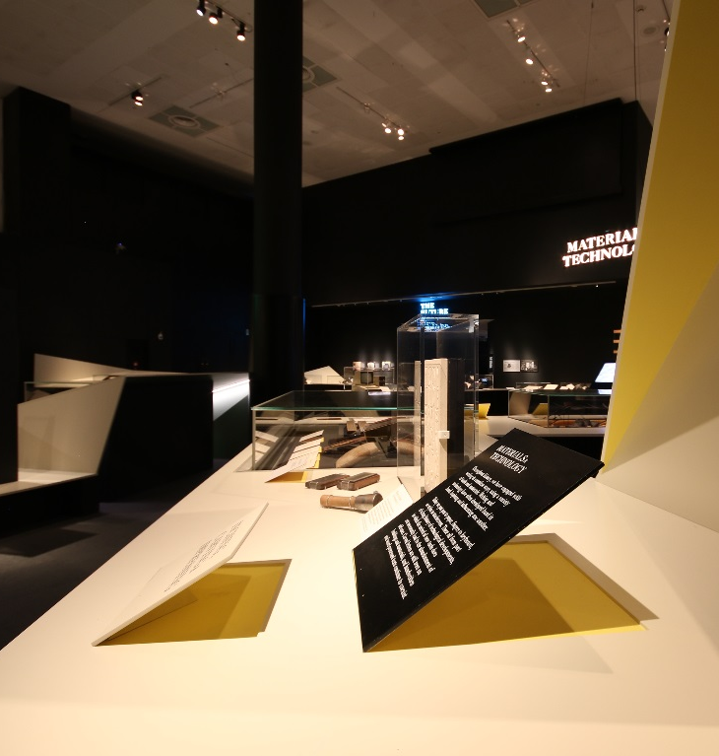
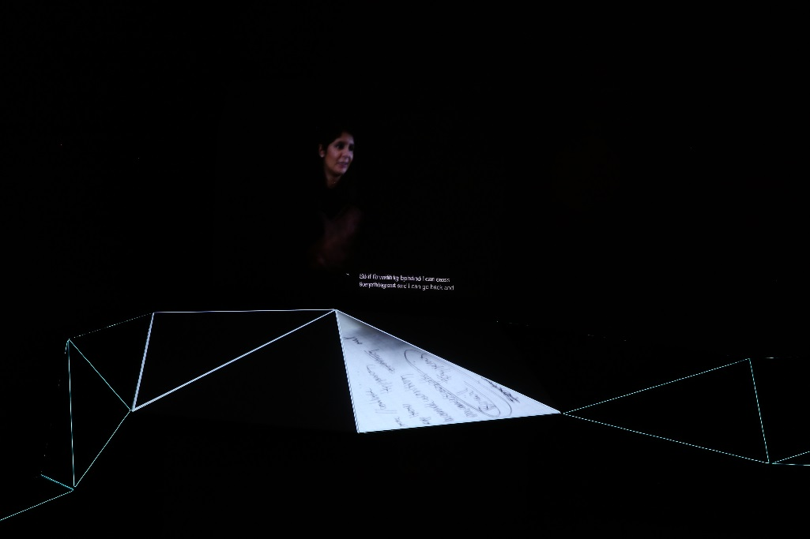
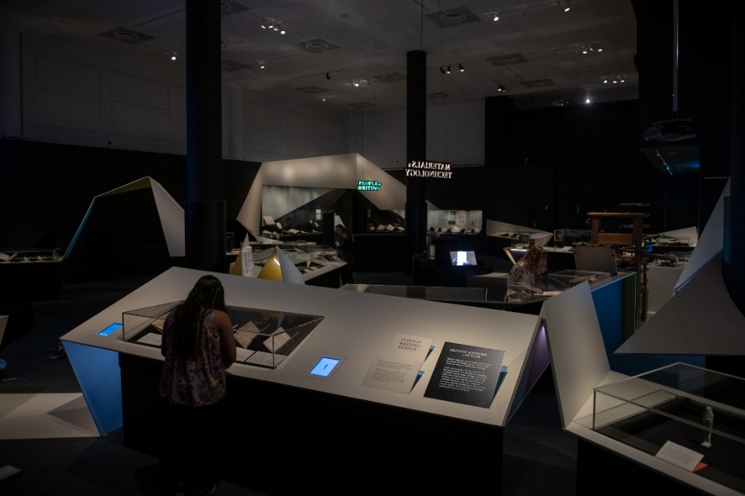
DESIGN

Slide 10

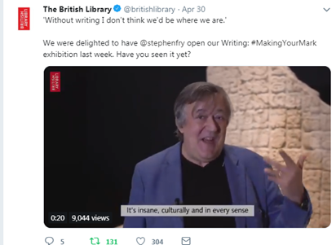
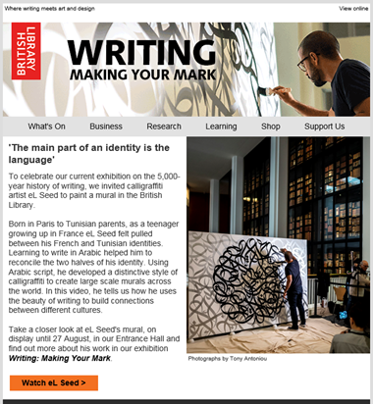
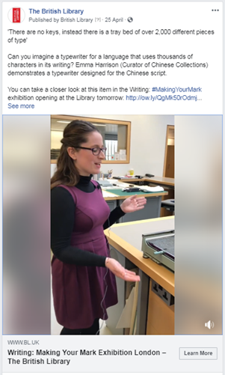
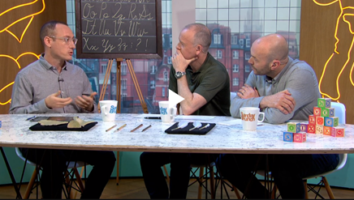


PRESS & PUBLICITY

Slide 11








Emma.Harrison@bl.uk
www.bl.uk/history-of-writing
www.bl.uk/blogs
@BritishLibrary / #MakingYourMark
THANK YOU
BritishLibrary
https://www.youtube.com/britishlibrary
https://sketchfab.com/britishlibrary
大英图书馆

