Slide 1
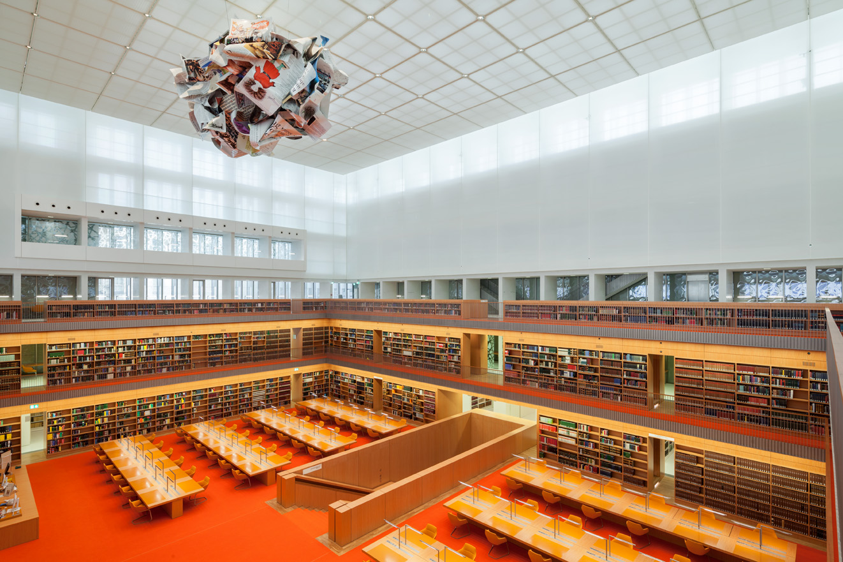
Licensing Activities & beyond Licensing Issues
dddBerlin,

Slide 2
Staatsbibliothek zu Berlin (Berlin State Library) – - largest research library in Germany and largest and agile East Asia Collection in Europe
Collection management, services, research data management, metadata management, content hosting, indexing, content delivery, licensing …

Slide 3
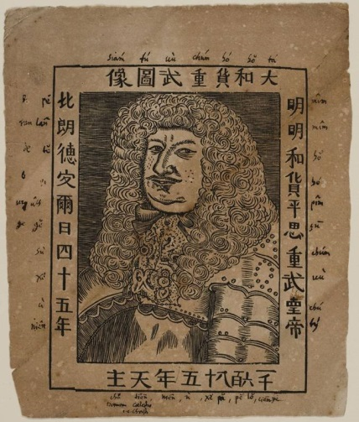
Collecting East Asian books in the Berlin State Library collecting East Asian books has
a long tradition in the
Berlin State Library
-since the founding of the
"Churfürstliche Bibliothek zu Berlin” (the Electoral Library of Berlin)350 years ago, Chinese material and later on East Asian (Manjurica, Japonica etc.) have been an important part of the collection
Great Elector Friedrich Wilhelm (1620-1688), 1685

Slide 4
Current Situation:
China Research Environment:
Here: access to content as a basis for excellent research:
Germany: national funded solution through DFG (German Research Foundation) funded platform, CrossAsia

Slide 6
Current Situation & Idea:
CrossAsia - Research Infrastructure for China and Asia related Studies
Licensing e-content for the German research community;
the scaling out of CrossAsia’s existing infrastructures and dissemination strategies; and
the harmonization of vendor expectations and researchers’ needs concerning the modes of access, use, reuse, and sharing of results produced by digital sciences.
develop and open an European perspective

Slide 7
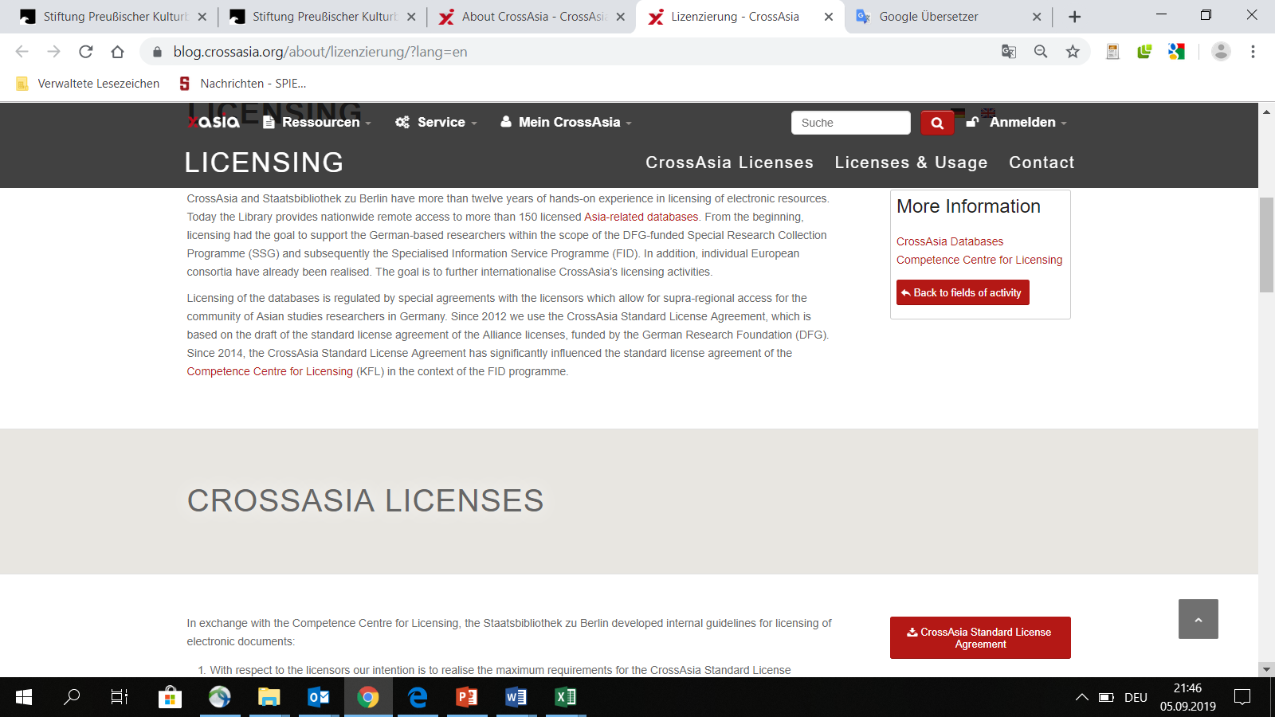

Slide 8
Current Situation & Idea:
Staatsbibliothek zu Berlin and CrossAsia
Large collection of print material
Large collection of e-resources form Asia, Europe and America
Access is granted and offered special ILL service and secure and controlled access through CrossAsia IT infrastructre on the basis of Shibboleth
-> Access and reading √

Slide 9
Maintaining e-resources:
Special license agreements
Metadata
Image data
Full-text data
Storge system (repository on the basis of Fedora 4.x) to
store and archive licensed content (according to our license agreements)
prepare material for Digital Humanities activties

Slide 10
Maintaining e-resources:
First new service based in the new field:
CrossAsia Full-text Search:

Slide 11
CrossAsia Fulltext Search (Beta)
Contained resources: 360,000 titles with together 52,5 mio. pages (Sept. 2019):
Adam Matthew - China America Pacific
Adam Matthew - China Trade & Politics
Adam Matthew - Foreign Office Files China
Adam Matthew - Foreign Office Files Japan
Adam Matthew - Meiji Japan (only metadata)
Airiti ebooks
CNKI eBooks
道藏輯要
Local Gazetteers (combining different databases, together about 11,000 title – including doubles)
Missionary, Sinology, and Literary Periodicals (1817-1949)
清代史料
人民日报 : People's daily
日本古典書籍 : Classical Works of Japan
四庫全書
續修四庫全書
Fulltext search in print books (sample set)
soon: 180,000+ titles published in Republican China
Notes:
First approach: fulltext seach

Slide 12
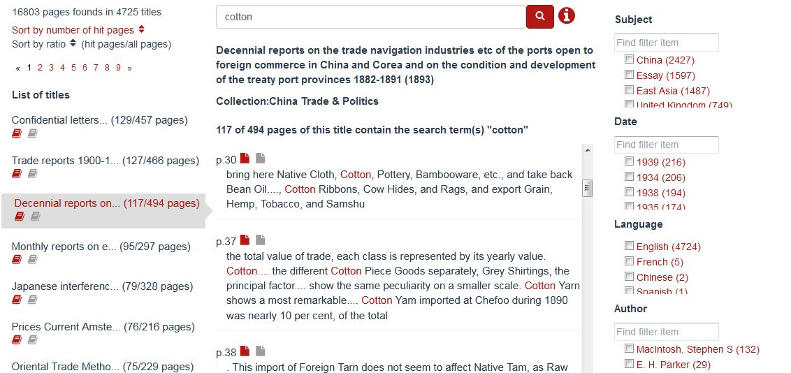
„i“ leads to list of search features or short description of resource
Filter by terms or „search“ for filter terms. More than one filter term can be selected within one filter to show results that match either the one OR the other.
(A) „Guided“ fulltext search
Hits are grouped into books; sequence according to number of pages with hits
Enter search term (space = AND; „“ = string search)
Choose a title to show pages with hits; go to book in database via icon (authorization required)
The centre column shows hit pages in the sequence of the book; go to page in database via icon (authorization required)
Notes:
Short intro: fulltext search A

Slide 13
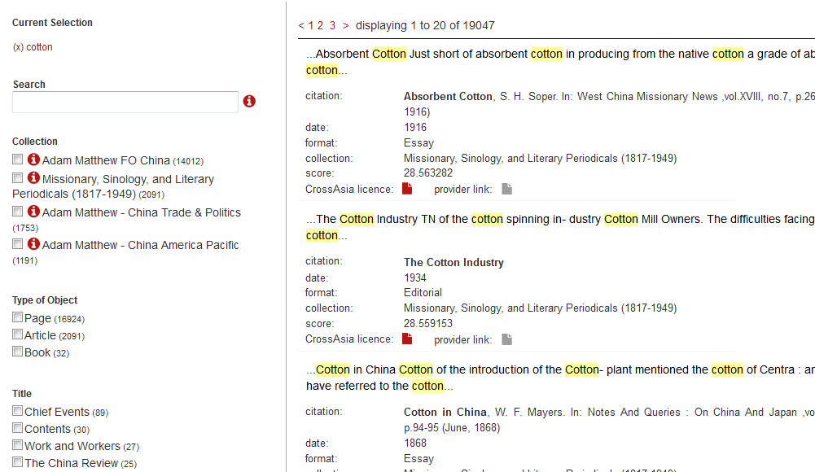
(B) „Explorative“ Volltextsuche
„i“ leads to list of search features or short description of resource
Enter search term (space = AND; „“ = string search)
Hits in book metadata and page content are shown in the sequence of their score. Open book/page via icon (authorization required)
Chooes type of object (book, article, page) and filter by title, subject, etc.
Notes:
Short intro: fulltext search B

Slide 14
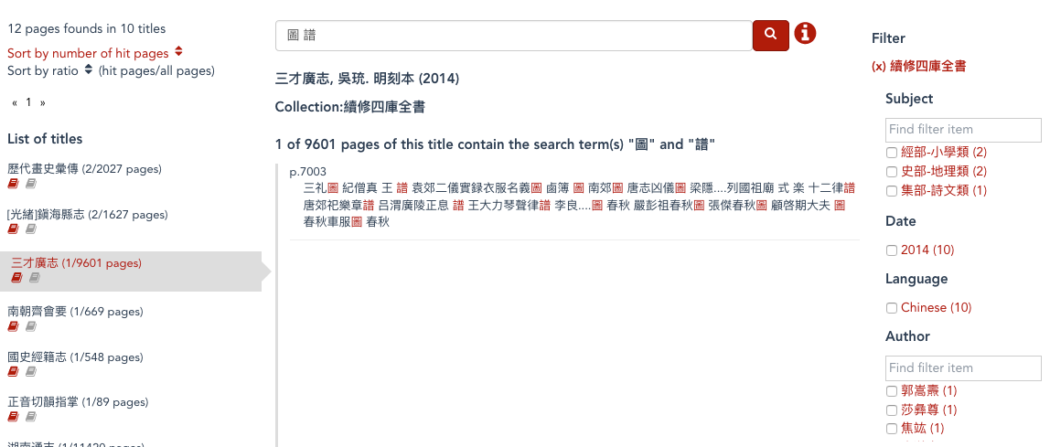
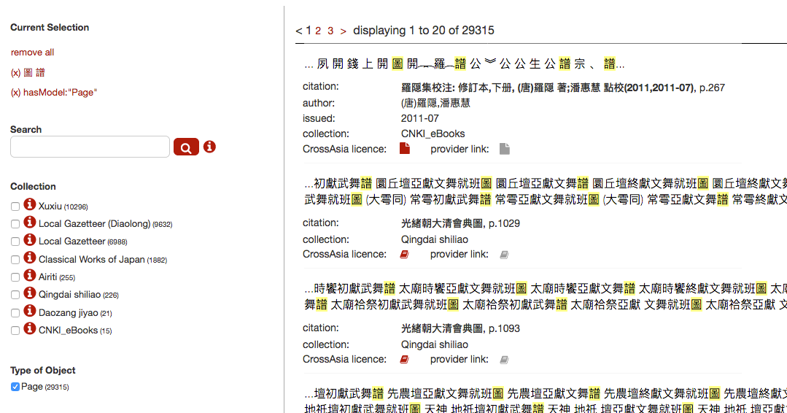
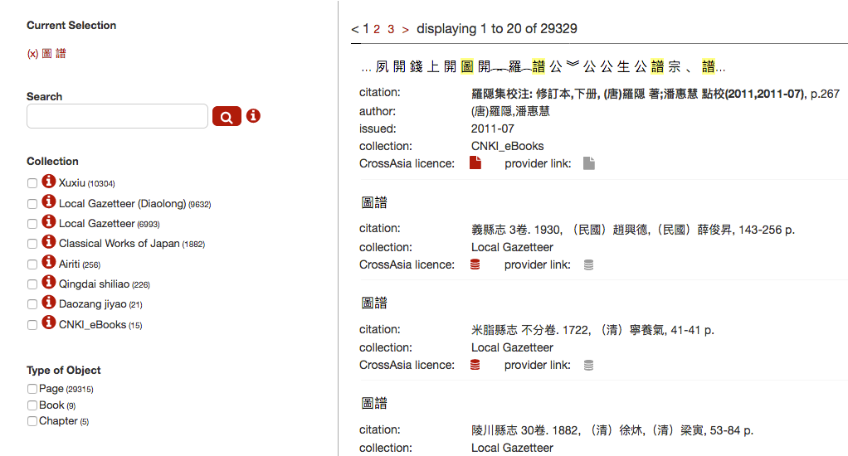
Notes:
Results > too many

Slide 15
Next CrossAsia search tool in development:
N-gram explorer (working title)
Aim:
higher speed when searching more and more millions of pages
indexing that does not only rely on dictionary terms (n-grams cleaned by dictionary and statistics)
showing contexts of search terms
Notes:
Next step: N-gram Explorer

Slide 16
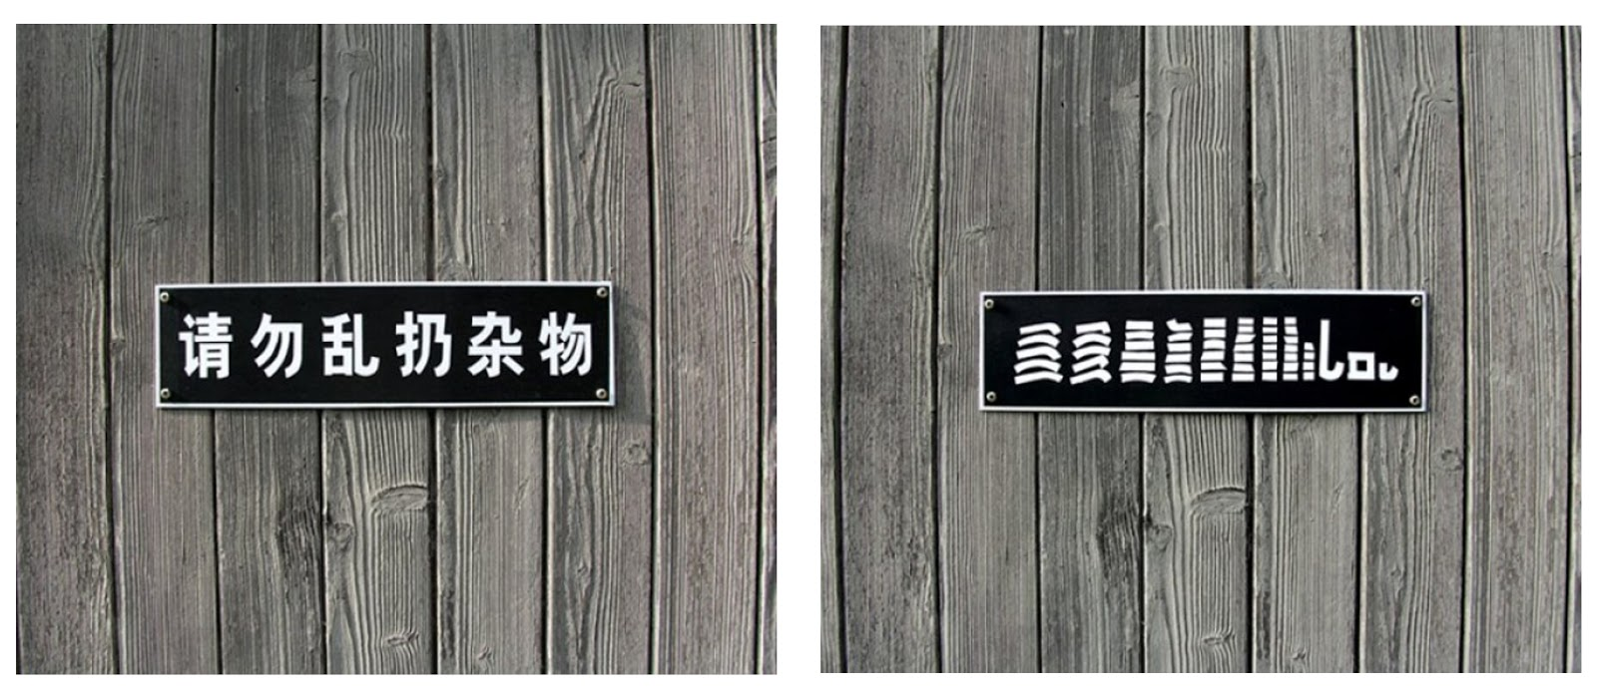
N-gram
道可道，非常道。名可名，非常名。無名天地之始, 有名萬物之母。
unigrams
bigrams: 道可, 可道, 道非 …
名, 5
道, 3
可, 2
非, 2
常, 2
之, 2
無, 1
天, 1
地, 1
始, 1
有, 1
萬, 1
物, 1
母, 1
(Ursus Wehrli, Tyding up)
Notes:
What are n-grams?

Slide 17
Notes:
CrossAsia N-Gram Service

Slide 18
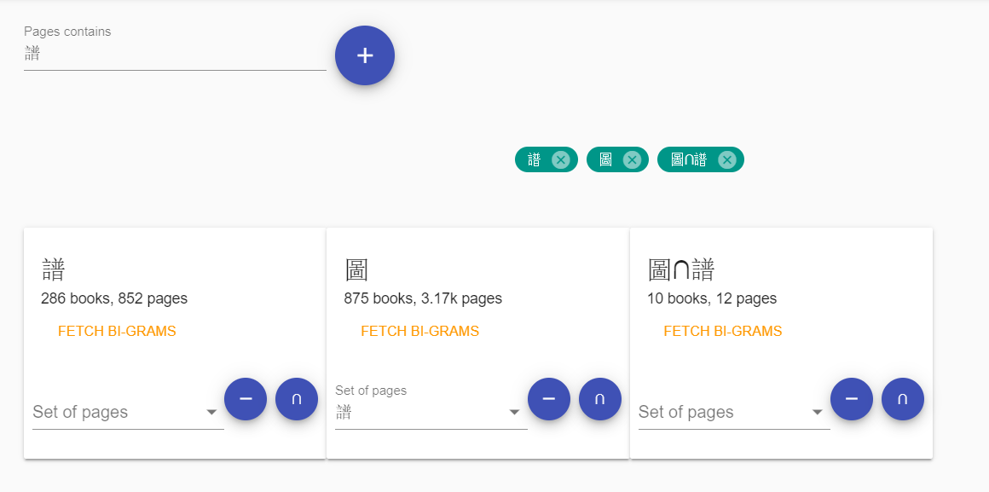
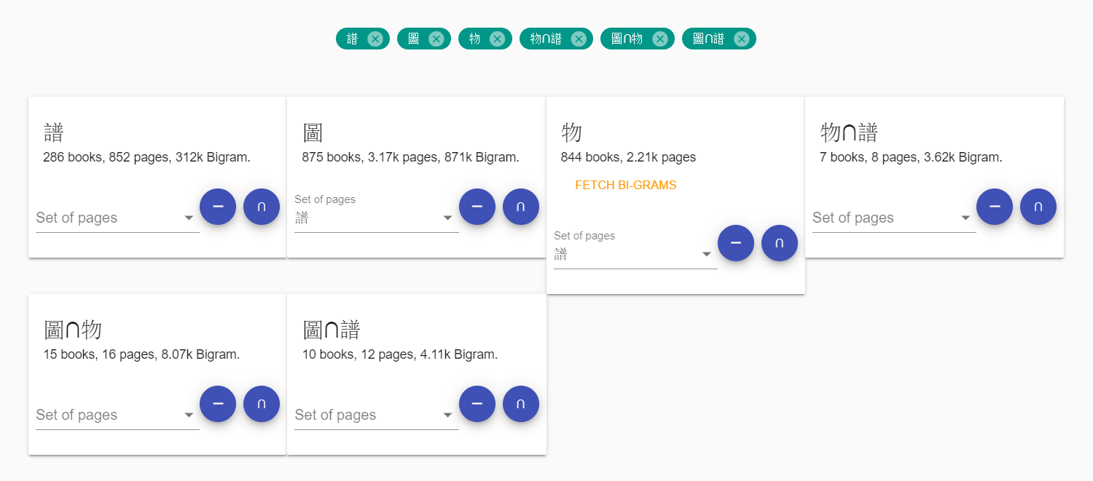
N-gram Explorer (in development)
Notes:
N-Gram Explorer: Search for individual terms and combine these terms (with AND or NOT)

Slide 19
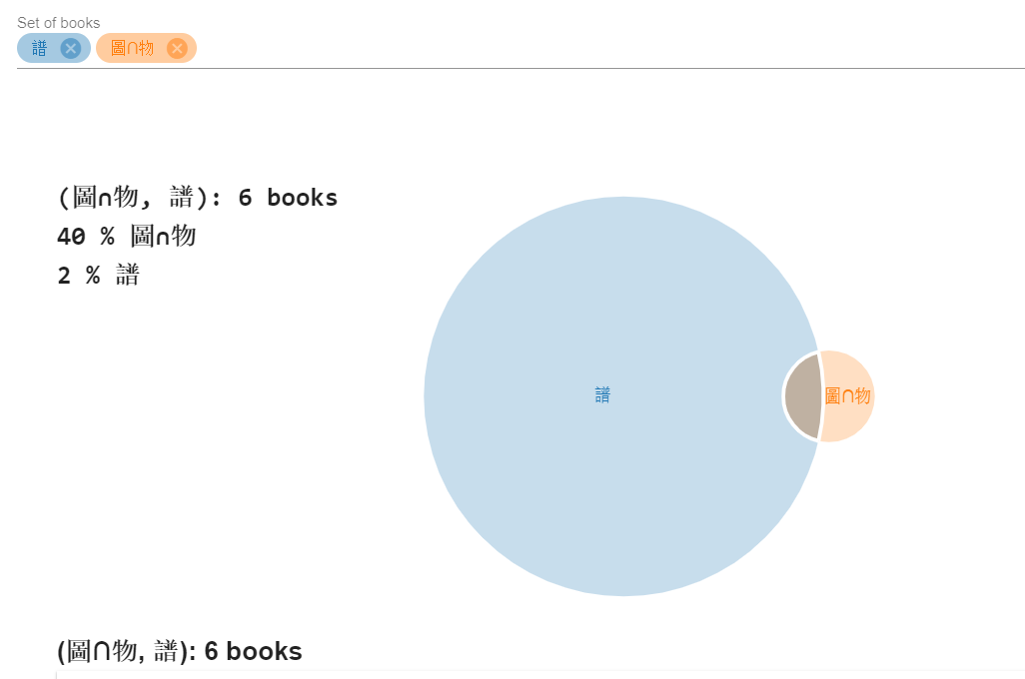
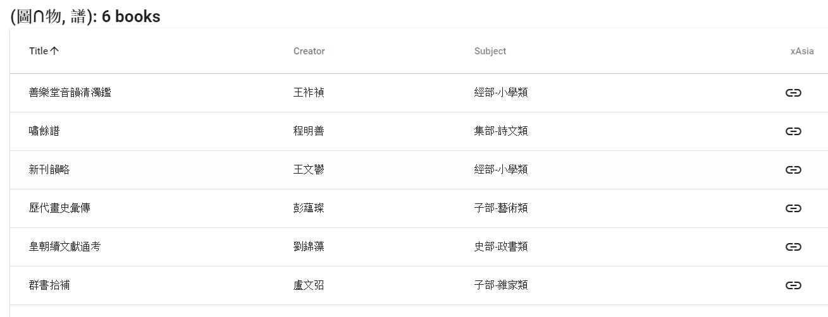
Notes:
N-gram Explorer > other functionality: Which books have pages with 圖 AND 物 and pages with 譜. Show their overlap and list the titles. Result: 2% of the books with pages containing 譜 also have pages with 圖 AND 物. NOTE: the search for terms is on the page level, the combination of the books is on the book level, i.e. the page with圖 AND 物 might be 100 pages apart from the page with 譜

Slide 20
PCA „Principal Component Analysis“
... is a dimensionality-reduction method that is used to reduce the dimensionality of large data sets, by transforming a large set of variables into a smaller one that still contains most of the information in the large set.
Aim is to reduce the number of variables of a data set, while preserving as much information as possible.
The starting point of the PCA values in the following are the unigrams of all 5443 book titles of the Xuxiu Siku quanshu
Notes:
Finding similarities between books without looking for specific terms (future: finding similarities AFTER one has produced a subset of titles by searching for a term or term combination). Testing results of PCA analysis on the Xuxiu Siku quanshu corpus (unigrams of books)

Slide 21
Plotly Chart Studio (https://plot.ly/create/#/)
Green: 經部
Pink: 史部
Yellow: 子部
Grey: 集部
Notes:
Map of the Four Bibliographical Categories as they are assigned to the 5443 books of the Xuxiu Siku quanshu (> map of China ;-))

Slide 22
Challenge:
International Research Activities – Virtual Research Environments … vs. Traditional access and licensing policies
- We hope for understanding and cooperation with researchers and content suppliers

Slide 23
Thank you very much for your kind attention
Staatsbibliothek zu Berlin – Preußischer Kulturbesitz x-asia@sbb.spk-berlin.de http://staatsbibliothek-berlin.de http://crossasia.org

