Slide 1
4-6 September, 2019 · EASL · OSLO
LoGaRT: Research Tools for Digital Scholarship beyond Search
Shih-Pei Chen, Calvin Yeh
Max Planck Institute for the History of Science (MPIWG)

Slide 2
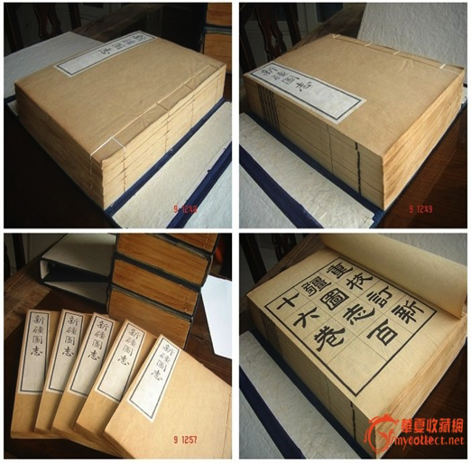
Local gazetteers: major sources for Chinese historical studies
Record local knowledge for governing purposes
Since at least 12c till 1949 (new LG not counted)
Organized structurally:
Common sections: geography, history of region, buildings & infrastructures, local products (flora and fauna, drugs...), local people (officials, elites, …), census & taxes, fortune signs and disaster, biographies, literature writings
Somewhat consistent across titles, time, and space
Notes:
For those of you who don’t work on Chinese history or who are not familiar with the local gazetteers, these gazetteers have been a common practice among local governments in historical China since at least the 12th century to record local knowledge, mostly for governing purposes. To clarify, while local gazetteers are still being produced nowadays in China, what I refer to my presentation today are the pre-1949 gazetteers, that was when the Republican government flew to Taiwan, and marked the end of the Repulican period.
The local gazetteers had been widely produced for administrative regions like counties, prefectures, provinces, and the whole country as well as for military frontiers and geographical regions. And they serve as the guidebooks for governance, which means two thing: 1st, they go beyond just geographical knowledge, and 2nd They don’t contain every kind of local knowledge, but only those that are important for governing purposes.

Slide 3
Massive digitization efforts in the last decade
Many LGs are still kept in libraries & musuems worldwide
Commercial databases providing digital access
Erudition: 4,000 titles
EastView: 7,000
Diao Long: 4,000
Significance
Not only scans but searchable full texts, opening more possibilities
Total amount covers at least half of extant LGs (statistically significant!)

Slide 4
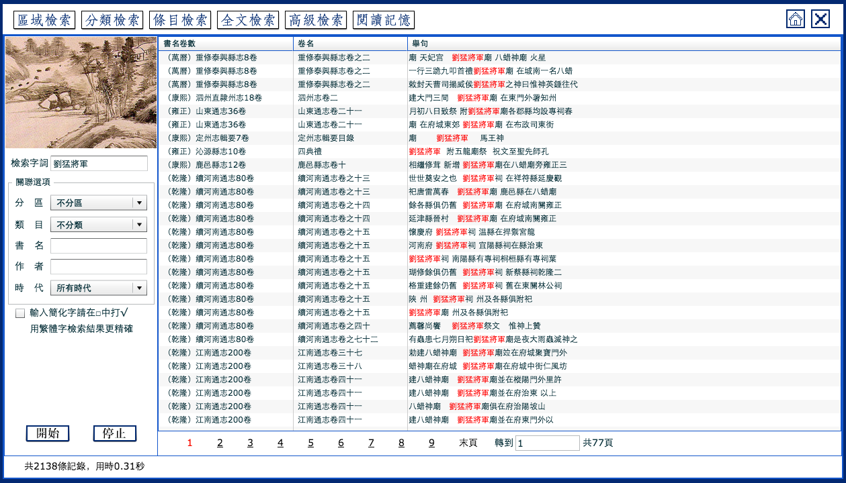
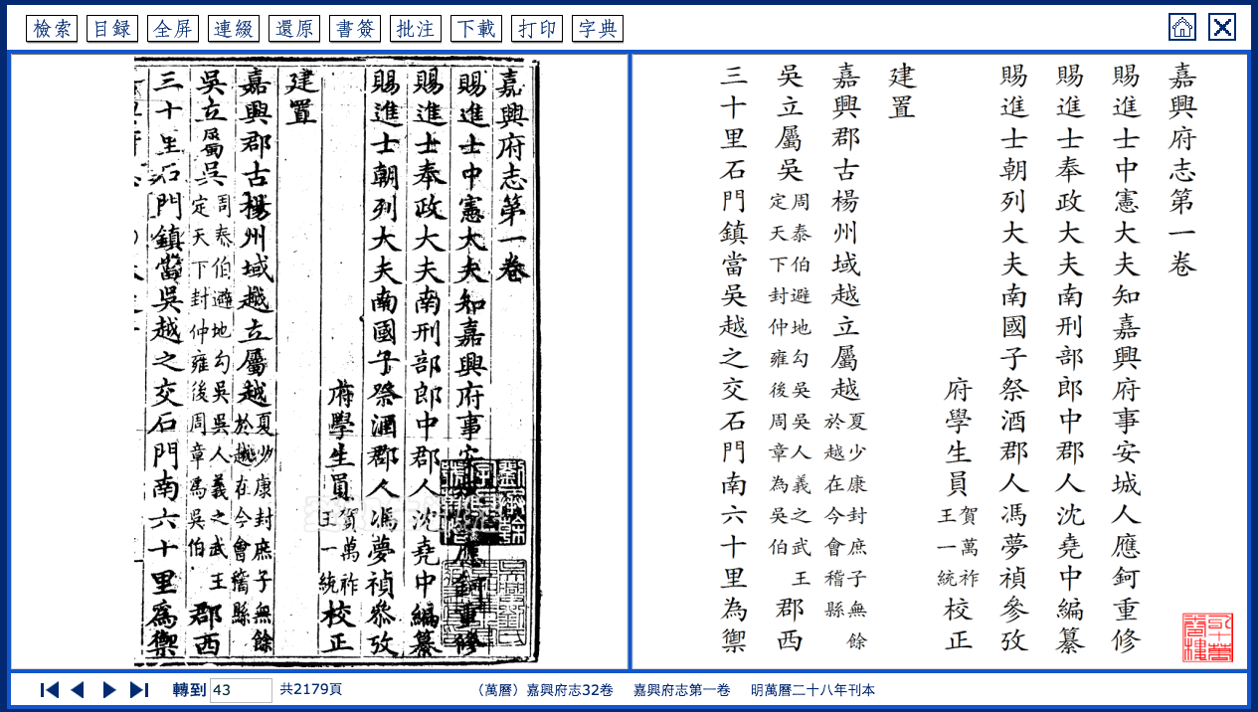
Example: Erudition ZGFZK
Get screenshots
Very nice reading environment
Search leads to close reading
No further features beyond reading
Notes:
It’s great that we have all these digital searchable LGs. But let’s see what these big databases provide as features for you to work with.
Nice reading enrionemnt, search

Slide 5
LoGaRT
Local Gazetteer Research Tools
Supporting Digital Scholarship!
Notes:
LoGaRT was born out of this philosophy

Slide 6
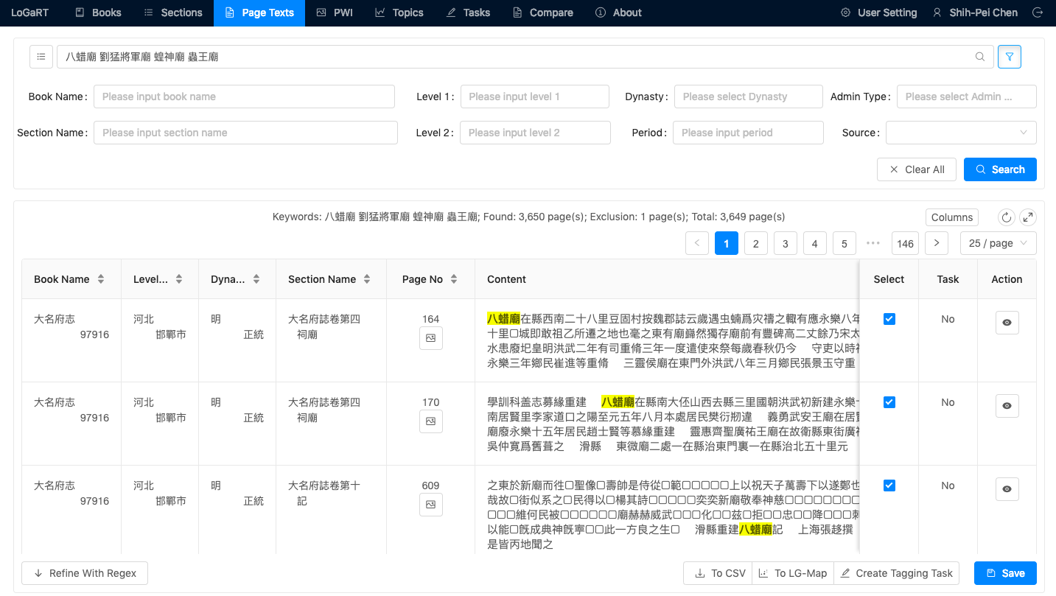
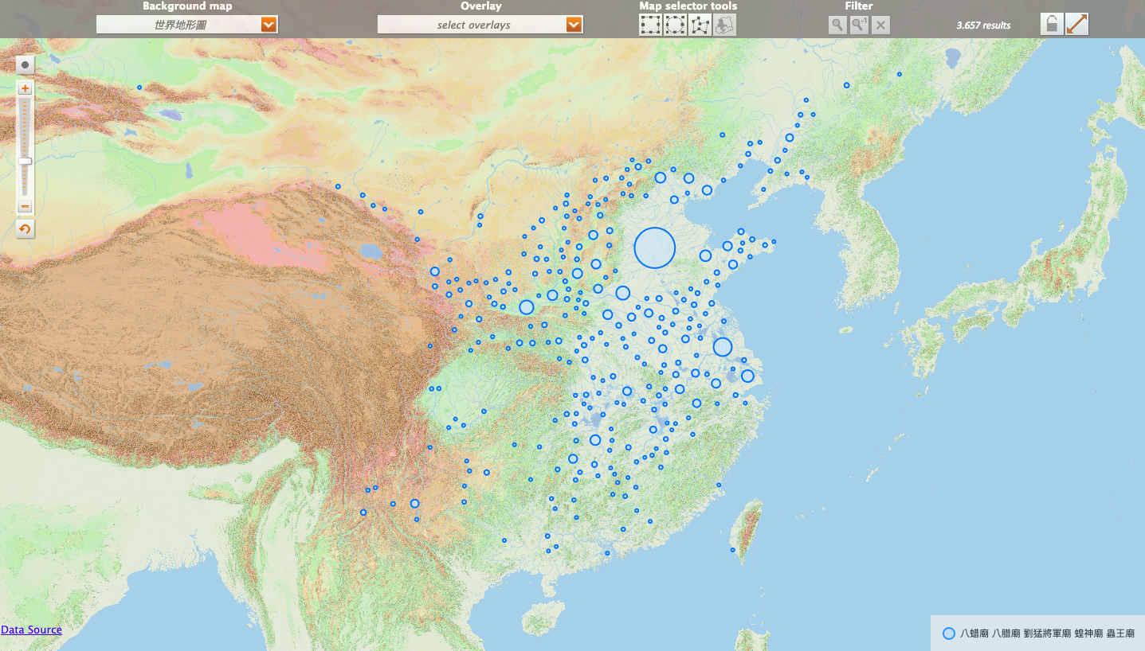
What can scholars do with LoGaRT?
Search at book level, page text level, and section level
Immediately see geo-spatial and temporal distributions of any research results
On every page: To CSV, to LGMap, to Tagging, Save

Slide 7
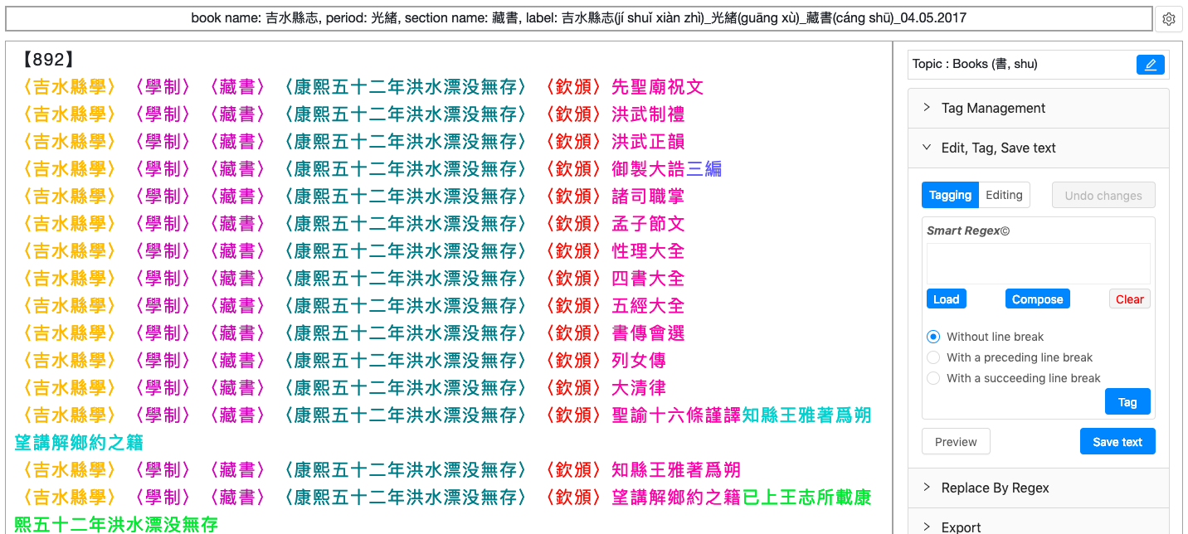
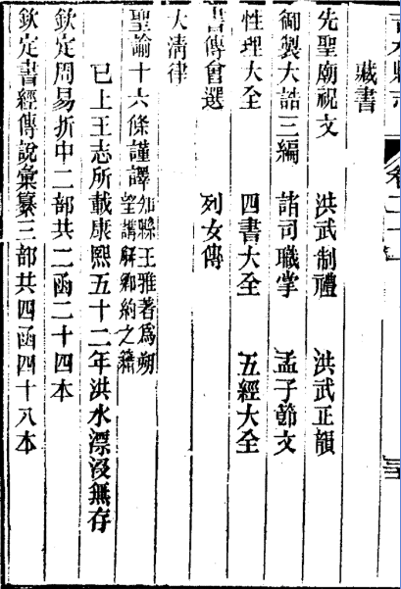
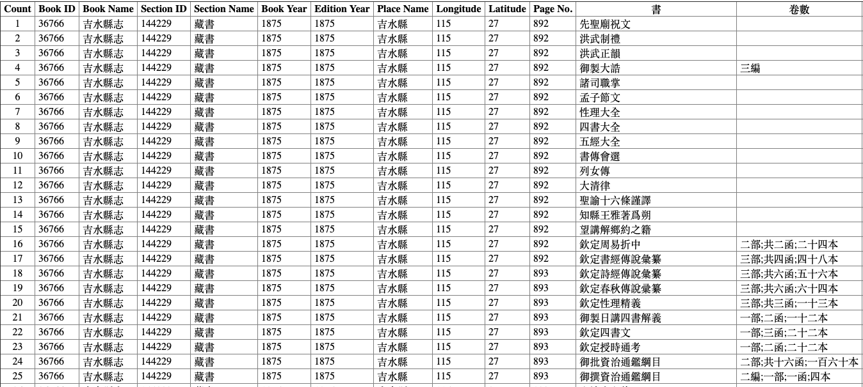
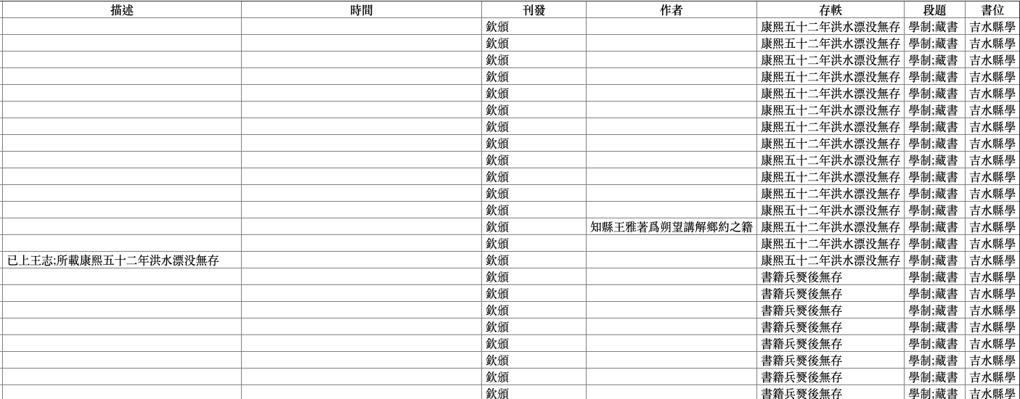
What can scholars do with LoGaRT?
Tagging: deep reading to reveal the underlying structures (lists) of texts
Converting structural contents from plain texts to computer understandable „data“

Slide 8
What can scholars do with LoGaRT?
Studying visual materials
LG has been a textual genre, with images illustrating and supplementing texts
E.g., maps, star maps, building layouts, plants, ritual implements, photos,...
We identified 63K pages with images from 4M pages, and assigned 17 categorical tags to them
TU (圖) group: 4 scholars, each has particular projects using visual materials from LGs

Slide 9
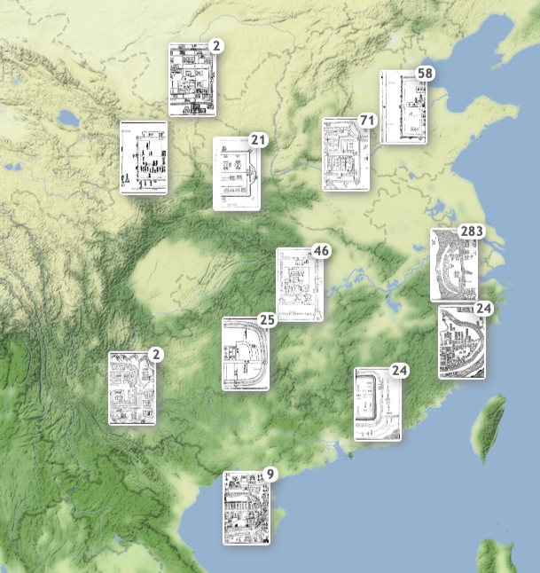
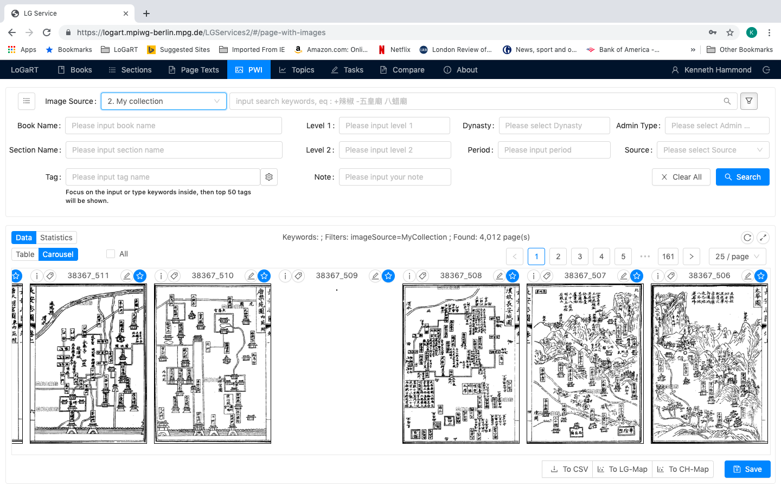
LoGaRT‘s TU features
Collecting images of individual interests
Carousel display to quick review the collection
Add more tags (shared) and personal notes
Show distribution on map and so on

Slide 10
Using LGs collectively
Rather than reading and gather information from individual gazetteers
Allow scholars to collect and analyze information across titles, time, and space
Allow schiolars to ask nation-wide questions: scale-up

Slide 11
How to access LoGaRT
Currently links to Erudition database with a text mining license negociated by SBB. Only for MPIWG affiliates.
Many external scholars expressed interests
LoGaRT as a piece of software, can link to any contents
Exploring ways to provide wider access to LoGaRT
LoGaRT as a software package + purchased contents by each library (with text mining license?)
LoGaRT Open Access: a website with open access contents (Harvard Yenching Library rare LG, 300 titles)
Collaborate with vendors & link LoGaRT to commercial databases directly?

Slide 12
Using digitized historical maps: from IIIF to GIS
Many historical maps are kept well in museums and libraries (with or w/o bibliographical records)
Some scanned as images, hosted on IIIF servers
Geo-referencing: for bringing those maps to GIS tools. Detailed geo-reference is expensive!

Slide 13
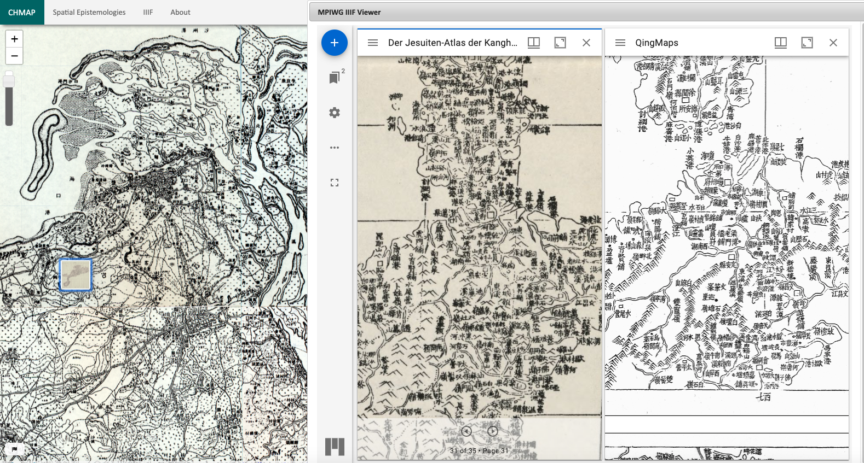
Geo-reference: as finding aid & location-based comparison
Hainan in a geo-referenced early 20c map on WebGIS
Hainan in the Kangxi Imperial Atlas of China
-- on LOC & qingmaps.org (both IIIF)
The area of maps is the north of "海南島" in China. These maps periods are 1936,1708~1717 and 1722~.

Slide 14
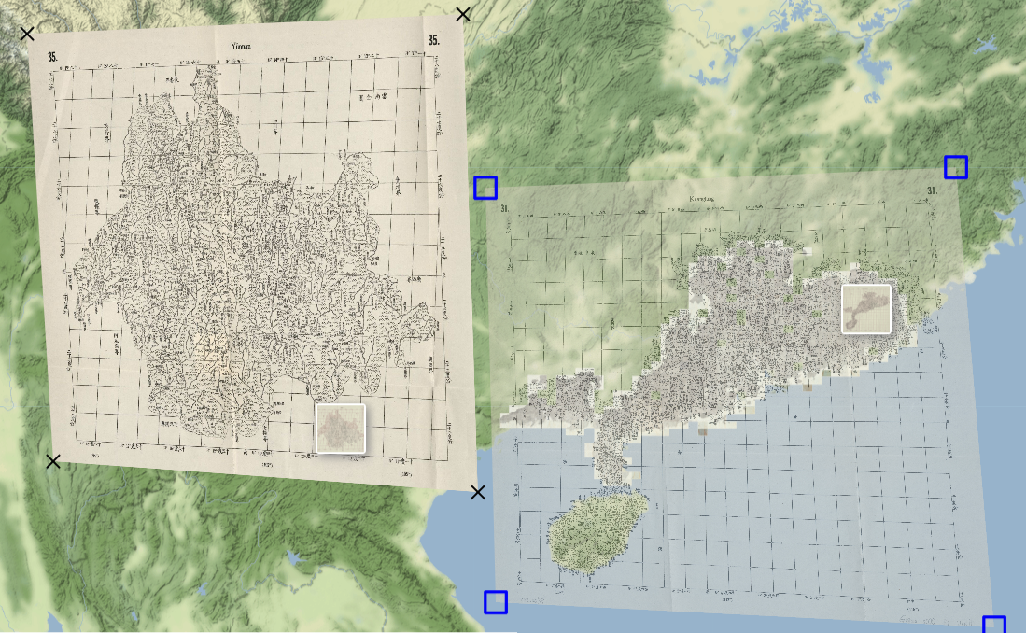
A prototype service to add low-level geo-reference to IIIF maps
1. Load a IIIF image -> Edit to add a single geo-coordinate or four corners (low-level geo-reference)
2. Save manifest.json (IIIF format) with geo-coordinates. Share (on IIIF server). Libraries can use this service to enhance their digital maps.
3. Export to QGIS: for advanced usage - professional georeferencing, digitalization, spatial analysis…
By Nungyao Lin
<nylin@mpiwg-berlin.mpg.de>

Slide 15
We welcome your questions and comments!

