Slide 1
The first carto-bibliography of Western maps of China and accompanying website
Dr. Marco Caboara
Lee Shau Kee Library
Hong Kong University of Science and Technology
Thirty-ninth annual EASL conference
Oslo, September 6 2019

Slide 2
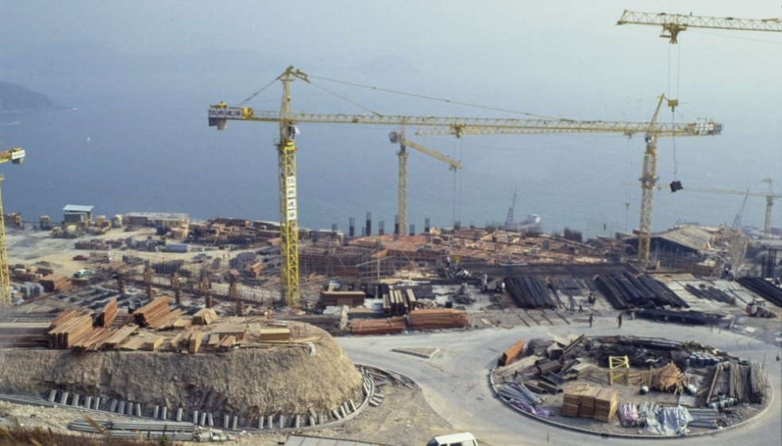
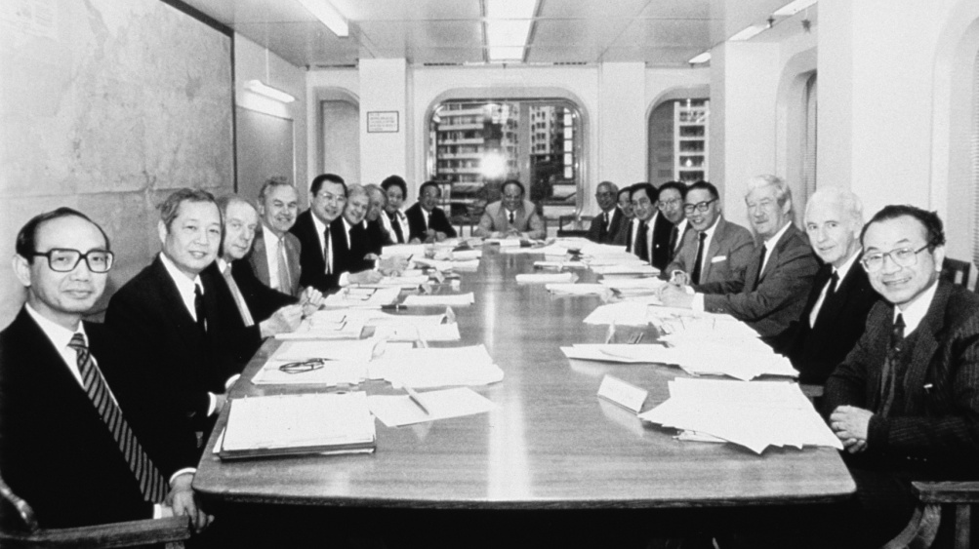
University Archives
Collects and preserves institutional records that have historical value
The first University Archives in Hong Kong- established in 1996
Archival repository | ~ 1200 linear feet
University publications | ~ 2,500 items
No. of offices and depts | ~ 70

Slide 3
Digital University Archives
http://archives.ust.hk/dspace/
Important documents, such as meeting minutes of Senate, Council, Court and other administrative committees.
Publications, newsletters, annual reports, faculty profiles, press releases, etc.
Video recordings of distinguished lectures by renowned scientists
Total no. of records | ~ 30,000
No. of public records | ~ 7,500
Online videos for public | ~ 850

Slide 4
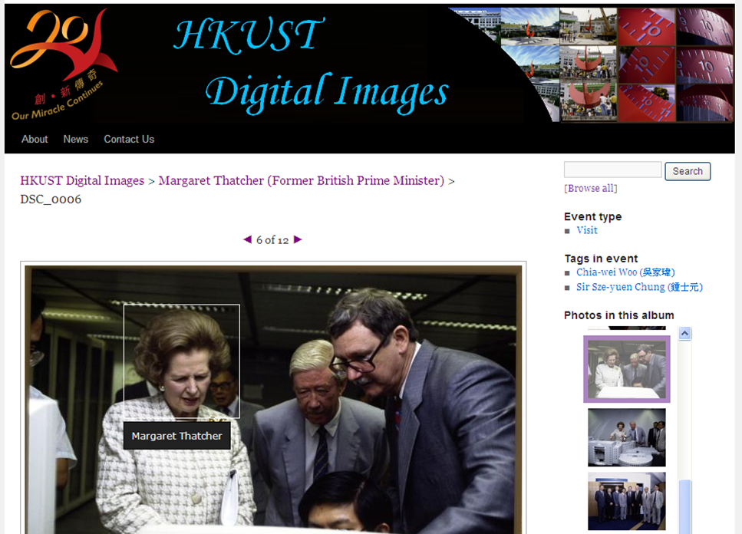
Digital Images
Years covered | 1988-1999
Number of events | ~ 1,100
Number of images | ~ 27,000
http://digitalimages.ust.hk/
Digitization of images from slides and negatives transferred to the Archives from various university offices
Rolled out in November 2011 for public access
The images cover a wide range of acitivities held on the campus, including ceremonies, congregations, distinguished lectures, conferences, as well as student and staff activities
Alumni, students, staff and faculty are invited to tag photos for identification

Slide 5
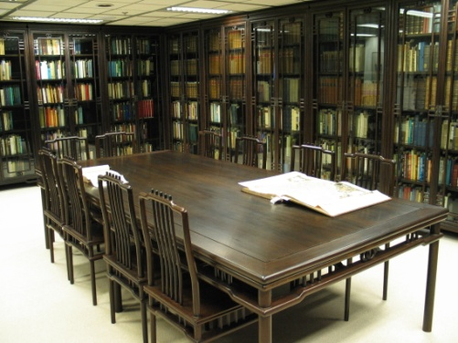
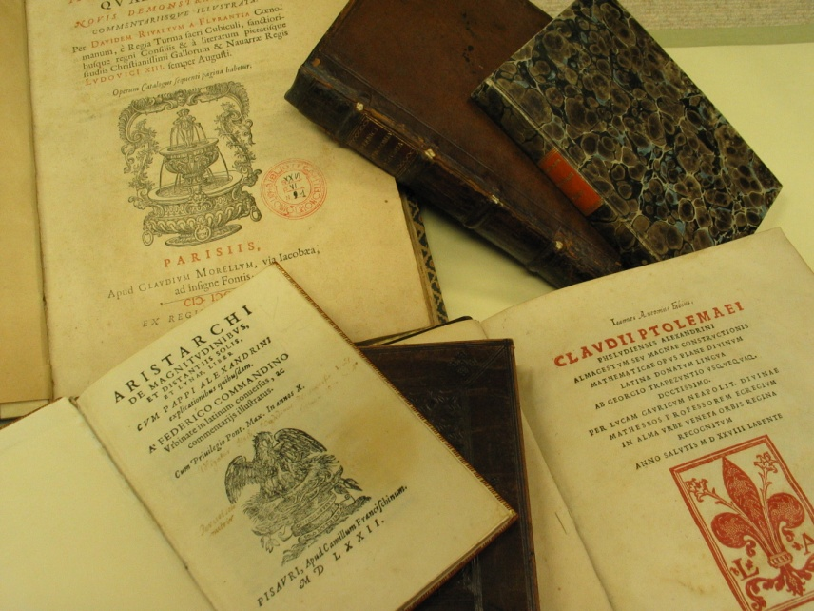
Special Collections
History of Science Collection
consists of 530 volumes of rare books and over 1,200 volumes recent publications of this subject matter.
provides a glimpse of the scientific discoveries and inventions in Europe during the past five hundred years.

Slide 6
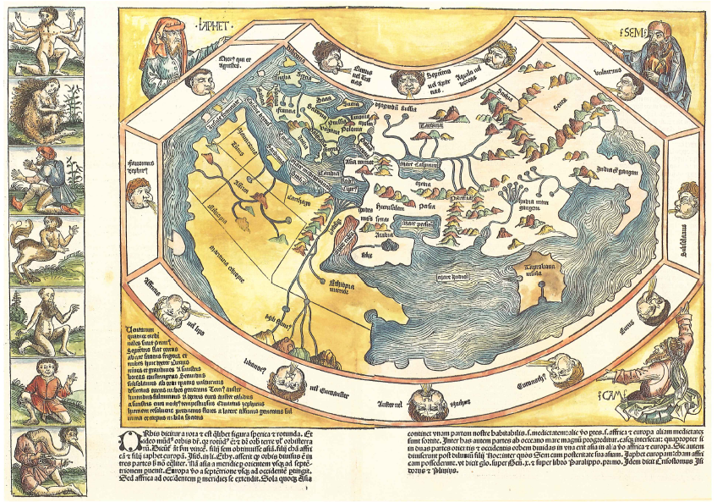
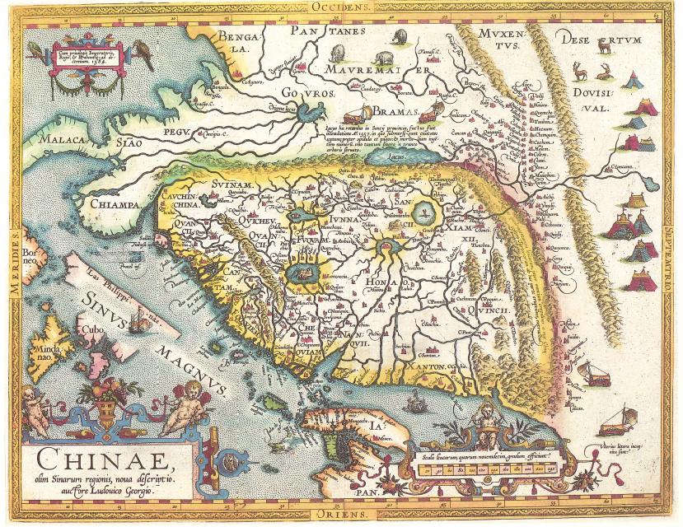
Special Collections
Antique Maps of China
consists of more than 230 maps, charts, pictures, books, atlases, and travelogues
samples of almost all maps of China produced by European cartographers from the 16th to 19th centuries, recording the long history of cross-cultural exchanges between China and the West

Slide 7
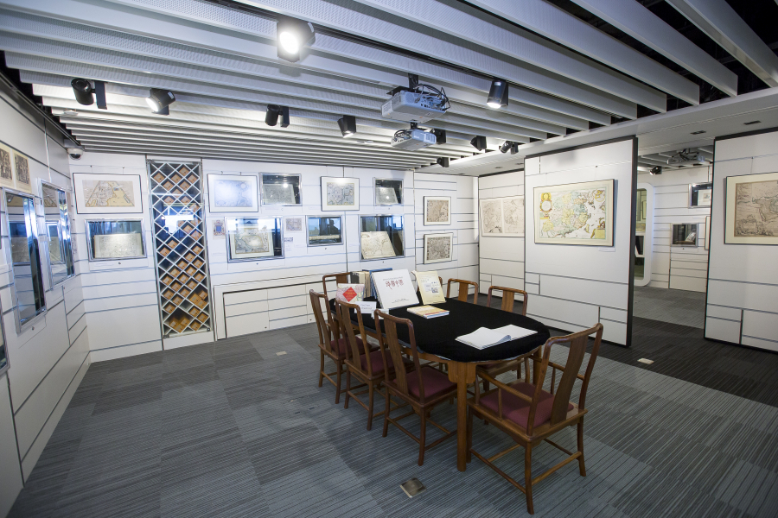
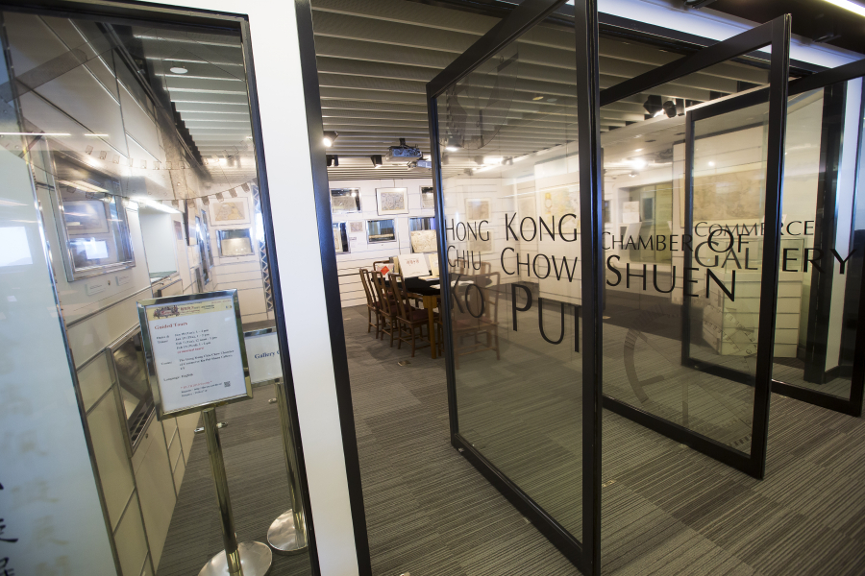
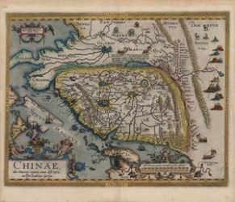
Previous donation
2012-2015
Digitization of the Special Collections:
  180 Antique Maps (1500s to 1800s)
  90 rare books on history of science
  Thousands other items in the special collections
Special Collections (KPS) Gallery

Slide 8
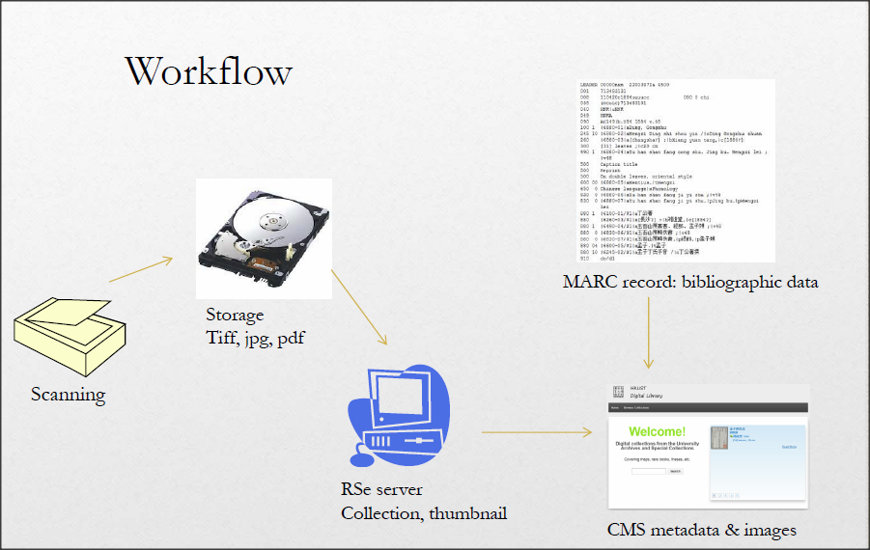
Digitization as preservation

Slide 9
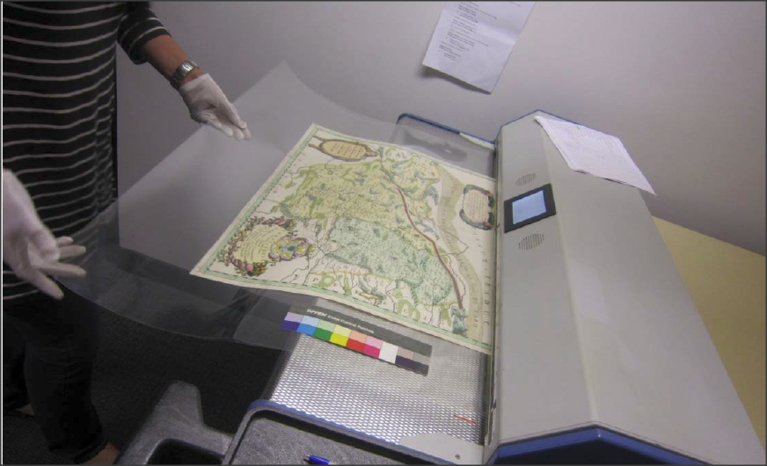
Digitization process

Slide 10
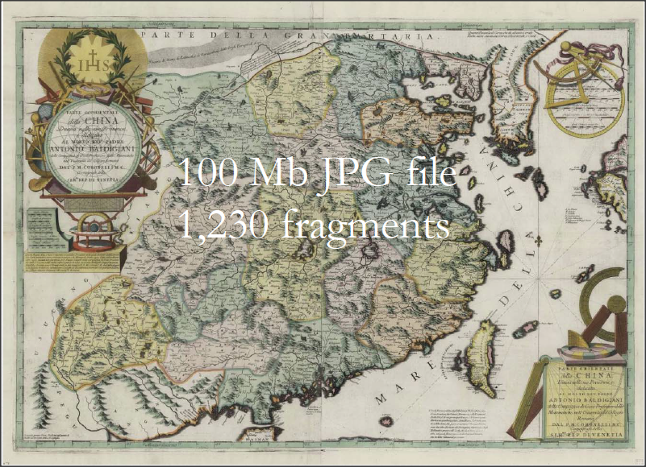
Digital images

Slide 11
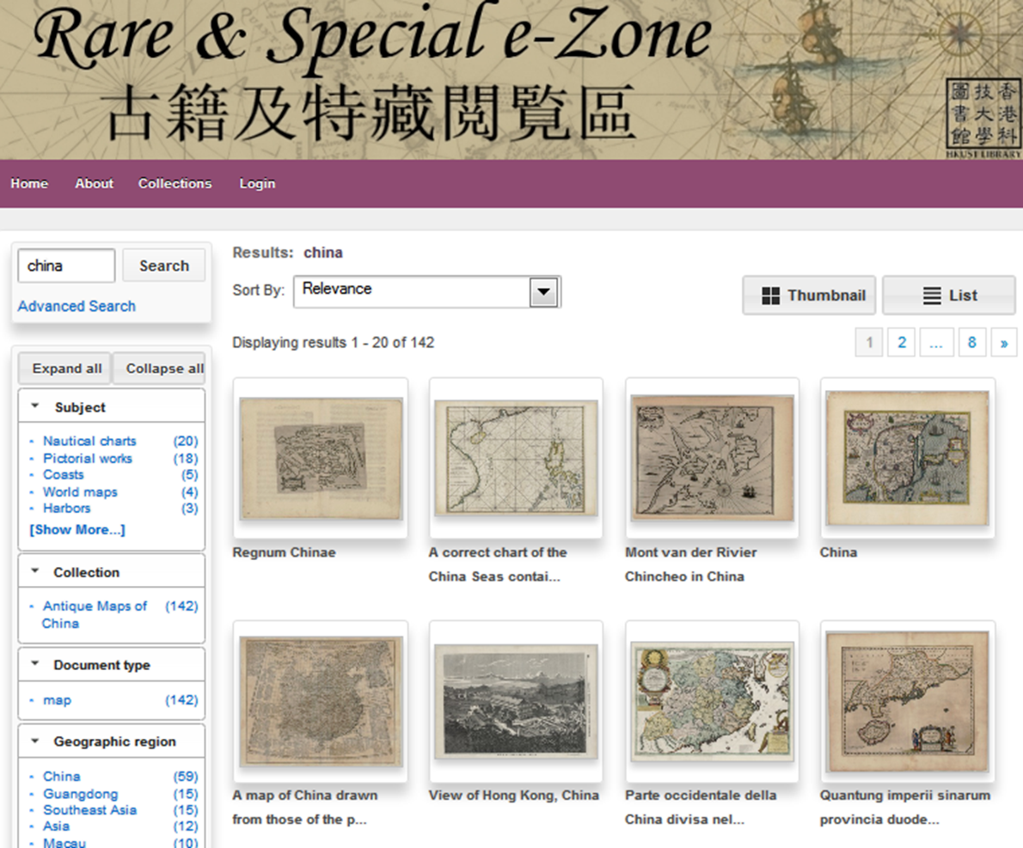
Rare & Special e-Zone http://lbezone.ust.hk/rse/

Slide 12
Proposed Project (2018-2021)
4 components
Book
  Reference work for a complete description of western printed maps of China from 1500s to 1800s, bilingual
  Currently no such title exist, in either English or Chinese
  It will be the first and unique scholarly work in this area
Website
  Interactive website for general public to explore the history of China through antique and modern maps
New maps
  To enrich the special collections and enable more exhibitions
  Workshops/Conferences
  To gather international expertise on Chinese Cartography

Slide 13

The Book
A complete inventory of Western maps of China (1550-1799), with a general introduction
Around 500 pages and 300 illustrations
Modeled on Jason Hubbard’s comparable book on Western Maps of Japan (1550-1799)
January 2012
Brill | Hes & De Graaf
Explokart Series http://explokart.eu/
444 pp. With 374 full colour illustrations

Slide 14
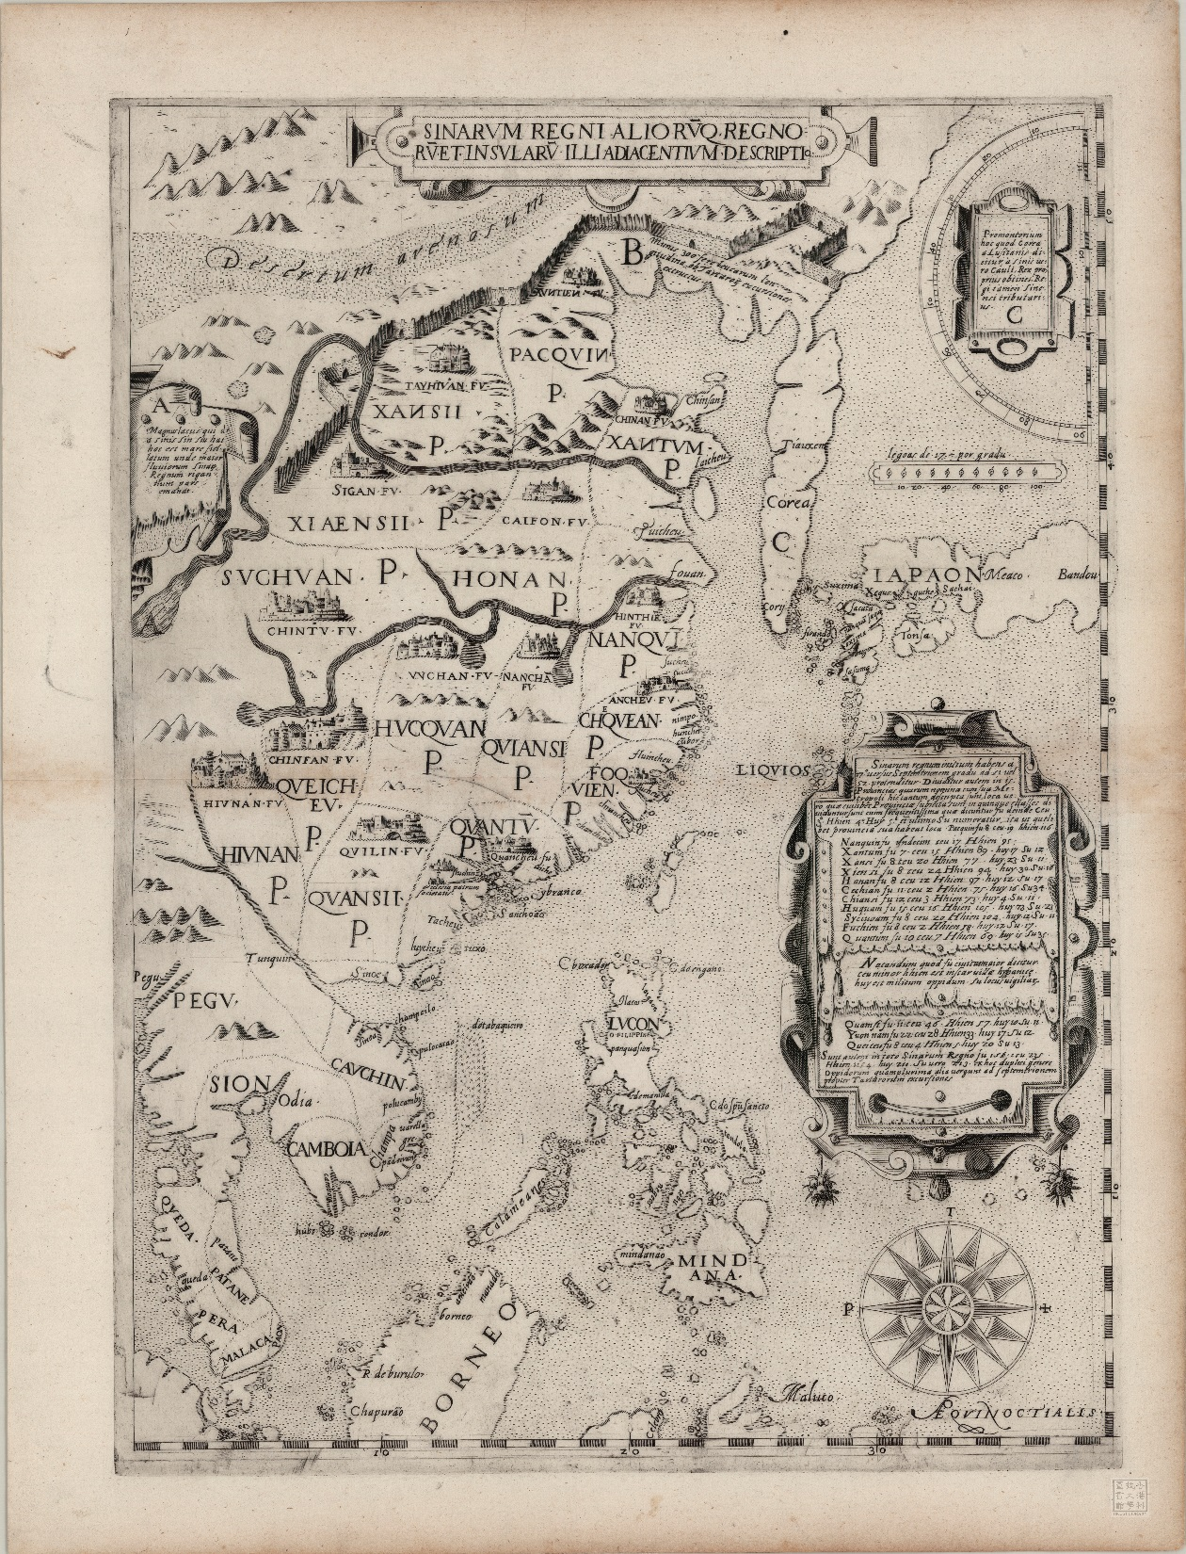
Sinarum Regni aliorumque regnorum et insularum illi adiacentium descriptio
(Map of China and surrounding kingdoms and islands)
Rome, 1583-1588 (?)
47 x 35 cm
https://lbezone.ust.hk/bib/b678889

Slide 15
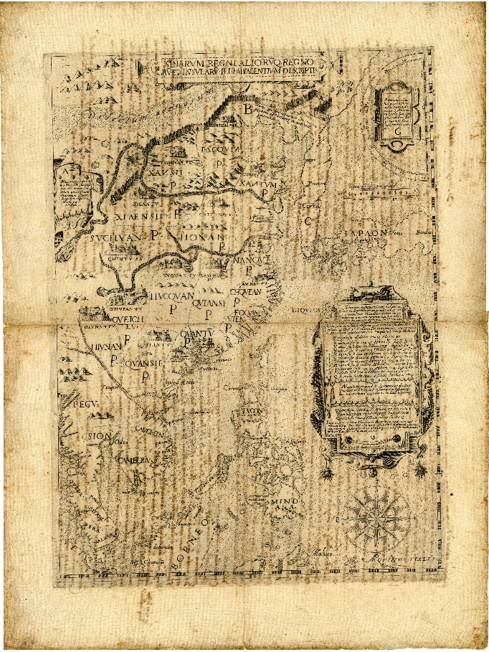
Jesuit Archives identical copy

Slide 16
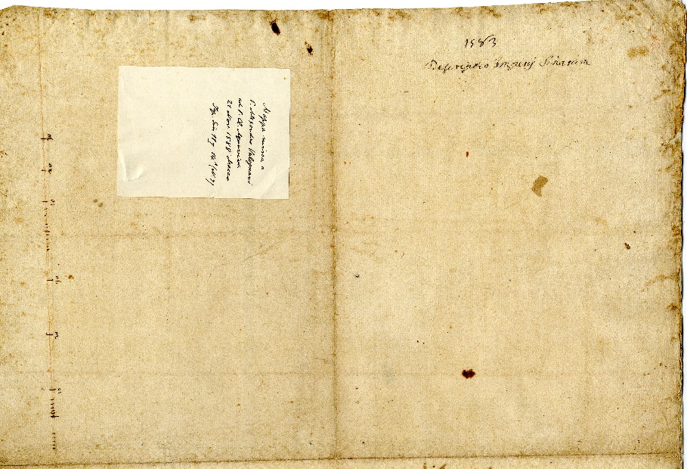
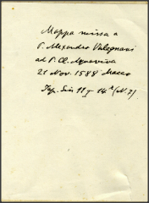
Jesuit Archives Report
1583-8 (?)
Descriptio Imperii Sinarum

Slide 17
“Novissima et exactissima Sinarum Monarchiae Descriptio, ab indigenis Ta Min appellata”
(New and precise map of the Kingdom of China, called Daming by the natives).
Carlo Giangolini
(1598 -1652)
Rome 1642
31 x 42 cm

Slide 18
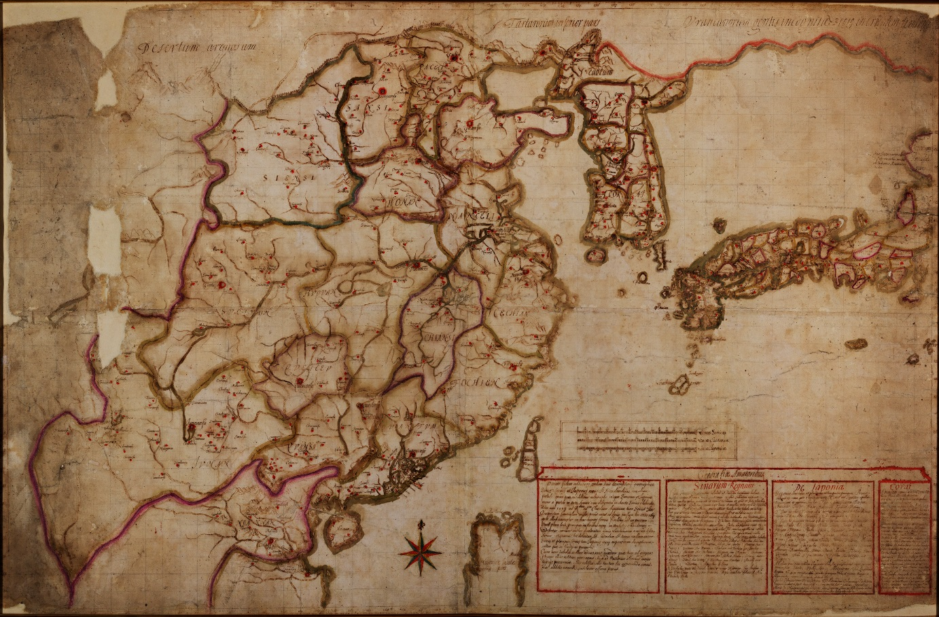
Jesuit Archives manuscript map
1651
82 x 126 cm

Slide 19
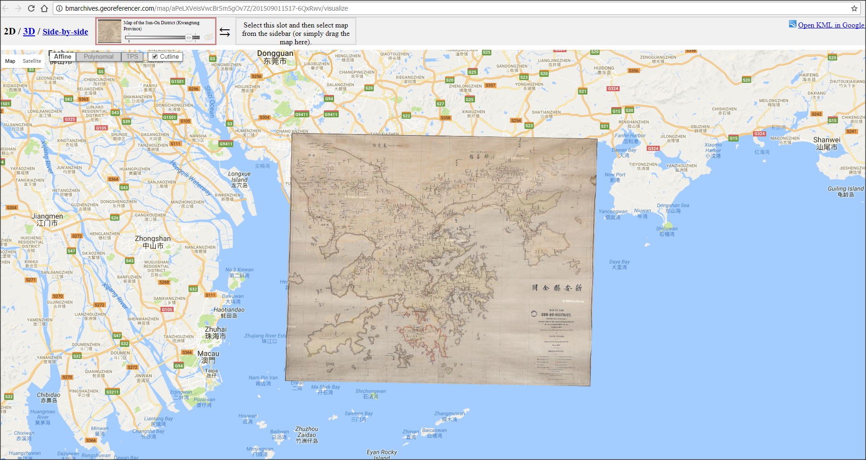
The Website

Slide 20
Digitization as enrichment
Digitized maps increase accessibility, but are static surrogates of the originals.
The next steps:
Transcribe old place names
Identify their modern counterparts
Link them to modern maps (geo-resolution)
Analyze them as visual objects (image indexing)

Slide 21
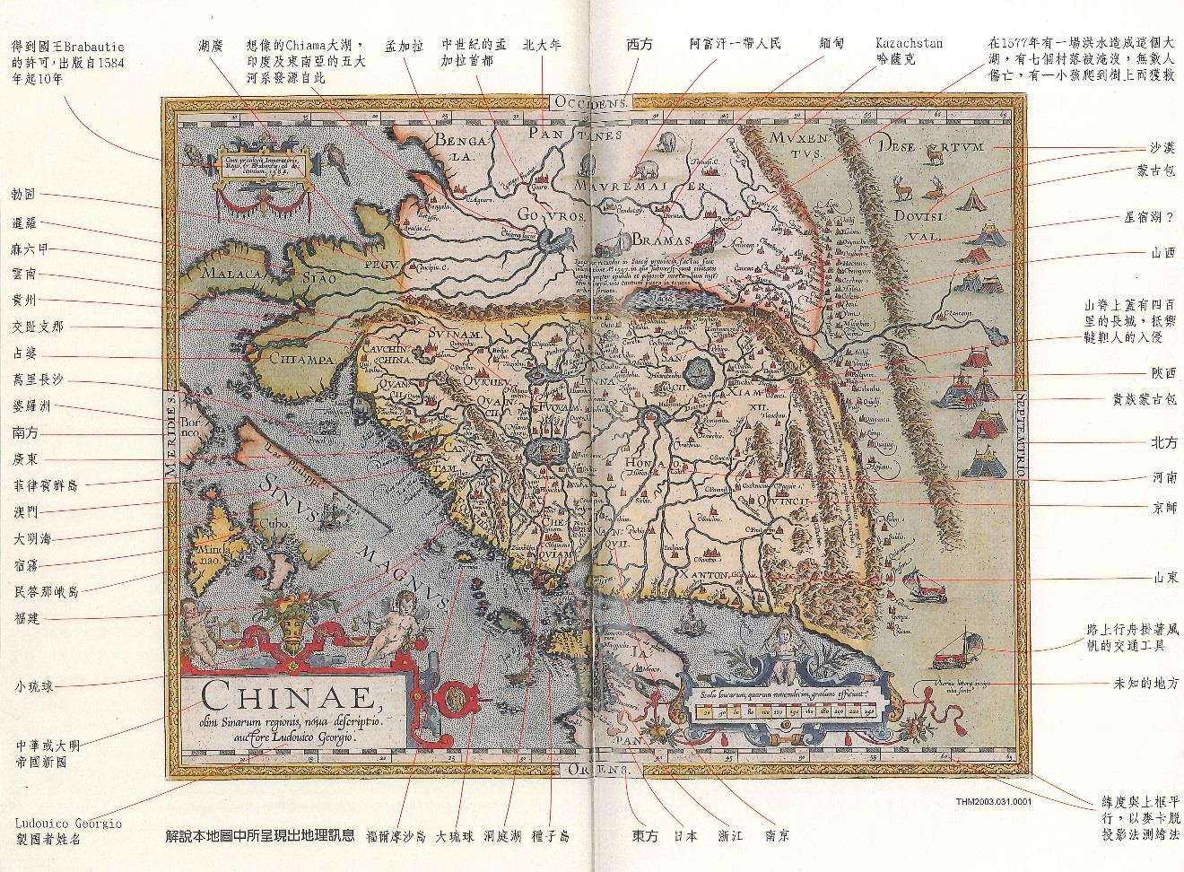
Map annotations

Slide 22
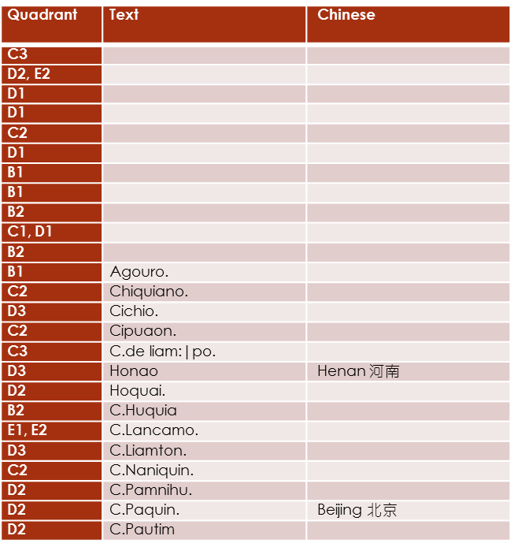
Transcribing and identifying locations
Place names in Speed’s map of China

Slide 23
Transcriptions of Chinese map names

Slide 24
Iconological analysis of cartouches

Slide 25
MAPS OF CHINA PROJECT TIMELINE
Fall 2017 | 2018 |  | 2019 |  | 2020 |  | 2021
Donation
First Installment from donor in Oct 2017: $2M for hiring project assistant (starts with a 2-year term)
 |  | Second installment in mid 2018: $2M (timing flexible)
Website
 | Phase I: Research data creation (2018 Jan+)
 |  | Phase II: ArcGIS server set up (2018 Sept –Dec)
 |  |  | Phase III: Website design and construction (2019 Jan+) |  |  | Website release (end of 2020)
Book
 | Research work, including visits to overseas collections (2018+)
 |  |  |  | Write up (mid 2019+) | First draft (early 2020); Final draft (end of 2020/early 2021); Publishing work - design, editing, translation, proofreading, etc. (2021) |  |  | Publication (end of 2021)
 |  |  |  | Workshop (mid 2019) |  | Conference (mid 2020)
New maps | Whenever appropriate items become available
Exhibitions |  |  | Special Collections exhibition (early 2019) |  | Special Collections exhibition (mid 2020) |  | Special Collections exhibition (late 2020)

