Slide 1
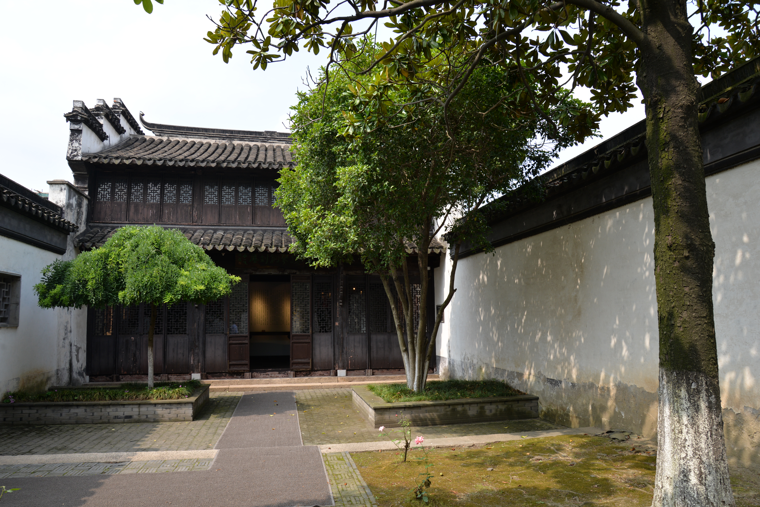
From the Iron-Lyre-Copper-Sword Library to the Library of the Miscellany: private book collecting for the public good since the late Qing Dynasty
从铁琴铜剑楼到杂书馆：晚清以来的公益私家藏书
Shenxiao Tong
Edinburgh University Library
EASL 2019, Oslo

Slide 2
1. Private book collecting before Qing Dynasty
From the Spring and Autumn period (770 BC – 476 AD)
Changes in the media carrier of the ‘book’
Inscriptions on oracle bones and metal
Writings on bamboo and silk
Writings on paper
Invention of paper in the East Han Dynasty (25 – 220) : a revolutionary event in the book history of China.
The Song Dynasty -- the popularity of wood block printing and the thriving of intellectual activities that private book collecting became wide-spread, in scale, and became an established cultural tradition.

Slide 3
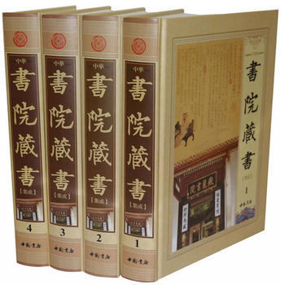
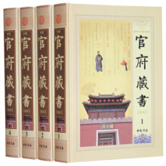
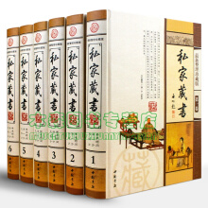
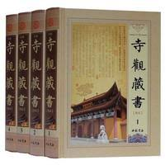
Four types of book collecting in historical China
Government or court
Colleges
Temples
Private

Slide 4
2. Private libraries in the late Qing Dynasty
The emergence of four major private libraries or library buildings :
Iron-Lyre-Copper-Sword Library in Changshu (常熟瞿氏铁琴铜剑楼)
Qu Shaoji (瞿绍基1772-1836), Qu Yong (瞿镛1794-1846), 5 generations, incorporation into the NLC and other libraries
Haiyuan Library in Liaocheng (聊城杨氏海源阁)
Yang Yizeng (杨以增1781-1855) , 4 generations, mostly lost; “Southern Qu and Northern Yang” （南瞿北杨）
Bisong Library in Huzhou (归安陆氏皕宋楼)
Lu Xinyuan (陆心源1834-1894), 2 generations, entire collection was sold by his son to Jingjiatang Library in Japan (日本岩崎氏静嘉堂文库 せいかどうぶんこ Seikado Bunko in 1907
Eight Thousand Volumes Library in Hangzhou (钱塘丁氏八千卷楼)
Ding Guodian丁国典(1770～1825), 4 generations, mostly dispersed during Taiping Rebellion, the rest sold to Jiangnan Library (now Nanjing Library) in 1907
Modelled in architecture and management on Tianyige (天一阁) which, founded by Fan Qin （范钦）between 1361-1566 （明嘉靖四十至四十五年)

Slide 5
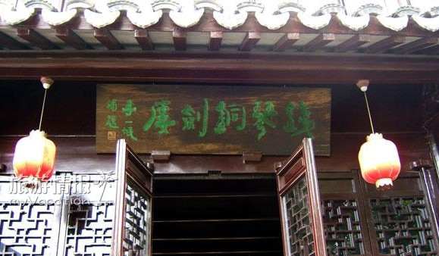
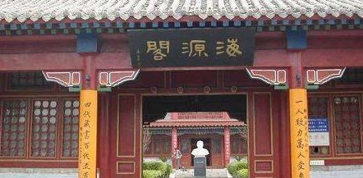
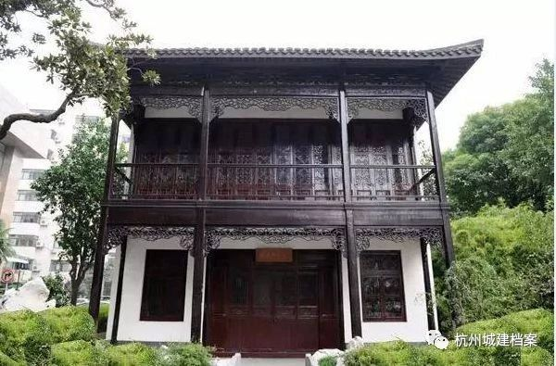
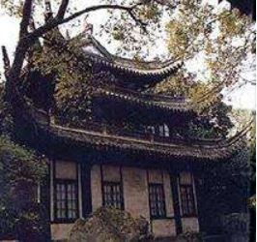
Four major private book collecting houses in late Qing Dynasty
铁琴铜剑楼
海源阁
八千卷楼
皕宋楼

Slide 6
Historical statistics of book collectors in China
中国历代藏书家人数统计表
Source: 范凤书. 《中国私家藏书史》History of Private Book Collecting in China. 修订版, 第1版. 武汉 : 武汉大学出版社, 2013
Dynasty 朝代 | Early Song 先宋 | Song 宋代 | Yuan 元代 | Ming 明代 | Qing 清代 | Early modern 近现代 | Total 总计
Collectors 人数 | 253 | 738 | 207 | 897 | 2082 | 868 | 5045

Slide 7
Number of book collectors by province and region in descending order
中国藏书家省区分布统计表
名次 | 省区名 | 藏书家数 | %
1 | 浙江 | 1139 | 22.28
2 | 江苏 | 998 | 19.19
3 | 山东 | 495 | 9.81
4 | 江西 | 331 | 6.15
5 | 福建 | 287 | 5.69
6 | 河南 | 218 | 4.32
7 | 安徽 | 206 | 4.08
8 | 山西 | 199 | 3.95
9 | 河北 | 174 | 3.45
10 | 广东 | 151 | 3
11 | 上海 | 135 | 2.68
12 | 四川 | 117 | 2.32
13 | 湖南 | 115 | 2.3
14 | 湖北 | 93 | 1.84
15 | 陕西 | 68 | 1.35
16 | 北京 | 61 | 1.21
17 | 云南 | 36 | 0.71
18 | 甘肃 | 33 | 0.65
19 | 辽宁 | 31 | 0.61
20 | 天津 | 25 | 0.5
21 | 贵州 | 18 | 0.37
22 | 广西 | 17 | 0.33
23 | 内蒙古 | 14 | 0.28
24 | 黑龙江 | 5 | 0.1
25 | 吉林 | 4 | 0.08
25 | 台湾 | 4 | 0.08
26 | 海南 | 2 | 0.04
26 | 新疆 | 2 | 0.04
27 | 青海 | 1 | 0.02
27 | 宁夏 | 1 | 0.02
28 | 西藏 | 0
 | 籍贯不明 | 65 | 1.28
合计 |  | 5045
Source:
范凤书. 《中国私家藏书史》. History of Private Book Collecting in China 修订版, 第1版. 武汉 : 武汉大学出版社, 2013. p.657-8

Slide 8
Of the four libraries mentioned above, the Iron-Lyre-Copper-Sword Library was the only private library that survived the Taiping Rebellion, Japanese invasion and natural disasters, and were well preserved into the period of the People’s Republic of China.
According to Fan Fengshu in his History of Private Book Collecting in China (范凤书. 《中国私家藏书史》), during the Qing Dynasty, there were 62 private libraries which were documented as destroyed, partially damaged or dispersed, mostly by war, and also by other kinds of disasters like fire, water, theft and pests. (p.466-470)

Slide 9
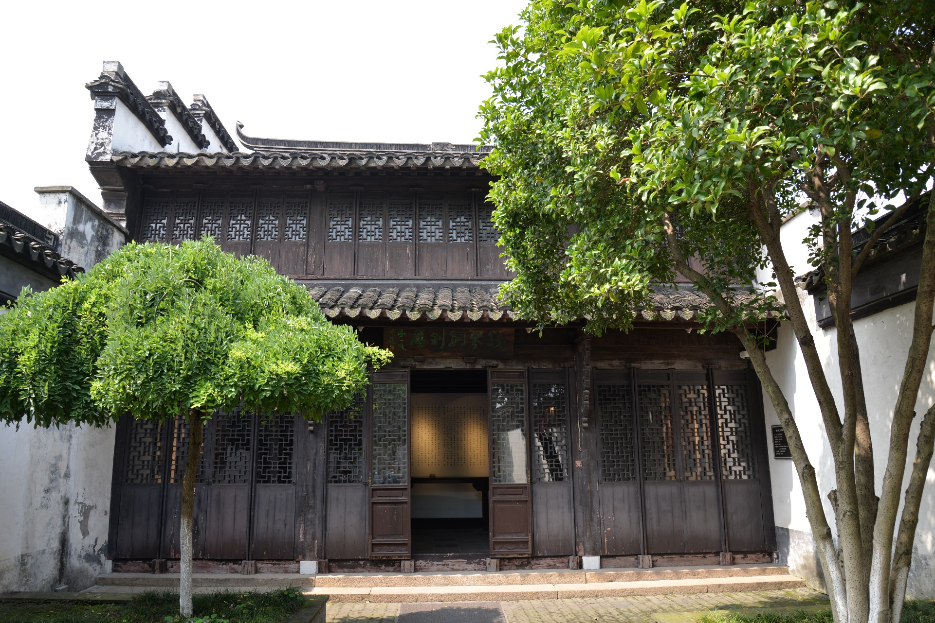
3. The Iron-Lyre-Copper-Sword Library 瞿氏铁琴铜剑楼

Slide 10
Brief chronology
Founded by Qu Shaoji (瞿绍基，1772-1836) in the late Qianlong period as Tianyu Zhai (恬裕斋)
Renamed 敦裕堂 and then renamed 铁琴铜剑楼 again after two ancient objects in their collections, an iron Qin and copper sword in 1874 (同治十三年, to avoid the use of 恬 as 光绪was called 載恬)
Taken over by government in 1986
Large donations to the National Library of China after 1946
Memorial House since 1991

Slide 11
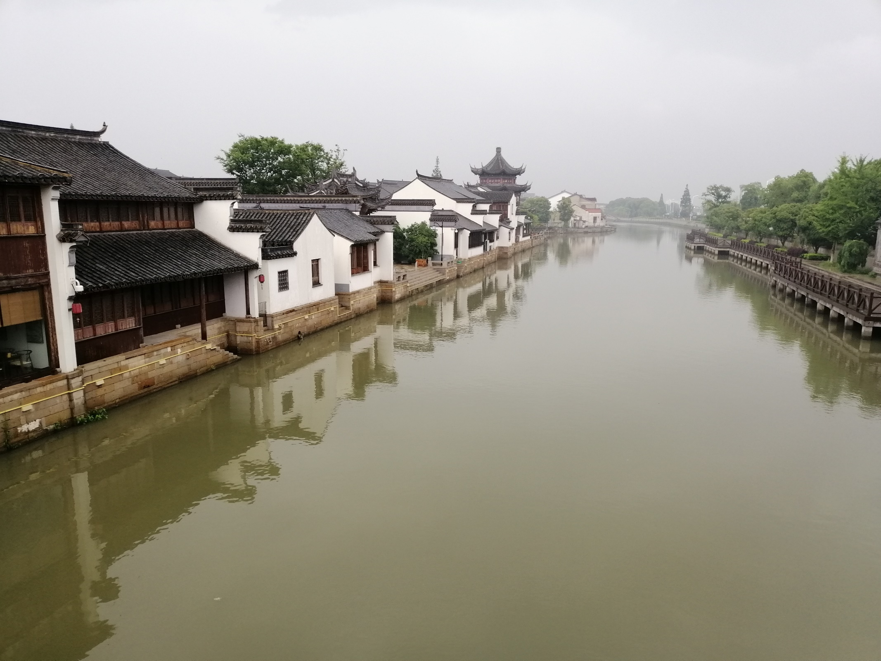

Slide 12
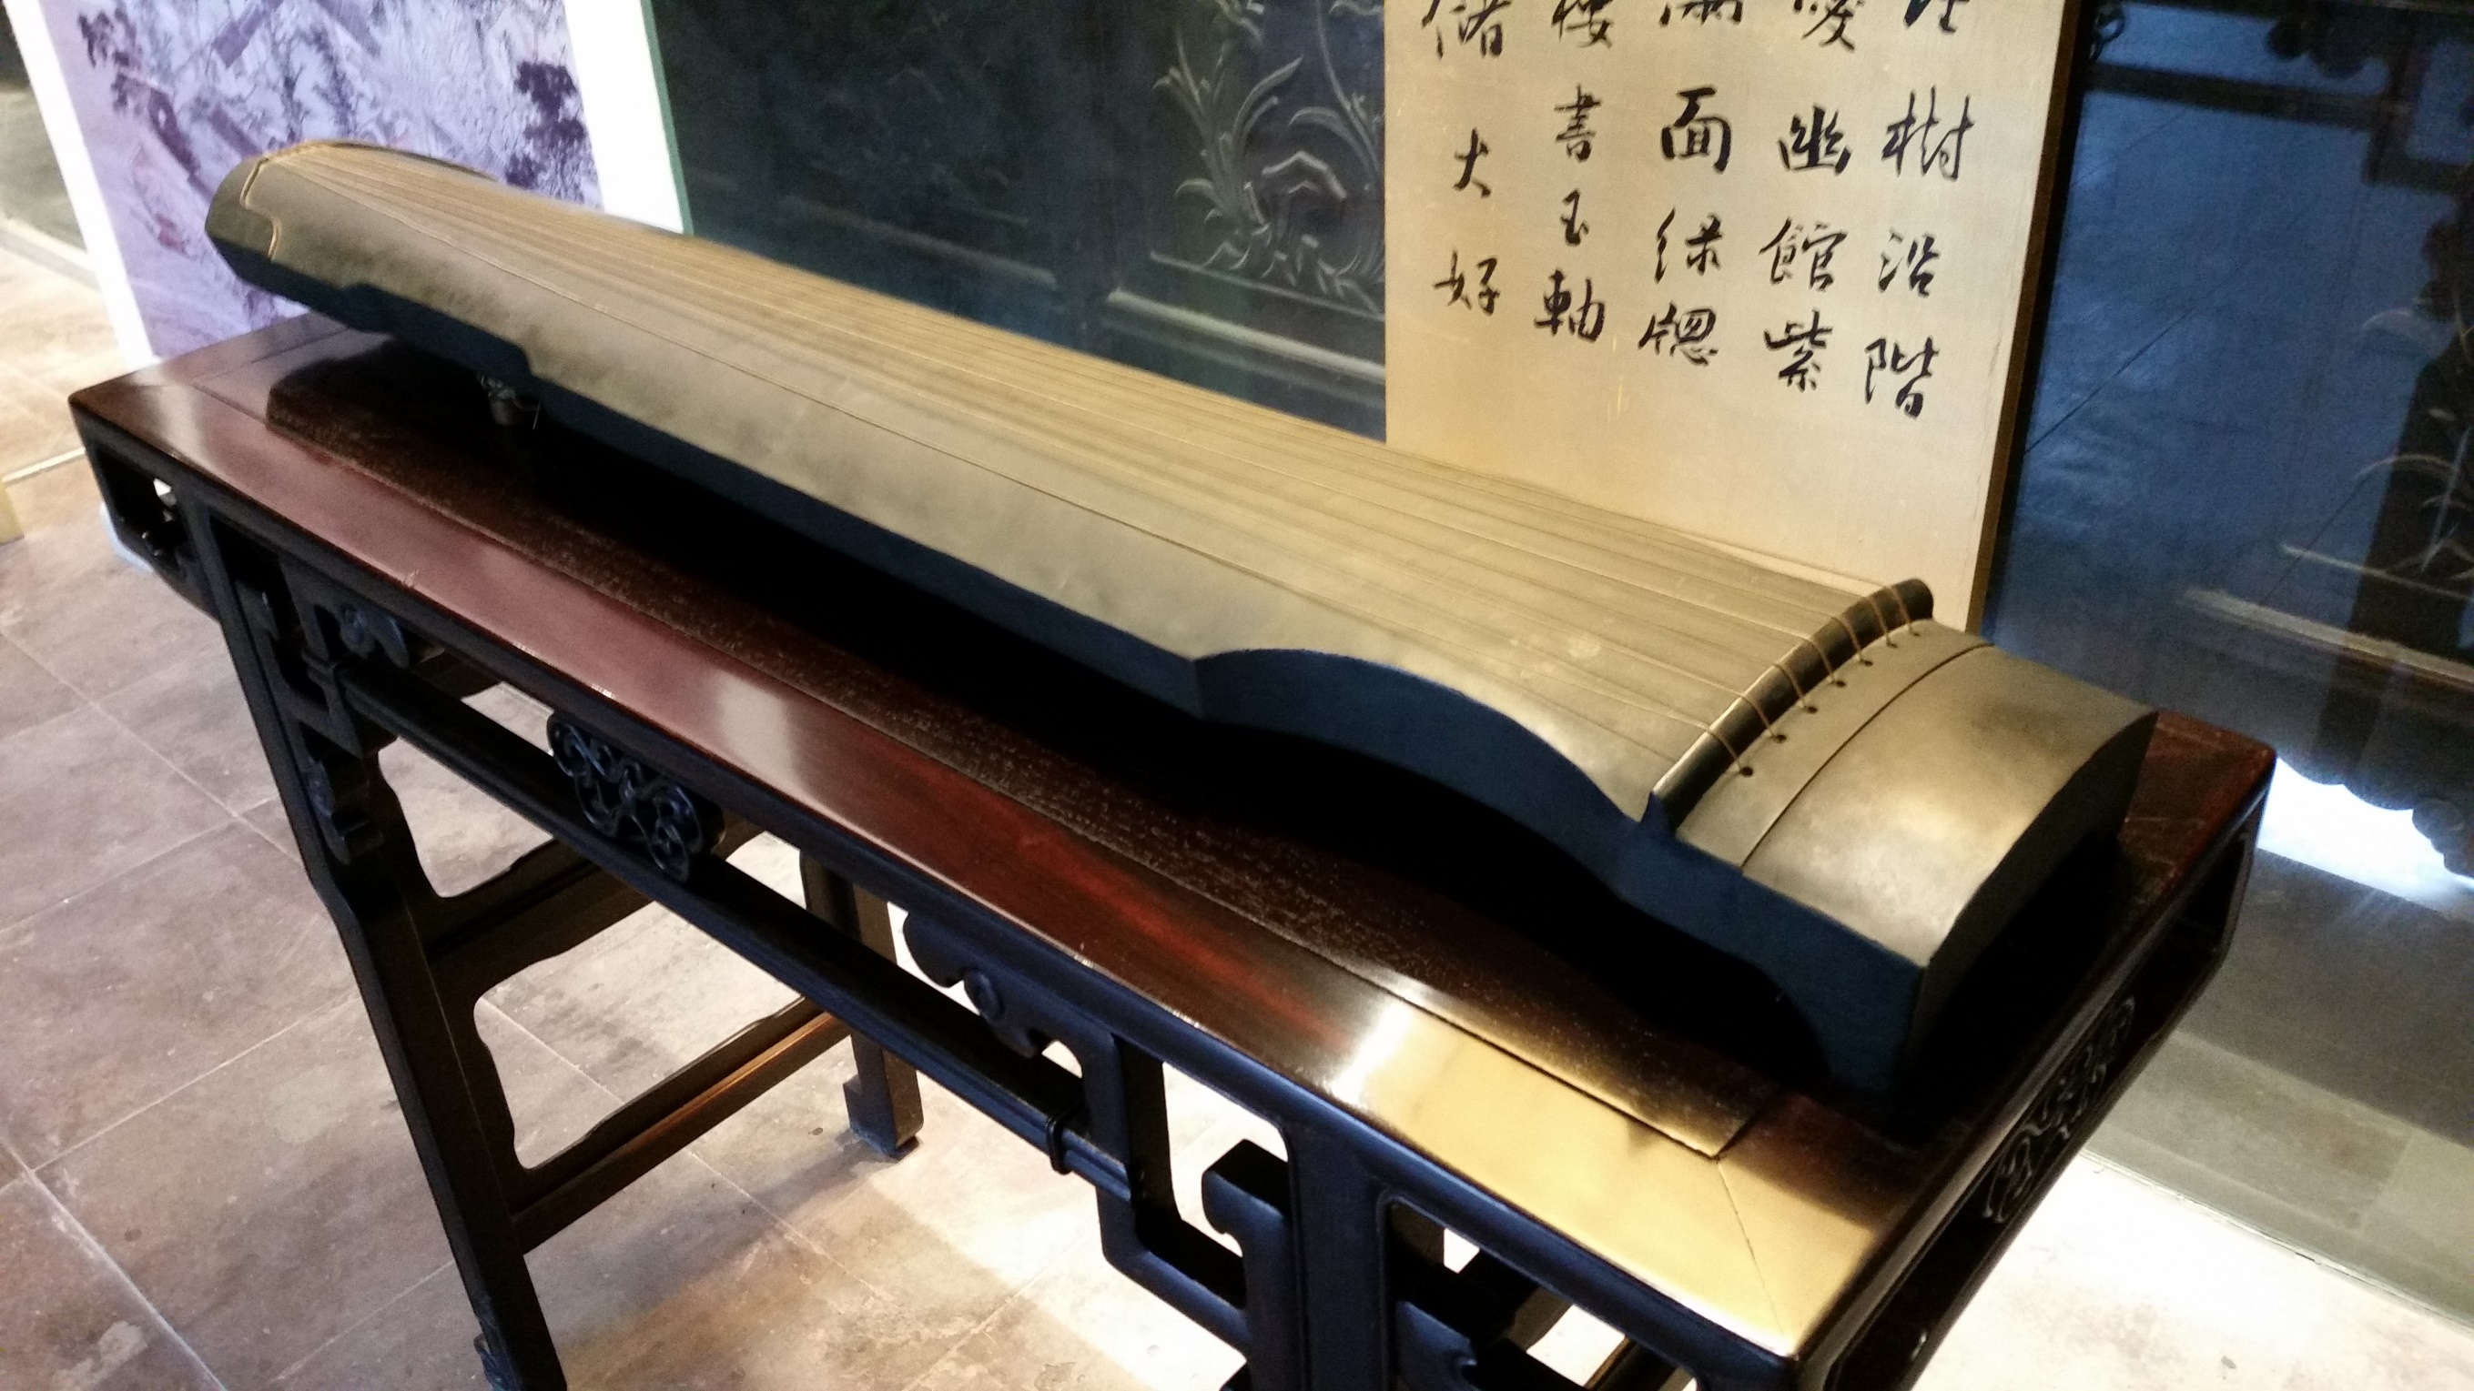

Slide 13
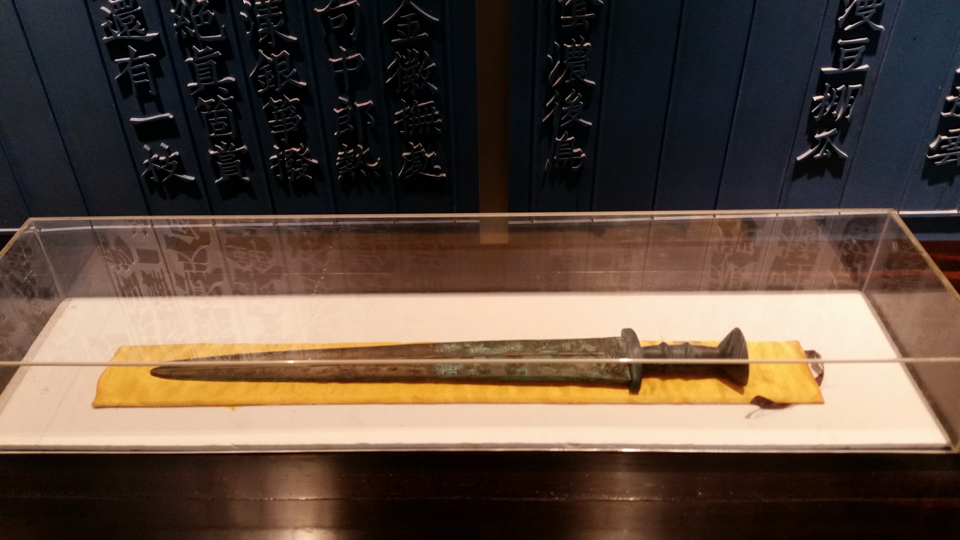

Slide 14
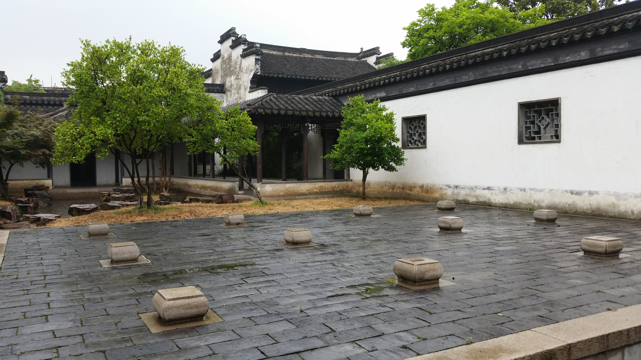

Slide 15
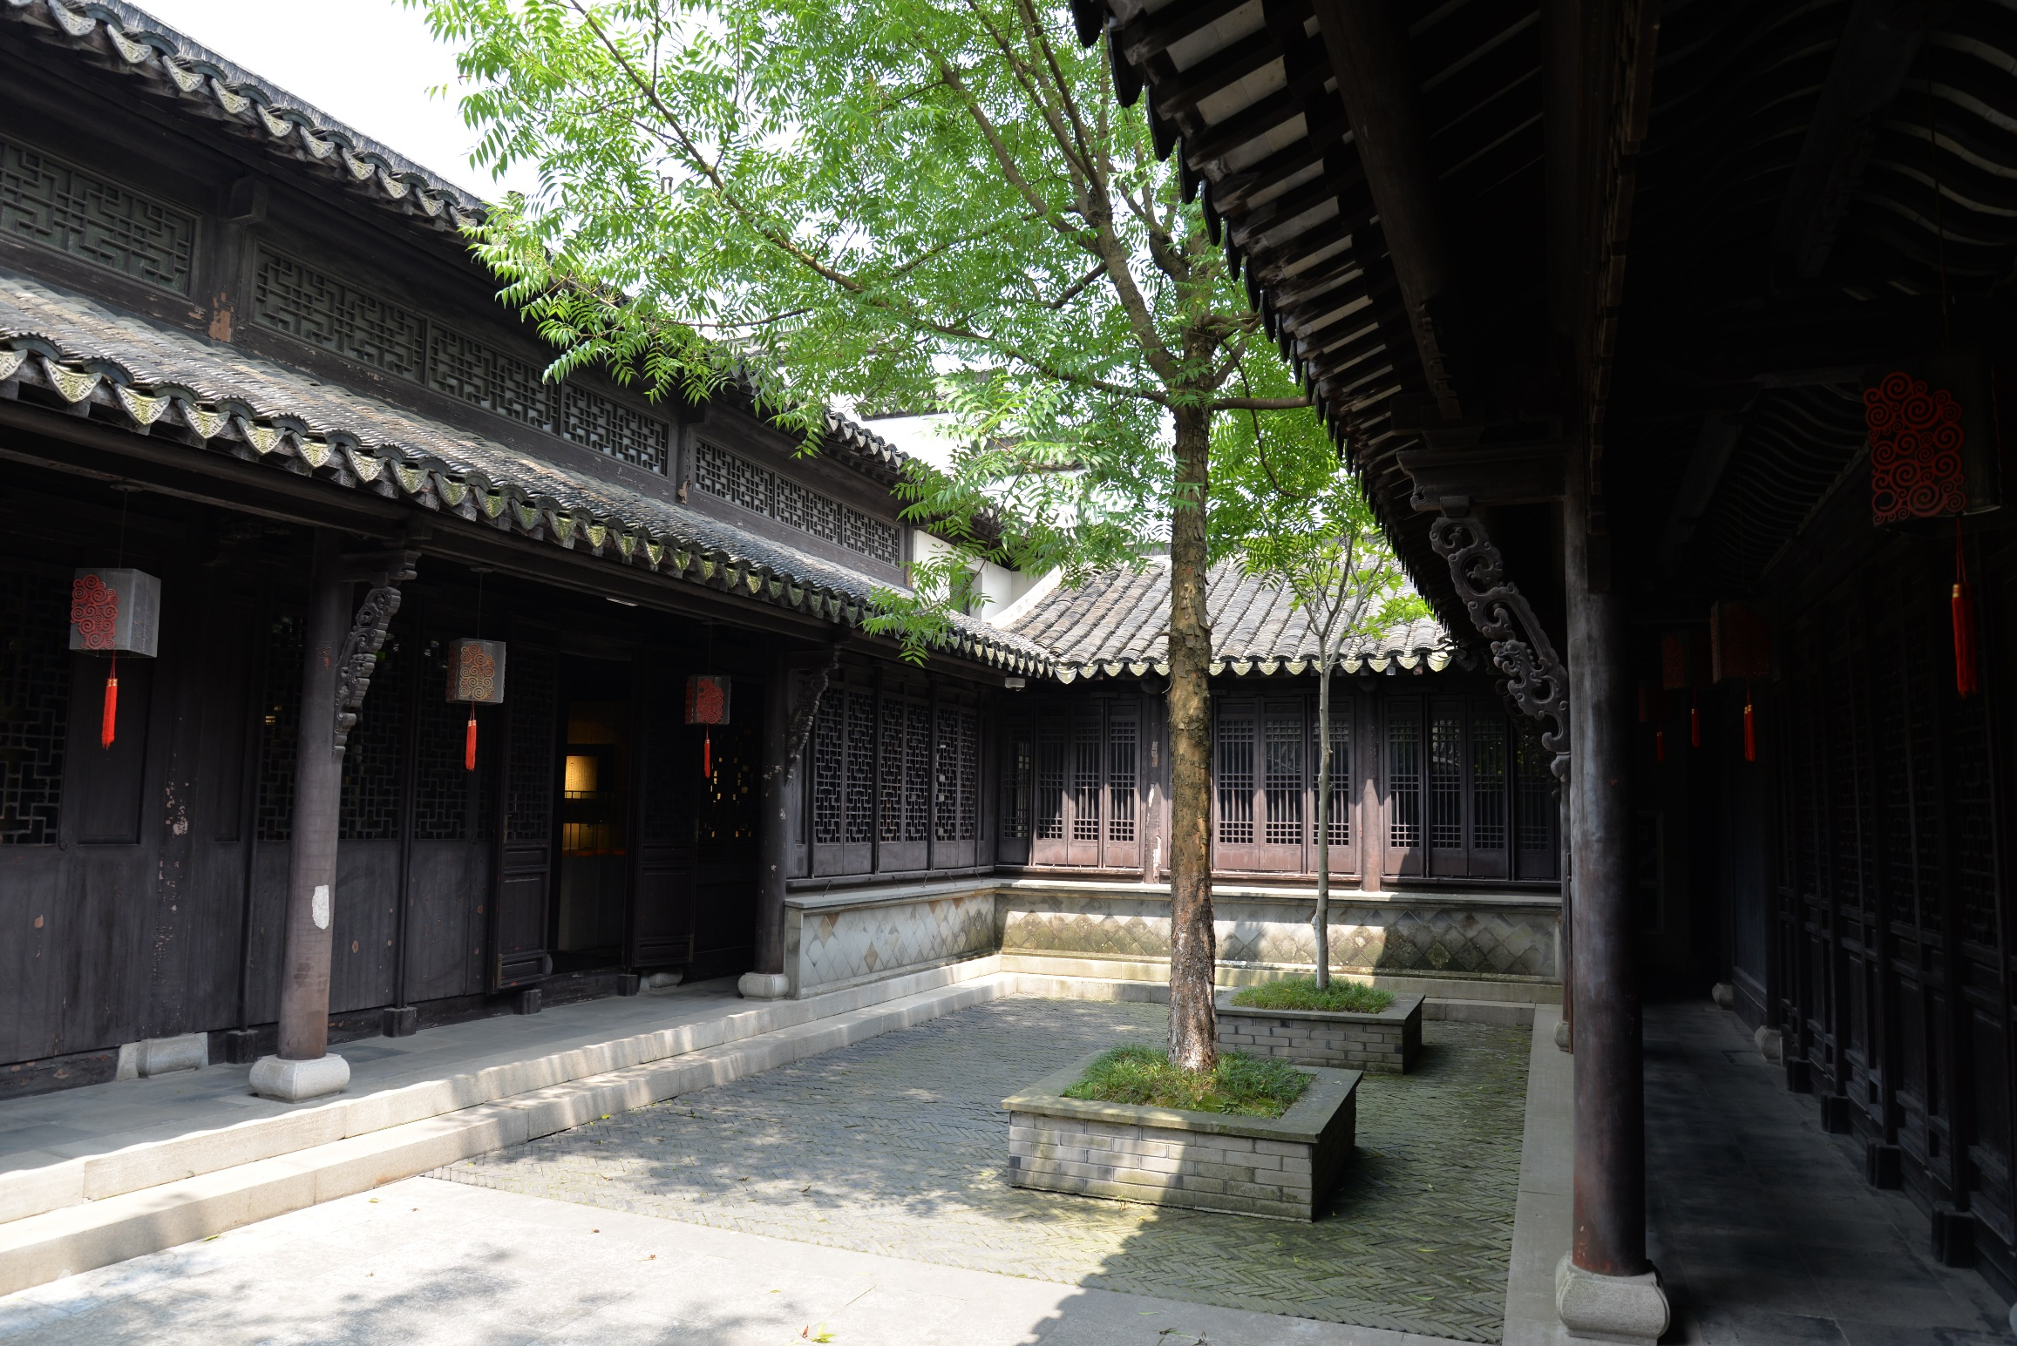

Slide 16
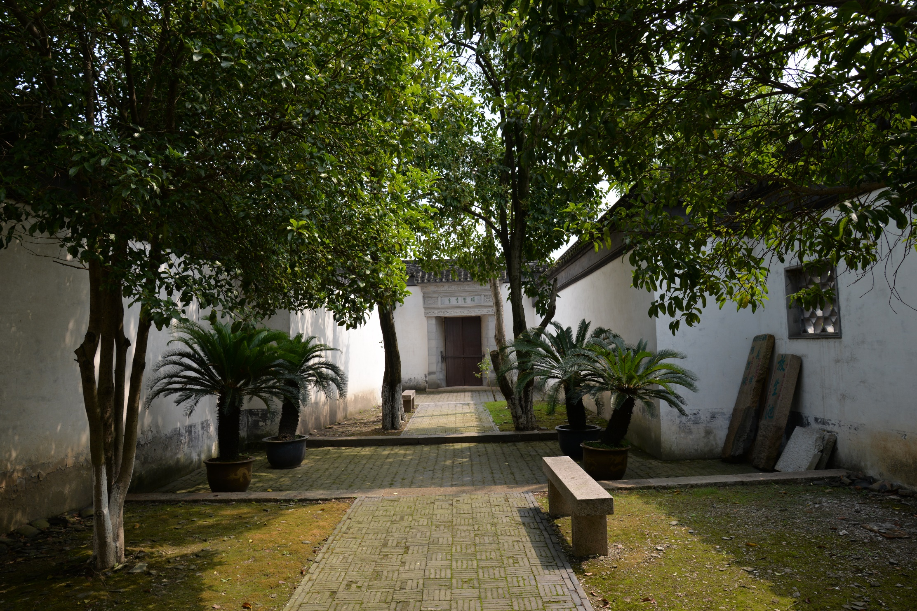

Slide 17
Five generations
Qu Shaoji (瞿绍基，1772-1836) -- founder
Qu Yong (瞿庸 1797-1846)
《鐵琴銅劍樓藏書目錄》, 24 juan, 1194 titles including 173 titles of printed books in Song Dynasty, 4 in Jin and 184 in Yuan, 275 in Ming
Qu Bingyuan (瞿秉淵 1820-1886) and Qu Bingqing (瞿秉清 1828-1877)
Credited with protecting the books from the treat of damages in the Taiping Rebellion. From 1860 to 1864, the two brothers transferred the books to hide them in safe places for 7 times to escape the war with damage; 《虹月歸來圖》in 1867 to 《虹月歸來圖》to mark and celebrate the safe return of the books.
Qu Qijia (瞿啓甲 1873-1940)
Protecting the books in 1907 (Governor Duanfang) and 1924 (location to Shanghai); Works: 《鐵琴銅劍樓宋金元本書影》《鐵琴銅劍樓藏書提拔集錄》; contribution to Siku Congkan 《四部叢刊》1920-25 (1/6 content); founder and first head of Changshu Library
Qu Chibang (瞿熾邦 1900-1972）， Qu Yaobang (瞿耀邦 1905-1980），Qu Fengqi (瞿鳳起1908-1987）
Donating their collections to the National Library of China, and other local libraries.

Slide 18
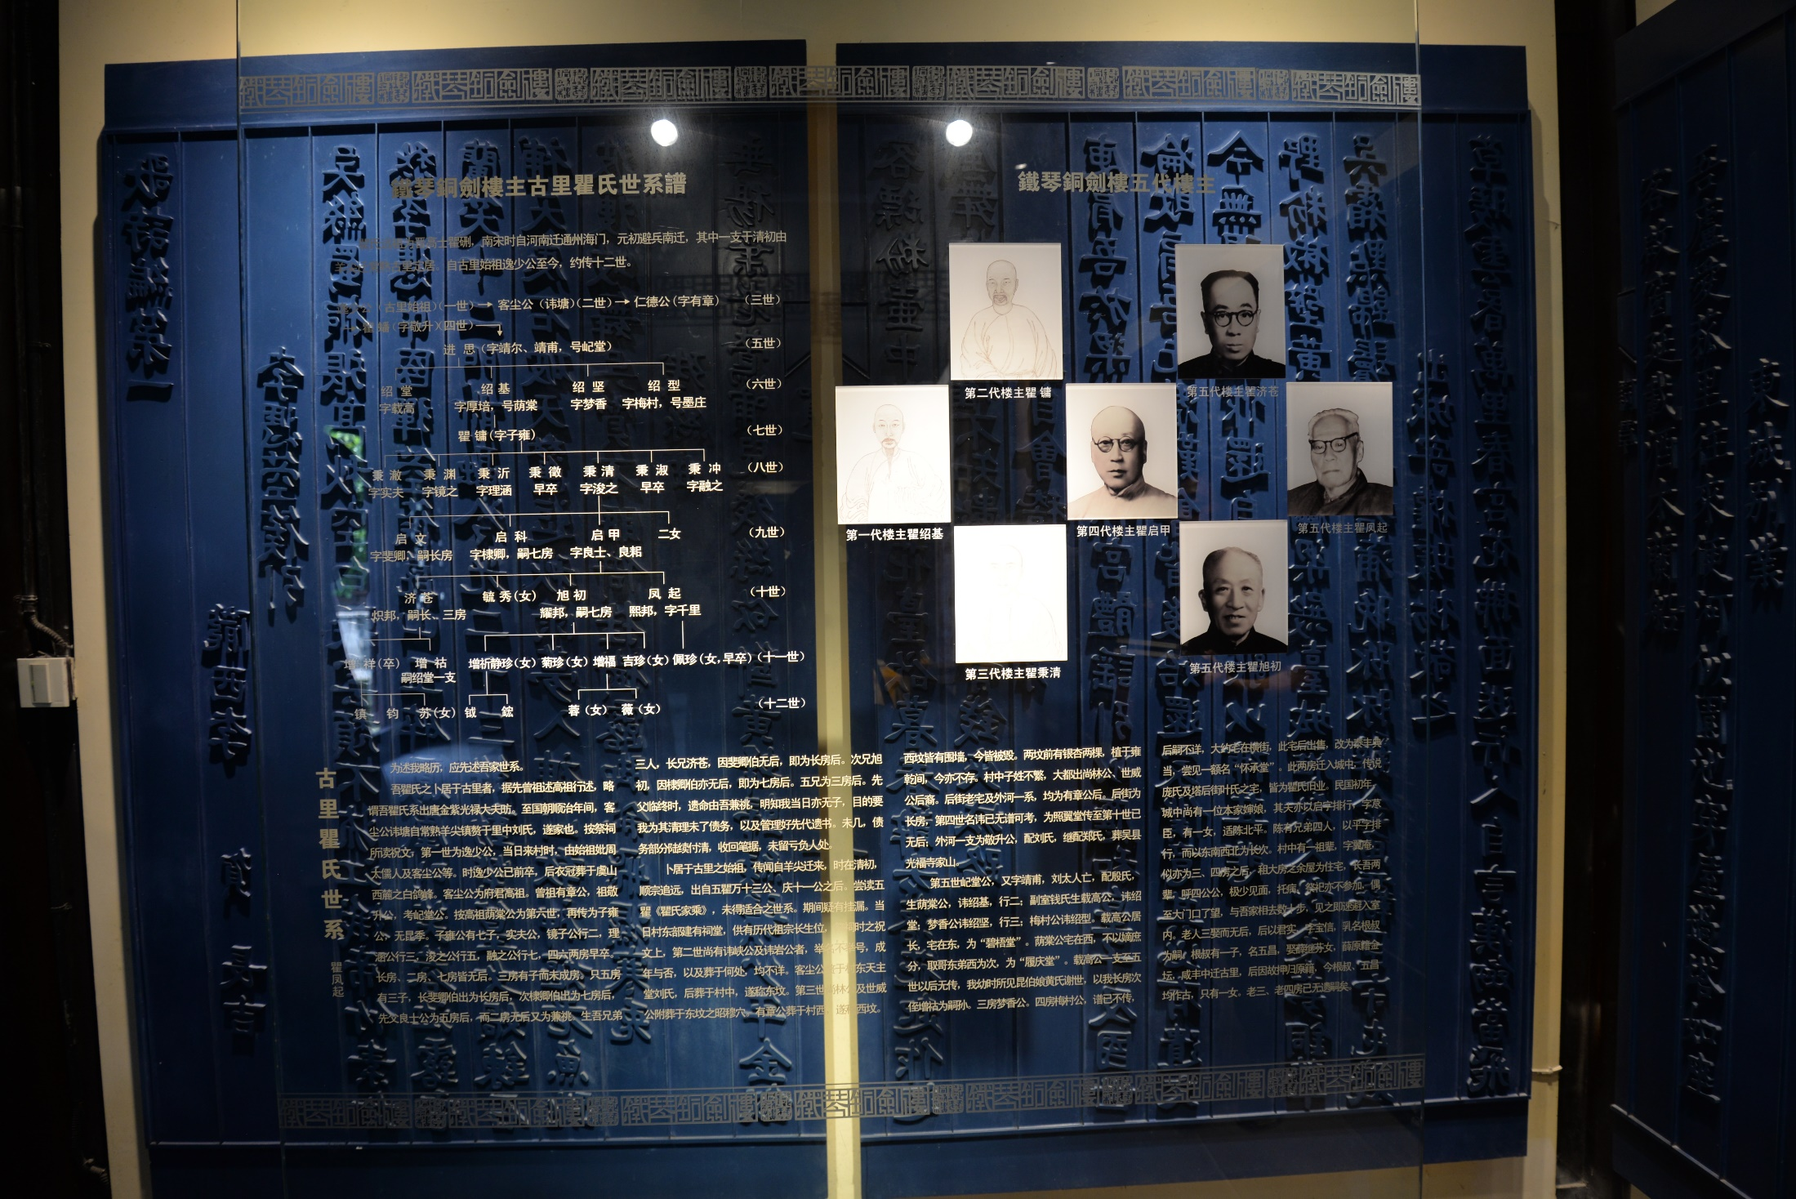

Slide 19
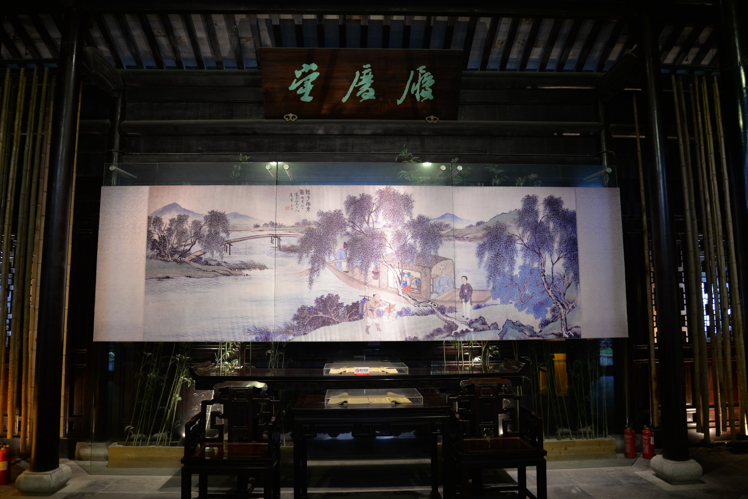
《虹月歸來圖》

Slide 20
Book collections donated by the Qu family
Beneficiary | Year | No. of titles | No. of volumes | Note
Peking Library 京师图书馆 | 1911 | 100 | ? | 595 titles in 4,000 volumes are recorded in 《北京图书馆善本书目》（the Catalogue of Rare Books in Peking Library），北京图书馆善本部编，中华书局，1959
北平图书馆 | 1928.7 | 12 | 20
北京图书馆 | 1950.1 | 52 | 1776
北京图书馆 | 1950.3 | 20 | 467
北京图书馆 | 1953.3 | 99 | 100
北京图书馆 | 1954.4 | 270 | 600
Changshu Library | Pre-1918 | 42 | 649
Changshu Museum | 1958 | 115 | 1132
Changshu Library | Pre-1979 | 13 | 33
Changshu Library | Post-1979 | 708 | 2050
Changshu Office of Culture | 1983 | ? | 1100
Changshu Library | 1987 | 399 | 920
Changshu Library | 1988 | 89 | 126
Nanjing Library | Post-1950 | ? | ?
Shanghai Library | Post-1966 | ? | ?
Total | 15 batches | 1919 (excluding those without data | 8973 (excluding those without data)

Slide 21
Why Changshu? Top 10 cities / counties with most book collectors
 | 1 | 2 | 3 | 4 | 5 | 6 | 7 | 8 | 9 | 10
City / County | Suzhou 苏州 | Hangzhou 杭州 | Changshu 常熟 | Ningbo 宁波 | Huzhou湖州 | Shaoxing绍兴 | Fuzhou福州 | Jiaxing 嘉兴 | Haining 海宁 | Nanjing 南京
Number of book collectors | 277 | 207 | 146 | 109 | 95 | 94 | 80 | 77 | 68 | 67

Slide 22
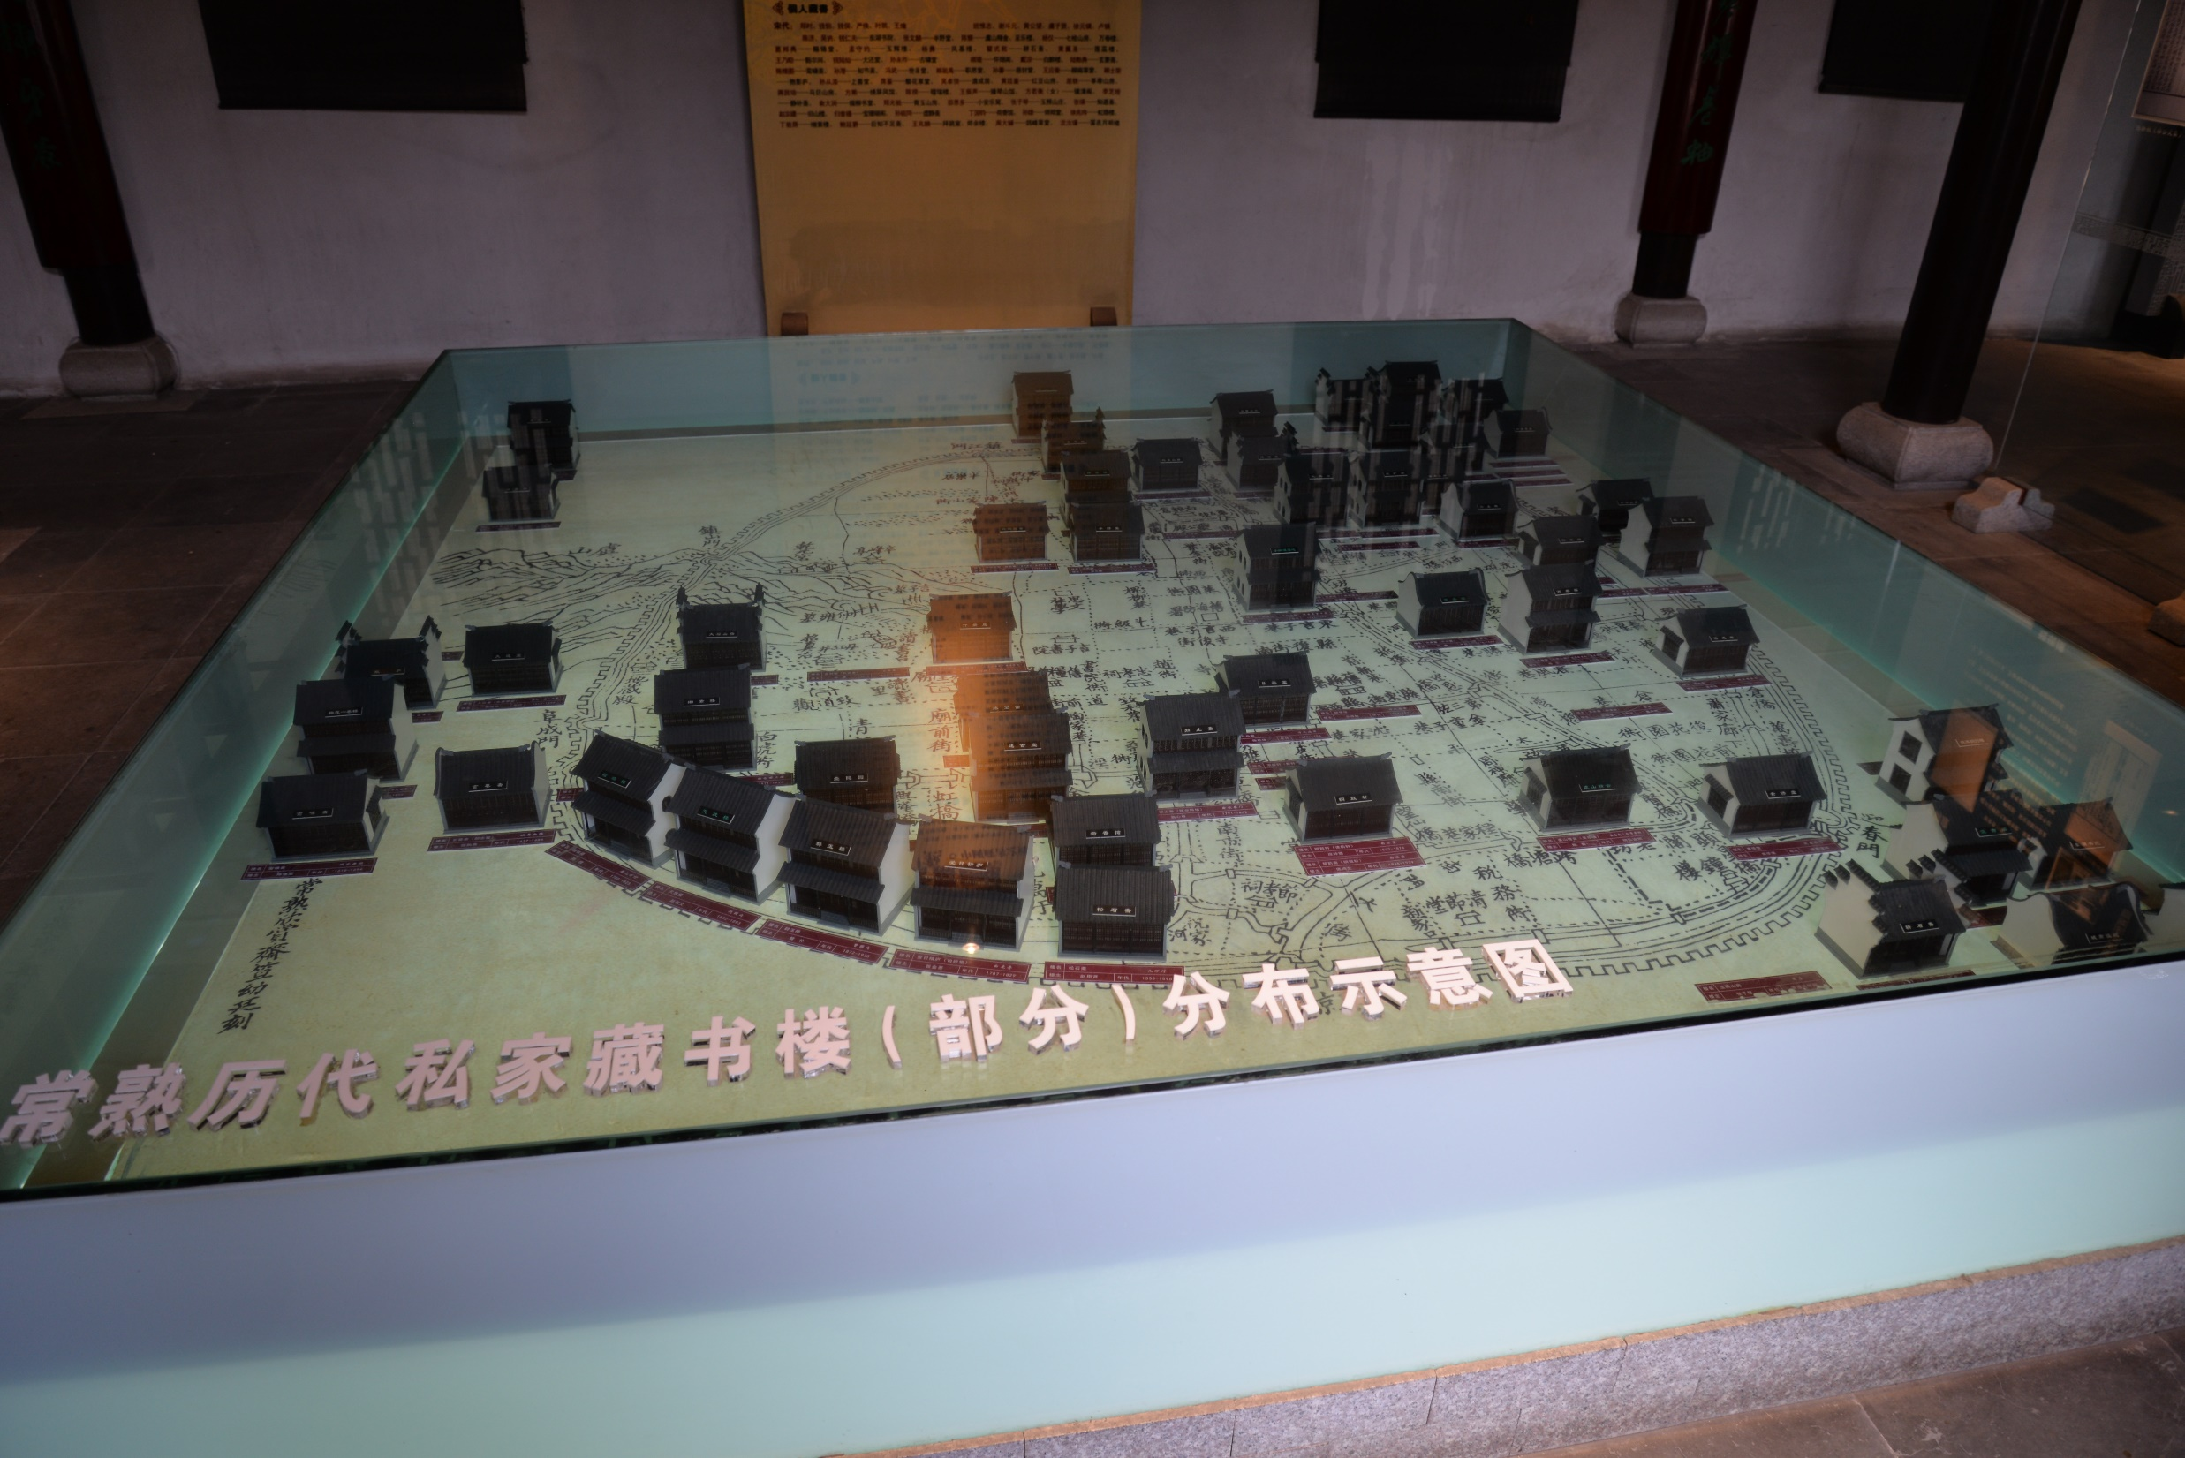

Slide 23
Comparison between Tianyige and TQTJ:
Featured time period.
TQTJ Library interested in the ‘old’ -- manuscripts and books printed in Song, Yuan and Ming Dynasties (excluding works written by Ming authors)
Tianyige focused on the ‘contemporary’, i.e. materials written in the Ming Dynasty.
Content.
TQTJ focused on Confucius classics, while Tianyige on local gazetteers, examinations, literary works, etc.
Management.
Tianyige focused on ‘collecting’ and ‘keeping’ (束之高阁，秘不视人) with strict rules
TQTJ didn’t regard the collection as only private. Instead, they encouraged people to come and use them, even provided food, drink and accommodation. They also made their collection public by publishing their detailed catalogues.
Curation.
TQTJ produced quite a few high quality descriptive catalogues (e.g. 《恬裕斋藏书记》，《恬裕斋藏书目录》，《铁琴铜剑楼藏书目录》，《铁琴铜剑楼藏书题跋集录》，《铁琴铜剑楼宋金元本书影》more and better than Tianyige.

Slide 24
4. Private book collecting since the late Qing Dynasty
A snapshot of number of public and private libraries in 1935
地区 | 公立图书馆 | 所占比例% | 私立图书馆 | 所占比例% | 公私图书馆总数
上海 | 34 | 23 | 114 | 77 | 148
南京 | 38 | 73 | 14 | 27 | 52
江苏 | 166 | 78 | 47 | 22 | 213
浙江 | 164 | 77 | 47 | 23 | 213
安徽 | 59 | 83 | 12 | 17 | 71
江西 | 45 | 83 | 9 | 17 | 54
湖北 | 66 | 81 | 15 | 19 | 81
湖南 | 89 | 84 | 17 | 16 | 106
四川 | 105 | 77 | 32 | 23 | 137
青岛 | 8 | 89 | 1 | 11 | 9
山东 | 153 | 97 | 5 | 3 | 158
北平 | 36 | 46 | 43 | 54 | 79
河北 | 131 | 92 | 11 | 8 | 142
河南 | 179 | 93 | 13 | 7 | 192
山西 | 85 | 90 | 9 | 10 | 94
陕西 | 72 | 97 | 2 | 3 | 74
甘肃 | 49 | 98 | 1 | 2 | 50
广东 | 215 | 70 | 92 | 30 | 307
福建 | 69 | 75 | 23 | 25 | 92
广西 | 69 | 100 | 缺 | 0 | 69
贵州 | 47 | 90 | 5 | 10 | 52
云南 | 84 | 99 | 1 | 1 | 85
绥远 | 17 | 100 | 缺 | 0 | 17
青海 | 7 | 100 | 0 | 0 | 7
察哈尔 | 10 | 100 | 0 | 0 | 10
宁夏 | 4 | 100 | 0 | 0 | 4
西康 | 4 | 100 | 0 | 0 | 4
合计 | 2005 | 80 | 515 | 20 | 2520

Slide 25
In the People’s Republic period, data on the number of public libraries in 《中国图书馆年鉴》1996-2017 , but no data for private libraries. Between 1949 and 2916, the number of public libraries increased year by year, from 52 to 3153:

Slide 26
5. The definition and legal status of private libraries since the late Qing Dynasty
Law of the People's Republic of China on Public Libraries (2018 Amendment) took effect on 26 October 2018. Clause 2:
第二条 本法所称公共图书馆，是指向社会公众免费开放，收集、整理、保存文献信息并提供查询、借阅及相关服务，开展社会教育的公共文化设施。
Library law in Taiwan (（台湾）图书馆法，2001年1月17日). Clause 4:
第四条：……“公共图书馆：指由各级主管机关，乡（镇、市）公所、个人、法人或团体设立，以社会大众为主要服务对象，提供图书信息服务，推广社会教育及办理文化活动之图书馆。” （（中国图书馆年鉴2003，p.335）
清宣统二年(1910年)颁布了我国近代图书馆事业的第一个法律——学部奏请拟定的《京师及各省图书馆通行章程》(Regulations of Peking Library and Provincial Libraries)

Slide 27
学部于191 0 年( 宣统二年) 颁布我国第一个全国性图书馆章程— 《京师图书馆及各省图书馆通行章程》

Slide 28
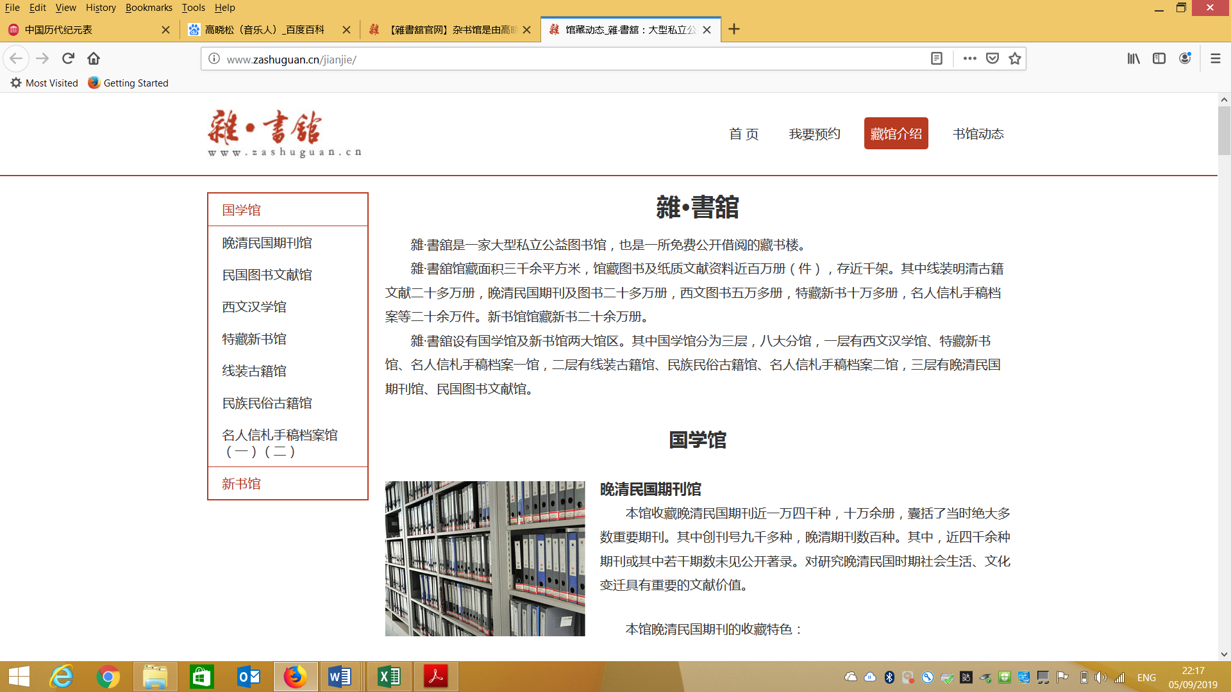
6. Private libraries now

Slide 29
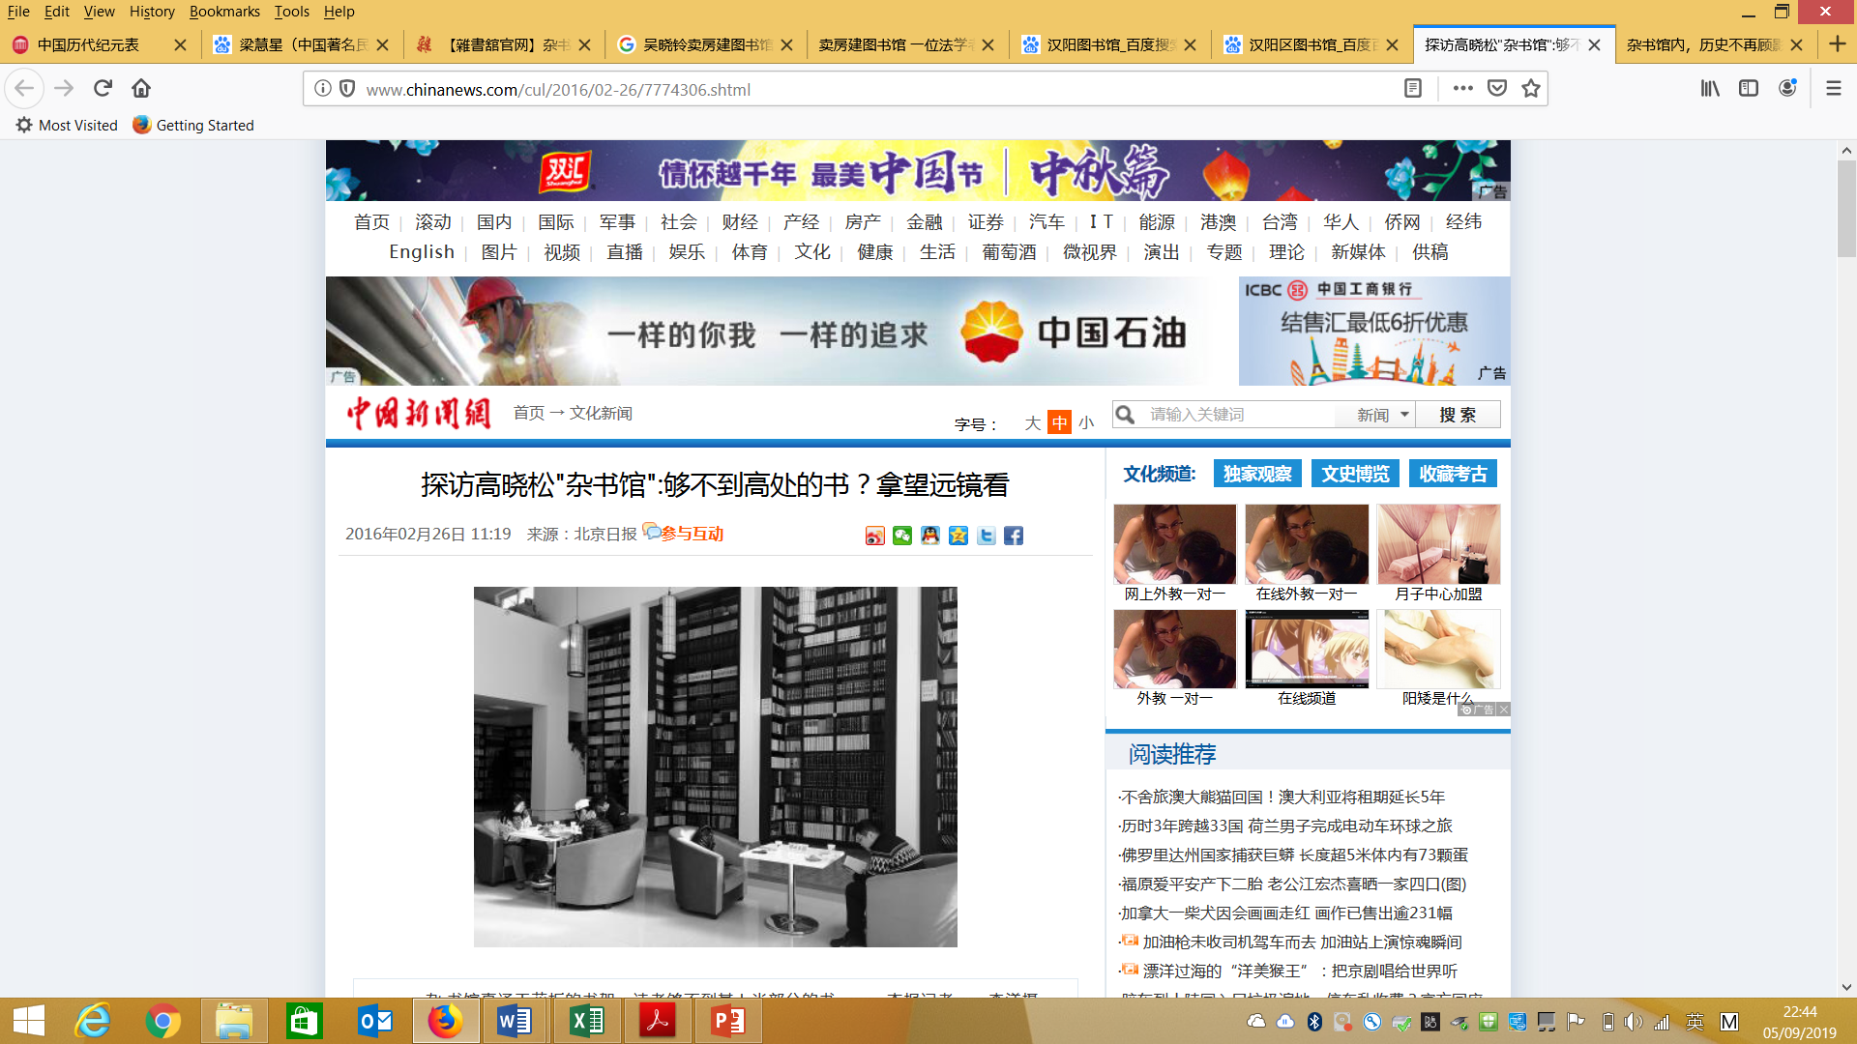

Slide 30
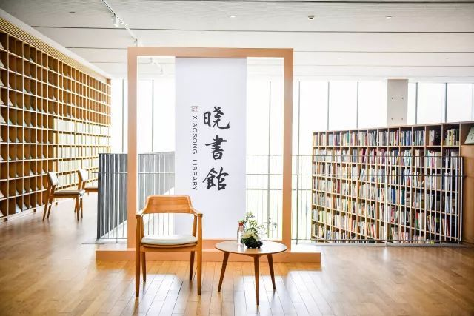
Xiaosong Library (晓松馆，2018 - ）also by Gao Xiaosong

Slide 31
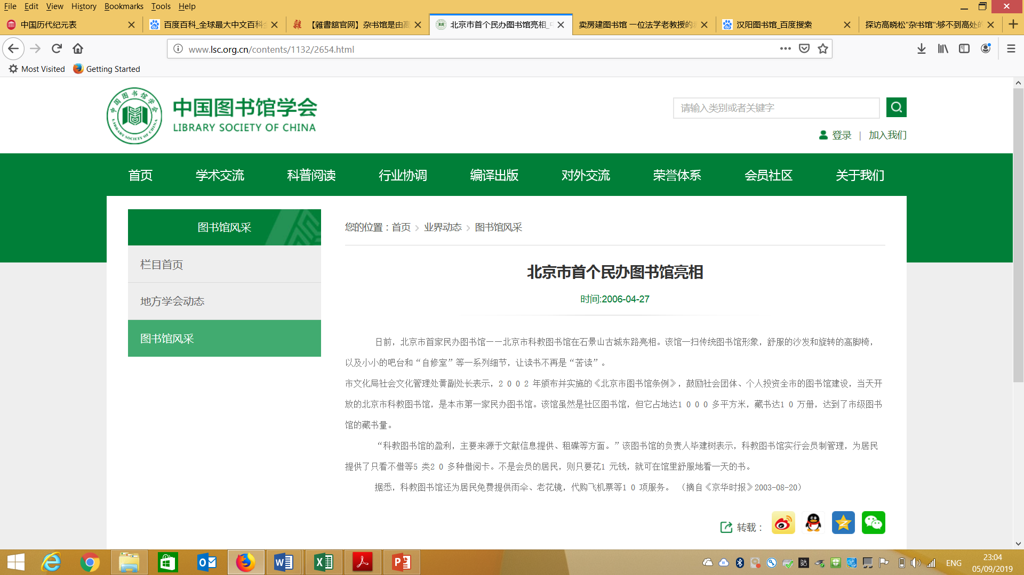
Beijing Science and Education Library (北京科教图书馆, 2003 – 2010)

Slide 32
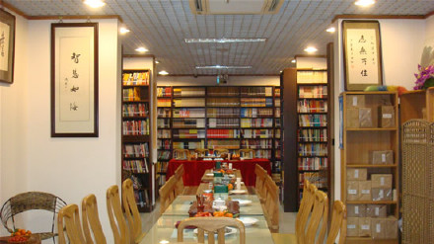
Beijing Huazang Library (北京华藏图书馆, 2007 - )

Slide 33
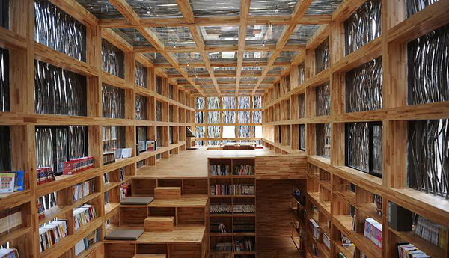
Liyuan Shuwu (篱苑书屋, 2011 – 2017 closed because of pirate editions)

Slide 34
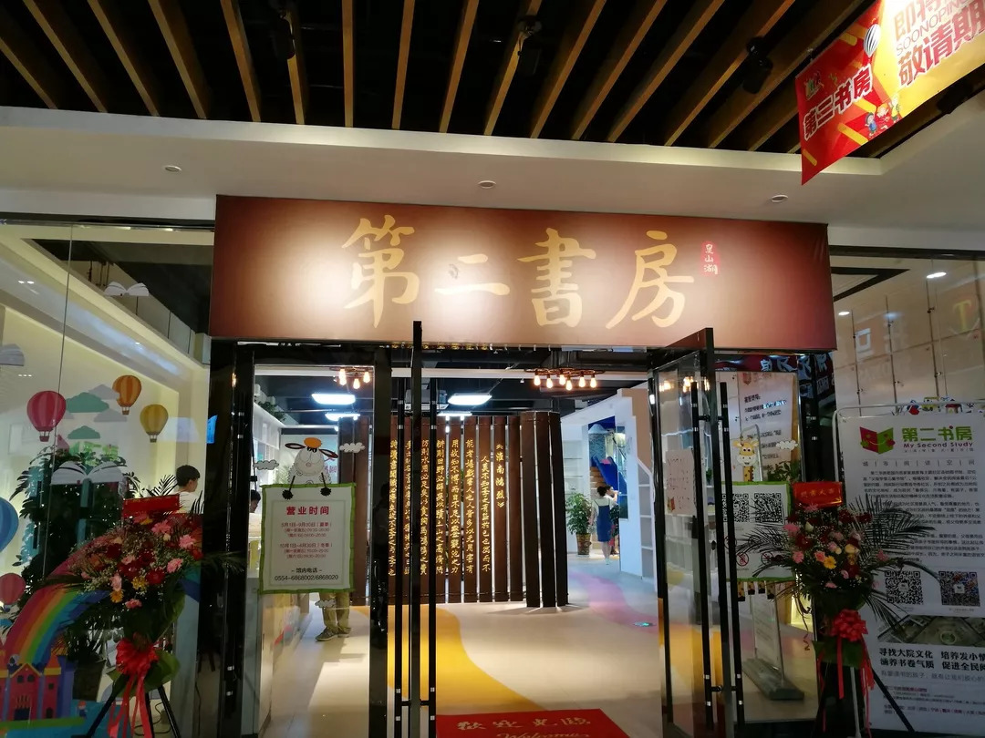
My Second Study (第二书房, 2013- ). For children

Slide 35
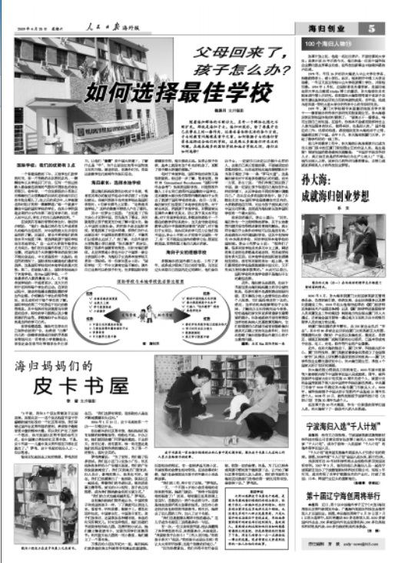
Peekabook House (皮卡书屋, 2006- ) – Children’s library with multiple sites;
Temporarily closed on 1 August 2019

Slide 36
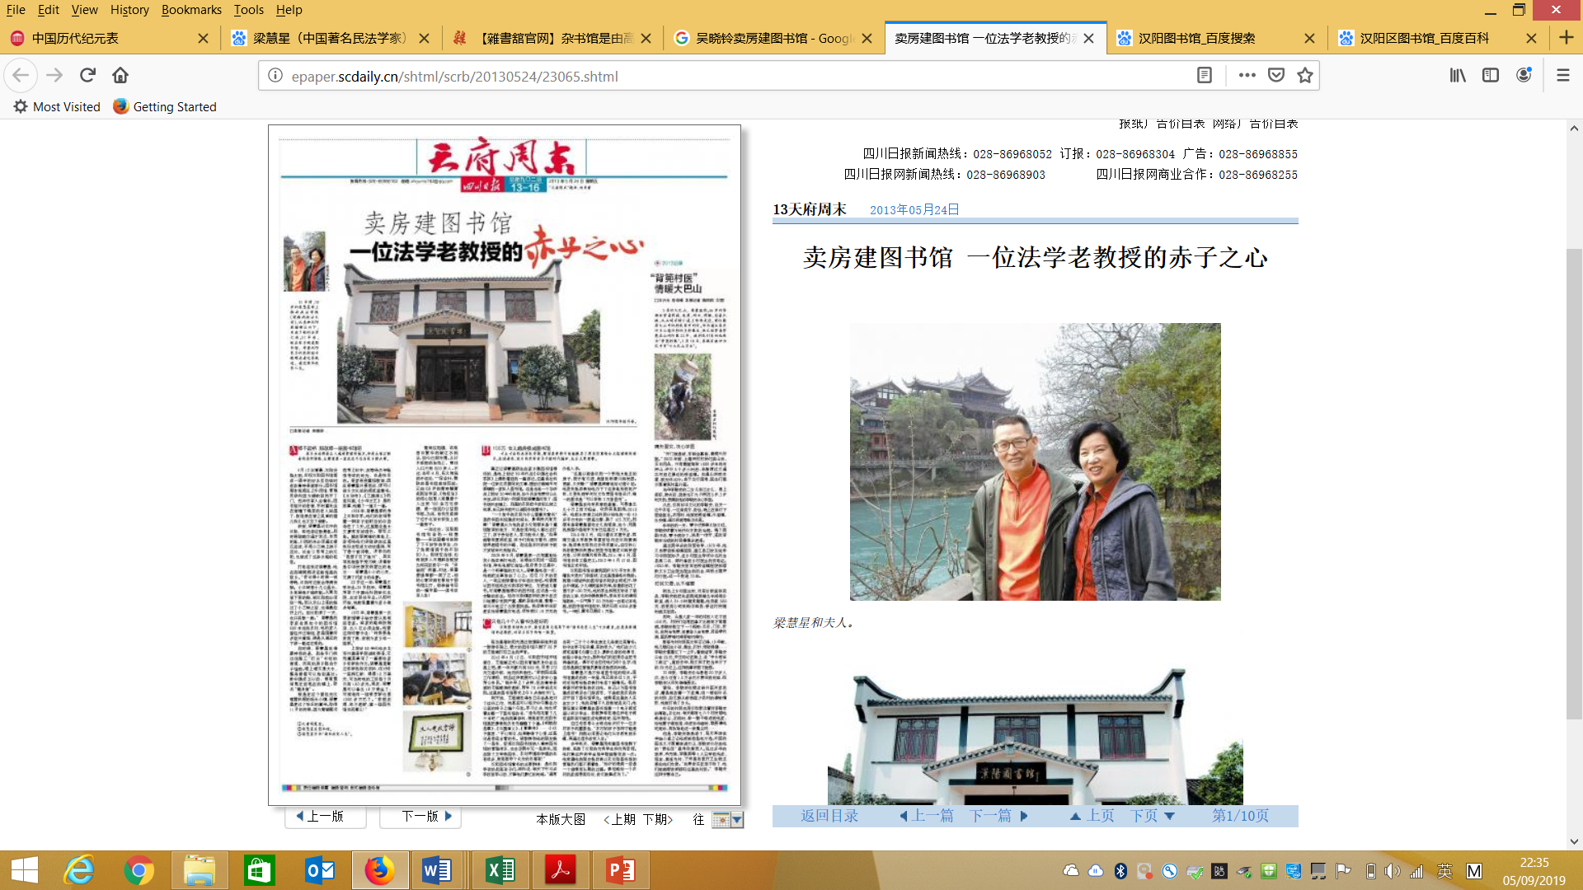
Hanyang Private Library (汉阳私立图书馆, 2013 -)，founded by Law Professor Liang Huixing (梁慧星）

Slide 37
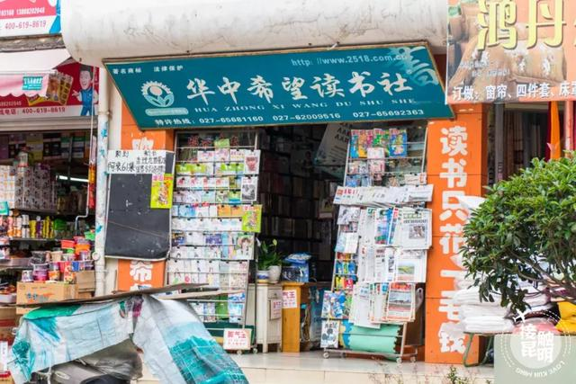
Hua Zhong Xi Wang Du Shu She (华中希望读书社, 1996 - ) with hundreds of site libraries across China. Not free – more like a bookstore

Slide 38
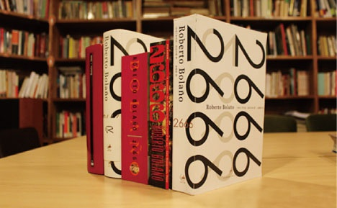
2666 Library (2666图书馆, Shanghai. 2011-2013)

Slide 39
Thanks!

