Slide 1
Enriched Knowledge Service Platform and Cross-Database Search
September, 2015

Slide 2
Wanfang Data Knowledge Service Platform (“Wanfang Platform”) integrates over 15 types of databases, covering journal articles, dissertation and theses, conference proceedings, English literatures, local gazetteers, laws, e-books, government reports, research achievements, patents, standards, statistical data, institutions, experts, videos, etc.
In China, Wanfang Platform serves as a main gateway to academic resources which are published in Chinese or English language.

Slide 3
In addition to comprehensiveness, one remarkable feature of Wanfang Platform is to offer user-friendly cross-database search for free. It allows users to easily find out targeted Chinese or English literatures in short time.
The first button that you see on Wanfang Platform is for cross-database search.

Slide 4
By one click, you may search five databases at the same time. The five databases cover:
- Chinese journal articles
- Chinese dissertations and theses
- Chinese conference papers
- English journal articles
- English conference papers
- English Open-Access journal articles
You may do a search from over 70 million records (by August 2015).

Slide 5
Quick Guide to Cross-Database Search
Enter the home page of Wanfang Platform (http://g.wanfangdata.com.cn/) . Make sure that the first button is selected or highlighted.
Input a keyword in Chinese or English. For example, let ‘s input an English keyword “Earthquake”.

Slide 6
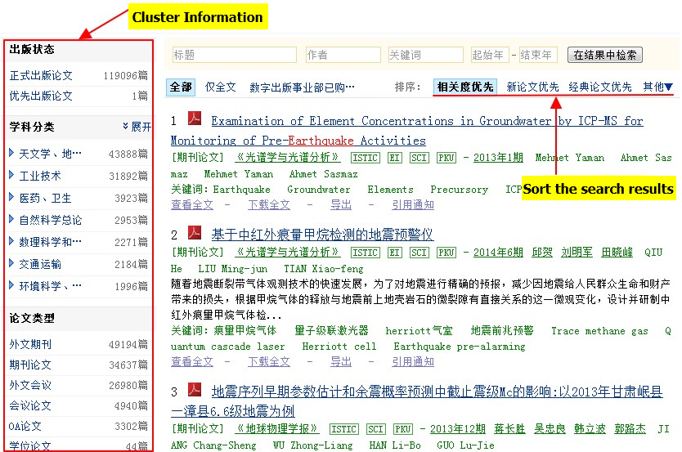
3) Get the search results.
Notes:
The results can be displayed in sequence of Relevancy or Publication Time or Citation Frequency.
The left-side column displays the numbers of records by Subjects and Types of Literatures.
The results can be displayed in sequence of Relevancy or Publication Time or Citation Frequency.
The left-side column displays the numbers of records by Subjects and Types of Literatures.
The results can be displayed in sequence of Relevancy or Publication Time or Citation Frequency.
The left-side column displays the numbers of records by Subjects and Types of Literatures.
The results can be displayed in sequence of Relevancy or Publication Time or Citation Frequency.
The left-side column displays the numbers of records by Subjects and Types of Literatures.

Slide 7
3) Notes:
- The results can be displayed in a sequence of Relevancy or Publication Time or Citation Frequency.
- The left-side column shows the numbers of records in search results by Subjects and Types of Literatures.

Slide 8
4) You may further do a refined search to get more accurate results.

Slide 9
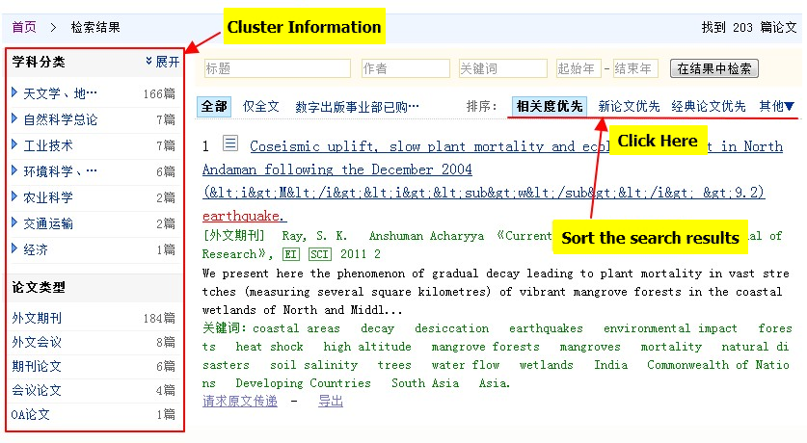
4) Refined search results
Notes:
The results can be displayed in sequence of Relevancy or Publication Time or Citation Frequency.
The left-side column displays the numbers of records by Subjects and Types of Literatures.
The results can be displayed in sequence of Relevancy or Publication Time or Citation Frequency.
The left-side column displays the numbers of records by Subjects and Types of Literatures.
The results can be displayed in sequence of Relevancy or Publication Time or Citation Frequency.
The left-side column displays the numbers of records by Subjects and Types of Literatures.
The results can be displayed in sequence of Relevancy or Publication Time or Citation Frequency.
The left-side column displays the numbers of records by Subjects and Types of Literatures.

Slide 10
4) Notes:
- From the cluster information on the left, you can see that, in addition to Chinese literatures, the search results also include English literatures and Open-Access articles.
- About 1 million English journal articles are added to the database per year. Over 200,000 English conference papers are added to the database per year.
Current Open-Access articles come from four sources, including DOAJ、arXiv、PubMed、SRP.
By mid-2015, there were nearly 4.5 million OA records searchable through Wanfang Platform.

Slide 11
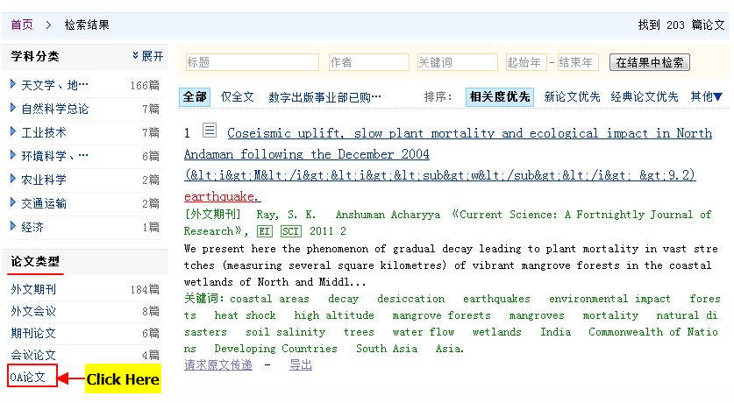
5) Assume that you need OA papers. So, click on “OA Paper” in the left-side column. Then, you can get a list of refined results including OA papers only.

Slide 12
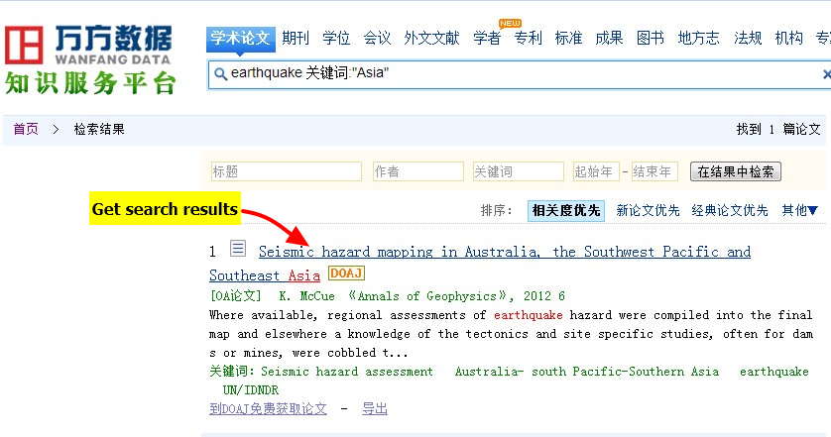
5) List of OA papers.

Slide 13
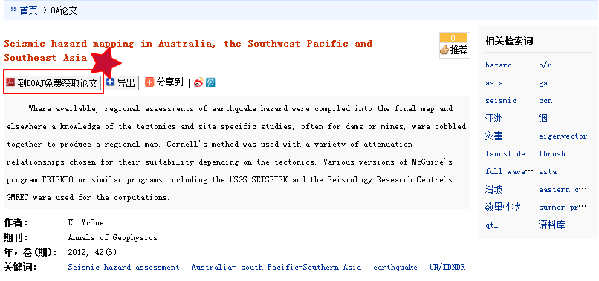
6) When you click on a particular paper title, you may go to the web page of the OA paper , where you can see a button linking to an external webpage for access to full-text of the OA paper

Slide 14
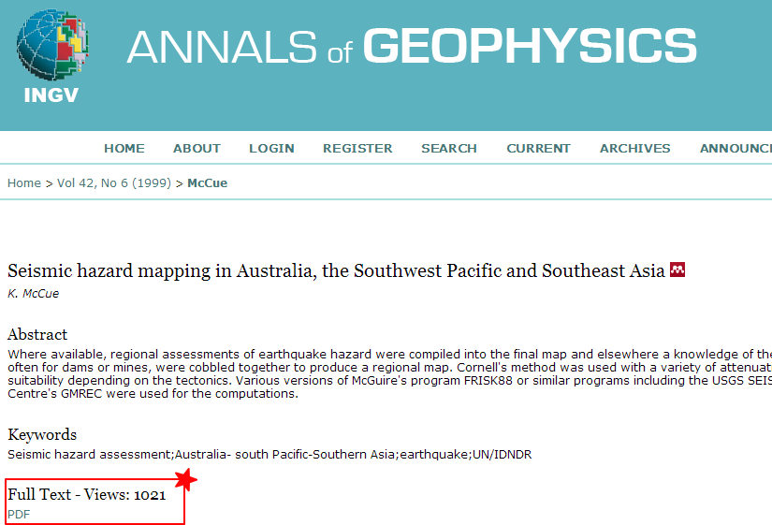
6) An example of External webpage for access to full-text of the OA paper

Slide 15
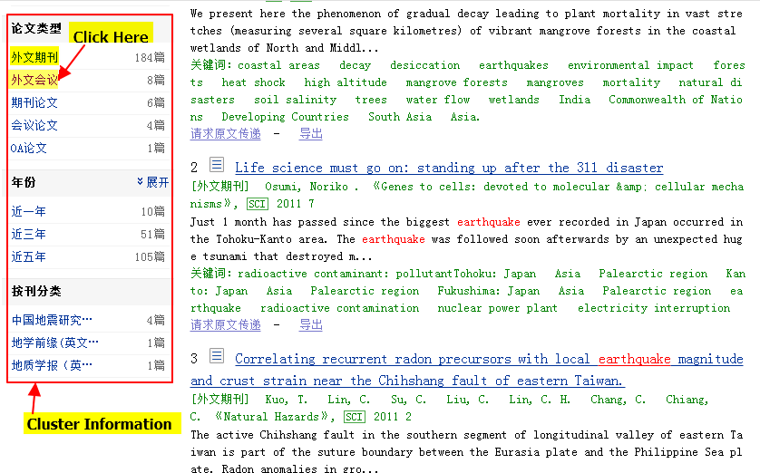
7) If you only need access to foreign-language literatures such as journal articles or conference papers, you may click on “Foreigh-Language Journals” or “Foreign-Language Conferences” in the left-side column.

Slide 16
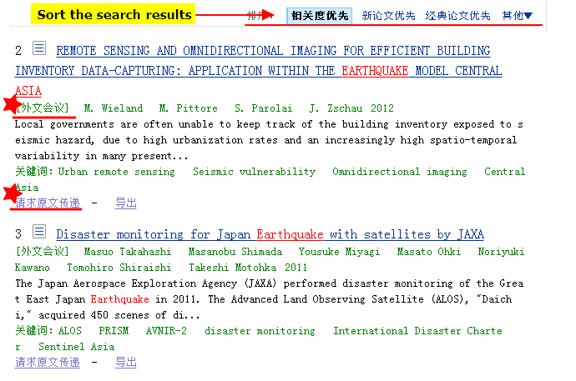
8) The result page after clicking on “Foreign-Language Conferences” in the left-side column.

Slide 17
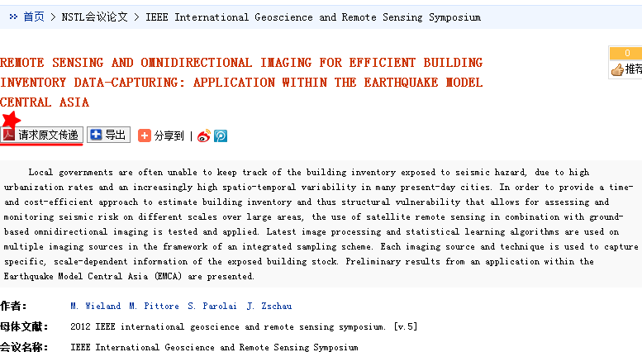
9) To get full-texts of foreign-language literatures, a user needs to pay for the On-Demand Document Delivery Service. A registered user will see a button named “Request for Document Delivery”.

Slide 18
Need more details or have any questions?
Please contact Wanfang Data:
Phone: +86-10-58882628
Email: overseas@wanfangdata.com
Thank you !

