Slide 1
Brill Online Resources on East Asia
Albert Hoffstadt
Senior Acquisitions Manager / Asian Studies
BRILL

Slide 2
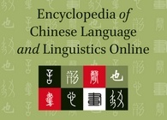
Encyclopedia of Chinese Language & Linguistics Online
First comprehensive encyclopedia of this kind for Chinese languages and linguistics
Systematic treatment of all aspects of Chinese linguistics, including:
Second Language Acquisition and Pedagogy
Sociolinguistics
Psycho and Neurolinguistics
Available in print and online

Slide 3
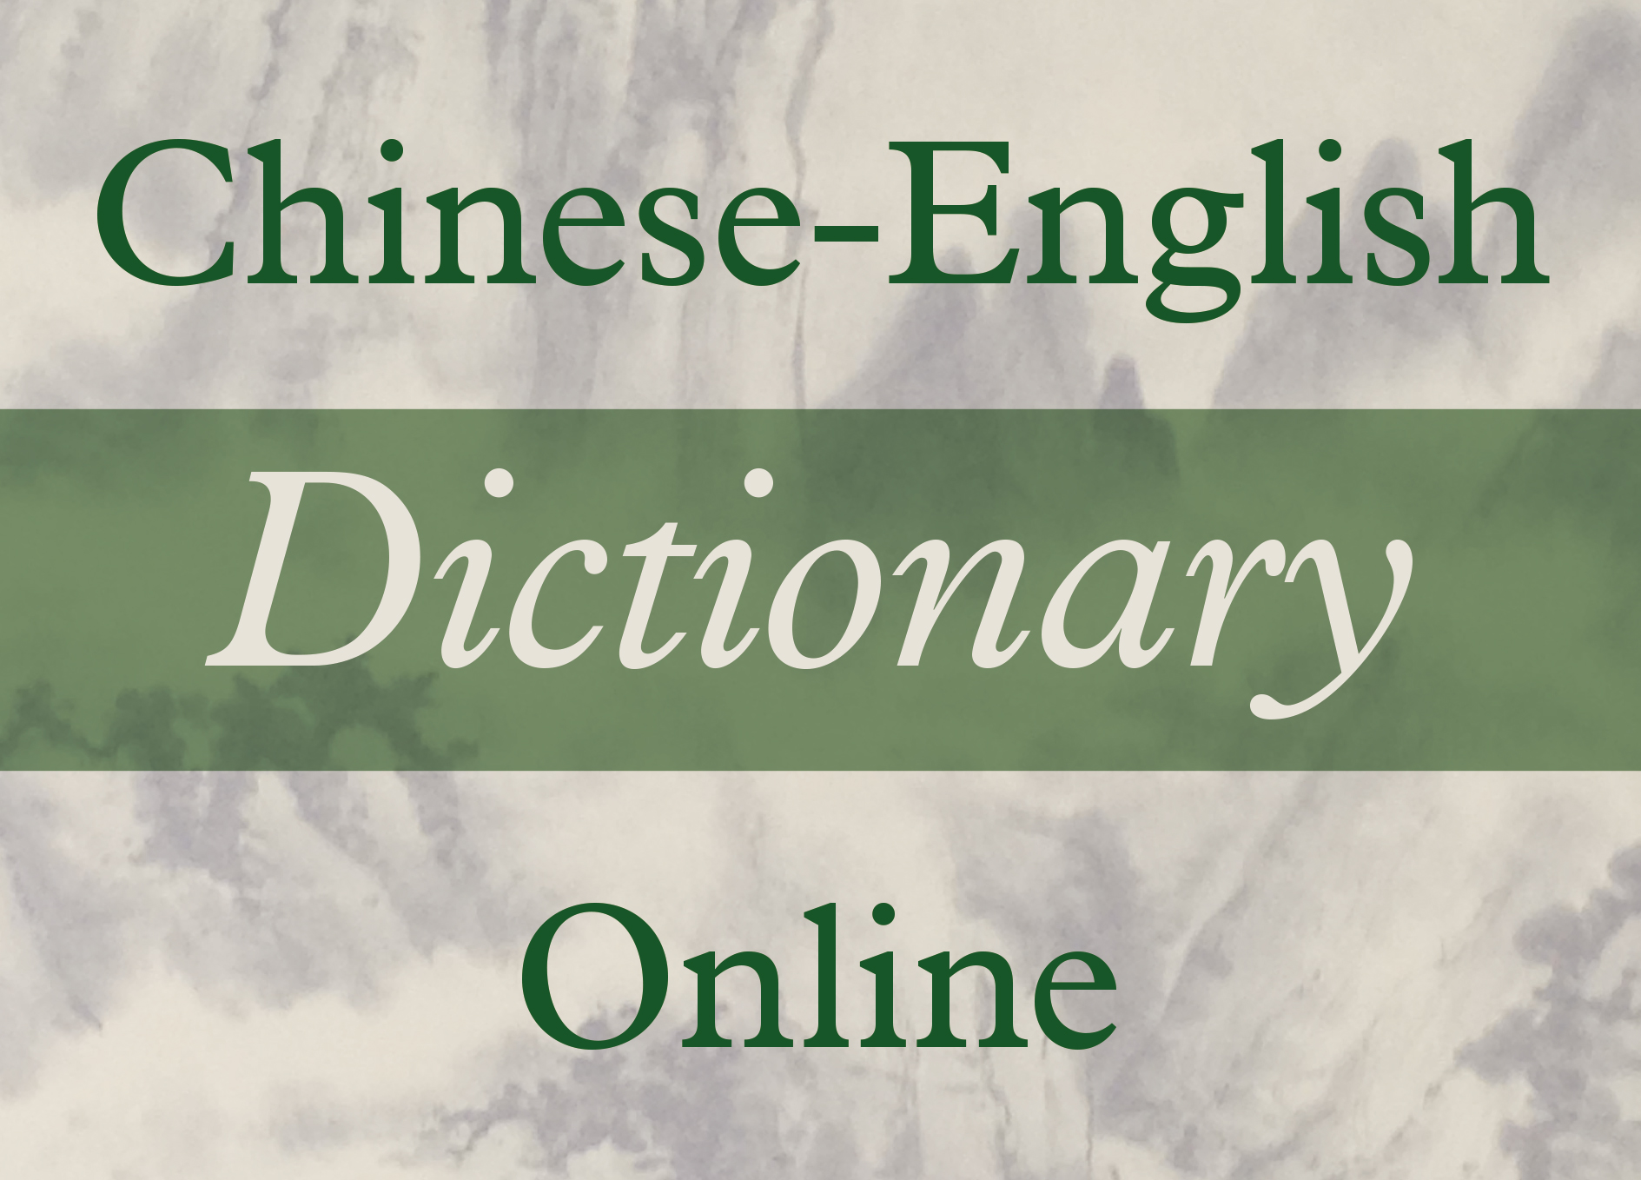
Chinese-English Dictionary Online
Chinese – English reference work for all those reading texts dating from the Warring States period through the Tang dynasty, and beyond
Online version of Kroll’s A Student's Dictionary of Classical and Medieval Chinese Online
Arranged alphabetically by Pinyin romanization
Extensive search options, including search by using Chinese characters

Slide 4
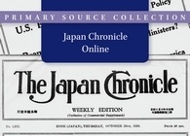
Japan Chronicle Online LEAVE OUT ?
The English-language Japan Chronicle Weekly (1902–1940) provides a unique perspective not only on the settler communities in Japan and East Asia but also to the historical development of East Asia as it happened. Includes access to the weekly Commercial Supplement.
Online edition available exclusively from Brill
Advisor: Peter O’Connor (affiliated with an institution ??)
Full text searchable
Ability to combine search with related primary source collections from East Asian Archive

Slide 5
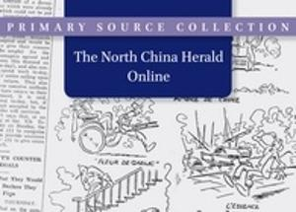
North China Herald Online
The English-language North China Herald is the prime printed source in any language for the history of the foreign presence in China from around 1850 to 1940s.
Advisor: Prof. Dr. Robert Bickers, University of Bristol, UK
Full Text searchable
Online demo and interview with Prof. Bickers available at youtube.com/brillpublishing

Slide 6
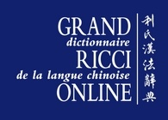
Le Grand Ricci Online
The most comprehensive, up-to-date dictionary of Chinese into a modern Western language. Though it covers the whole history of Chinese language development, most of the dictionary deals with early and imperial period Chinese language usage. Explanations and translations are in French. Special rates available to Couperin members.
“Le Grand Ricci has established itself as an indispensable reference tool. Now available online, and easily searchable, its functionality has only further increased. It is difficult to imagine any scholar in Chinese studies who will not eagerly welcome this new digital incarnation of the Le Grand Ricci.’” Wilt L. Idema. Research Professor of Chinese Literature, Harvard University
Entries can be looked up: - by Chinese character - by romanization (pinyin) with or without tones - by radical (Kangxi or simplified) and the number of additional strokes - by total number of strokes (of the simplified or traditional forms)

Slide 7
For more information and free trials
Free 30 day trials are available
Please contact sales@brill.com
www.brill.com

