Slide 1

New Chinese Studies Resources
from East View
Uncommon Information
Extraordinary Places

Slide 2
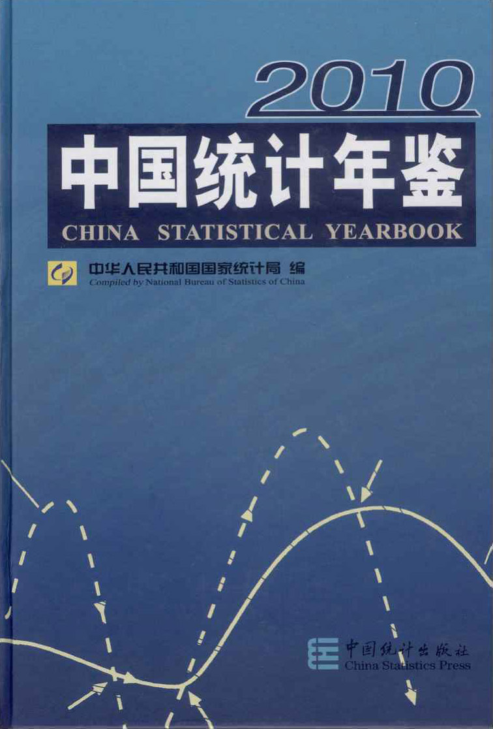
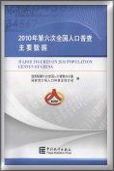
China National Knowledge Infrastructure
China Statistical Yearbooks Database
National Population Census of China

Slide 3
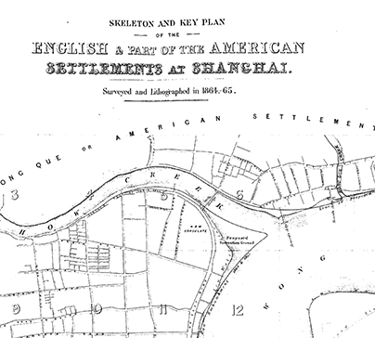
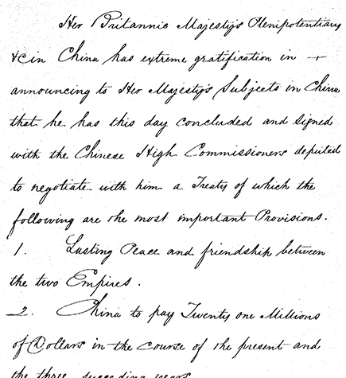
Cambridge Archive Editions: East & Southeast Asia

Slide 4
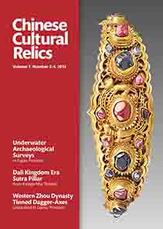


Chinese Cultural Relics

Slide 5

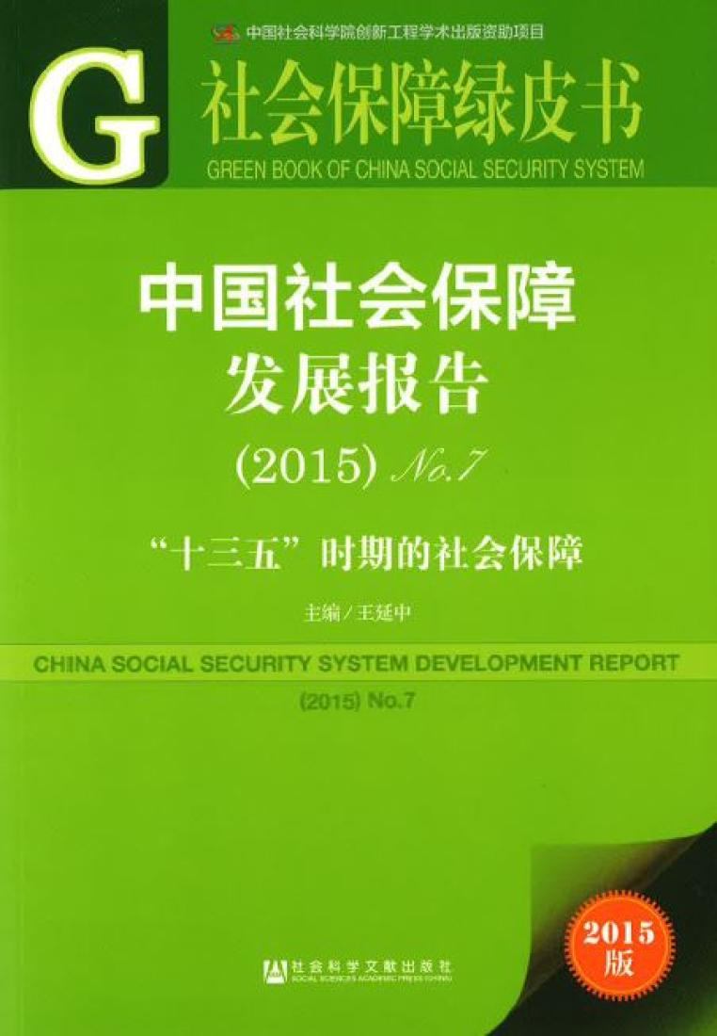
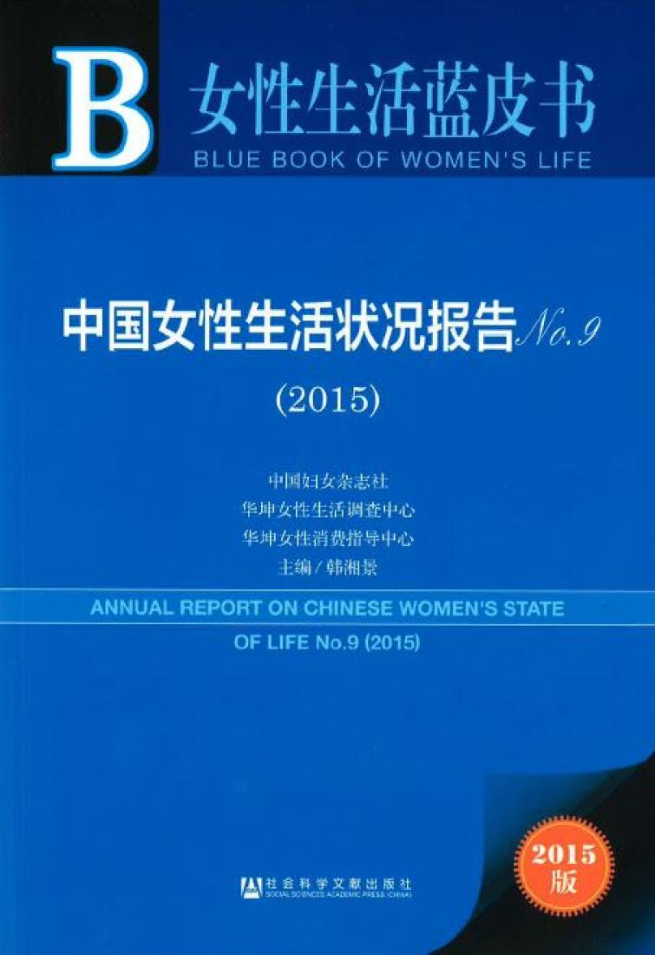
China Economy, Public Policy, and Security Database (Pishu)

Slide 6

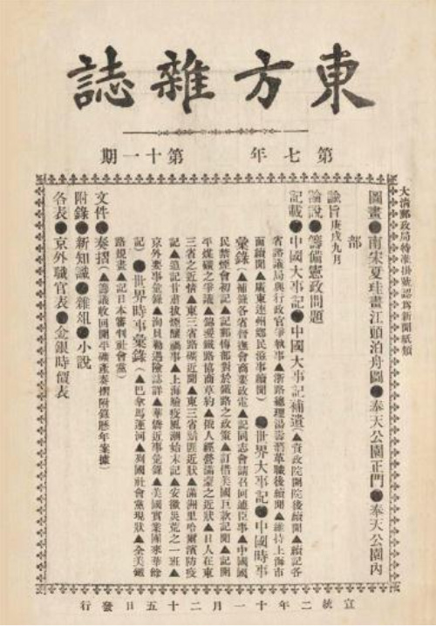

The Eastern Miscellany

Slide 7

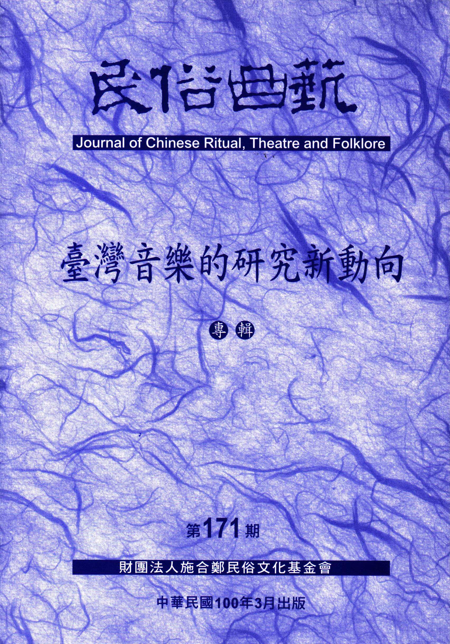

Sinica Sinoweb from Academia Sinica

