Slide 1
New Data & New Services Xiaosen Wang China Data Center University of Michigan xiaosenw@umich.edu

Slide 2
About China Data Center
Established in 1997
Hosted by the Institute of Social
Research (ISR & ICPSR) of the University of Michigan
The primary data source for China studies outside of China
The central place for the distribution of many comprehensive and unique China data products and services, including statistics, census data and spatial data
Serving more than 200 institutional memberships (university libraries) across the world
Offering online data services in English and Chinese

Slide 3
The Unique China Data Products
GIS Based China Spatial Data:
2000/2010 China Township Population Census Data with GIS Maps
2000/2010 China County Population Census Data with GIS Maps
2000/2010 China Province Population Census Data with GIS Maps
2000/2010 China Grid Population Census Data with Township Boundaries
China Historical Province Population Census Data with GIS Maps (1953, 1964, 1982, 1990, 2000)
China Historical County Population Census Data with GIS Maps (1953, 1964, 1982, 1990, 2000)
China 1995 Industrial Census Data with GIS Maps
China 2001 Basic Unit Census Data with GIS Maps
China 2004 Economic Census Data with GIS Maps
China 2008 Economic Census Data with GIS Maps
China City and County Statistical Indicators with Maps (1996-)

Slide 4
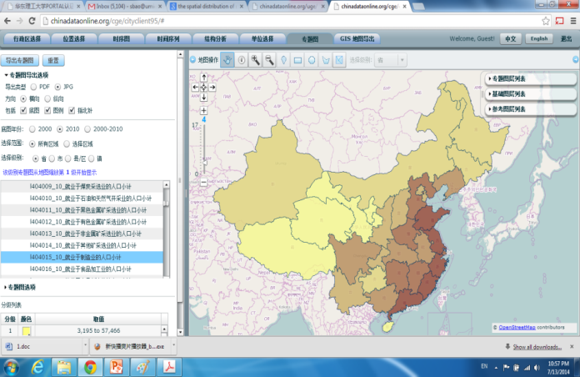
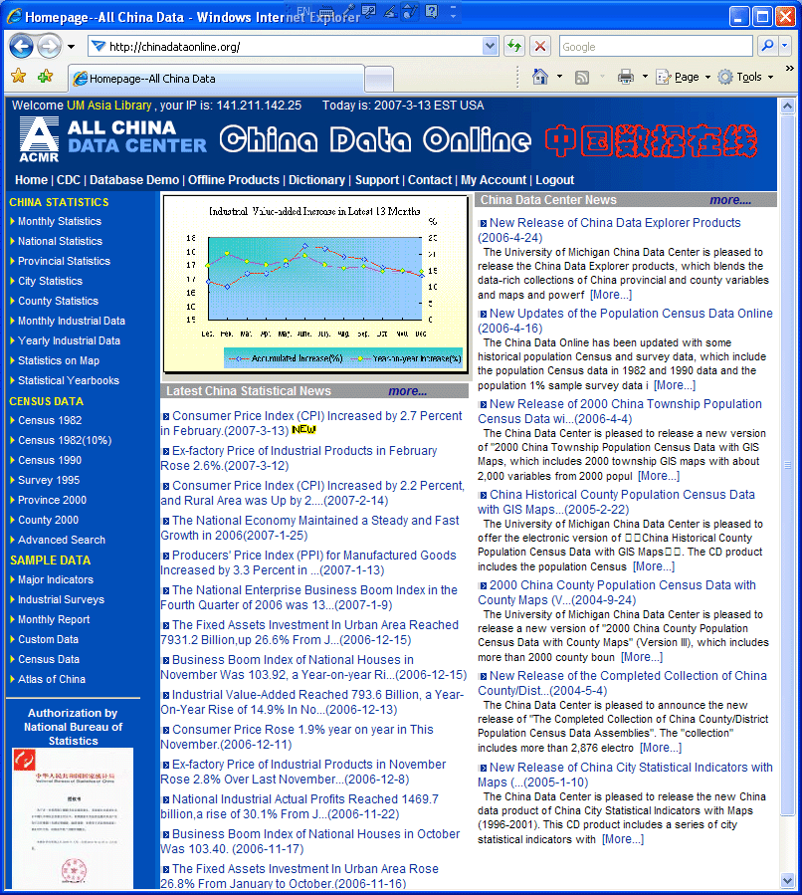
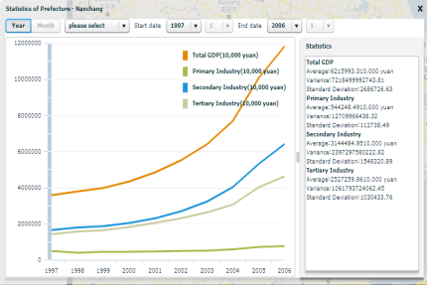
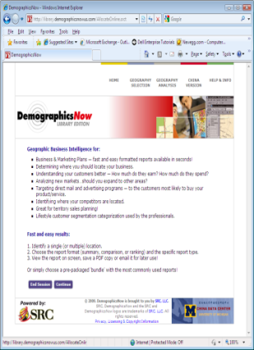
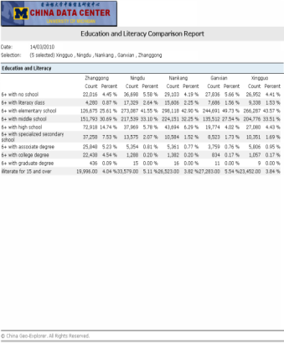
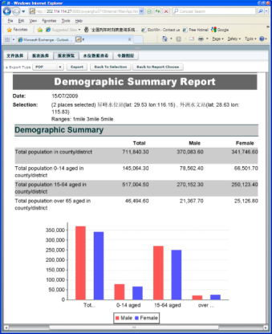
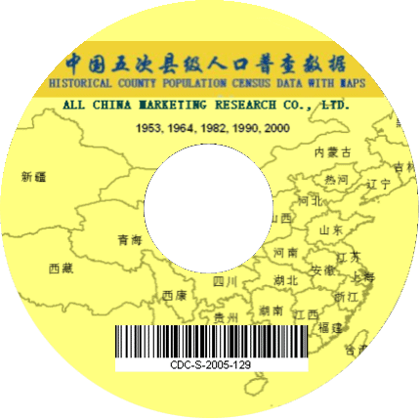
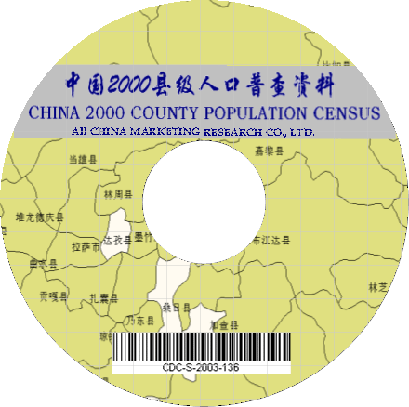
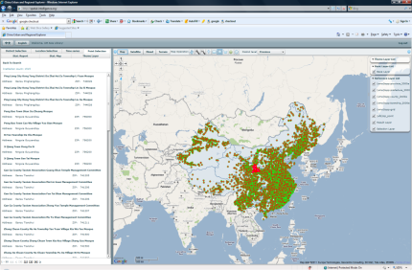
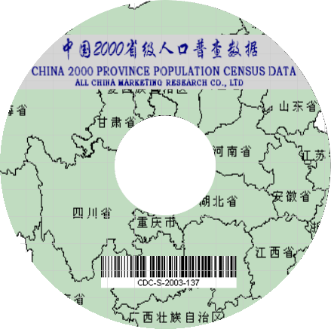
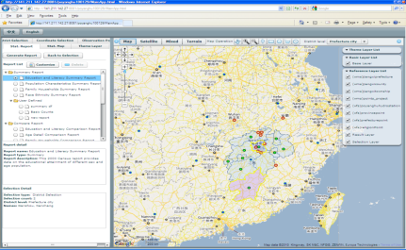
China Geo-Explorer An Integration of Spatial Data and Analysis for China Studies
Statistics
Data
Charts
Output
Tables
Government Statistics
Provincial Statistics (1949 - )
City Statistics (1996 - )
County Statistics (1997 - )
Population Census
Census 53/64/82/90/00/10 (GRID)
Census 2000/2010 (province, city, county, township)
Economic Census
Industrial Census 1995 (province, city, county, ZIP)
Basic Unit Census 2001 (province, city, county, ZIP)
Economic Census 2004/2008 (province, city, county, ZIP)
Establishments (individual companies and orgs)
Industrial Census(1995)
Basic Unit Census (2001)
Economic Census (2004/2008)
Geography and Environment
Land Use data (GRID)
Night-Time data (GRID)
Transportation (railway, highway, roads)
Rivers and Lakes
….
Reports
Census
GIS
Maps

Slide 5
US Data Service-US Geo-Explorer
Data Sources (Licensed data from business information providers):
Applied Geographic Solutions, Inc. (“AGS” - www.appliedgeographic.com)
InfoGroup, Inc. (www.infogroup.com)
Data Coverage:
Population Census (State, County, Tract, Block, Metropolitan, CCD, Place)
Census 1970, 1980, 1990, 2000, 2010
American Community Survey
Economic Census (State, County, Metropolitan)
Annual Census reports from 1986 to current
Business Establishments (individual companies and organizations)
More than 13 million firm level records for 2013 (85 fields)
Aggregated data tables by State, County, Tract, Block, Metropolitan, CCD, Place, ZIP (1997-2013)

Slide 6
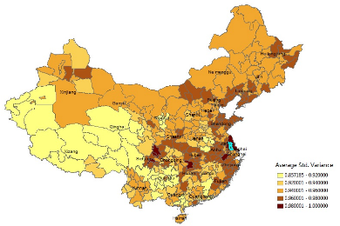
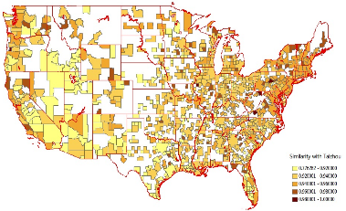
Features of China and US Geo-Explorers
Comparable:
Comparable data from different sources (years)
Comparable data for different regions
Comparable data for the US and China
Flexible:
Flexible functions for data selection
Flexible formats for data export (Excel, HTM, Word, PDF, GIS shape file)
Flexible outputs of tables, reports, charts, and maps
Unlimited:
Unlimited data access
Unlimited new data sets generated from limited databases
Unlimited outputs (reports, charts, maps and tables)
Easy:
No professional training is required for using the explorers
No GIS skills is required for spatial analysis and mapping

Slide 7
Explore the Largest Map Collection:
Chinese Map Library
Maps:
Province maps: 7,000
Prefecture city maps (31*7,000): 217,000
County maps (345*7000): 2,415,000
Township maps (2876*2100): 6,039,600
Total number of maps: 8,678,600
Export:
Map in PDF or JPG
Data in Excel or CSV(Comma-Separated Values)
Browse and Search:
By categories
By administrative regions (province, city, county and town)
By data sources
By year

Slide 8
The Online Chinese Map Library

Slide 9
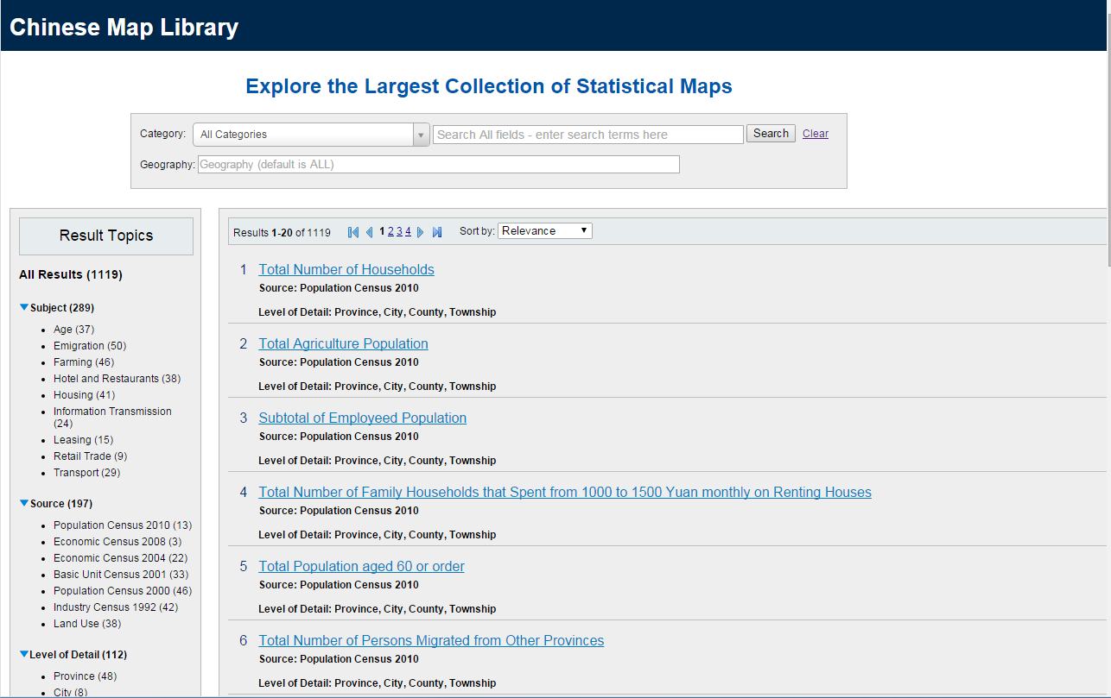
The Online Chinese Map Library

Slide 10
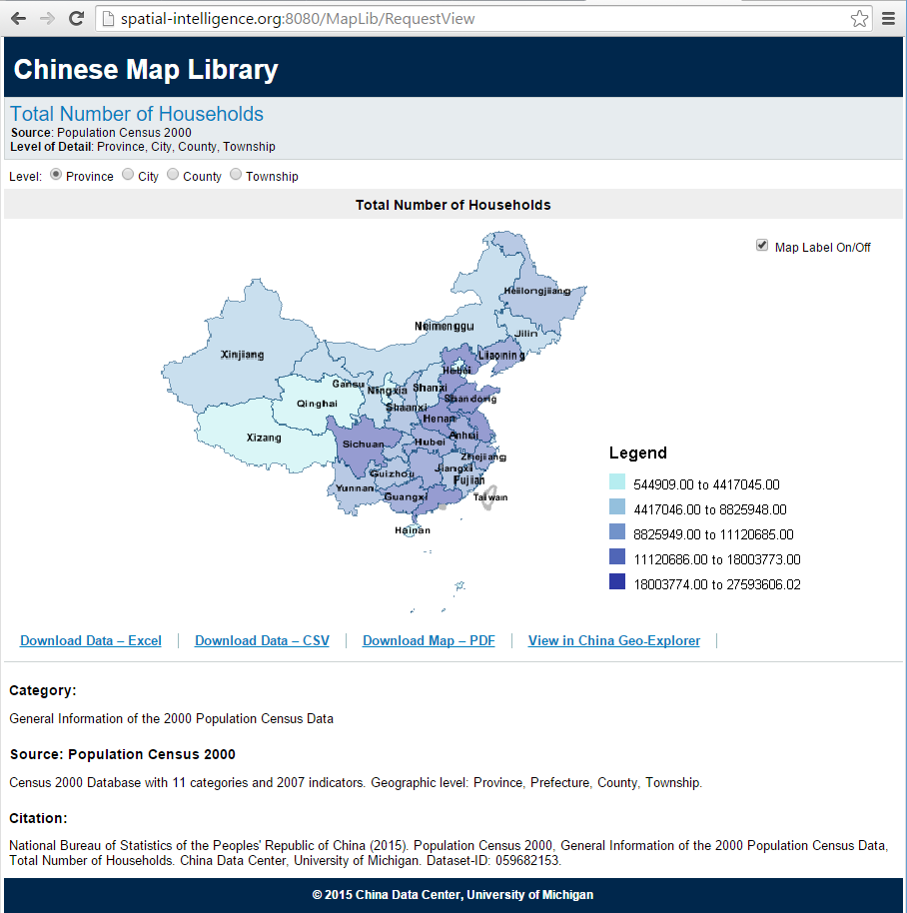
The Online Chinese Map Library

Slide 11
To Apply for a Trial:
China Data Center
University of Michigan
Chinadata@umich.edu
(734)647-9610
http://chinadataonline.org

