Slide 1
Unique Digital Primary Source Collections for Exploring Chinese History
Tom Derrick
Senior Collections Analyst
www.amdigital.co.uk

Slide 2
Global customer base including leading institutions
Over 70 resources with cross disciplinary appeal
Dedicated resources on Chinese history
Notes:
Used by customers around the world, including many leading institutions such as Ivy league schools, Oxford and Cambridge, to name but a few.
Large portfolio of collections - Covering more than 5 centuries.
Products ranging from Medieval Family Life to American trade with China and 20th century Popular Culture
Dedicated resources on Chinese cultural, social and political history
Today two most recently published resources on Chinese history, FO China and China, America and the Pacific.

Slide 3
Notes:
FO China part of Archives Direct portal – self-contained collections sourced exclusively from TNA
Describe homepage – cross-search or enter each collection

Slide 4
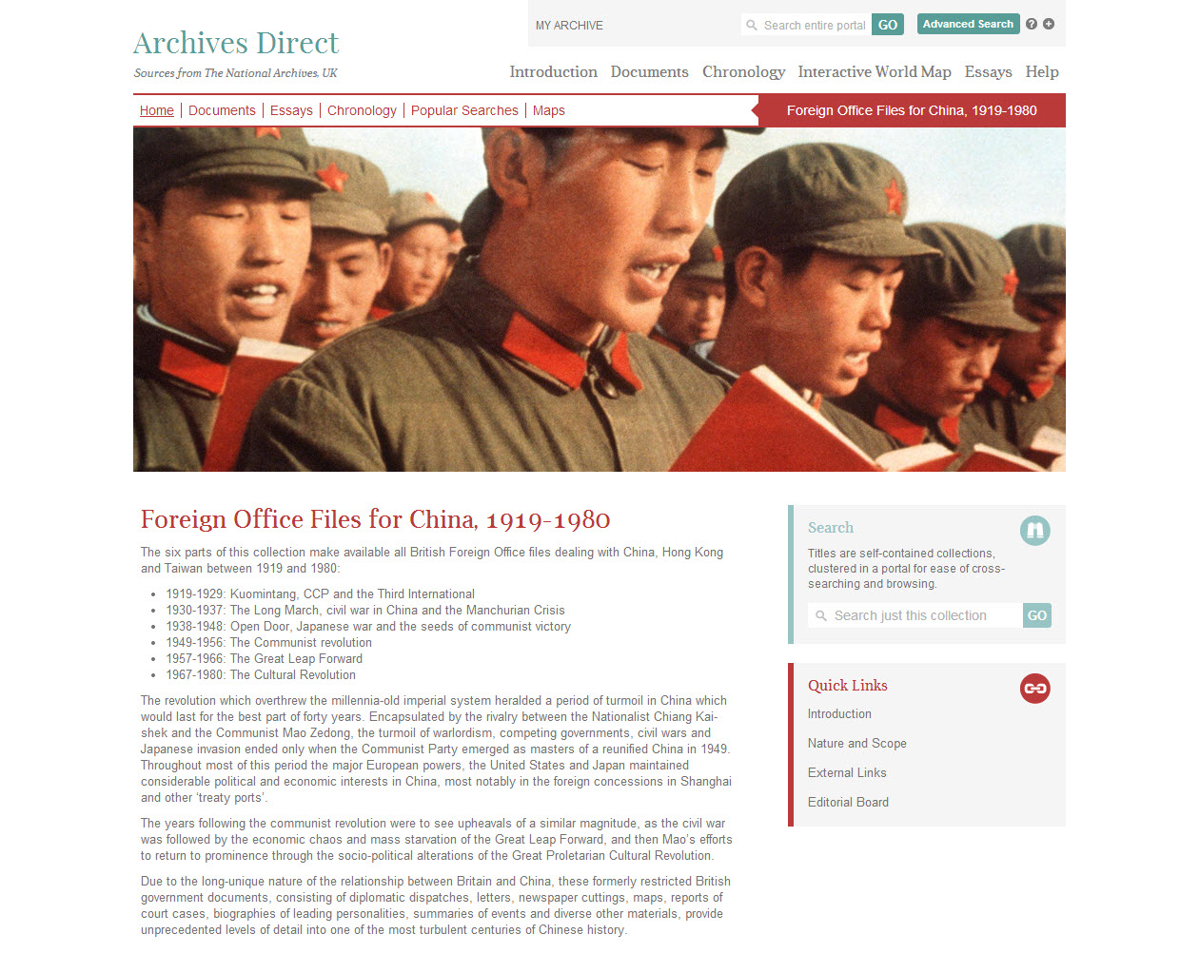
Notes:
Makes available all British Foreign Office files on China, Taiwan and Hong Kong between 1919 and 1980
Published over several years. The material covers key events throughout Chinese history:
> May 4th movement and subsequent power struggle between Kuomintang and Communist
> long march
> war with the Japanese in the 1940s and detailing the communist revolution.
> 1950s documenting the newly developed People’s Republic
> great leap forward and cultural revolution
Serious research tool for scholars of English language material on China
Explain page options

Slide 5
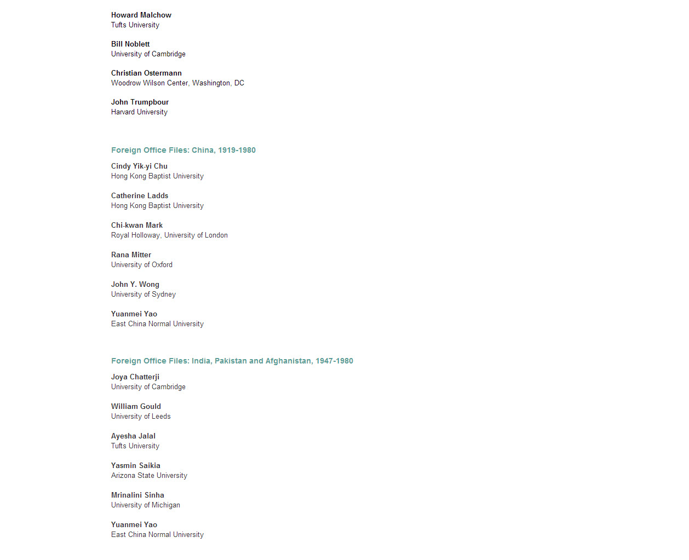
Notes:
Editorial board of leading scholars in Chinese studies helped write essays which contextualise the primary source content
Accessed within the resource and link to documentary evidence
Great starting point for users who want an expert summary of key themes covered by the material.

Slide 6
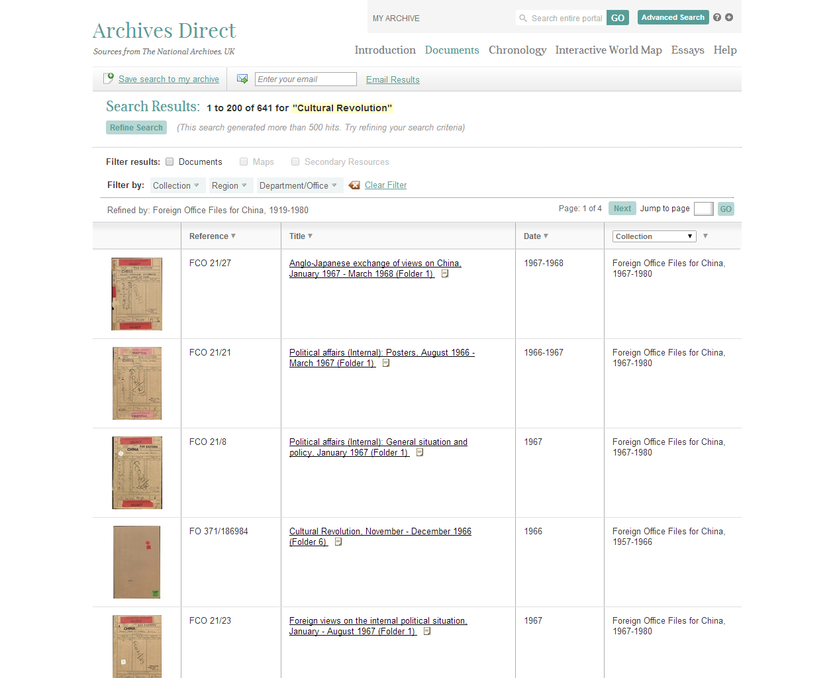
Notes:
All documents are full-text searchable
Formerly restricted government documents. Varied, consisting for the most part of:
British diplomatic dispatches, originating in both London and China
Correspondence, both government and private
Minutes of meetings
Political, economic and military analyses
Reports of visits, investigations etc
Many files in the later period are single topic.
Most files prior to 1930 by contrast, cover a number of unconnected topics, which are listed in the document’s title.
Describe page functionality

Slide 7
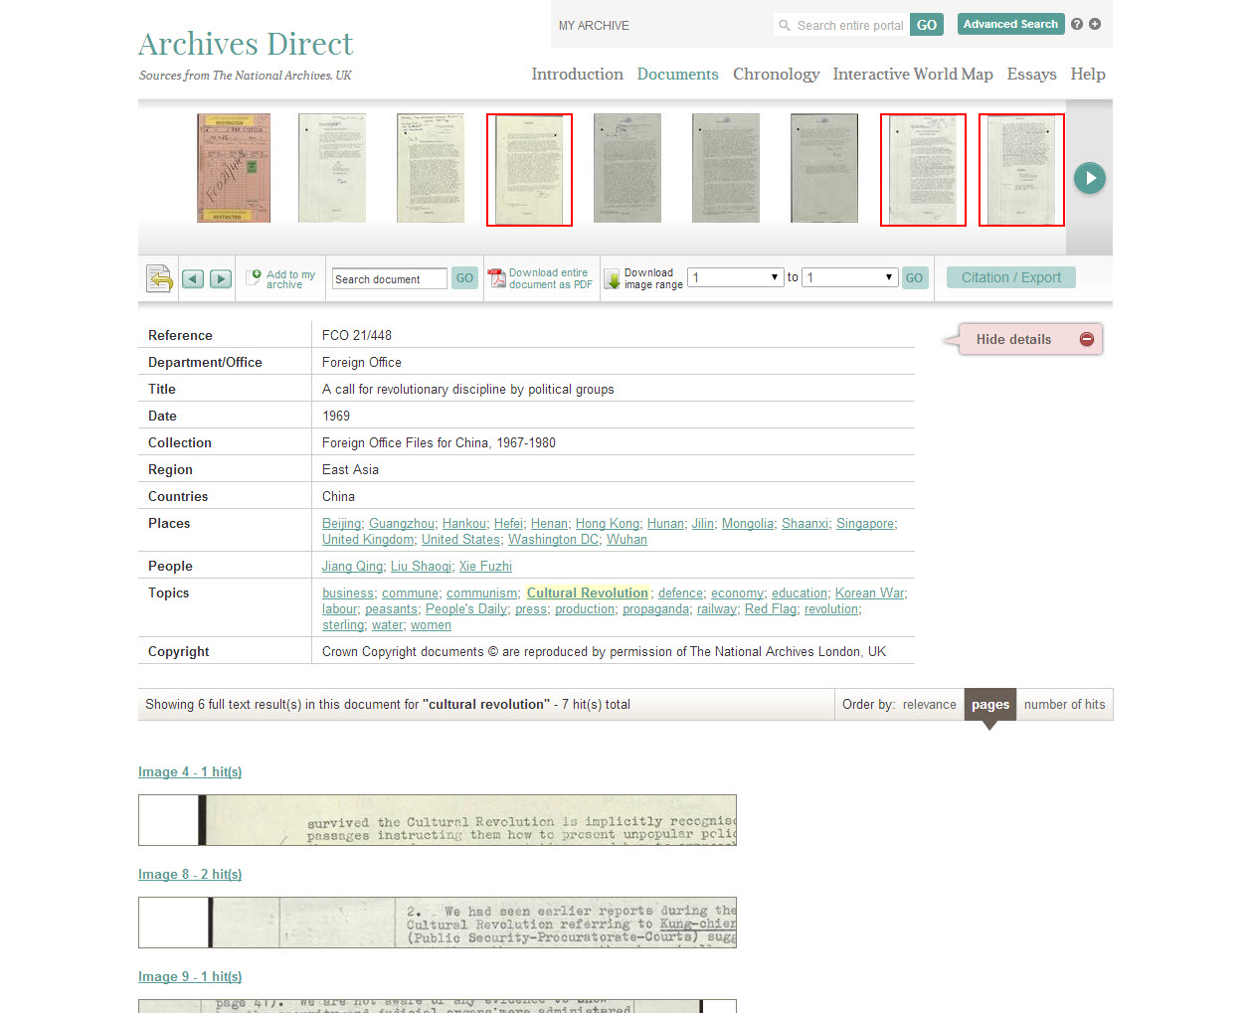
Notes:
Consultant Editors helped define key metadata terms
Rich metadata
Report discusses centralising of military control by Mao of public security functions and the courts and their support of proletarian red guard revolutionaries
Describe page functions

Slide 8
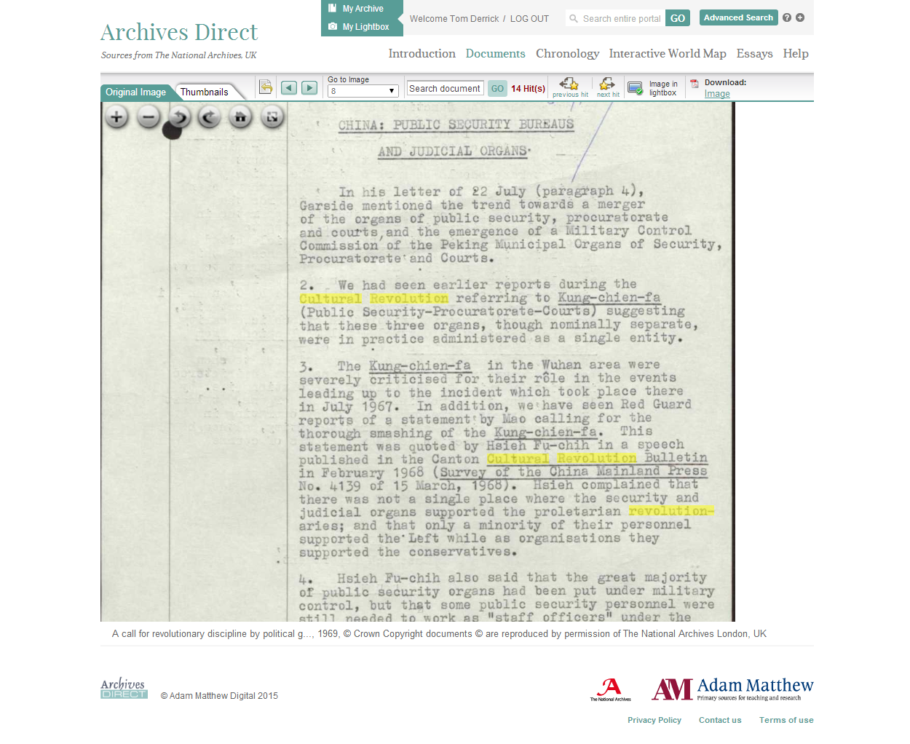
Notes:
Search term highlighted.

Slide 9
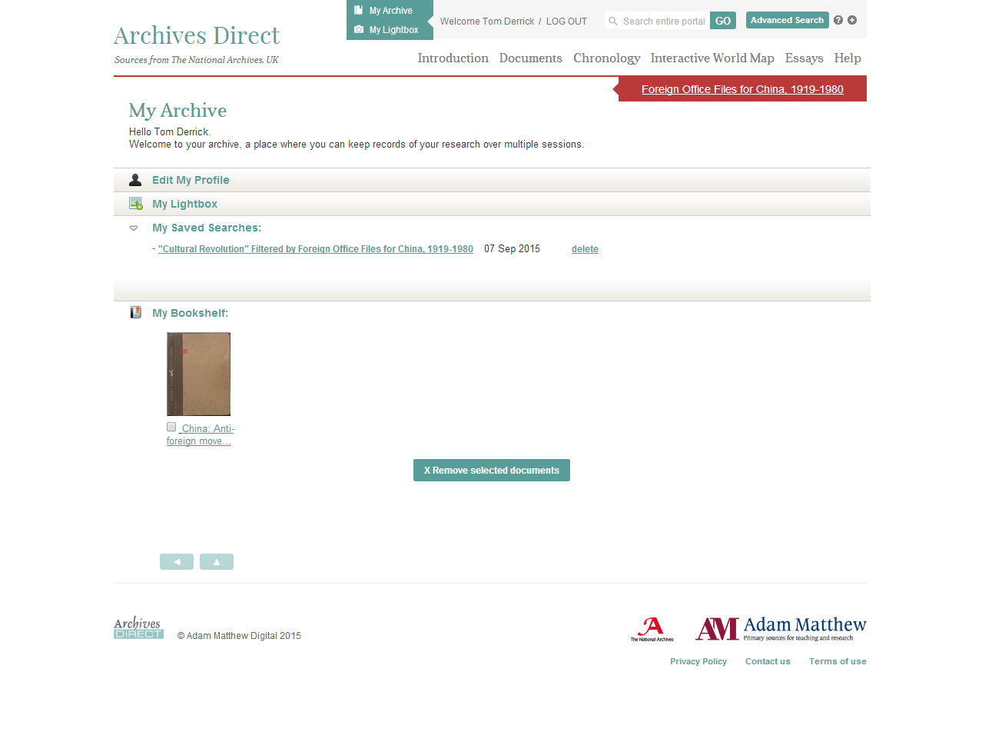
Notes:
Describe functionalities

Slide 10
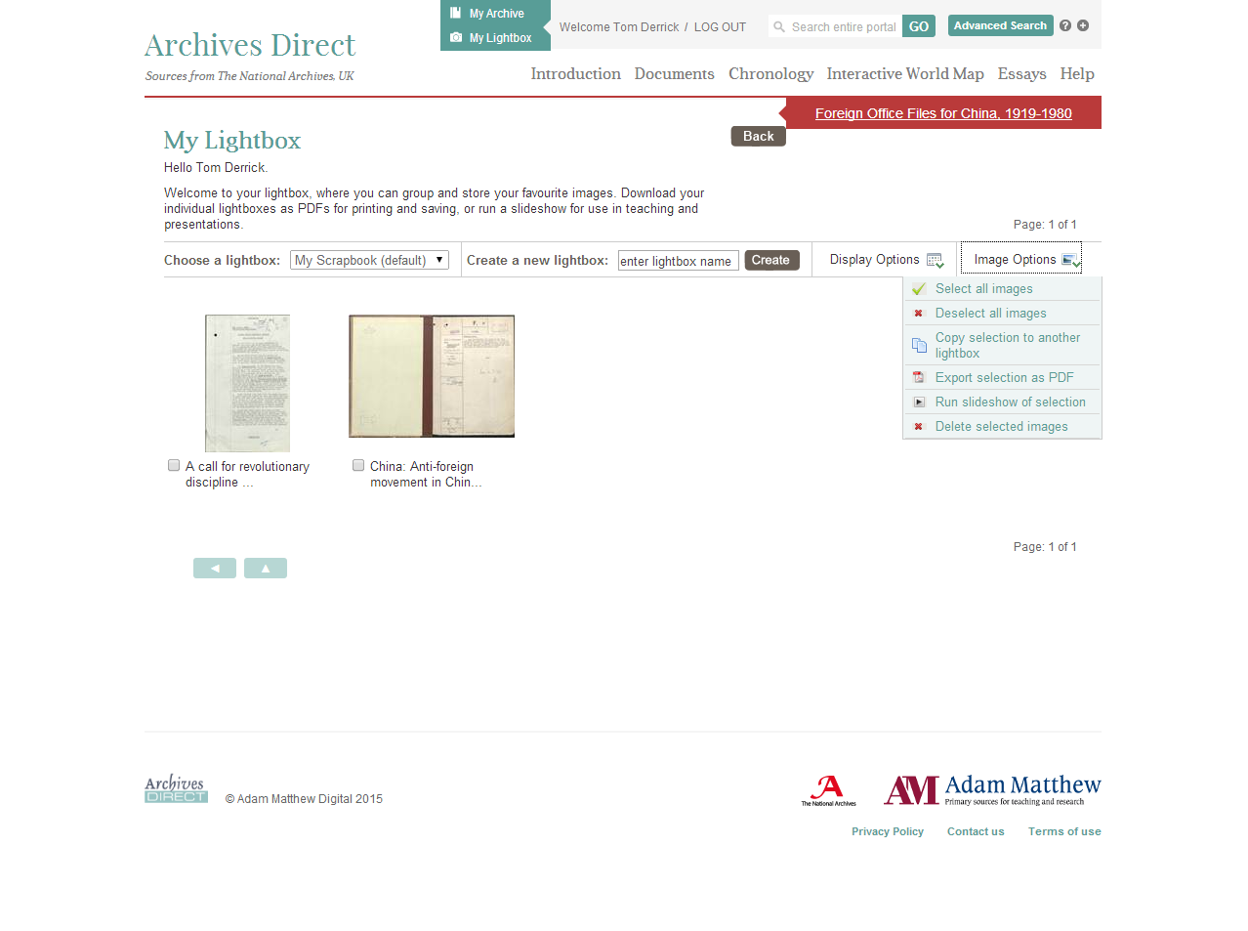
Notes:
Describe

Slide 11
Three thematic resources on Chinese history
China: Trade, Politics and Culture, 1793-1980
Sources from SOAS and British Library
China, Culture and Society
Sources from the Wason Pamphlet collection at Cornell University
China, America and the Pacific
Materials for the study of the history of North American trade and cultural exchange with China

Slide 12
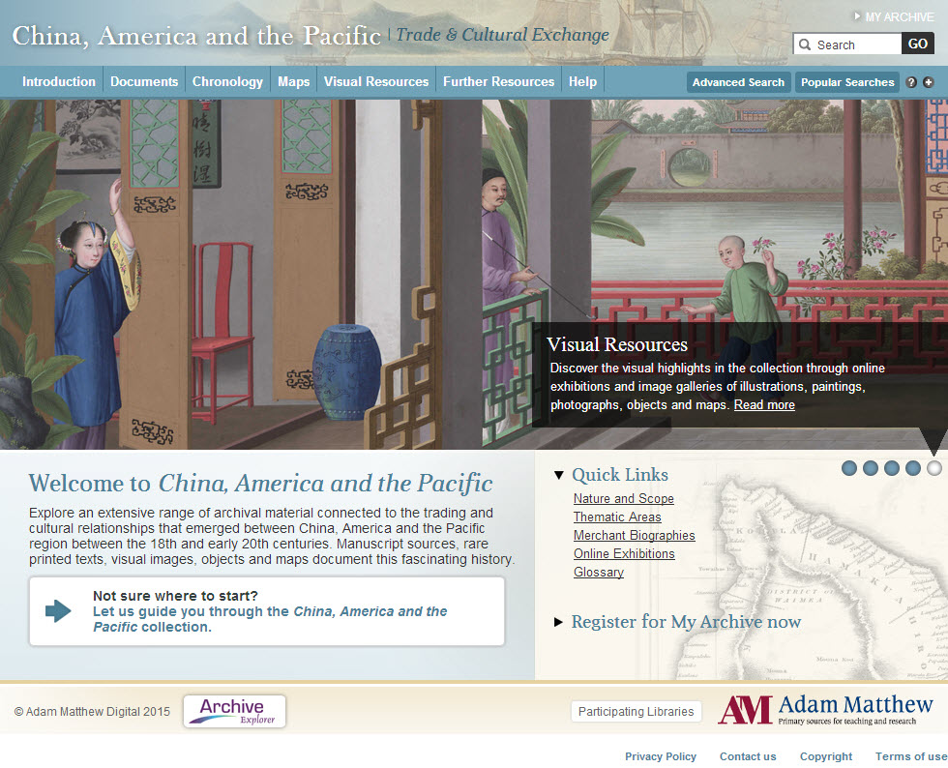

Slide 13
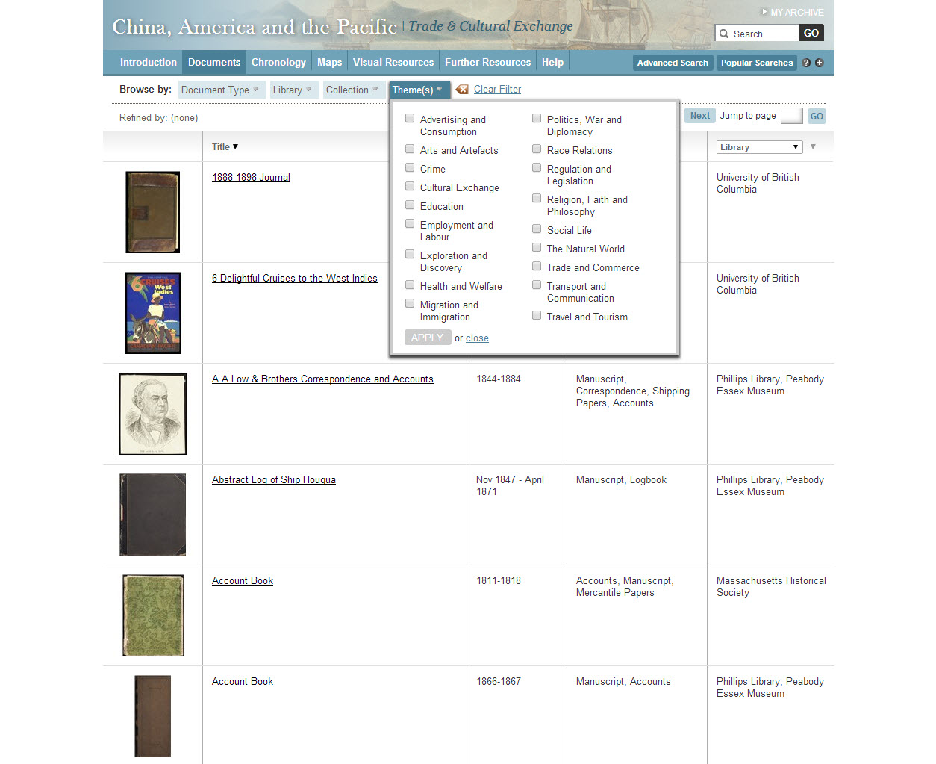
Notes:
China, America and the Pacific includes some of the strongest collections on the subject of the ‘Old China Trade’, including:
Thematically broad – can refine documents by theme

Slide 14
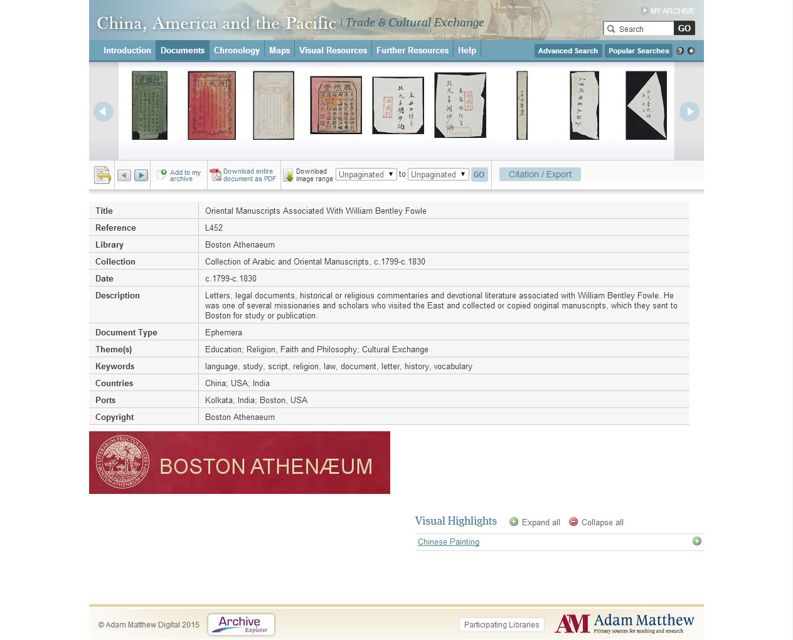
Notes:
Collection of letters, legal documents and other religious literature
Collected by the missionary William Bentley Fowle and sent to Boston for study or publication.

Slide 16
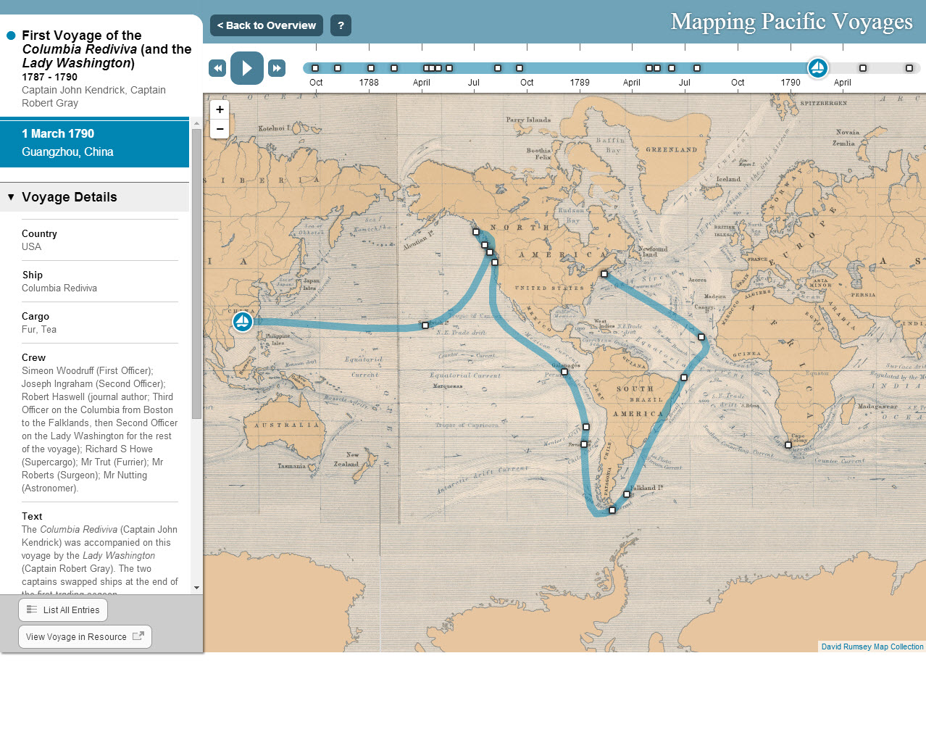
Notes:
Great contextual tools
Plots routes of early traders using data from the ship logs and journals that feature in the resource
Cross-section of the many hundreds of voyages that took place between 1787 and 1863
Playback tool allows users to see video of the voyages
A very interactive and engaging way to explore the routes that were undertaken. Links into the log or journal within the resource

Slide 17
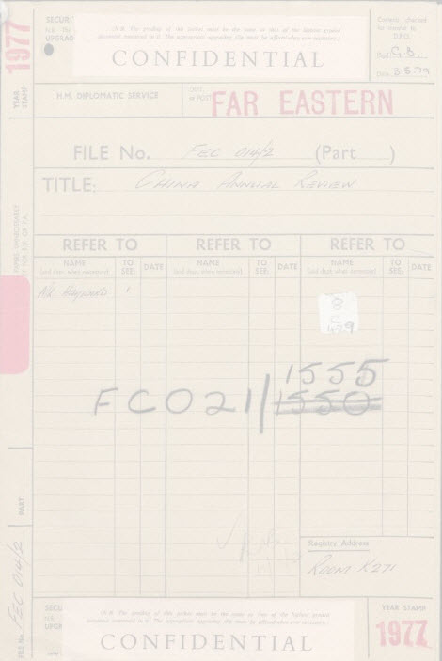
"This will be an excellent collection, which covers not only British experience of China’s massive domestic issues, such as the conflict between the Kuomintang and the Communist Party, but also the external relations of China with other countries. This resource will be a great aid to understanding the real China.”
Yuanmei Yao
School of Advanced International and Area Studies
East China Normal University, Shanghai
www.amdigital.co.uk | info@amdigital.co.uk | @AdamMatthewGrp

