Slide 1
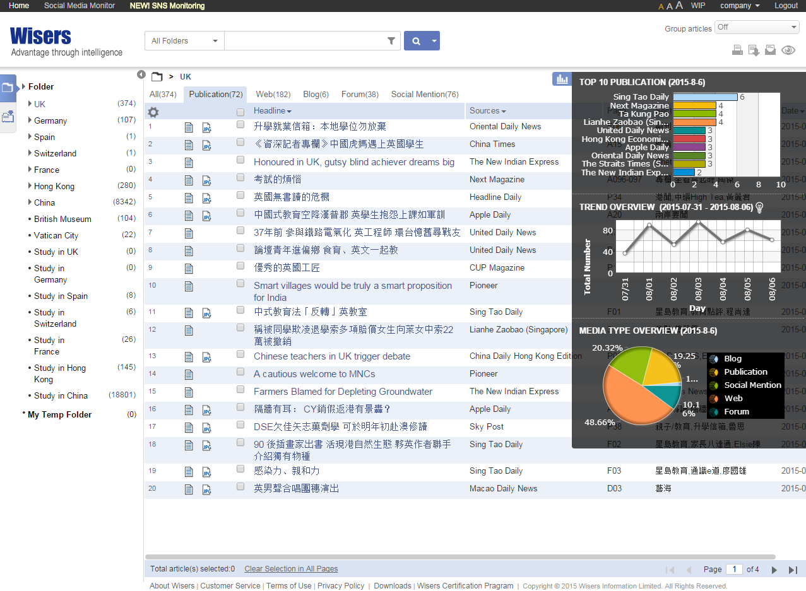
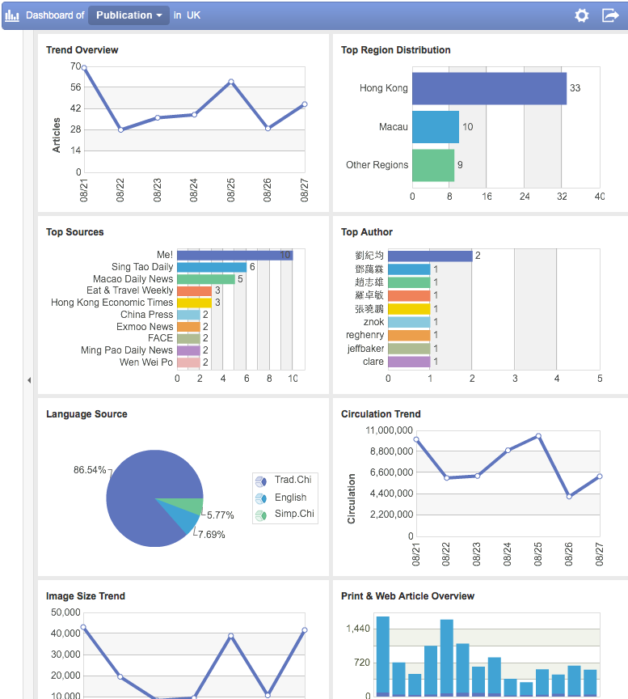
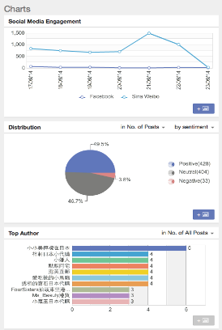
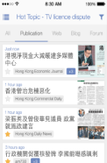
The Greater China Information Gateway
Presented by:
Denise Che
Chief Executive Officer
Wisers Information Limited
11th September, 2015

Slide 2
Wisers is DATA-POWERED
2.1 Billion
3.5 Million
12,000+
sources of news & information
new items per day in average
items archive dating back to 1979
Originated since 1992 from Chinese University of Hong Kong
Established in 1998
World’s leader in Chinese media and marketing intelligence
Coverage throughout Greater China, and all over the world
Notes:
Wisers help researches to uncover valuable insights across all media types, including online, social, print & broadcast media

Slide 3
Academic Clients
Library of Congress
Asian Division
State Library, Berlin
East Asia Department
University of Hong Kong
Library
Chinese University of Hong Kong
Faculty of Medicine
Hong Kong University of Technology and Science
Faculty of Business
Oxford University
Library
Cambridge University
Development Office
Princeton University
Library, Asian Studies
University of California
Library, Chinese Studies
Florida International University
International Economic Studies
Duke University
School of Business
Nanyang Technological University, Singapore
Library, Faculty of Engineering

Slide 4
How Wisers Makes a Difference
Difficulties
Regional perspective
Single platform
Total archive
Public opinion on social medial platform from one source
Full digital historical data
Locate regional information sources
Searching through different platforms and engines
Consolidating fragmentized information
Browsing randomly on various social media
Reading old physical articles

Slide 5
Social Media
Public opinions
Social impacts
Website
Live news
Independent media
2011
2008
Magazine
Cover stories
Analysis
2007
2000
Print Ad
Strategies
Media spending
Newspaper
Editorials
News covers
1998
Broadcast
Video and audio clips
Visual facts
News Agency
Press release
Official announcements

Slide 6
Case Sharing
“A social science researcher needs media
sources of recent RMB depreciation in greater
China region for comparative analysis.”

Slide 7
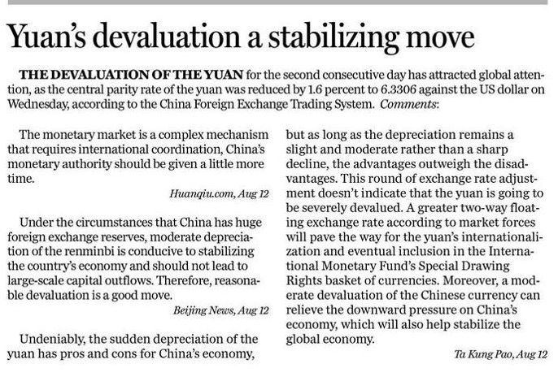
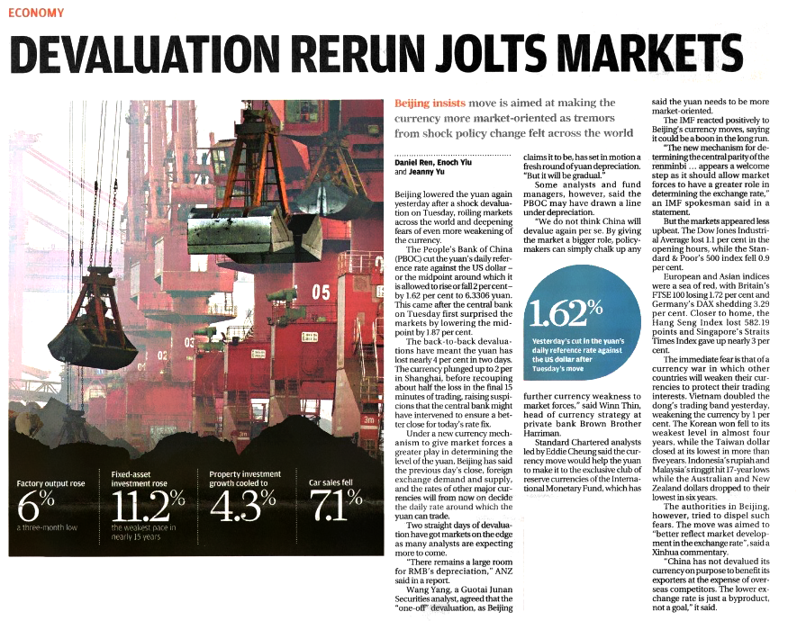
News Comparison from
13th August, 2015
China Daily
The first and unique international English newspaper in China
13th August, 2015
South China Morning Posting
Hong Kong’s premier reputable English newspaper
13th August, 2015
The Sun
One of the most famous local Chinese newspaper in Hong Kong

Slide 8
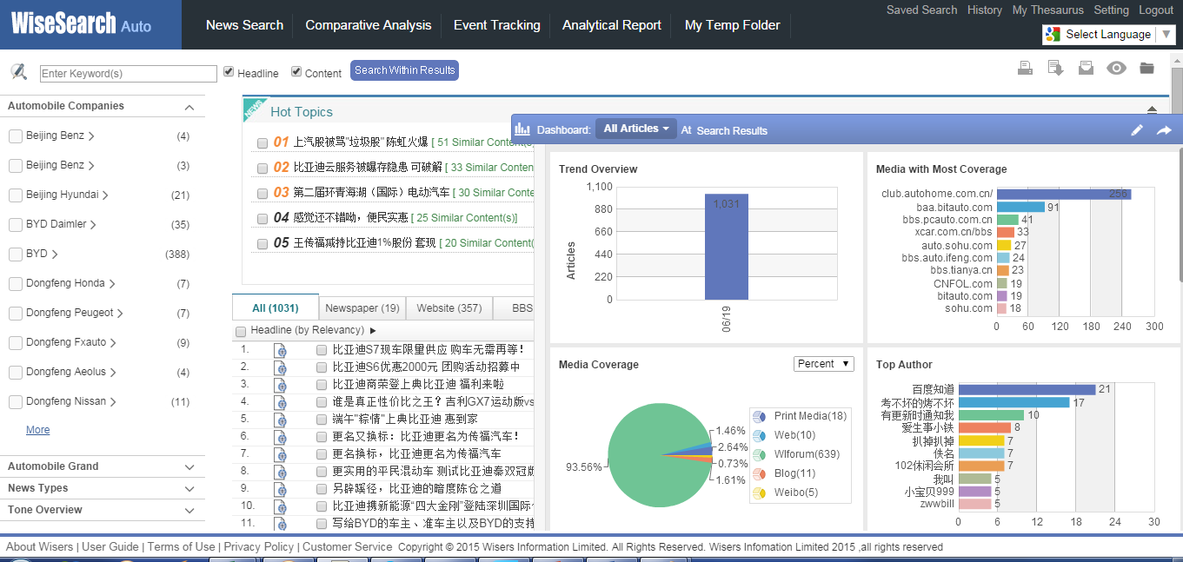
Wise Search for Vertical Industries
A Great Research Tool with Specific Industry Focus
Comprehensive & Classified Industry News
Efficient & Powerful News Search
Agile Comparative Analysis
Real Time Event Tracking
Deep Integrated Industry Report

Slide 9
Wise Search for Vertical Industries
A Great Research Tool with Specific Industry Focus
Covering 6 main industries in the region
Extensive Industrial Coverage
Media Coverage per industry
Up to
150+ Companies
900+ Models
For each covered industries
Up to
800+ Printed media
110+ Websites
Automobile
Medical
Luxury
Food & Beverage
Banking
Insurance
400+ Forums
30+ Blogs/ Sina Weibo
For each covered industries
Agile comparative analysis
Intuitive Search
Industry Report
Companies / Brands / Models
Thesaurus keywords
Specific period
Customized campaign
Side-by-side comparison
Real time event tracking
Deep Integrated Reports

Slide 10
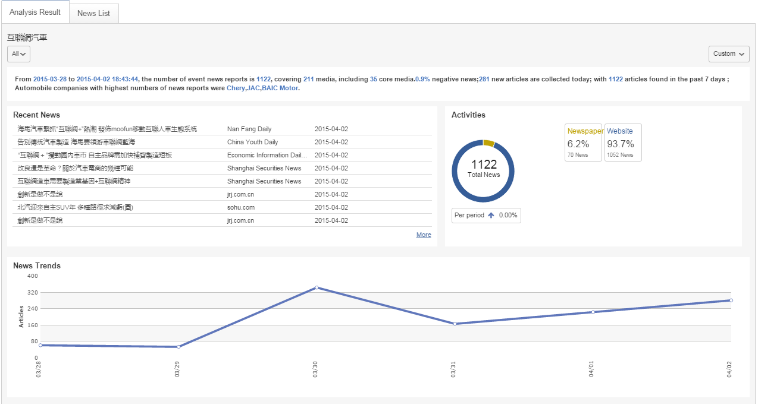
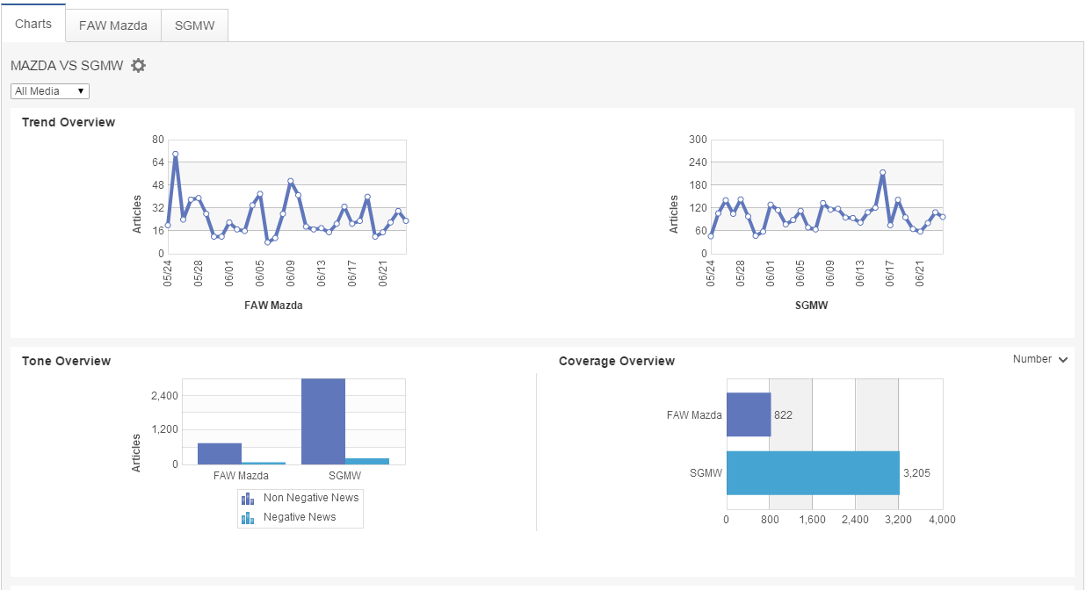
Wise Search for Vertical Industries
A Great Research Tool with Specific Industry Focus
vs

Slide 11
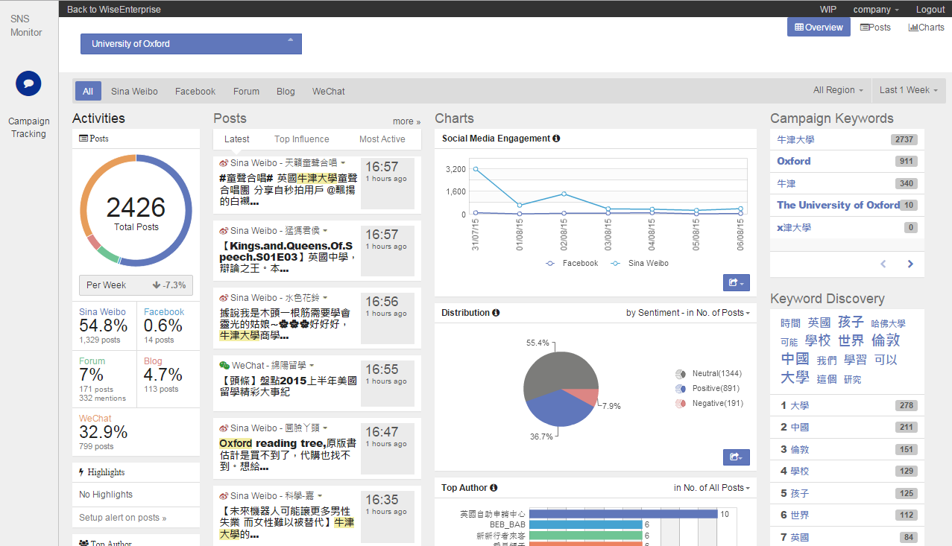
WiseEnterprise
WiseSNS
Intelligent Media Monitoring & Analysis Solution customized for your specific needs
A Social Media Intelligence Solution
Continuous Monitoring platform
Automatic news tracking by folders
Intelligent dashboard in real-time
Well-categorized cross-media result
Flexible DIY Folder
Monitor reputation and public opinions
Accurate sentiment analysis
Auto keyword discovery
1,500+ influential social networks in Greater China, including
FB, Weibo, WeChat…

Slide 12
We Provide
Media & Market Intelligence
Information Database
Industry Solutions
Customised Services
http://www.wisers.com
Copyright @ 2015 Wisers Information Ltd. All rights reserved.

Slide 13
Thank
You
Denise Che
Chief Executive Officer
http://www.wisers.com
Copyright @ 2015 Wisers Information Ltd. All rights reserved.

