Slide 1
East Asia Department of the Staatsbibliothek zu Berlin Digitisation in Berlin and Kraków
(Dr. Cordula Gumbrecht, The Berlin State Library / East Asia Department)

Slide 2
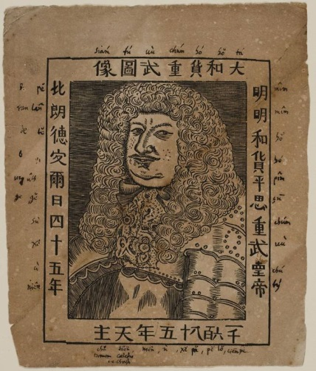
Collecting East Asian books in the Berlin State Library
-collecting East Asian books has
a long tradition in the
Berlin State Library
-since the founding of the
"Churfürstliche Bibliothek zu Berlin” (the Electoral Library of Berlin)350 years ago, Chinese material and later on East Asian (Manjurica, Japonica etc.) have been an important part of the collection
Great Elector Friedrich Wilhelm (1620-1688), 1685

Slide 3
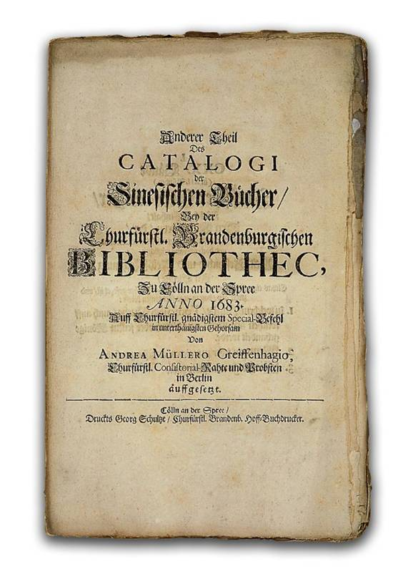
East Asia collection (1) – growing of the collection
1674 – acquisition of Chinese books of Arnold Gijsels van Lier (1593-1676) by Andreas Müller (1630-1694) for the Great Elector
1683 - the first and second catalogue of the Chinese collection (Müller Greiffenhagen, Andreas: Catalogus librorum Sinicorum Bibliothecae Electoralis Brandenburgicae, Anderer Theil Des Catalogi der Sinesischen Bücher) listing 22 and 24 numbers on 1 and 14 folio pages respectively (Zizhi tongjian資治通鑒, Zihui字彙 und Sishu 四書)
First printed catalogue
of the Electoral Library of Berlin, 1683
SBB, Libri sin. 167
Gotha, Digital Historical Library

Slide 4
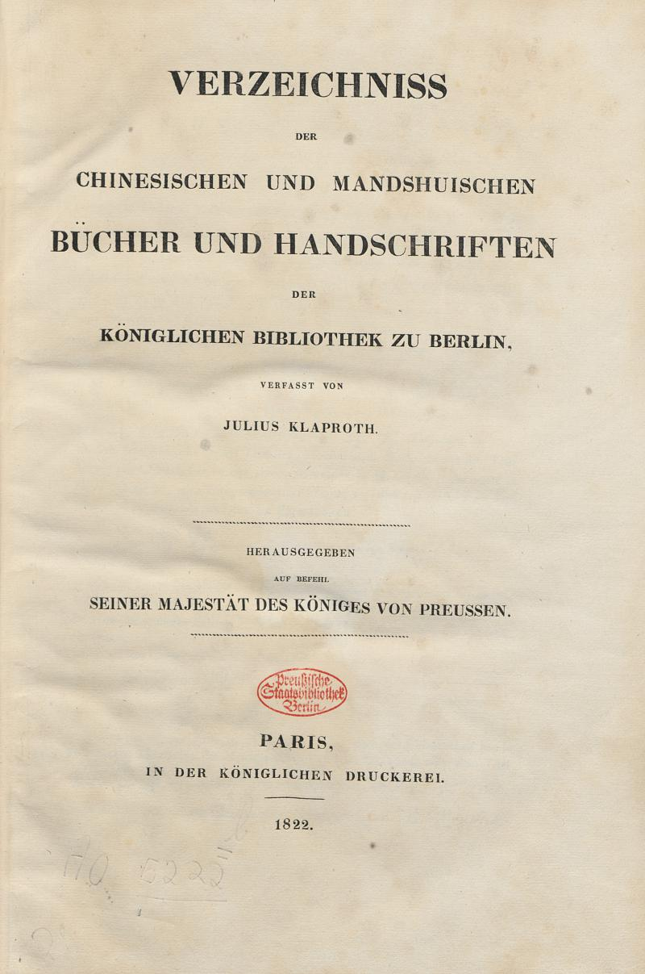
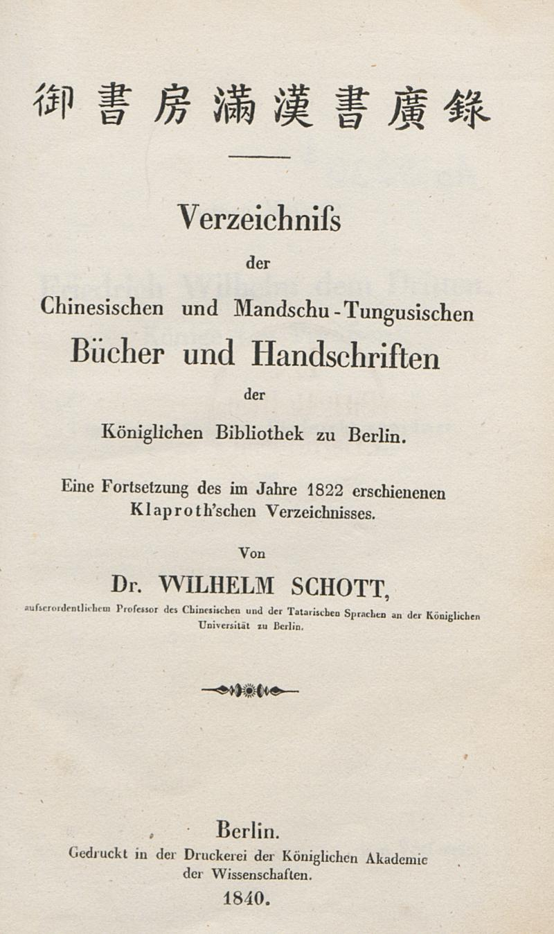
East Asia collection (2) – growing of the collection
1702 – the private collection of Christian Mentzel (1622-1701), the court physician, was integrated into the collection
1810 - Julius Klaproth (1783-1835) sells Chinese books to the library
1822 – Catalogue: Klaproth, Heinrich Julius: Verzeichniss [Verzeichnis] der chinesischen und mandshuischen Bücher und Handschriften der Königlichen Bibliothek zu Berlin.
1832 - Karl Friedrich Neumann’s (1793-1870) collection (bought 1830/31 in Kanton, 2,410 voll.)
1840 - Schott, Wilhelm: Verzeichniss der chinesischen und mandschu-tungusischen Bücher und Handschriften der Königlichen Bibliothek zu Berlin: Eine Fortsetzung des im Jahre 1822 erschienenen Klaproth'schen Verzeichnisses. Berlin 1840

Slide 5
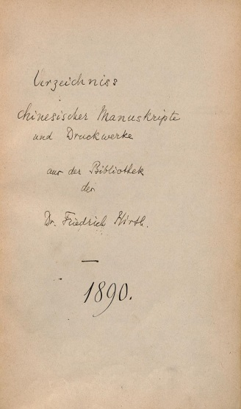
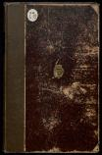
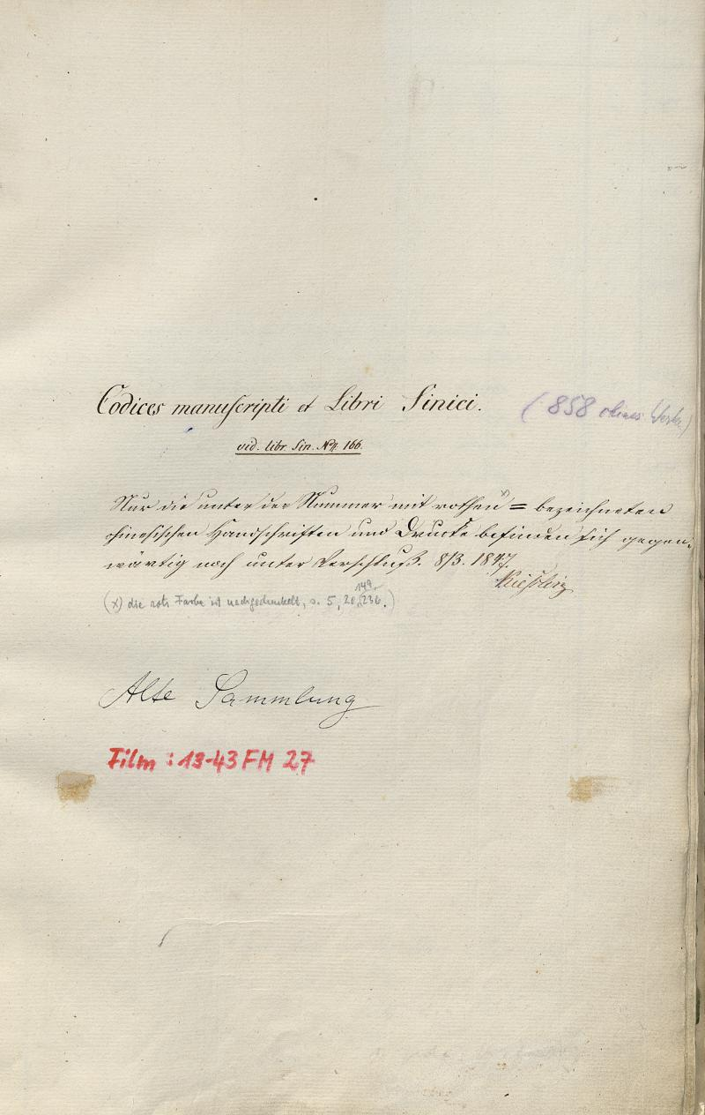
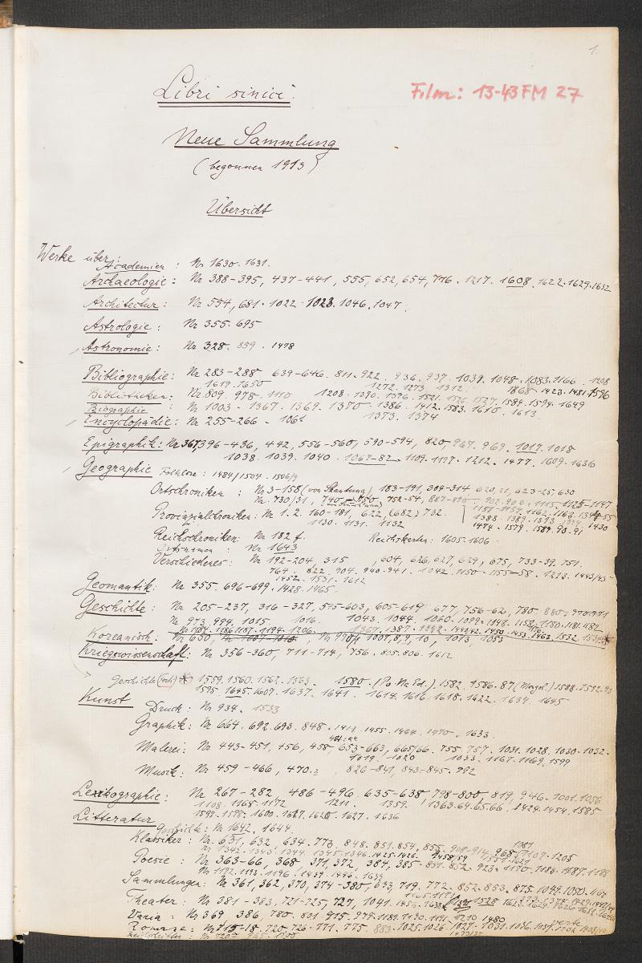
East Asia collection (3) – growing of the collection
Late 19th/Early 20th century - systematical acquisition trips to China of Herbert Müller (1885-1966) and Friedrich Wilhelm Karl Müller (1863-1930), as well as the purchase of collections by Friedrich Hirth (1845-1927), Paul Georg von Moellendorff ((1847-1901))[mainly Manchu titles] and Eugen Pander (1854-1894)[mainly Tibetan titles]
1912 – 1,603 Libri sinici titles (Codices manuscripti et Libri Sinici. Alte Sammlung (1847-1913; Libri sin. 1 - Libri sin. 1603))
1922 The East Asia Department was established as an independent unit.
1945 – 2,049 Libri sinici N.S. [Neue Sammlung, „New series“] (Libri sinici. Neue Sammlung (begonnen 1913) / [geführt von Hermann Hülle] (1913 bis ca. 1939; Libri sin. N.S. 1 bis Libri sin. N.S. 2049)

Slide 6
East Asia collection (4) – evacuation during World War II / situation after 1945
1943 - 72,000 vols. of East Asian books and Mss
During World War II – (hasty) evacuation of all holdings of the library to surrounding estates, coal mines, etc. East and West of Berlin (all in all 30 places)
After the war - only about 27,000 volumes of the collection made their way back into the library. Ca. 20,000 volumes were stored after the war on now Polish territory and transferred in its entirety to Krakow’s Biblioteka Jagiellonska, where today it comprises a part of the so-called “Berlinka”.

Slide 7
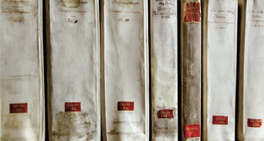
Two digitisation projects of the East Asia Department (SBB)
SSG 6,25 Digital (Special Collection Area East and Southeast Asia Digital)
Berlin-Kraków Project

Slide 8
SSG 6,25 Digital (Special Collection Area East and Southeast Asia Digital)
2010 - the Berlin State library started the digitisation of selected sections of its holdings. The DFG-funded project consisted of 5 parts of original language materials and as a sixth part, Western-language publications on East Asia that were published before 1912.
2014 – project completed

Slide 9
SSG 6,25 Digital (statistics)
in East Asian languages 1,699 titles
820,464 pages
60,800 structural data
577 Chinese titles (Libri sinici , Libri sinici N.S., Hirth and Haenisch collection)
258 Manchu titles (Libri sinici, Libri sinici N.S. Moellendorff, Haenisch and Polevoi Collection)
568 Japanese titles (Libri japonici)
296 Tibetan titles (Waddell Collection)
in Western languages 4,335 titles
1,471,607 pages
121,097 structural data
all in all 6,034 titles
2,292,071 pages
182,097 structural data

Slide 10
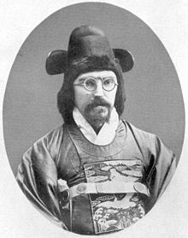
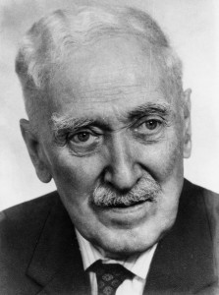
SSG 6,25 Digital (collections)
• Moellendorff collection
Moellendorff - linguist and diplomat, Chinese maritime customs, German consular services, founder of the Korean maritime customs, advisor to the king of Korea. The Berlin State library brought the collection of ca. 100 titles in 1911.
• Haenisch collection
Haenisch - prof. in Berlin, Göttingen, Leipzig for Chinese, Mongolian, Manchu studies. The Berlin State library brought the collection of ca. 4500 vols in 1960.
• Polevoi collection
Polevoj – studied Chinese, Manchu, Mongolian. Teacher for Russian in China later for Chinese, Manchu in Harvard. The Berlin State library brought the collection of ca. 150 Mss in the 70ies.
Paul Georg von Moellendorff (1847-1901)
Erich Haenisch (1880-1966)
Sergeij Aleksandrovič Polevoj (1886-1971)

Slide 11
SSG 6,25 Digital (selection principle, workflow, core concern)
• main principle: to digitise the mentioned sections of the old collection as a whole
• sole exception: exactly same edition of a title digitised anywhere else ➔ only example pages
• workflow: review and classification of the collection – recataloguing of the segments selected for digitisation– workflow software Goobi ((“Göttingen online-objects binaries”)
• core concern of the project was the indexing of structural data and the assignment of page labels

Slide 12
SSG 6,25 Digital (Goobi 1)
-central feature: assigning of pagination and structural data to the sequel of scans, writing these data into a METS/MODS-container (Metadata Encoding & Transmission Standard/Metadata Object Description Schema-container)
•structural data: types of content features (title page, chapter, map ...) in its hierarchy (chapter / subchapter / map)
•metadata: heading of a ‘chapter’, caption of a ‘map’, author of a preface …

Slide 13
SSG 6,25 Digital (Goobi 2)
-under the need of SSG 6,25 digital
• Goobi had to be adjusted in order to process Unicode characters above FFFF (Extension B)
• Goobi was trained for a pagination feature allowing page a and page b numbering and adding prefixes to pagination like juan 卷
-thus for titles in Japanese, Chinese and Manchu for every image, respectively every page, the complete formal page number is displayed („卷1:1r“, „卷1:1v“ )
-structural elements are reserved for contents structure components

Slide 14
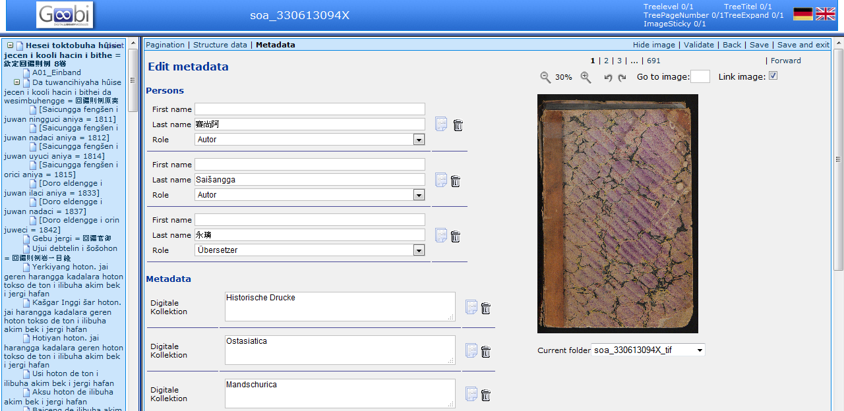
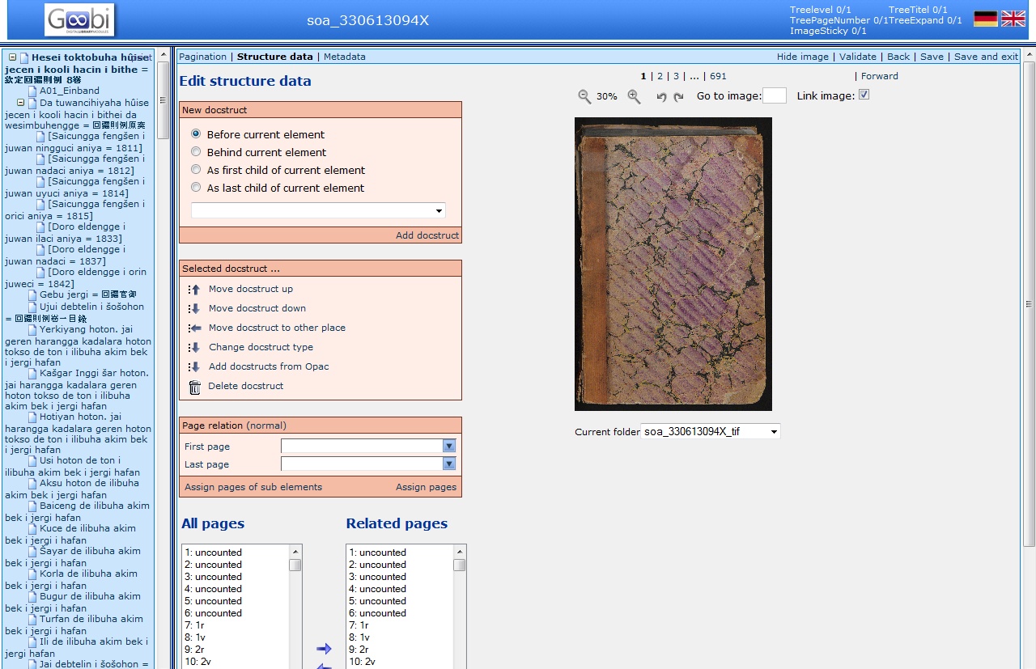
SSG 6,25 Digital (Goobi 3)
metadata
pagination
structure data

Slide 15
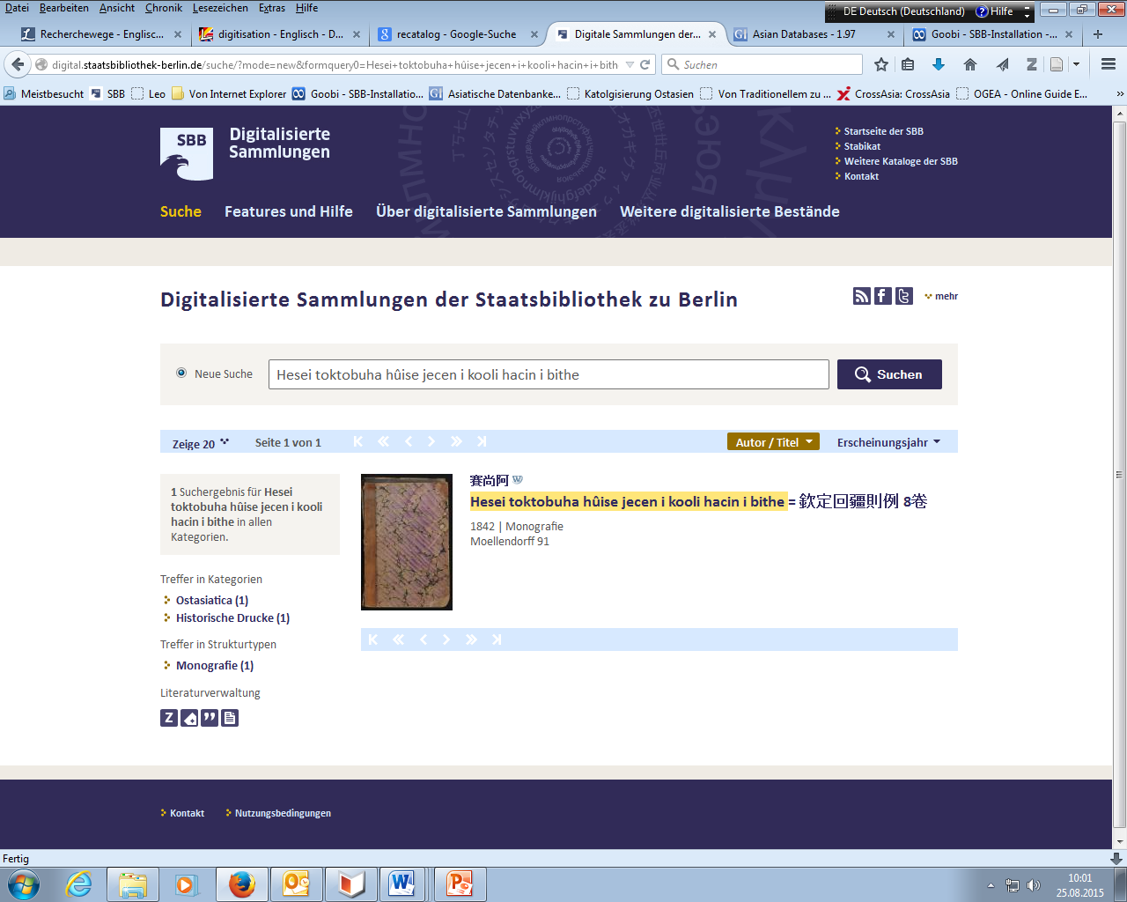
SSG 6,25 Digital (ways to get to (1))
all segments of documents of SSG 6,25 digital are available
via
the Digital Collections of the SBB
http://digital.staatsbibliothek-berlin.de/

Slide 16
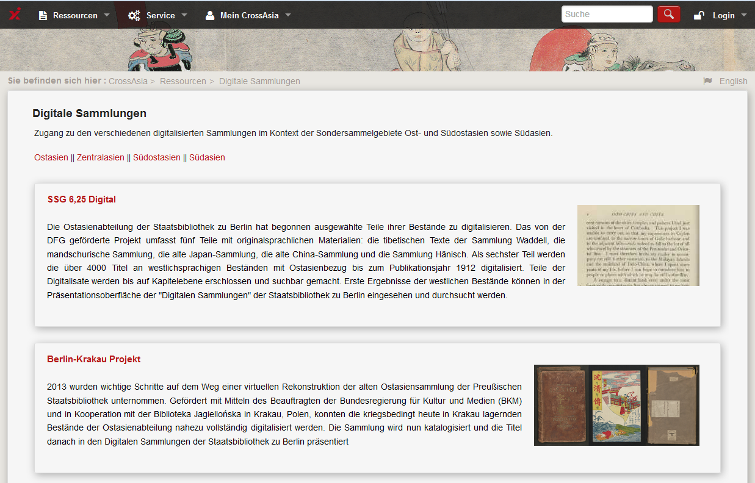
SSG 6,25 Digital (ways to get to (2))
via
Cross Asia > Resources > Digital Collections
http://crossasia.org/en/ressourcen/digital.html

Slide 17
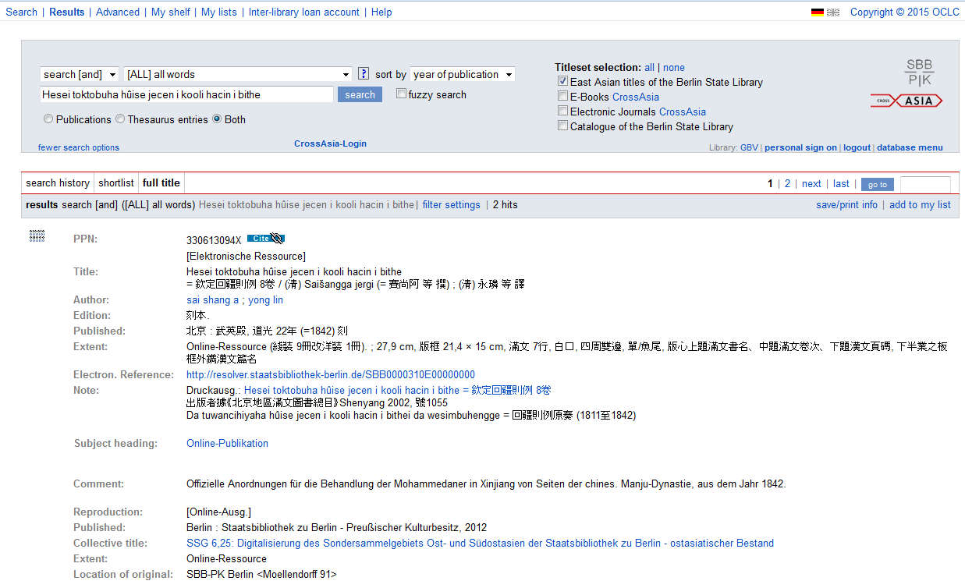
SSG 6,25 Digital (ways to get to (3))
via
The Online Catalogue of the East Asia Department
http://gso.gbv.de/xslt/DB=1.97/

Slide 18
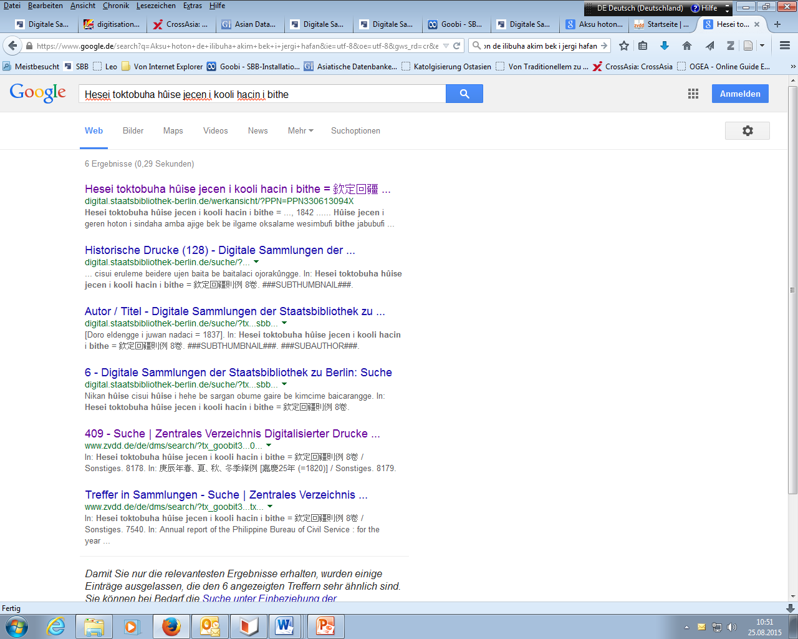
SSG 6,25 Digital (ways to get to (4))
via Google

Slide 19
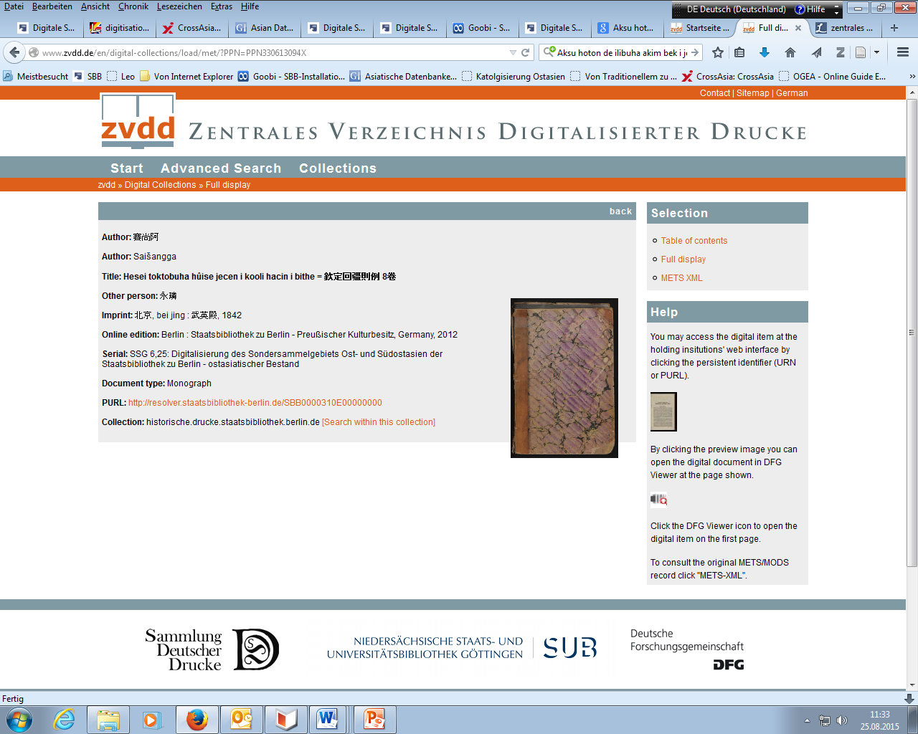
SSG 6,25 Digital (ways to get to (5))
via ZVDD (Zentrales Verzeichnis Digitalisierter Drucke = „Central Directory of Digitised Printed Works”)

Slide 20
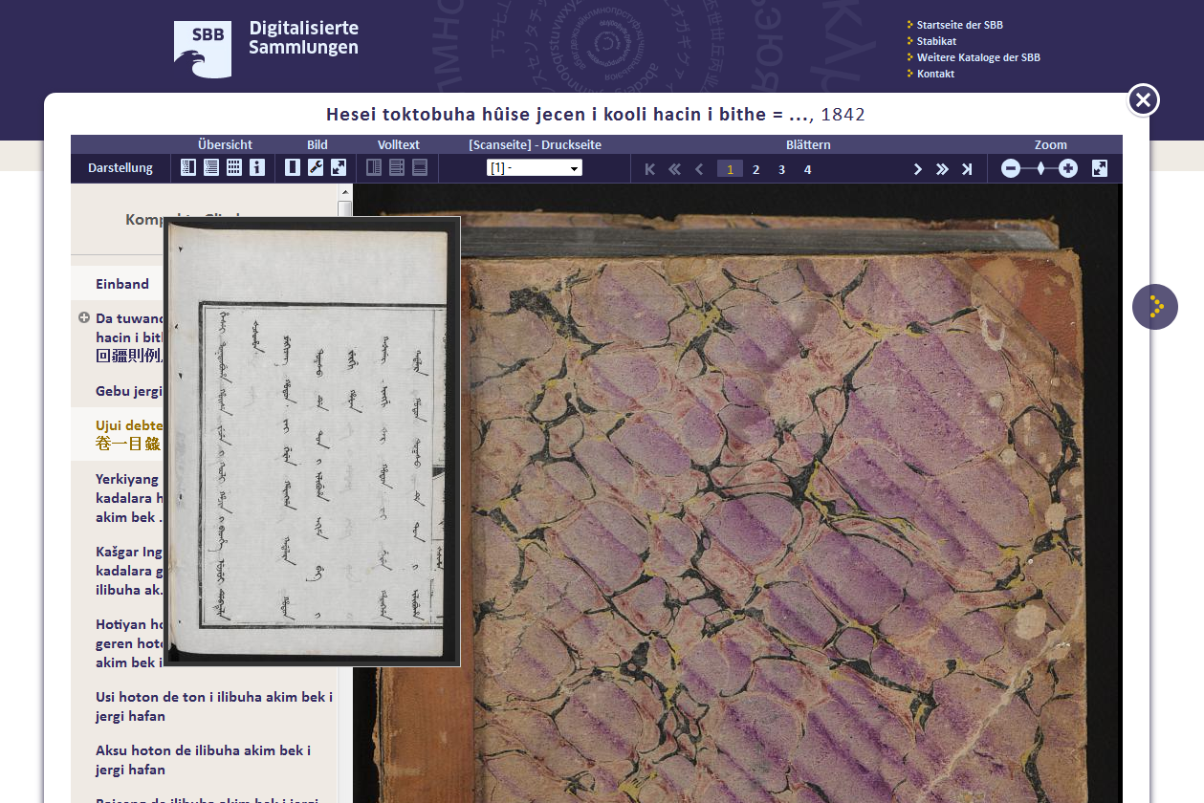
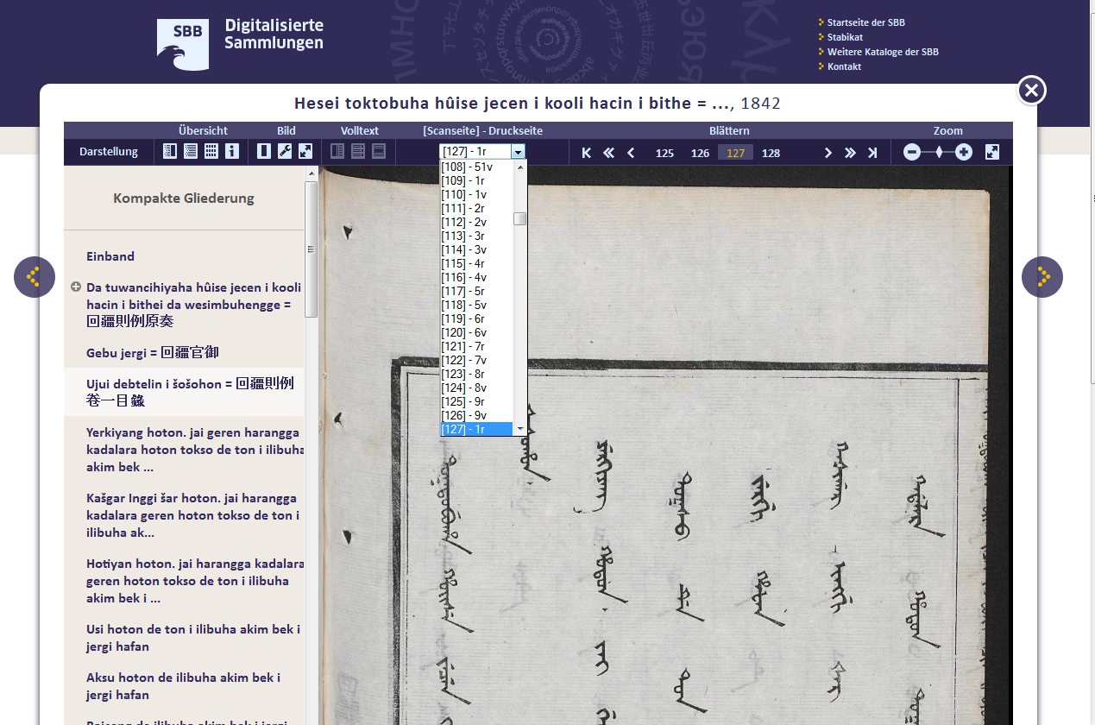
SSG 6,25 Digital (presentation (1))

Slide 21
SSG 6,25 Digital (presentation (2))

Slide 22
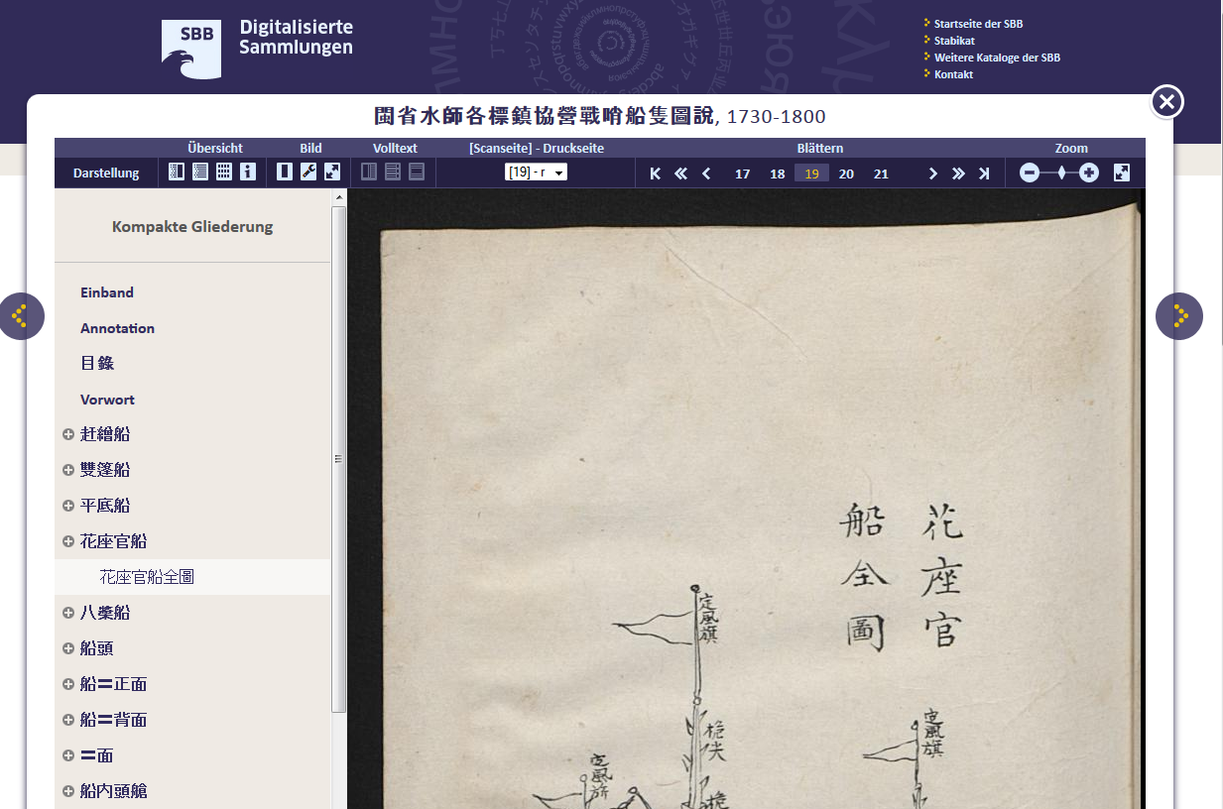
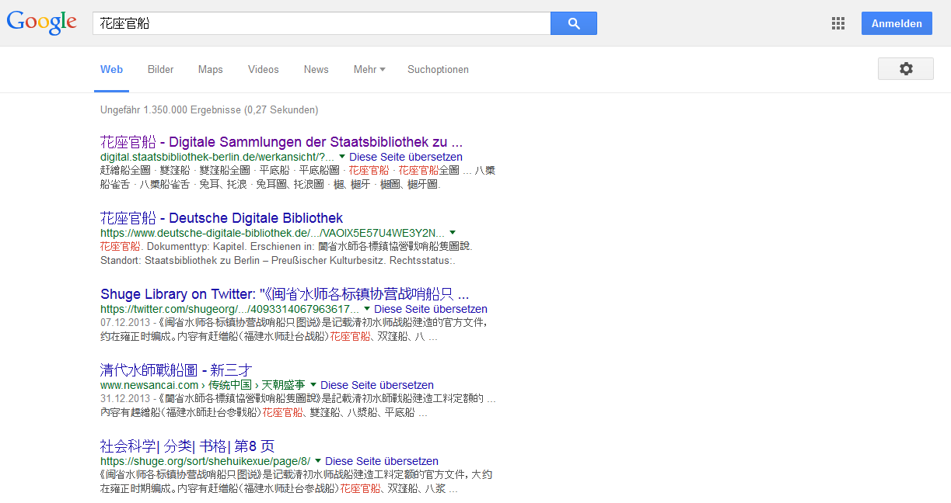
SSG 6,25 Digital (presentation (3))

Slide 23
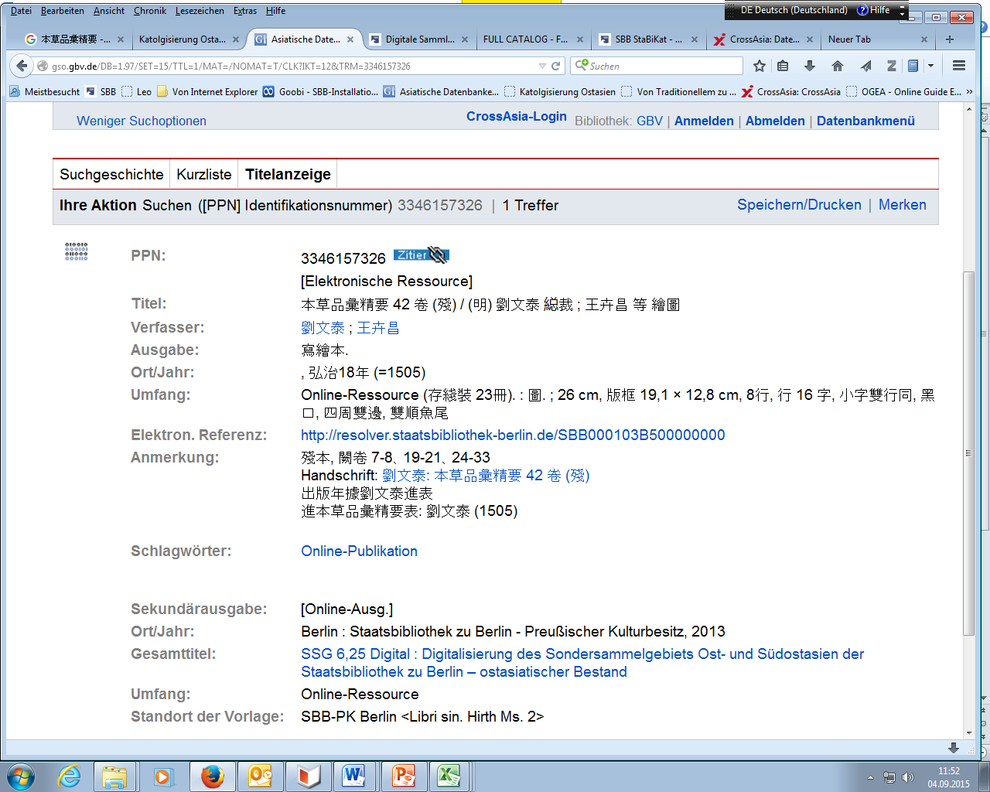
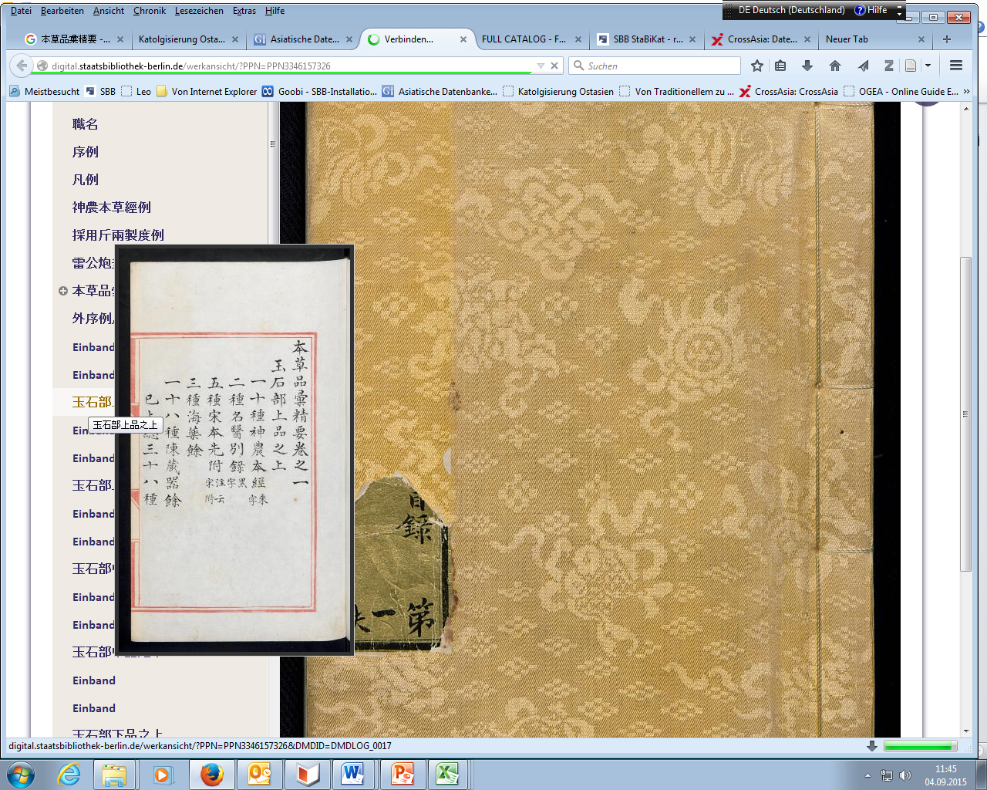
SSG 6,25 Digital (highlights (1))

Slide 24
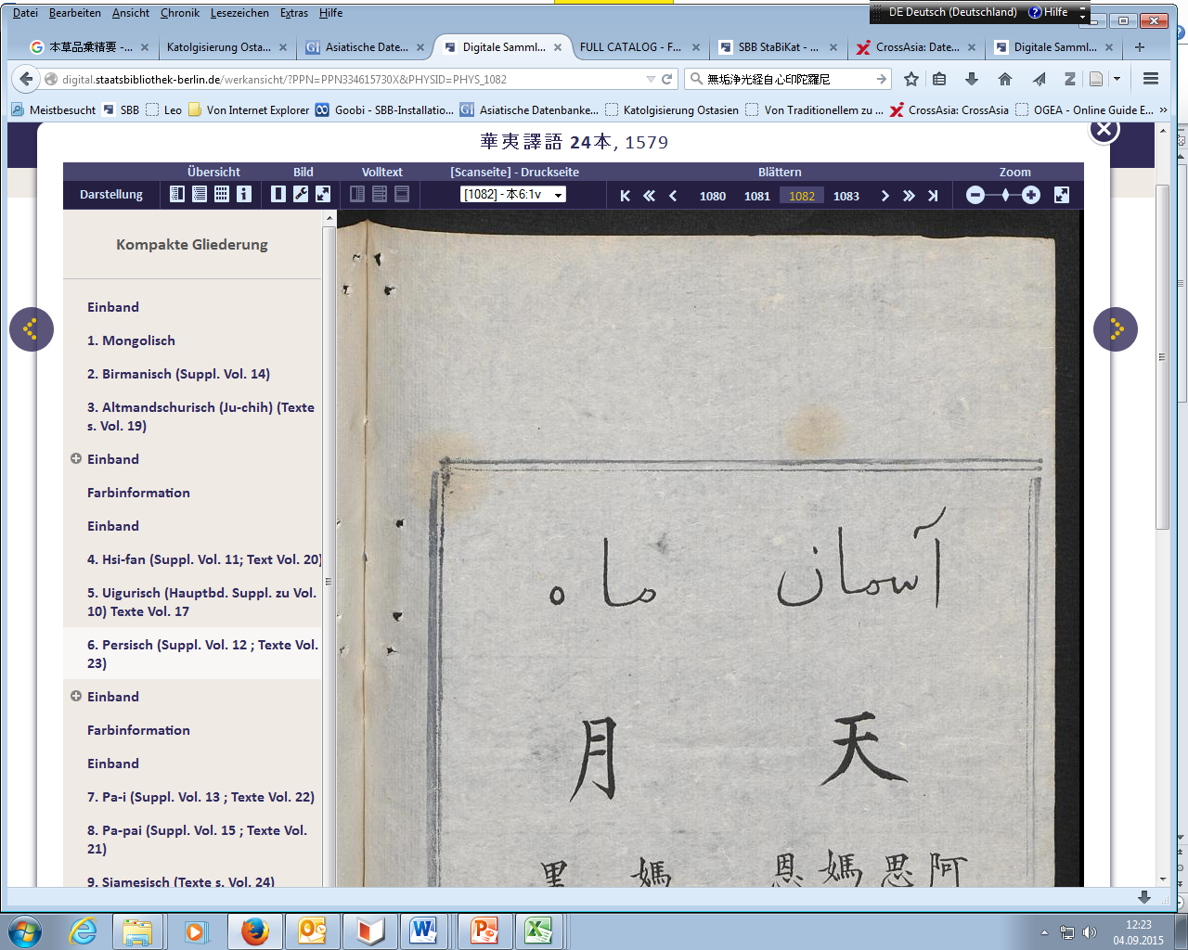
SSG 6,25 Digital (highlights 2)

Slide 25
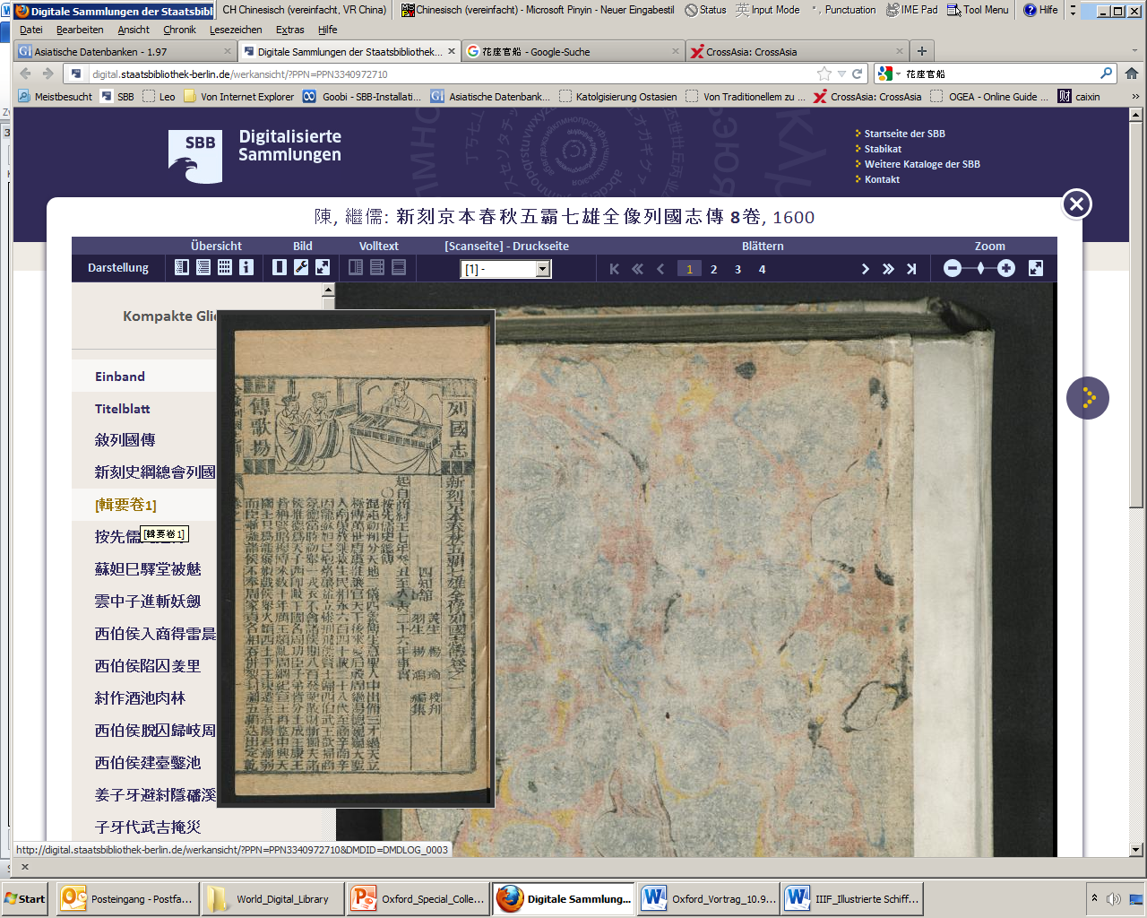
SSG 6,25 Digital (highlights 3)

Slide 26
Berlin-Kraków Project -Supported by a grant allotted by the Commissary for Culture and Media (BKM) of the German Federal Government and the cooperation with the Biblioteka Jagiellońska in Kraków, Poland, enabled the Berlin State Library to take first steps towards a virtual reconstruction of the old East Asia Collection of the Prussian State Library. -2013 - Digitisation of East Asian Berlinka started and completed. (Pilot project of the SBB and the Biblioteka Jagiellońska) -the old collection was digitized almost in its entirety -the titles will be presented in the Digital Collections of the State library -until now cataloguing ongoing

Slide 27
Berlin-Kraków Project (statistics)
Libri sinici 62 titles
Libri sinici N.S. 254 titles
Libri coreanici 71 titles
Hirth collection [Friedrich Hirth] 152 titles
Müller collection [F.W.K. Müller] 249 titles
Moellendorff coll. Paul Georg von Moellendorff] 47 titles
Pander collection [Eugen Pander] 42 titles

Slide 28
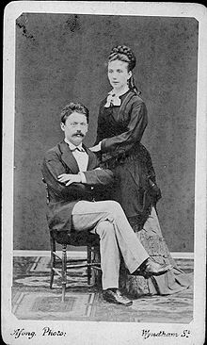
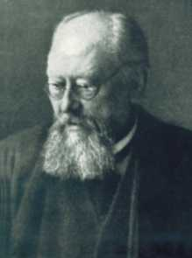
Berlin-Kraków Project (collections (1))
• Hirth collection - Classical Philology, 1869 turned to the study of the Chinese language, Chinese Custom Service, Statistical Bureau of the Custom Office in Shanghai, President of the local China Branch of the Royal Asiatic Society in Shanghai, characterized his collection as one „mainly serving the sinological problems of the time“, interested in the study of the Chinese-Western relations
• Müller collection - scientific employee at the ethnological museum of Berlin, went to China in 1890 and 1912 respectively on behalf of the museum and the library to acquire exhibits and books, later became famous for his decipherment of the Manichaean script on fragments excavated by the Prussian Turfan excavations
Pander
Libri coreanici
Friedrich Hirth (1845-1927)
FWK Müller (1863-1930)

Slide 29
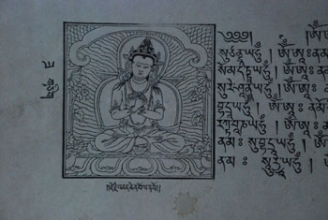
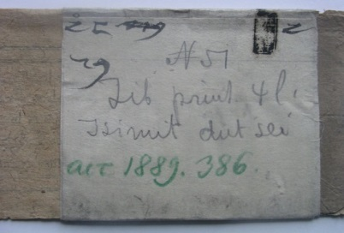
Berlin-Kraków Project (collections (2))
• Moellendorff collection
• Pander collection - Eugen Pander (1854-1894) since 1881 China’s Imperial Maritime Custom Service, Professor of National Economics at Tongwenguan 同文館 College in Peking, collector of Lamaist books and works of art, latter were acquired by the Ethnological Museum in Berlin, the books passed into ownership of the Royal Library and were accessioned in Berlin in 1889.
• Libri coreanici -
Pander Pantheon, (The Great Vajradhāra), 永樂八年 (1411)

Slide 30
Berlin-Kraków Project (selection principle, workflow, core concern)
• main principle: to digitise the collection as a whole
• sole exception: exactly same edition of a title digitised anywhere else ➔ only example pages
• workflow: review and classification of the whole collection in Kraków– digitising of the collection in Kraków – transfer of the data to Berlin - cataloguing of the of the titles (ongoing) – workflow software Goobi
• core concern of the project: the indexing of structural data and the assignment of page labels

Slide 31
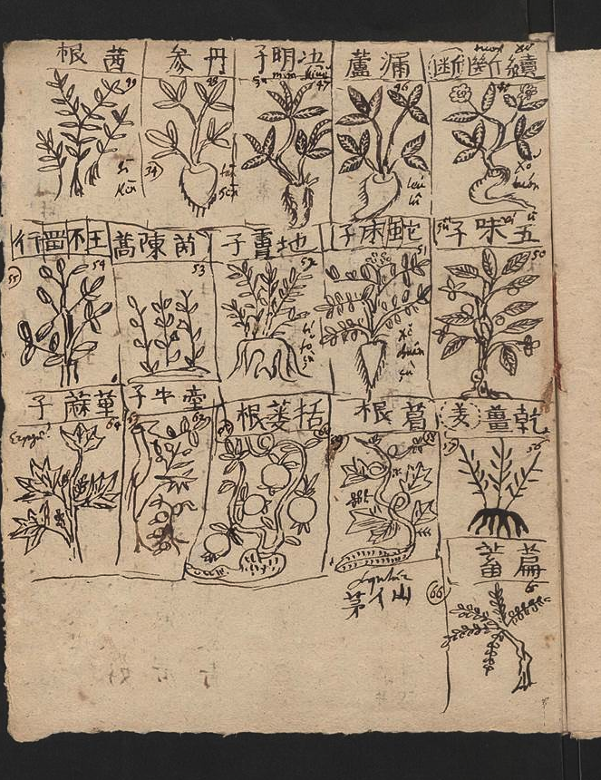
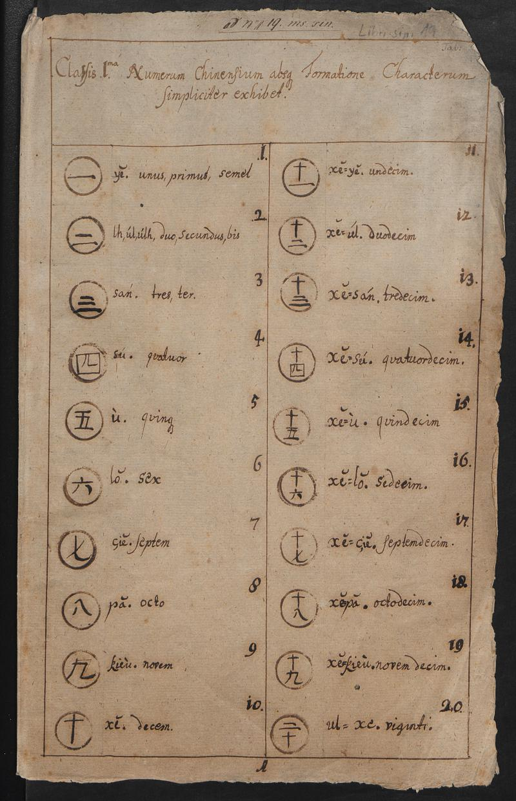
Berlin-Kraków Project (highlights (1))
Libri sin. – Christian Mentzel, excerpts
– Clavis sinica („Key to Chinese“)

Slide 32
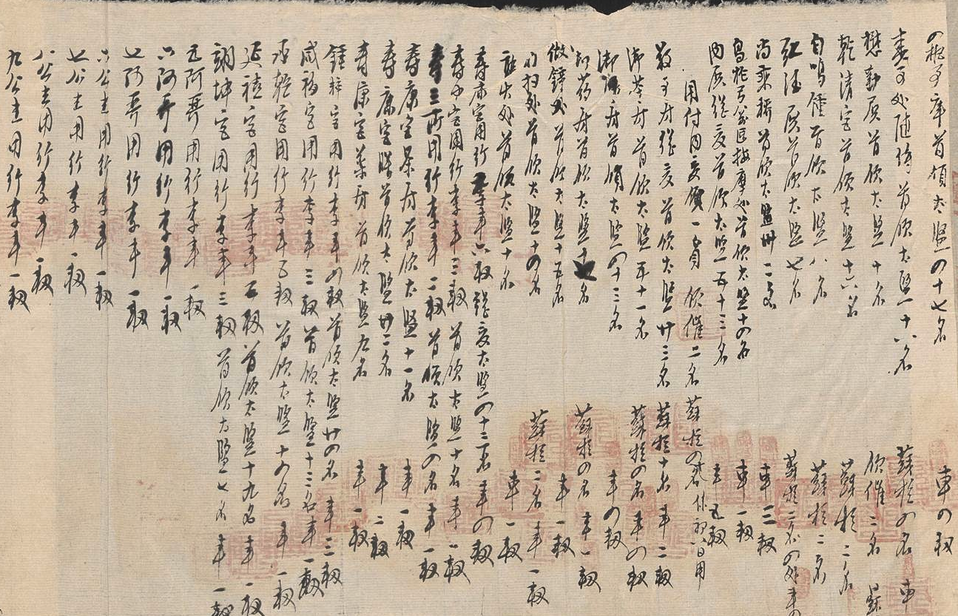
Berlin-Kraków Project (highlights (2))
Müller collection - bundles of archival material from 道光era

Slide 33
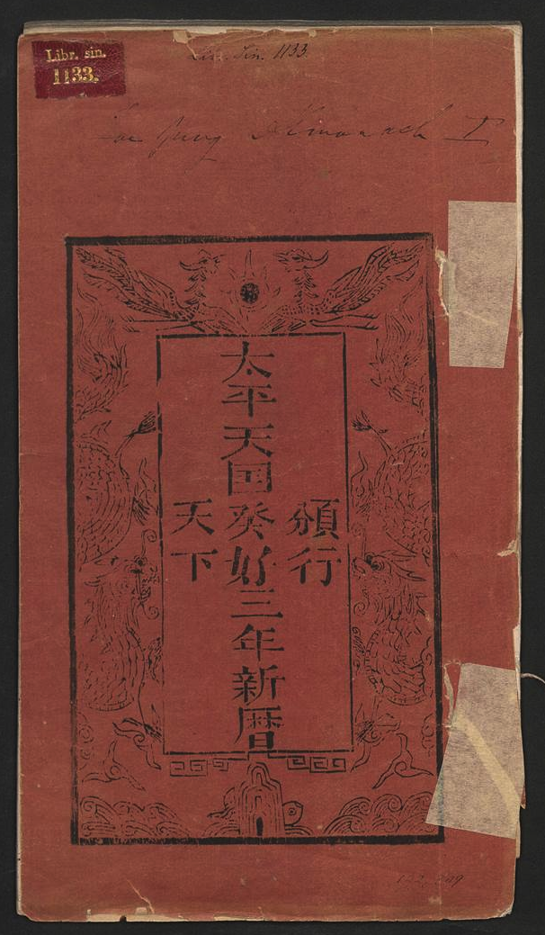
Berlin-Kraków Project (highlights 2)
Libri sin. collection – ten 太平天国 titles

Slide 34
ostasienabteilung@sbb.spk-berlin.de x-asia@sbb.spk-berlin.de cordula.gumbrecht@sbb.spk-berlin.de
(Dr. Cordula Gumbrecht, The Berlin State Library / East Asia Department)

