Slide 1
The new Chinese a35 allegro catalogue
Joshua Seufert

Slide 2
The old DOS allegro
Eten 倚天
BIG 5 Encoding
Lower ASCII code values
DOS
WIN 95
WIN XP with some modifications

Slide 3
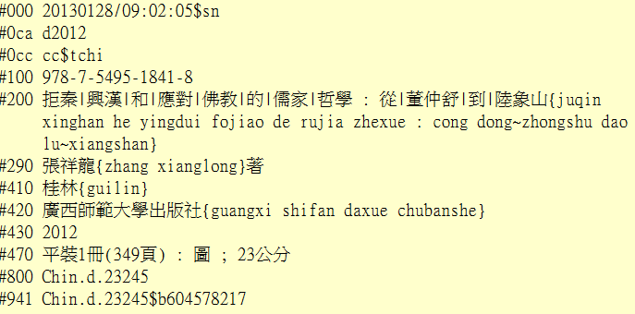
The old DOS allegro

Slide 4
Never touch a running system ?
University WINDOWS 7 upgrade until April 2014

Slide 5
Problems to consider
Technical problems
Institutional problems
Analytic records not reproducible in MARC 21
Direct change to MARC 21 difficult
Needs of the academic community
Conversion of other Allegro catalogues at the same time
Ongoing SERICA project
Uncatalogued Chinese material in the Chinese Studies Library

Slide 6
New a35 allegro catalogue
Internally
Unicode compatible
Time proof system (runs on Linux)
Externally
Platform independent system (any modern browser)
Browseable indexes

